Slide 1

VIII Semester Major Project Work (21CS81P)
Department of Computer Science,
R V College of Engineering, Bengaluru.

Slide 2

Ambient Experience Software
Abhishek Hurakadli 1rv21cs006
Internship : Company Name: Philips
Internal Guide : Dr. Pratiba D Associate Professor
External Guide : Raghavan Tirumale, Senior Manager II
Monday, 28 April 2025
RV COLLEGE OF ENGINEERING

Slide 3
Identification of Problem in the program Domain and Detailed Analysis
The program domain for this project is creating Ambient Experience in MRI procedures. The core issue lies in the anxiety, discomfort, and operational inefficiencies associated with traditional MRI procedures. These challenges are prevalent across hospitals and diagnostic centers worldwide, affecting both patients and healthcare providers.
Key Problems Identified:
Patient Anxiety and Stress : MRI machines are inherently intimidating due to their enclosed structure, loud operational noises, and long scan durations.
Psychological factors, such as claustrophobia and fear of the unknown, exacerbate patient anxiety.
Special Challenges for Children: Pediatric patients face unique challenges, as the intimidating MRI environment can lead to crying, panic, and refusal to cooperate.
Operational Inefficiencies: Patient discomfort and stress frequently lead to interrupted or failed scans, requiring rescheduling and causing delays.
Monday, 28 April 2025
RV COLLEGE OF ENGINEERING

Slide 4
Study of the Existing Systems and Feasibility of Project Proposal
Traditional MRI Systems:
Hardware: Enclosed structure; loud noise (100-120 dB) increases discomfort.
Software: Basic imaging with no real-time user engagement.
Patient Interaction: Limited focus on comfort or personalization.
Challenges:
Static systems cannot adapt dynamically to patient needs.
Pediatric solutions are superficial and lack concentration.
Anxiety-induced interruptions reduce efficiency and delay procedures.
Modern Enhancements:
Fixed lighting and visuals (e.g., dynamic lights) for positive distraction.
Basic audio systems with pre-recorded relaxing sounds.
Pediatric features (cartoon themes) offer limited comfort.
Monday, 28 April 2025
RV COLLEGE OF ENGINEERING

Slide 5
Final Objectives
Enhance Patient Comfort: Create a stress-free and calming environment for patients undergoing MRI scans.
Reduce anxiety through dynamic lighting, visuals, and soothing audio.
Improve Pediatric Experience: Provide gamified features to engage children during scans.
Minimize the need for sedation by creating a child-friendly atmosphere.
Increase Operational Efficiency: Reduce interruptions and rescheduling caused by patient discomfort or stress.
Ensure smoother workflows and improved throughput in MRI operations.
Personalization and Adaptability: Allow real-time adjustments to visuals, lighting, and audio based on patient preferences and reactions.
Offer tailored experiences for diverse patient demographics, including children and claustrophobic individuals.
Enhance Diagnostic Accuracy: Minimize patient movement by reducing anxiety, ensuring high-quality imaging results.
Use real-time adaptability to maintain patient cooperation, improving image clarity and diagnostic reliability.
Monday, 28 April 2025
RV COLLEGE OF ENGINEERING

Slide 6
Objectives
To study and understand the architecture of an existing legacy application built using the .NET Framework.
To perform a structured migration of the application to .NET Core.
To refactor and modularize application components to follow modern software design principles.
To document the migration process, including challenges, best practices, and technical improvements.
Monday, 28 April 2025
RV COLLEGE OF ENGINEERING

Slide 7
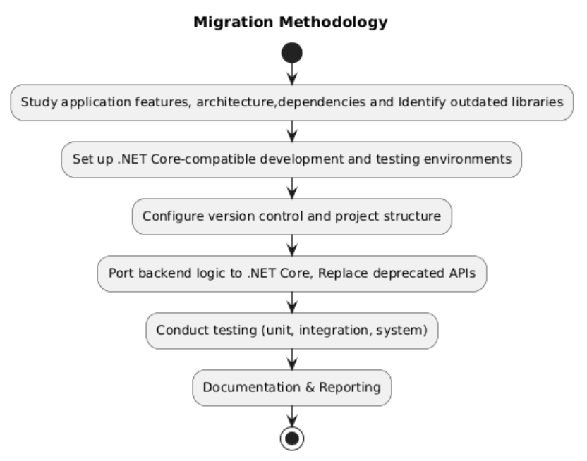
Methodology
Monday, 28 April 2025
RV COLLEGE OF ENGINEERING

Slide 8
Interdisciplinary Work (Knowledge, Skills, and Research Base)
Skills to be learnt:
Kubernetes: For container orchestration and managing Docker containers at scale.
Azure DevOps : To manage CI/CD pipelines within cloud platforms.
Swagger: For documenting and testing REST APIs.
Postman: For API testing and validation.
Authentication & Authorization: Learn OAuth2.0, JWT, and IdentityServer4 for secure authentication in .NET Core.
Supporting Technologies:
Message Queues: Learning NSQ for event-driven architecture.
Database Technologies: couchDB
Reverse Proxy: Tools like NGINX for load balancing and routing.
Monday, 28 April 2025
RV COLLEGE OF ENGINEERING

Slide 9
Thank you
Monday, 28 April 2025
RV COLLEGE OF ENGINEERING

