Slide 1

VIII Semester Major Project Work (21CS81P)
Phase 2
Department of Computer Science,
R V College of Engineering, Bengaluru.

Slide 2

Ambient Experience Software
Abhishek Hurakadli 1RV21CS006
Internship / Inhouse : Internship Company Name: Philips
Internal Guide : Dr Pratiba D Associate Professor
External Guide : : Raghavan Tirumale, Senior Manager II
Monday, 19 May 2025
RV COLLEGE OF ENGINEERING

Slide 3
Literature Review
Year, Name of the Journal/Conference | Title of the paper | Authors of the paper | Model/Sub Model used | Challenges of the paper | Limitations of the paper
2021, IEEE Open Journal of the Communications Society | Optimal Container Migration/Re-Instantiation in Hybrid Computing Environments | Sam Aleyadeh , Abdallah Moubayed, Parisa Heidari, And Abdallah Shami | OC-MRI: Optimal Container Migration/Re-Instantiation model, based on Integer Linear Programming (ILP). | Balancing migration vs. re-instantiation decisions depending on container states and dependencies. | OC-MRI model is computationally heavy and not scalable for real-time use (NP-complete).
2019, IEEE Access | Emerging Trends, Techniques and Open Issues of Containerization: A Review | Junzo Watada, Arunava Roy, Ruturaj Kadikar, Hoang Pham, Bing Xu | Orchestration tools (like Kubernetes, Docker Swarm) Container technologies (like LXC, Docker, rk | Cross-platform support and portability limitations. | Review is broad but doesn’t dive deeply into specific orchestration limitations per platform.
2023, International Journal of Innovative Research in Engineering & Multidisciplinary Physical Sciences | Containerization Technologies: ECR and Docker for Microservices Architecture | Venkata Ramana Gudelli | implementation of Docker + Amazon ECR in a microservices setup using AWS and Kubernetes. | Complex networking for service discovery and secure communication between microservices. | Doesn’t explore resource optimization, energy efficiency, or failure handling in dynamic environments.
Monday, 19 May 2025
RV COLLEGE OF ENGINEERING

Slide 4
Literature Review
Year, Name of the Journal/Conference | Title of the paper | Authors of the paper | Model/Sub Model used | Challenges of the paper | Limitations of the paper
2016, IEEE International Conference on Cloud Computing in Emerging Markets | Economically Efficient Virtualization over Cloud Using Docker Containers | Krishan Berwal, Manish Kurhekar | OpenStack Cloud, Checkpoint/Restore in Userspace (CRIU) | Container state preservation for high-availability in case of failures. | Focused only on Docker + OpenStack, with no comparison to modern orchestrators like Kubernetes.
2025, ResearchGate | Microservices Architecture: Beyond Containerization vs. Serverless – A Hybrid Model for Enterprise Scale | Britney Johnson Mary | AWS Lambda, Azure Functions, Google Cloud Functions | Handling inter-service communication across container and serverless systems. | Lack of automated orchestration
2022, ACM Symposium on Cloud Computing (SoCC) 2022 | SWITCH-ing from Multi-tenant to Event-Driven VC Services | Chuan Qin, Kai Chen, Zeyu Zheng, Jiangshan Yu, Rui Miao, Zhaoguo Wang, Haibo Chen | SWITCH, which is an event-driven architecture tailored for Virtual Classrooms (VCs) | Managing high dynamic load and on-demand instantiation. | No cost-benefit analysis comparing SWITCH with conventional multi-tenant systems.
Monday, 19 May 2025
RV COLLEGE OF ENGINEERING

Slide 5
Literature Review
Year, Name of the Journal/Conference | Title of the paper | Authors of the paper | Model/Sub Model used | Challenges of the paper | Limitations of the paper
2022, Journal of Clinical Medicine | More Space, Less Noise—New-generation Low-Field Magnetic Resonance Imaging Systems Can Improve Patient Comfort: A Prospective 0.55T–1.5T-Scanner Comparison | Thilo Rusche, Jan Vosshenrich, David J. Winkel, Ricardo Donners, Martin Segeroth, Michael Bach, Elmar M. Merkle, Hanns-Christian Breit | 0.55T low-field MRI scanner (MAGNETOM FreeMax), 1.5T conventional MRI scanner | Maintaining comparable diagnostic image quality despite differing field strengths. | Noise level influence not only by field strength but also sequence and hardware design.
2020, IEEE 20th International Conference on Software Quality, Reliability and Security Companion | Microservices: Architecture, Container, and Challenges | Guozhi Liu, Minmin Qin, Bi Huang, Hua Zhou, Zhihong Liang, Zhang Li | Monolithic Architecture → Service-Oriented Architecture (SOA) → Microservices Architecture | Performance degradation due to network communication and cascading failure risks | No empirical or experimental validation: The paper is a theoretical overview.
Monday, 19 May 2025
RV COLLEGE OF ENGINEERING

Slide 6
Research Gap
Research Gap | Solutions
1. Lack of hybrid orchestration frameworks for both containerized (stateful) and serverless (stateless) components. | This system may require serverless triggers (e.g., patient input, lighting control) and containerized services (e.g., media player).
2. No end-to-end deployment architecture specifically tailored for real-time medical use cases. | Project application must deliver real-time patient comfort with no latency or crash tolerance.
3. No mention of persistent media session handling in serverless or containerized setups. | Project is managing patient-specific sessions and music/light states—state preservation is vital.
4. Current systems do not focus on load balancing for multimedia-rich microservices. | This system streams audio/video; existing models lack
5. No study shows containerization benefits in patient-facing medical environments (like MRI). | This Project bridges a crucial research gap—patient experience + software orchestration.
Monday, 19 May 2025
RV COLLEGE OF ENGINEERING

Slide 7
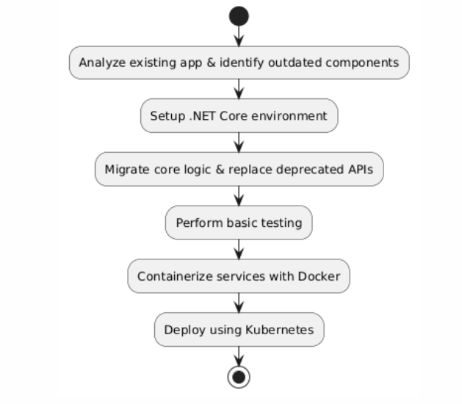
Methodology
Monday, 19 May 2025
RV COLLEGE OF ENGINEERING

Slide 8
Objectives Revisited
Design a modular and stateless web application architecture using container-ready components to enable independent deployment and maintainability (Containerization using docker).
To deploy images in the private registry
Monday, 19 May 2025
RV COLLEGE OF ENGINEERING

Slide 9
Planning of Project work
Migration
Containerization
Deploying Kubernetes
Timeline In progress: Migration of services
Todo: Containerization, Kubernetes
Monday, 19 May 2025
RV COLLEGE OF ENGINEERING

Slide 10
References
1 Balalaie, A., Heydarnoori, A., and Jamshidi, P., ‘Microservices Architecture Enables DevOps: Migration to a Cloud-Native Architecture’, IEEE Software, 33, (3), pp. 42–52, May–June 2016.
2 Rademacher, F., Sorgalla, J., and Sachweh, S., ‘Challenges of Domain-Driven Microservice Design: A Model-Driven Perspective’, IEEE Software, 35, (3), pp. 36–43, May–June 2018.
3 Merkel, D., ‘Docker: Lightweight Linux Containers for Consistent Development and Deployment’, Linux Journal, 2014, (239), pp. 2–11, March 2014.
4 Burns, B., Grant, B., Oppenheimer, D., Brewer, E., and Wilkes, J., ‘Borg, Omega, and Kubernetes: Lessons Learned from Three Container-Management Systems over a Decade’, ACM Queue, 14, (1), pp. 70–93, January 2016.
5 Buyya, R., Broberg, J., and Goscinski, A. M., ‘Cloud Computing: Principles and Paradigms’, John Wiley & Sons, pp. 1–36, 2011.
6 Adzic, G., and Chatley, R., ‘Serverless Computing: Economic and Architectural Impact’, Proceedings of the 2017 11th Joint Meeting on Foundations of Software Engineering, pp. 884–889, September 2017.
7 Richards, M., ‘Fundamentals of Event-Driven Architecture’, O'Reilly Media, pp. 1–28, 2020.
Monday, 19 May 2025
RV COLLEGE OF ENGINEERING

Slide 11
Thank you
Monday, 19 May 2025
RV COLLEGE OF ENGINEERING

