Slide 1

VIII Semester Major Project Work (21CS81P)
Department of Computer Science,
R V College of Engineering, Bengaluru.

Slide 2

Ambient Experience Software
Abhishek Hurakadli 1RV21CS006
Internship / Inhouse : Internship
Company Name: Philips
Internal Guide : Dr. Pratiba D, Associate Professor
External Guide : Tirumale Raghavan, Senior Manager II
Thursday, 29 May 2025
RV COLLEGE OF ENGINEERING

Slide 3
Incorporation of suggestions
Ensure objectives are specific and not open to multiple interpretations, making them easier to evaluate.
Add a brief note on how the project works.
Thursday, 29 May 2025
RV COLLEGE OF ENGINEERING

Slide 4
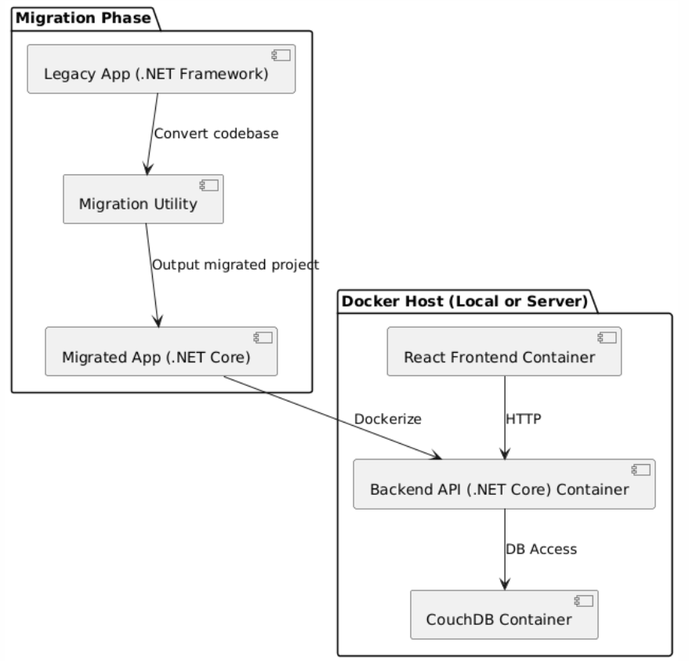
High Level Design
Architecture
Thursday 29 May 2025
RV COLLEGE OF ENGINEERING

Slide 5
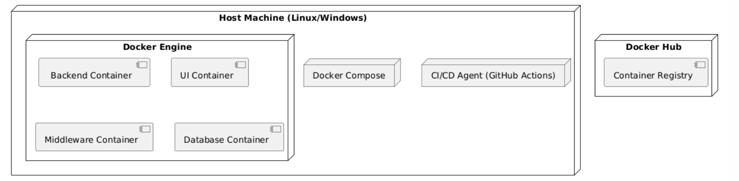
High Level Design
Docker Architecture
Thursday 29 May 2025
RV COLLEGE OF ENGINEERING

Slide 6
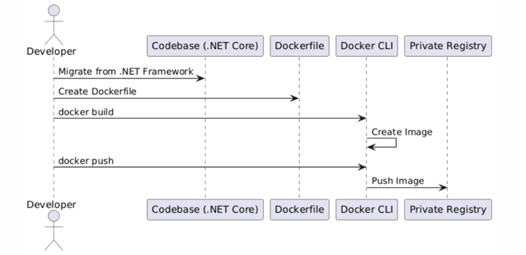
Low Level/ Detail Design
Sequence Diagram
Thursday 29 May 2025
RV COLLEGE OF ENGINEERING

Slide 7
Low Level/ Detail Design
Code Migration: The legacy .NET Framework application is systematically refactored and converted to a modular .NET Core codebase.
Containerization: A Dockerfile is created to define the build environment and execution process for the .NET Core application.
Image Creation: Using Docker CLI, the application is built into a lightweight, portable container image ready for deployment.
Image Distribution: The container image is pushed to a private registry, enabling consistent deployment across different environments.
Thursday, 29 May 2025
RV COLLEGE OF ENGINEERING

Slide 8
References
1 Balalaie, A., Heydarnoori, A., and Jamshidi, P., ‘Microservices Architecture Enables DevOps: Migration to a Cloud-Native Architecture’, IEEE Software, 33, (3), pp. 42–52, May–June 2016.
2 Rademacher, F., Sorgalla, J., and Sachweh, S., ‘Challenges of Domain-Driven Microservice Design: A Model-Driven Perspective’, IEEE Software, 35, (3), pp. 36–43, May–June 2018.
3 Merkel, D., ‘Docker: Lightweight Linux Containers for Consistent Development and Deployment’, Linux Journal, 2014, (239), pp. 2–11, March 2014.
4 Burns, B., Grant, B., Oppenheimer, D., Brewer, E., and Wilkes, J., ‘Borg, Omega, and Kubernetes: Lessons Learned from Three Container-Management Systems over a Decade’, ACM Queue, 14, (1), pp. 70–93, January 2016.
5 Buyya, R., Broberg, J., and Goscinski, A. M., ‘Cloud Computing: Principles and Paradigms’, John Wiley & Sons, pp. 1–36, 2011.
6 Adzic, G., and Chatley, R., ‘Serverless Computing: Economic and Architectural Impact’, Proceedings of the 2017 11th Joint Meeting on Foundations of Software Engineering, pp. 884–889, September 2017.
7 Richards, M., ‘Fundamentals of Event-Driven Architecture’, O'Reilly Media, pp. 1–28, 2020.
Thursday, 29 May 2025
RV COLLEGE OF ENGINEERING

Slide 9
Thank you
Thursday, 29 May 2025
RV COLLEGE OF ENGINEERING

