Slide 1
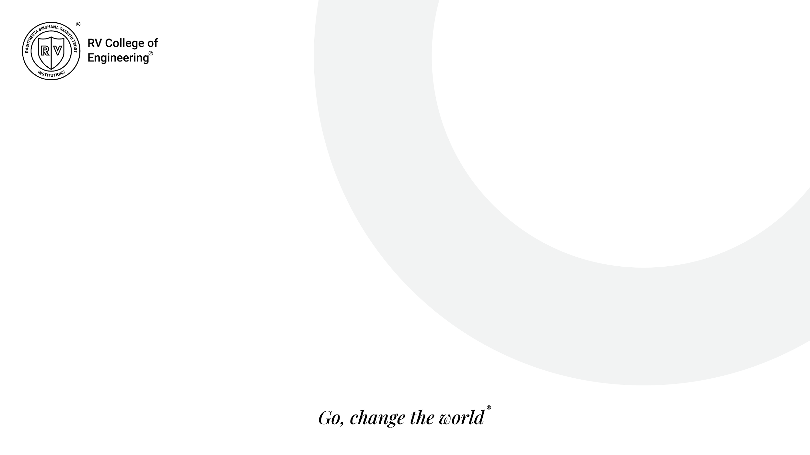
VIII Semester Major Project Work (21CS81P)
Department of Computer Science,
R V College of Engineering, Bengaluru.

Slide 2

Ambient Experience Software
Abhishek Hurakadli 1RV21CS006
Internship / Inhouse : Internship
Company Name: Philips
Internal Guide : Dr. Pratiba D, Associate Professor
External Guide : Tirumale Raghavan, Senior Manager II
Thursday, 29 May 2025
RV COLLEGE OF ENGINEERING

Slide 3
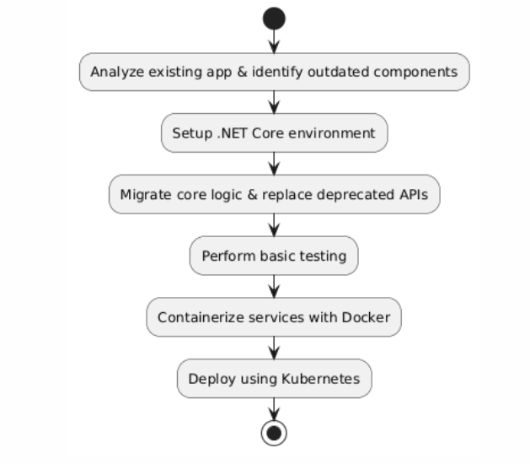
Implementation
Friday, 30 May 2025
RV COLLEGE OF ENGINEERING

Slide 4
Hardware and Software requirement
Software Requirements:
OS: Windows 10
Language: C#
IDE: VS Code, Visual Studio
Version Control: Git
Tools: Docker desktop, Team foundation server
CI/CD: Github Actions
Hardware Requirements:
CPU: Quad-core (Intel 5/Amd Ryzen 5 or higher)
RAM: 16 Gb
Storage: SSD with at least 512 GB free ( for images, volumes, logs)
Friday, 30 May 2025
RV COLLEGE OF ENGINEERING

Slide 5
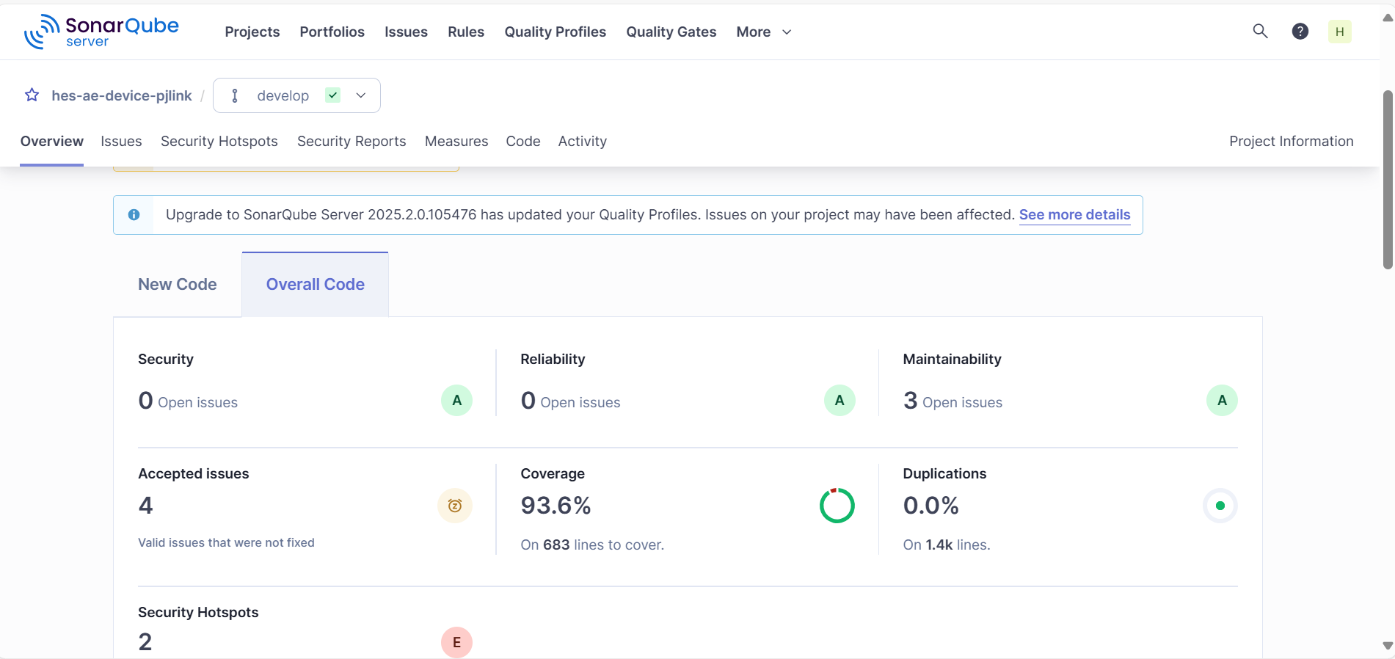
Testing
Thursday, 29 May 2025
RV COLLEGE OF ENGINEERING

Slide 6
Conclusion & Future Work
Conclusion:
The successful migration of the legacy .NET Framework application to .NET Core and its subsequent containerization marks a significant advancement in modernizing the Ambient Experience software. This transition enhances the system's scalability, resilience, and modularity, aligning it with contemporary cloud-native architectures. Containerization of the application using Docker, enabling consistent deployment across different environments enables to run microservices as container.
Future Work:
Hybrid Orchestration: Implementing hybrid orchestration frameworks to manage both containerized (stateful) and serverless (stateless) components, allowing for greater flexibility in deploying various system functionalities.
Kubernetes Deployment: Full deployment and orchestration of the containerized application using Kubernetes to automate deployment, scaling, and management.
Friday, 30 May 2025
RV COLLEGE OF ENGINEERING

Slide 7
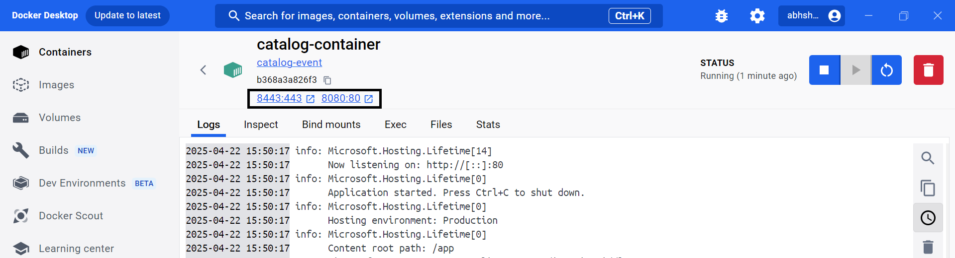
Demonstration of the project
Friday, 30 May 2025
RV COLLEGE OF ENGINEERING

Slide 8
Draft paper and information about the Journal to which it will be submitted
Title Name: Migration of .NET-to-.NET core and containerization using Docker and Kubernetes
Thursday, 29 May 2025
RV COLLEGE OF ENGINEERING

Slide 9
References
1 Balalaie, A., Heydarnoori, A., and Jamshidi, P., ‘Microservices Architecture Enables DevOps: Migration to a Cloud-Native Architecture’, IEEE Software, 33, (3), pp. 42–52, May–June 2016.
2 Rademacher, F., Sorgalla, J., and Sachweh, S., ‘Challenges of Domain-Driven Microservice Design: A Model-Driven Perspective’, IEEE Software, 35, (3), pp. 36–43, May–June 2018.
3 Merkel, D., ‘Docker: Lightweight Linux Containers for Consistent Development and Deployment’, Linux Journal, 2014, (239), pp. 2–11, March 2014.
4 Burns, B., Grant, B., Oppenheimer, D., Brewer, E., and Wilkes, J., ‘Borg, Omega, and Kubernetes: Lessons Learned from Three Container-Management Systems over a Decade’, ACM Queue, 14, (1), pp. 70–93, January 2016.
5 Buyya, R., Broberg, J., and Goscinski, A. M., ‘Cloud Computing: Principles and Paradigms’, John Wiley & Sons, pp. 1–36, 2011.
6 Adzic, G., and Chatley, R., ‘Serverless Computing: Economic and Architectural Impact’, Proceedings of the 2017 11th Joint Meeting on Foundations of Software Engineering, pp. 884–889, September 2017.
7 Richards, M., ‘Fundamentals of Event-Driven Architecture’, O'Reilly Media, pp. 1–28, 2020.
Thursday, 29 May 2025
RV COLLEGE OF ENGINEERING

Slide 10
Thank you
Thursday, 29 May 2025
RV COLLEGE OF ENGINEERING

