Slide 1

Comparing COVID-19 Deaths Reported by Age Group
By Christopher Clegg
ece.clegg@gmail.com

Slide 2
Why? : Learning to Extract Meaningful
Insights From Data
The motivation:
Practice my new data science skills
Interesting, important, and worth knowing
The data: deaths attributed to the COVID-19 virus, aka: the Coronavirus, aka: SARS-CoV-2 (severe acute respiratory syndrome coronavirus 2)

Slide 3
According to the CDC website:
“As you get older, your risk for severe illness from COVID-19 increases. For example, people in their 50s are at higher risk for severe illness than people in their 40s. Similarly, people in their 60s or 70s are, in general, at higher risk for severe illness than people in their 50s. The greatest risk for severe illness from COVID-19 is among those aged 85 or older.”
Last Updated Sept. 11, 2020
Content source: National Center for Immunization and Respiratory Diseases (NCIRD), Division of Viral Diseases
Found at: https://www.cdc.gov/coronavirus/2019-ncov/need-extra-precautions/older-adults.html#:~:text=The%20greatest%20risk%20for%20severe,as%20having%20underlying%20medical%20conditions.

Slide 4
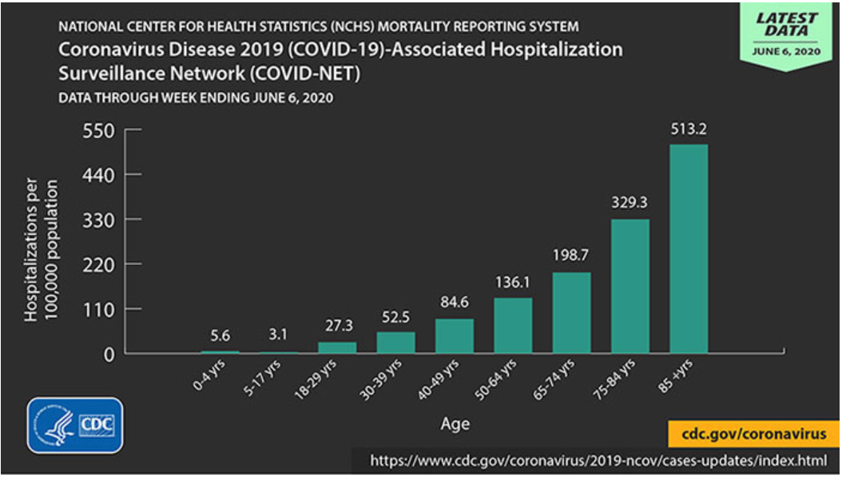
Will the reported deaths impact these age groups the same way the reported hospitalization have?

Slide 5
When I consider all the records for deaths attributed to COVID-19 that had at least one death, can a statistically significant difference be observed between age groups, and how does this compare with the reported deaths attributed to the ‘Flu’ or Pneumonia?
Forming a black and white question:
Doctors and medical professionals in the media claim that the elderly are at a greater risk of having a fatal encounter with COVID-19. Does this data set confirm or contradict that claim?

Slide 6
The null hypothesis
(The difference of (means or medians) is ~0 )
The alternative hypothesis
(or prediction that the (means or medians) will have a statistically significant difference)

Slide 7
What do you think will happen?
Will the null be rejected and the alternative be accepted, or will the null be kept?

Slide 8
Research: A brief “play-by-play”
Search for data
Found some open source data at: https://data.cdc.gov/NCHS/Provisional-COVID-19-Death-Counts-by-Sex-Age-and-S/9bhg-hcku
Alway read accompanying documentation
Exploring and Cleaning
Data rarely comes in ideal shape and never comes conveniently pre-arranged just for you.
Determine arrangement and eliminate overlap and excess.

Slide 9

Research: A brief “play-by-play” cont’d...
Getting a feel for the data
Preliminary visualization:
Distribution
What Tools Should I Use?
Determine testing methods
Which test best fits the distribution of my data sets?

Slide 10
Research: A brief “play-by-play” cont’d...
Apply test methods
Do post hoc analysis
Visualize the results and put them into an explanation that is relatable and form a final conclusion

Slide 11
My methods
Not your normal distribution...
Histogram - skewness, kurtosis
How many are being compared?
Not normal in the same way?
Quartile/quartile plot, box plot
Kruskal-Wallis Test
Confidence Interval, Common Language Effect size
These are the method I chose, and why I chose them.

Slide 12
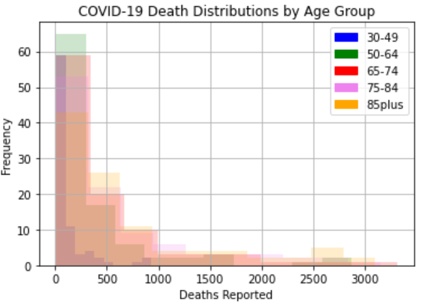
Distribution of COVID-19 Deaths.
Each color represents a different Age group.
Figure 1. Each of the age groups are similarly distributed

Slide 13
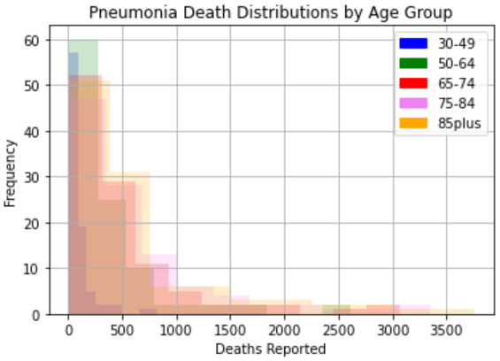
Distribution of Pneumonia Deaths.
Each color represents a different age group
Figure 2. Each of the age groups are similarly distributed

Slide 14
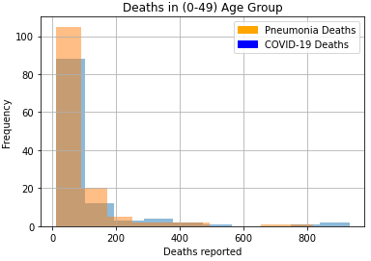
Distribution Deaths in the 0-49 Age Group For COVID-19 and Pneumonia.
Each color represents a different age group
Figure 3. Each are similarly distributed

Slide 15
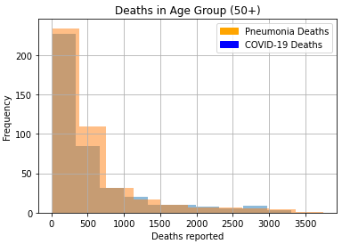
Distribution Deaths in the 50+ Age Group For COVID-19 and Pneumonia.
Each color represents a different age group
Figure 4. Each are similarly distributed

Slide 16
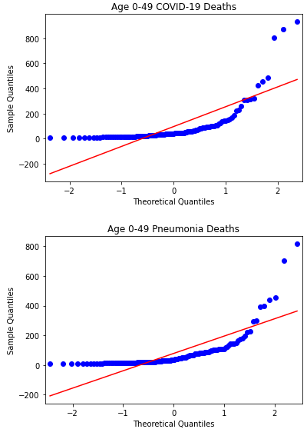
Quartile-Quartile Plots.
Red line represents normality
Both data sets are ‘non-normal’ in a similar way.
Figure 5. Each are similarly distributed

Slide 17
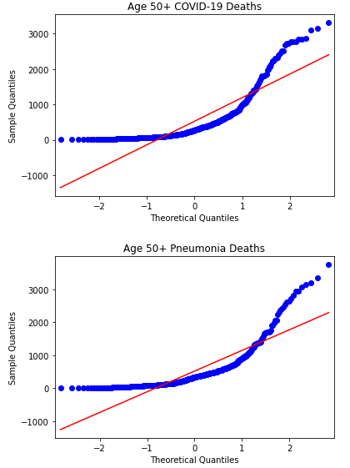
Quartile-Quartile Plots.
Red line represents normality
Both data sets are ‘non-normal’ in a similar way.
Figure 6. Each are similarly distributed

Slide 18
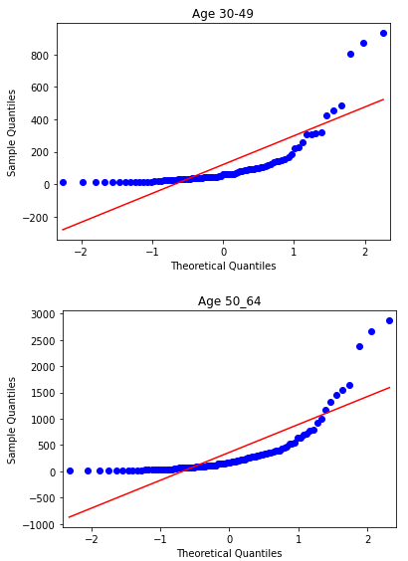
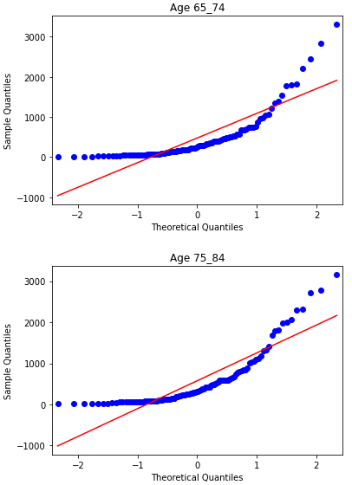
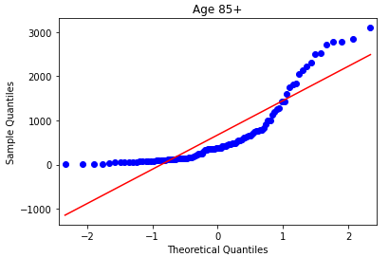
COVID-19 Quartile-Quartile Plots.
Red line represents normality
Both data sets are ‘non-normal’ in a similar way.
Figure 7. Each are similarly distributed

Slide 19
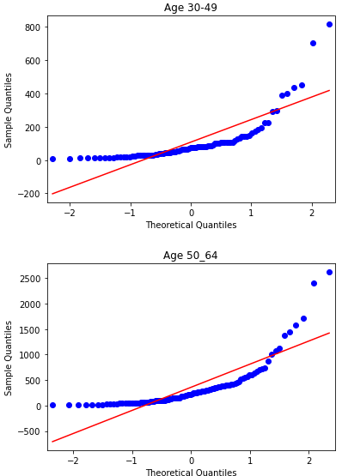
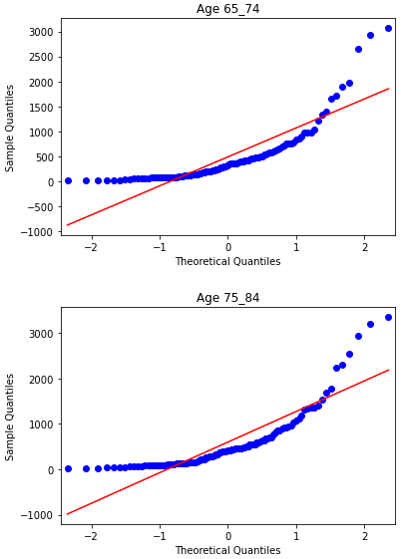
Pneumonia Quartile-Quartile Plots.
Red line represents normality
Both data sets are ‘non-normal’ in a similar way.
Figure 8. Each are similarly distributed

Slide 20
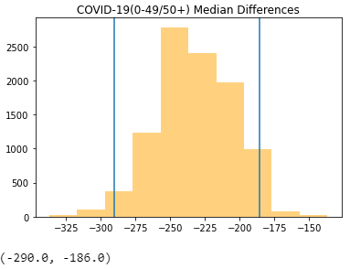
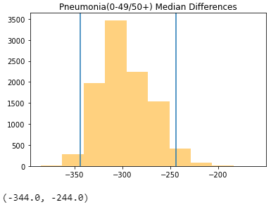
Aha! My discoveries
What do these confidence intervals show?
COVID-19: We can see from the analysis above that when considering only non-zero death counts, there are 186 to 293 more deaths reported in the '50+' age group compared to the '0-49' age group
Pneumonia: We can see from the analysis above that when considering only non-zero death counts, there are 244 to 344 more deaths reported in the '50+' age group compared to the '0-49' age group

Slide 21
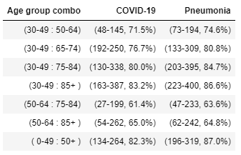
Aha! My discoveries
What about the other age groups?
This table lists the confidence interval and the common language effect size for all the age group that had a statistically significant difference in deaths reported.
For example: you can expect the 75-84 age group to have either 48-145 more deaths or about 71.5% more deaths than the 30-49 age group.

Slide 22
So what the doctors and medical professionals on TV says makes sense! It is important to take precautions to keep our older population safe!

Slide 23
Conclusion
The data used in this research shows that among records with at least one reported death there are statistically significant differences in the number of deaths attributed to COVID-19 by age group, and the older the age group the greater number of deaths. The data shows that COVID-19 and Pneumonia both display this trend.

Slide 24
What else can we learn from this data?
This only considers deaths. What about the survivors?
The younger generations may be able to carry the virus asymptomatically, and that could have a big impact on transmission. Is that something that can be investigated with this data set?
Are there differences between genders?
Are there other data sets that we can pair with this one?
What about deaths reported from states with a larger elderly population? Can that influence be observed?

Slide 25
The End
Questions?

