Slide 1

Predicting Video Game Sales
By Christopher Clegg
ece.clegg@gmail.com

Slide 2
Why? Build a model that can predict video game sales.
The motivation:
Practice my new data science skills, investigate the relationships between my variables and target
Interesting, important, and worth knowing
The data:
Sales: North America, Europe, Japan, an accummulation from other places, and a Global Total.
Video Game Descripters: Platform, Genre, Rating, Year Released
Public reaction: Critic Score, User Score, and quantities of critics and users

Slide 3

IS THIS LIKE ONE OF THOSE ‘CHICKEN OR EGG SENARIOS?
Did the critics review boost sales, or did the critic’s review come after the boosted sales?
Picture Source: https://www.brainpickings.org/2013/02/01/which-came-first-the-chicken-or-the-egg/

Slide 4
How important are those reviews? The number of Yelp’s reviews has steadily grown over the quarters in 2018-2019, and year over year (YoY) growth stands at 17%. Nearly half of the small businesses listed on Yelp have a 5-star rating! There is a high probability that customers logging into the platform will be persuaded by positive reviews to finally convert. Yelp has consistently battled fake and misleading reviews. In Q4, 2019, it released 198 alerts, notifying consumers of biased review practices, thereby protecting business ratings.
Source: https://www.martechadvisor.com/articles/seo/yelp-vs-google-for-smbs/

Slide 5
How accurately can sales be predicted?
What data is used to form a predictions? What other data could be used?

Slide 6
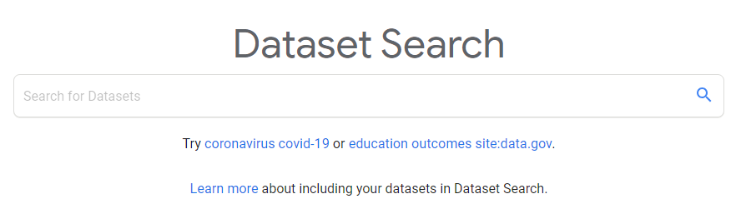


Research: A brief “play-by-play”
Search for data
Found some open-source data at Kaggle.com provided by Rush Kirubi and Kendall Gillies
Exploring and Cleaning
Data rarely comes in ideal shape and never comes conveniently pre-arranged just for you.
What to do about missing data?
Drop it or fill it in?
Preparation for the model.
Encoding, and scaling.

Slide 7

Research: A brief “play-by-play” cont’d...
Getting a feel for the data
Preliminary visualization:
Distributions
Scatterplots
What Tools Should I Use?
Determine models to use
Which model best fits the goal of this project.

Slide 8

Research: A brief “play-by-play” cont’d...
Apply model methods
Tuning Parameters
Visualize the results, incorporate them into an explanation that is relatable, and form a final conclusion.
Picture Source: https://www.123rf.com/photo_124220354_stock-vector-finish-banner-symbol-of-championship-successful-racing-symbol-finish-line-flat-design-eps-10-.html

Slide 9
My methods
XGBoost Regression
Linear Regression
Lasso, Elastic Net
K Nearest Neighbors
Tune parameters in a ‘Grid Search’
Compare the training and test scores.
Observe the plot of true vs predicted values.
These are the method I chose, and why I chose them.

Slide 10
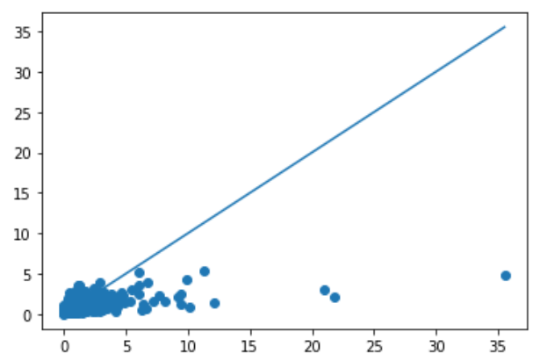
XGBoost Regression.
Random Decision Tree with a self-correcting feature.
Accuracy:
Train Score: 0.852977
Test Score: 0.58996
Parameters:
Column Sample by tree: 1
Max Depth: 14
Subsample: 0.5
MAE: 0.437(million)
MAPE: 1.9332 x 100%
Figure 1. Predicted vs True values (Sales in Millions)

Slide 11
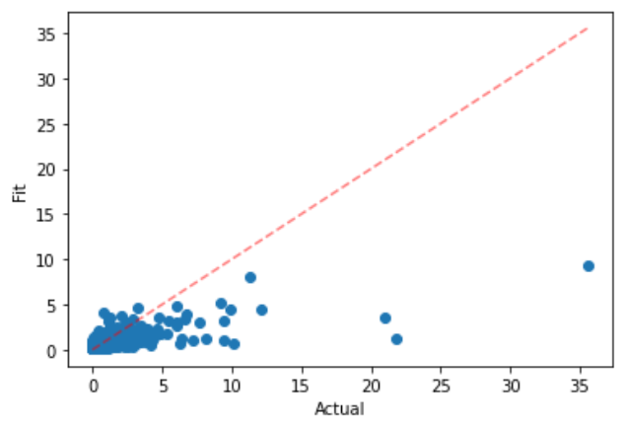
Lasso Model
Linear Regression with L1 regulariation
Accuracy:
Train Score: 0.5004
Test Score: 0.4364
Parameters:
Lambda = 0.0001
MAE: 0.4982 (million)
MAPE: 0.2307 * 100%
Figure 2. Predicted vs True (Sales in mllions)

Slide 12
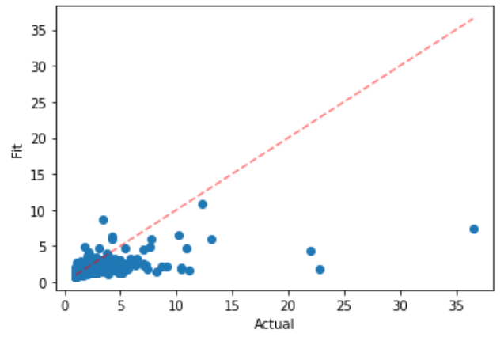
Elastic Net Model
Linear Regression with L1 & L2 regulariation
Accuracy:
Train Score: 0.4786
Test Score: 0.4201
Parameters:
Lambda = 0.001
L1 Ratio = 0.1
MAE: 0.5064 (million)
MAPE: 0.2340 * 100%
Figure 3. Predicted vs True (Sales in mllions)

Slide 13
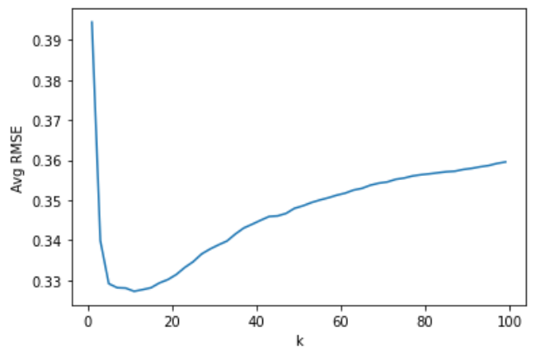
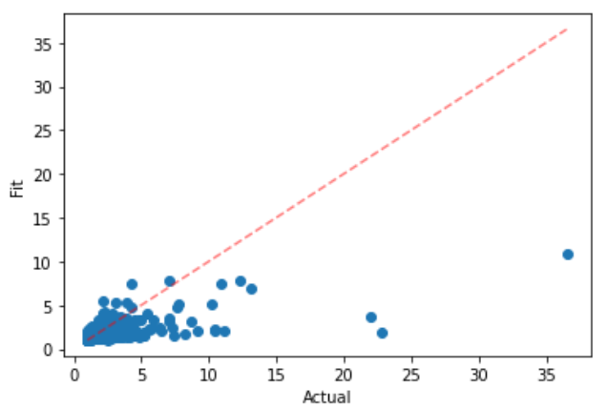
KNN Regression
K-nearest neighbors’ regression
Accuracy:
Train Score: 0.58312
Test Score: 0.4769
Parameters:
13 neighbors
MAE: 0.4735 (million)
MAPE: 0.2073 * 100%
Figure 4. Finding the best number of neighbors
Figure 5. Predicted vs True (Sales in mllions)

Slide 14
Where to go from here? Improve models for sales in other countries Investigate further investment in sponsored critics.

Slide 15
The End
Questions?

