Slide 1
Rendezvous
Couch Level

Slide 2
Outline
Team
Product Overview
Service Overview
Organizational Tools
Links
UI Design
Use Cases
Website
Where We Are
Where We’re Going
What We’ve Learned

Slide 3
Team
Nick Petty: Product Owner, UI Designer
Caio Farias: Scrum Master, Website Creator
Scott Hinden: Developer, Tester
Avi Rao: Developer, Use Case Planner

Slide 4
Product Overview
Rendezvous is a platform for people to connect through shared-interest outdoor events.
Our competitive advantage is our focused feature, ease of use, and controlled event visibility.
This service targets active adults and requires little technical skill.

Slide 5
Service Overview
Specific terminology – activities and events.
Through our website, users join the service. They can view lists of activities and events, then join or create events based on these activities.

Slide 6
Organizational Tools
Team management – FAU Blackboard
Taskboard – Someone
Document and code management – GitHub, SourceTree
General communication – text messages, email

Slide 7
Links
Project home page: http://lamp.cse.fau.edu/~fariasc2013/pseproject2/index.php
GitHub: https://github.com/Ninjinkai/Couch-Level-Project
Someone: https://couchlevel.someone.io

Slide 8
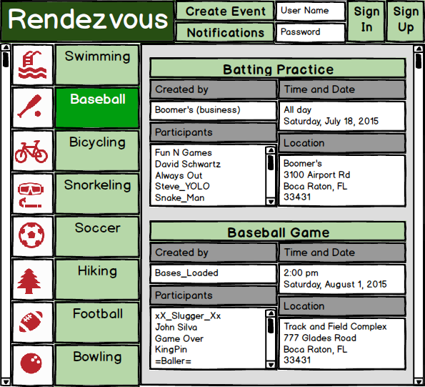
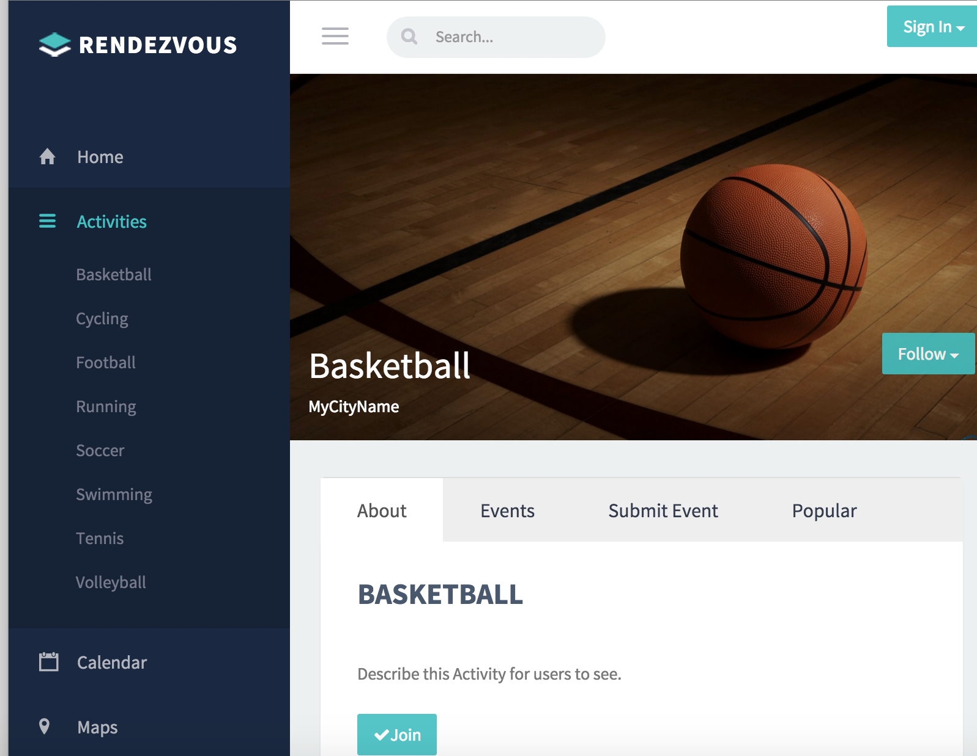
UI Design
Layout tool – Balsamiq
Color scheme – green, grey, white
Simple – most usage done in one page view

Slide 9
Use Cases
Make an Account
Join Event
Create Event
Authenticate User (not documented)
Actors: visitor, existing user, web administrator, website system, web moderator

Slide 10
Website
Developed with notepad++
Written in HTML, CSS, JavaScript, PHP, MySQL
Deployed on FAU LAMP server
Templates from Bootstrap
Optimized for desktop browsers, mobile responsive

Slide 11
Where We Are
Welcome page
Creating an account
Creating and joining events
Joining activities
Adding cover photos to events

Slide 12
Where We’re Going
Documentation
Product testing
Events calendar
Creating activities
Maps
Messages
Notifications
Search
Always more to do, never enough time.

Slide 13
What We’ve Learned
Delegation matters, one person can’t do everything.
Communicate, ask for help and clarification, let others know what you’re doing.
Be flexible, things will rarely go your way.
Plan ahead, get started early.

Slide 14
Thank you

