Slide 1
Min 10% between 0% and 100% ice
Max 90% of 0% and 100% ice
Per year balancing to prevent all samples from one year
Total samples: 47122

Slide 2
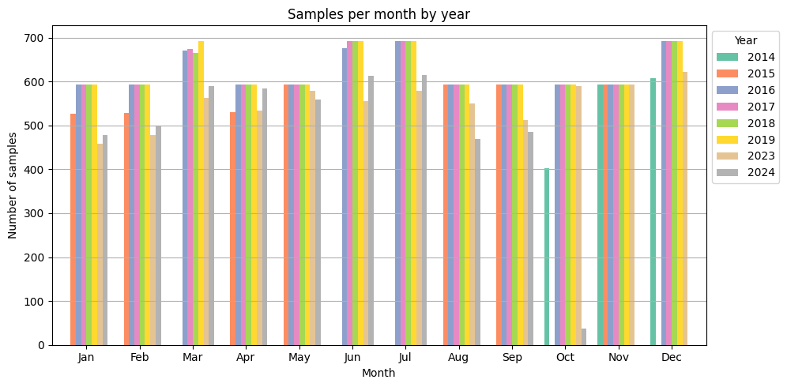

Slide 3
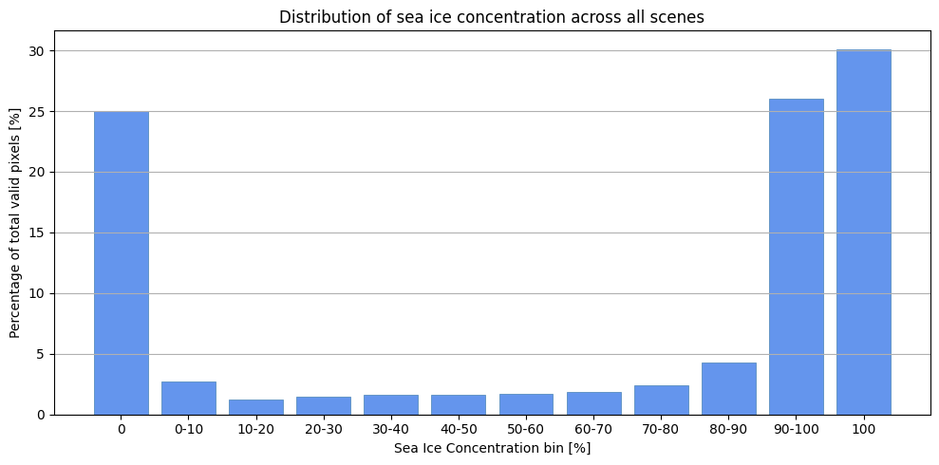

Slide 4
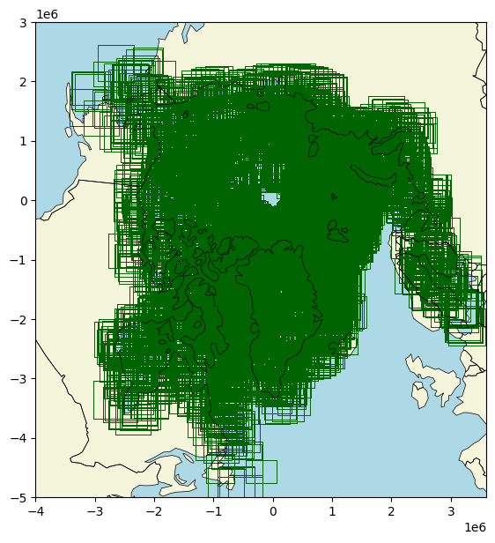

Slide 5
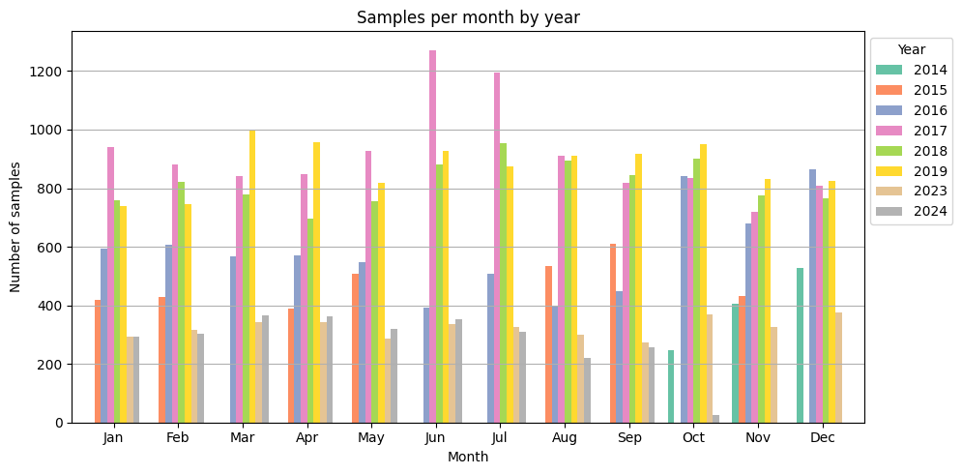
49504 samples

Slide 6
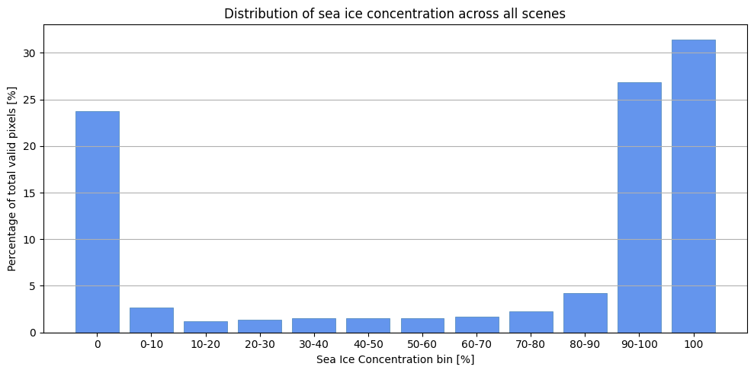

Slide 7
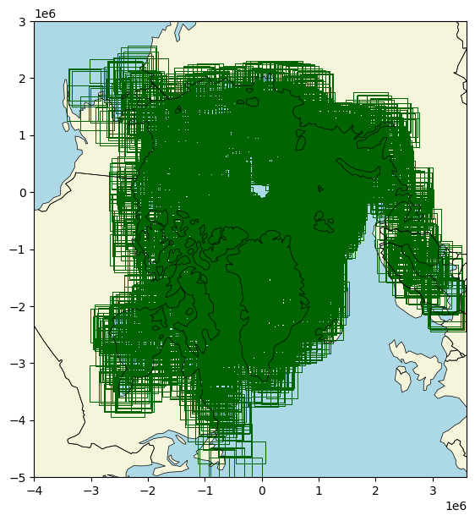

Slide 8
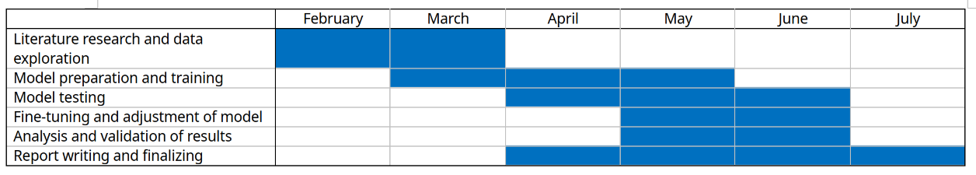
Train basis network – simple Unet
  Fix dataloader
Make better network

Slide 9
