Slide 1
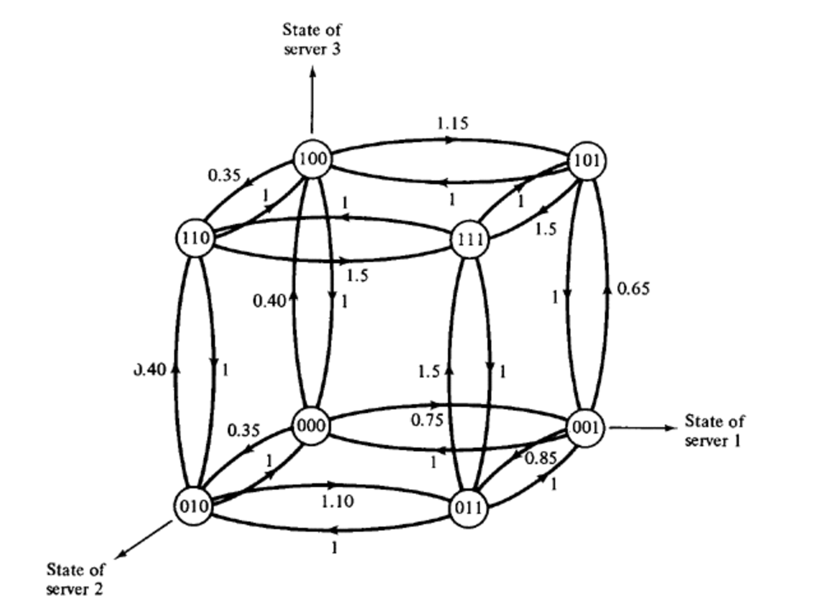
Project：Hypercube Queuing Model
Jiufan Wang

Slide 2
Introduction：
The model addresses critical emergency service challenges by optimizing facility locations, designing efficient service districts, and determining optimal response unit allocations. These optimizations are essential for improving urban emergency service delivery while managing operational costs.
The framework has broad applications across emergency services, including police patrol routing, ambulance station positioning, and fire department coverage planning. Each service type benefits from the model's ability to handle both fixed locations (like fire stations) and mobile units (like patrol cars).
Initially developed by Richard C. Larson at MIT, this groundbreaking approach has become a fundamental tool in emergency service planning and operations research. The model's computational efficiency and practical applicability have made it particularly valuable for real-world implementation.

Slide 3
Queueing theory：
Core Concept: Queueing theory studies the behavior of waiting lines, focusing on the arrival of tasks (or customers), service processes, and resource allocation to optimize performance and reduce delays.
Applications: It is widely used in various fields, including telecommunications, transportation, healthcare, and emergency services, to design systems that manage congestion and improve efficiency.
Mathematical Framework: Queueing models typically involve stochastic processes, analyzing metrics such as average wait time, queue length, and system utilization to evaluate and optimize performance under uncertainty.

Slide 4
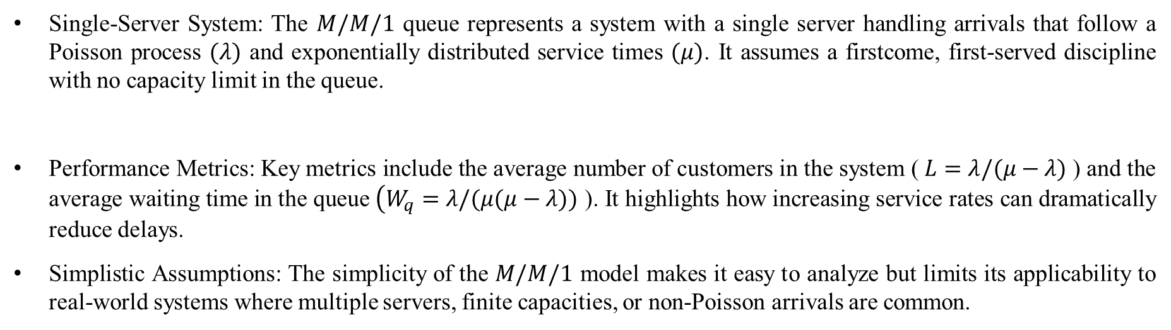
Basic M/M/1 queue：
Single-Server System: The $M/M/1$ queue represents a system with a single server handling arrivals that follow a Poisson process $(λ)$ and exponentially distributed service times $(μ)$. It assumes a firstcome, first-served discipline with no capacity limit in the queue.
Performance Metrics: Key metrics include the average number of customers in the system ( $L=$ $λ/(μ−λ)$ ) and the average waiting time in the queue $\left(W_{q}=λ/(μ(μ−λ))\right.$ ). It highlights how increasing service rates can dramatically reduce delays.
Simplistic Assumptions: The simplicity of the $M/M/1$ model makes it easy to analyze but limits its applicability to real-world systems where multiple servers, finite capacities, or non-Poisson arrivals are common.

Slide 5
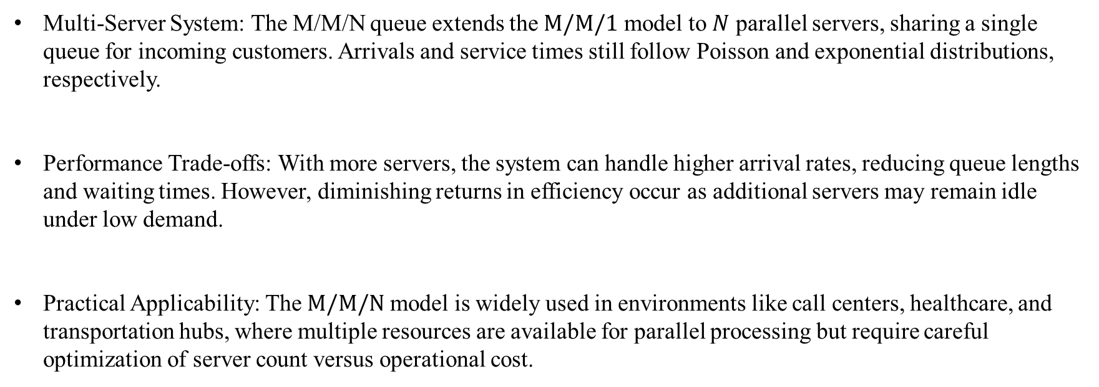
M/M/N queue：
Multi-Server System: The M/M/N queue extends the $M/M/1$ model to $N$ parallel servers, sharing a single queue for incoming customers. Arrivals and service times still follow Poisson and exponential distributions, respectively.
Performance Trade-offs: With more servers, the system can handle higher arrival rates, reducing queue lengths and waiting times. However, diminishing returns in efficiency occur as additional servers may remain idle under low demand.
Practical Applicability: The $M/M/N$ model is widely used in environments like call centers, healthcare, and transportation hubs, where multiple resources are available for parallel processing but require careful optimization of server count versus operational cost.

Slide 6
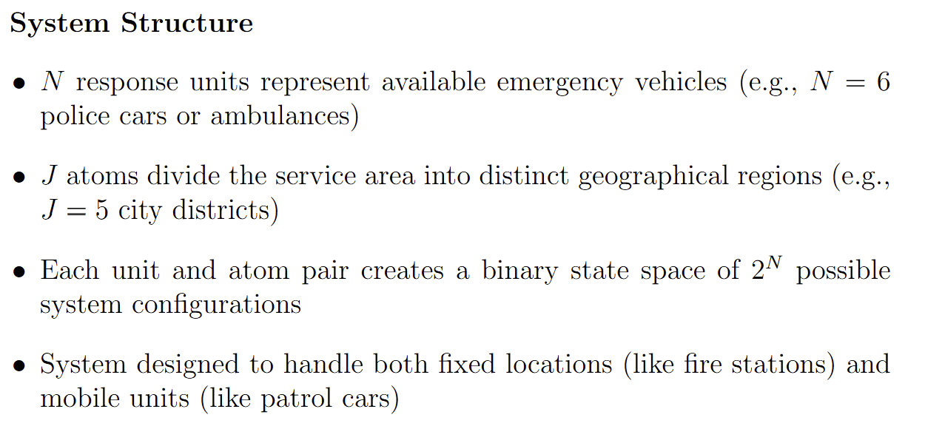
Key element：

Slide 7
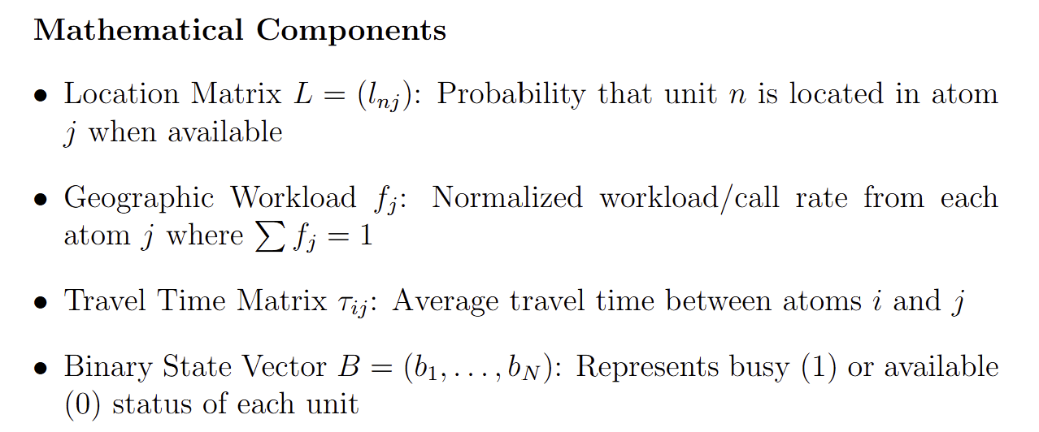
Key element：

Slide 8
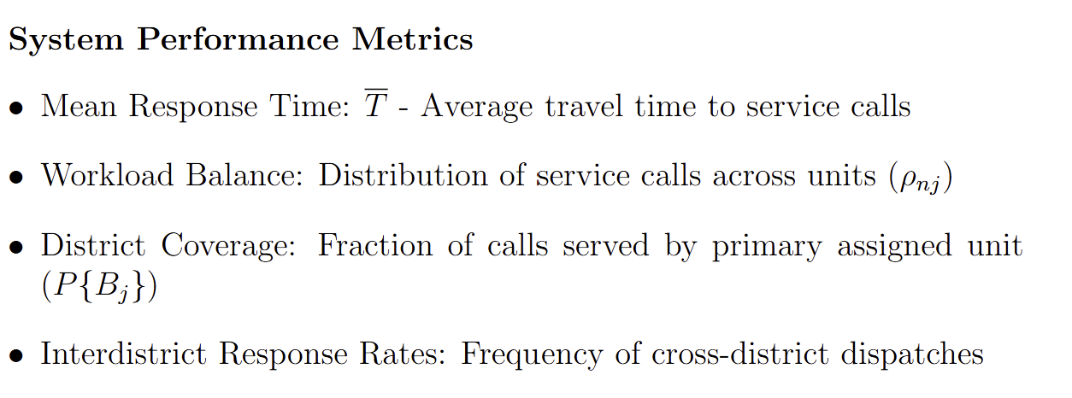
Key element：

Slide 9
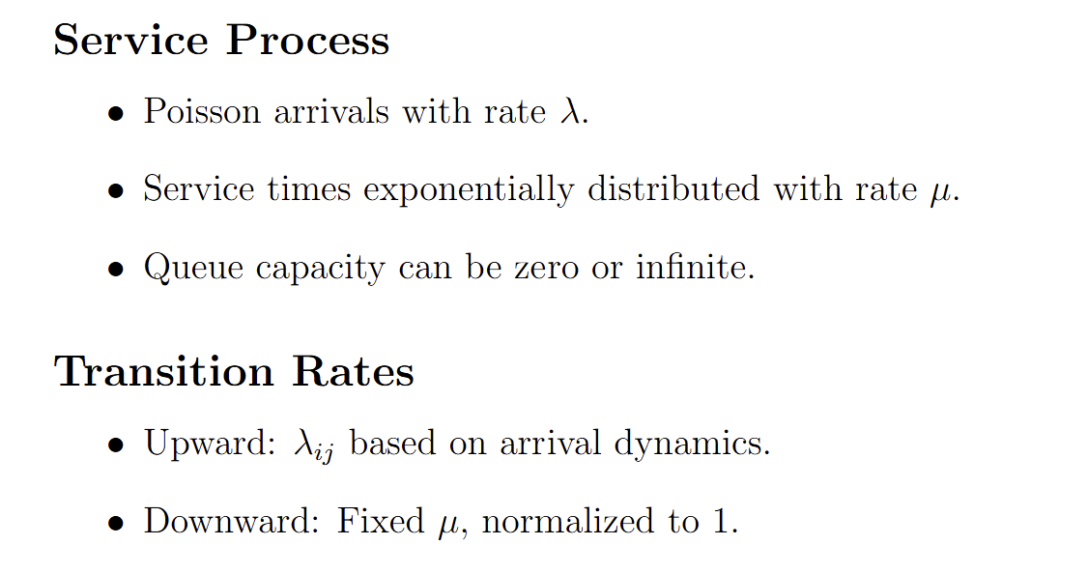
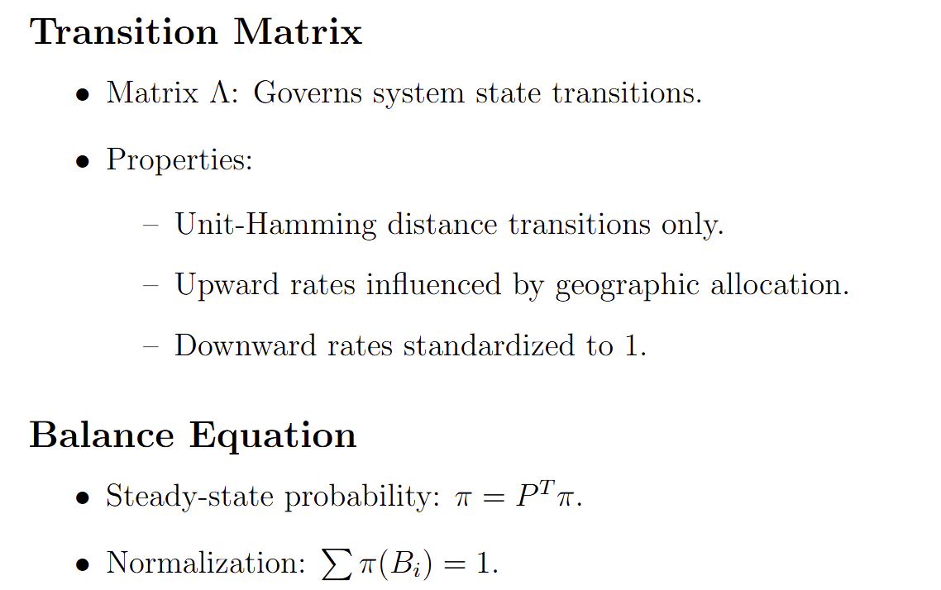
Math Framework：

Slide 10
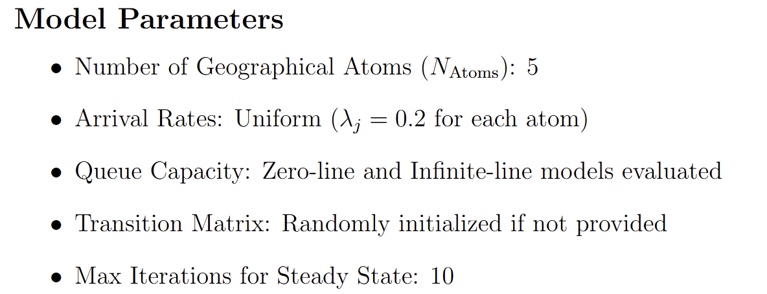
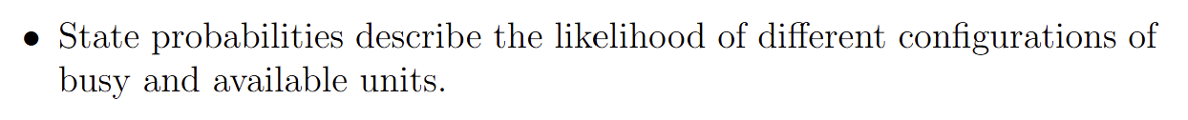
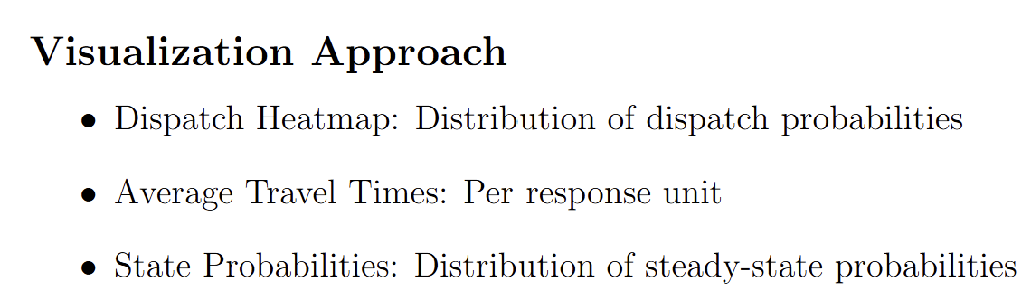
Experiment Setup：

Slide 11
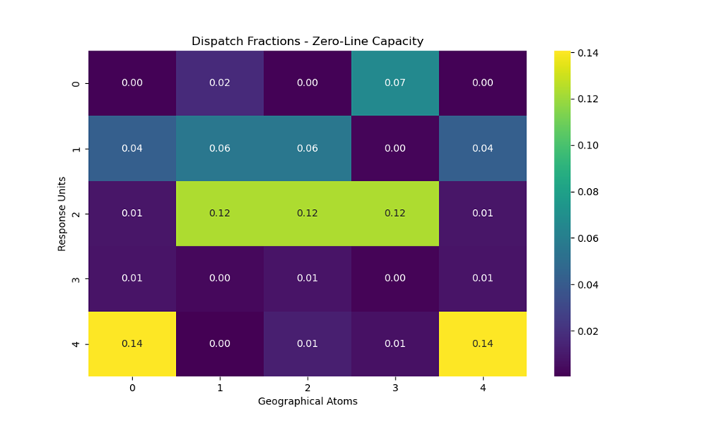
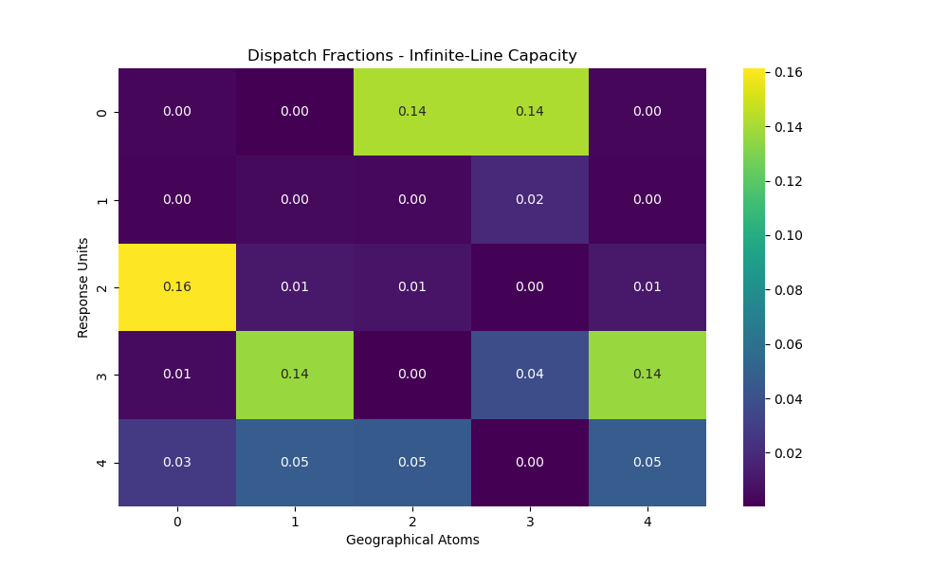
Result Comparison：
zero-line capacity and infinite-line capacity
Coverage Distribution: The zero-line capacity model exhibits more uniform dispatch fractions across response units, while the infinite-line capacity model shows a pronounced specialization for certain units, such as Unit 2 dominating Atom 0 dispatches.
Geographical Variability: In the zero-line capacity scenario, all units contribute more evenly to multiple geographical atoms, whereas the infinite-line capacity model concentrates dispatch activity on fewer units for specific atoms.

Slide 12
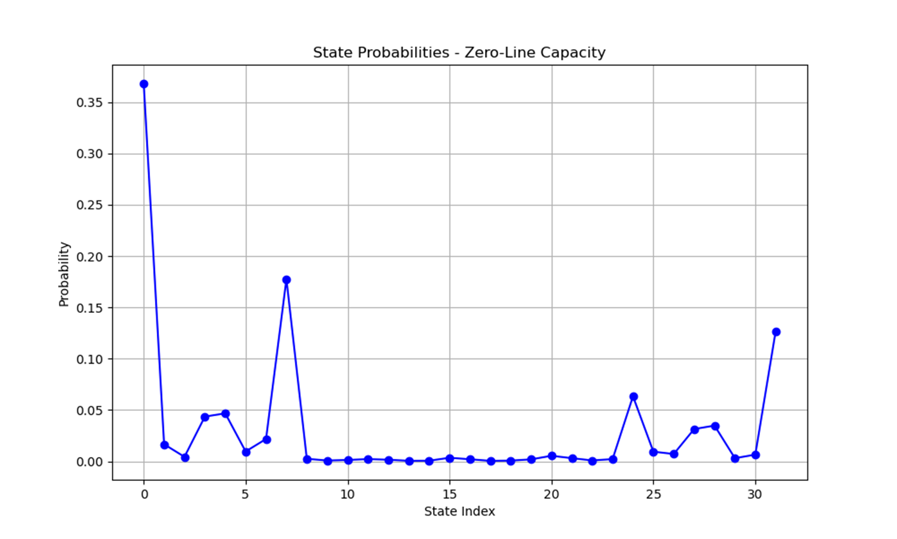
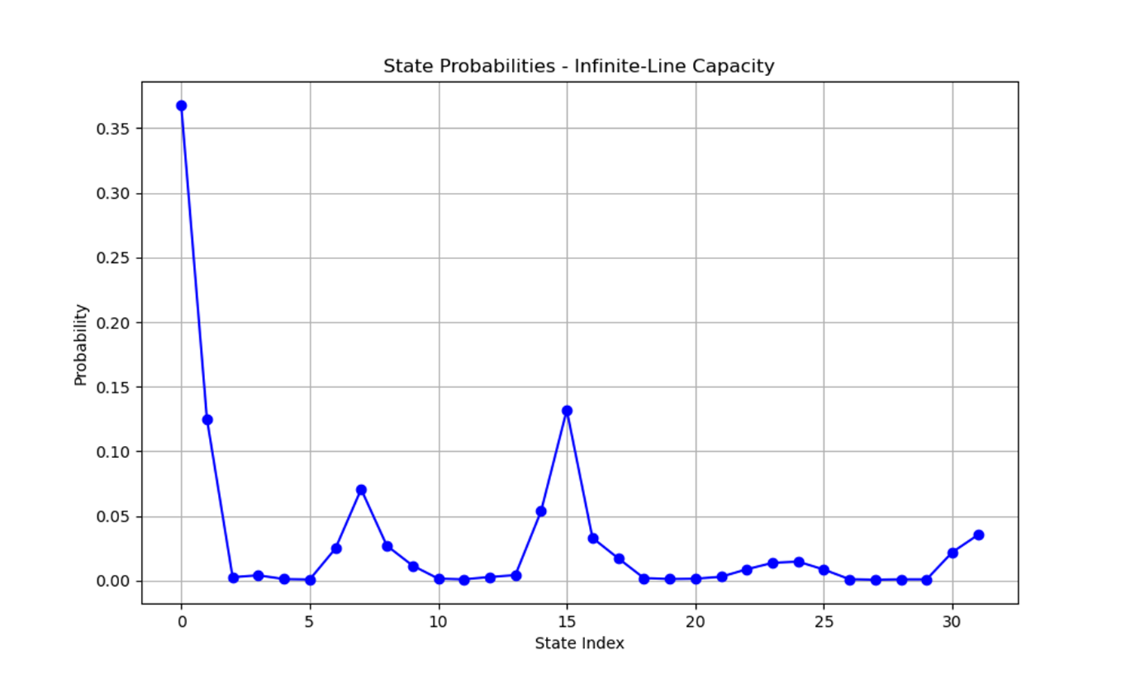
Result Comparison：
zero-line capacity and infinite-line capacity
Peak State Probability: In both models, the all-units-available state dominates with the highest probability (≈0.35), but the infinite-line capacity model shows smoother transitions across other states compared to the zero-line capacity model.
Rare Busy States: The zero-line capacity model exhibits sharper peaks for intermediate states indicating higher likelihoods of specific busy configurations compared to the infinite-line capacity model, which distributes probabilities more evenly.

Slide 13
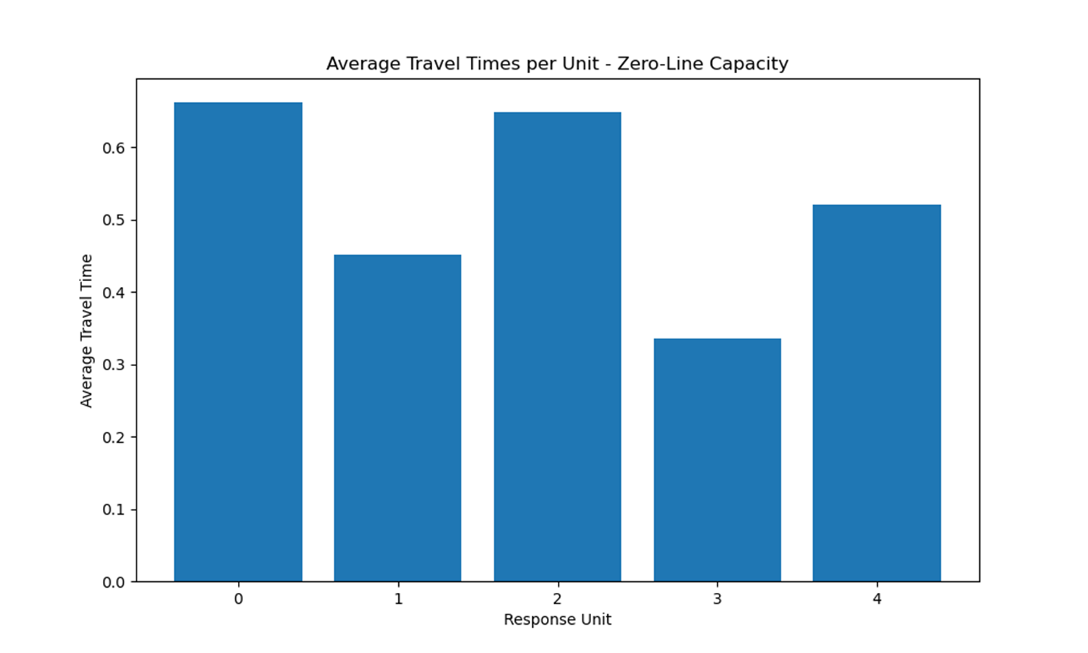
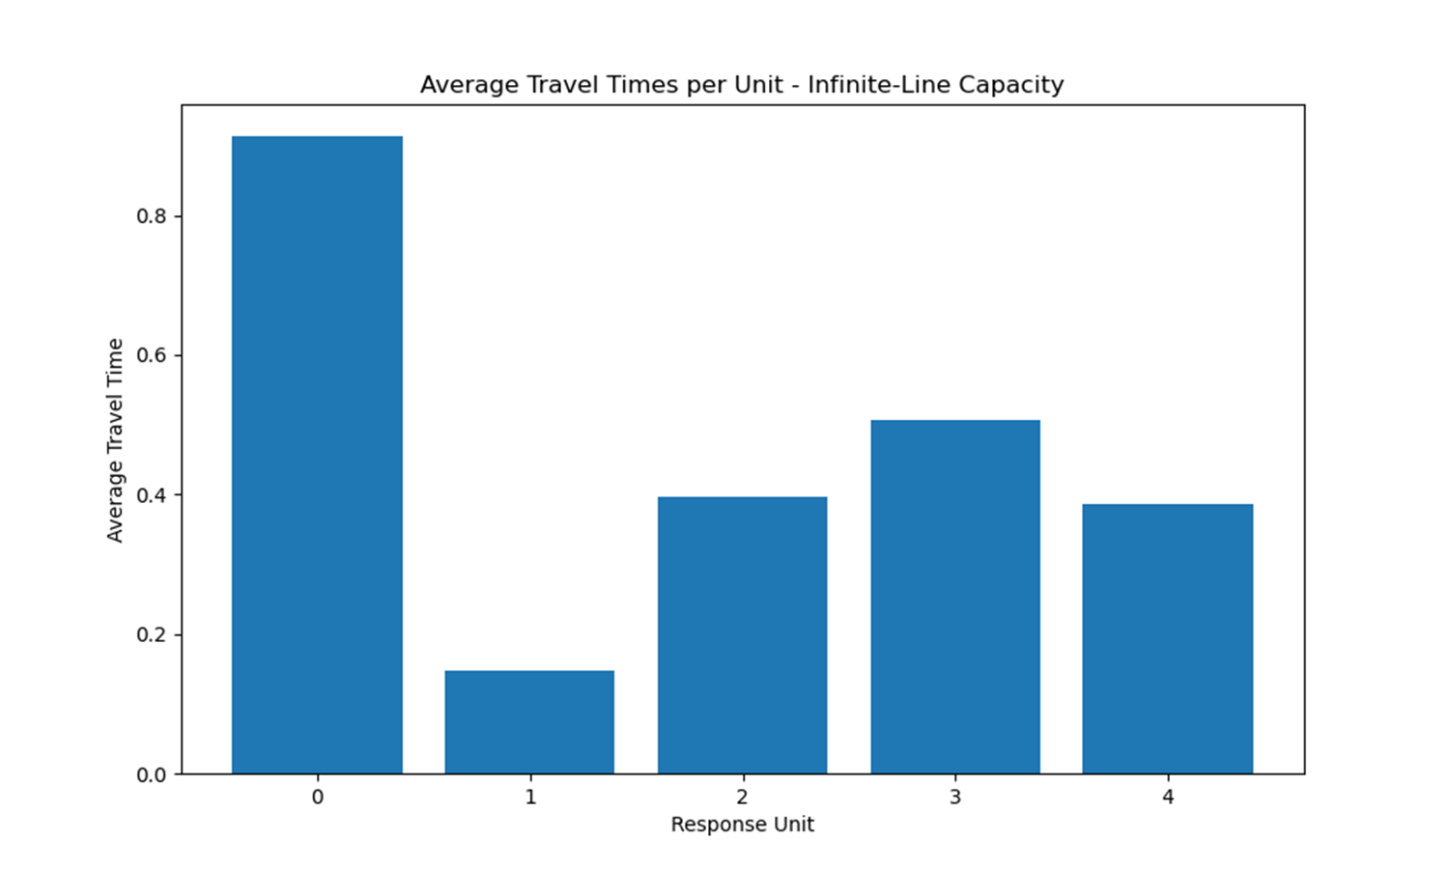
Result Comparison：
zero-line capacity and infinite-line capacity
Unit 0 Dominance: In both models, Response Unit 0 consistently has the highest travel time, but it is more pronounced in the infinite-line capacity model (≈0.9) compared to the zero-line capacity model (≈0.6), indicating a higher reliance on Unit 0 in the infinite-line scenario.
Balanced Travel Times: The zero-line capacity model exhibits a more balanced travel time distribution across other units, while the infinite-line capacity model shows greater variability, with Unit 1 having significantly lower travel times in the infinite-line model.

Slide 14
Summary：
Dispatch and State Patterns: The zero-line capacity model achieves more balanced dispatch probabilities and sharper peaks for intermediate busy states, while the infinite-line capacity model centralizes activity on specific units with smoother transitions, highlighting potential for dynamic dispatch optimization in future studies.
Travel Time Variability: The infinite-line capacity model shows higher variability in travel times, especially for Unit 0, emphasizing the need for geospatial optimization to reduce travel inefficiencies and improve response times.
Adaptive and Hybrid Models: Future work could explore adaptive dispatch policies and hybrid capacity models, combining zero-line and infinite-line features to handle practical constraints and improve overall system performance

