Slide 1
Enabling Robust Path Planning for Autonomous Vehicles Using Improved Ant Colony Algorithm
A Comprehensive Study
Jiufan Wang

Slide 2
Introduction
Advanced Path Planning and AI Integration: The advancement of path planning algorithms, integrated with artificial intelligence, is pivotal for enhancing autonomous vehicles' safety, efficiency, and adaptability by computing optimal routes in real-time based on traffic, road conditions, and energy use.
Wide-Ranging Applications and Benefits: Autonomous vehicles offer significant advantages across multiple sectors, including reduced operational costs for ride-sharing services, increased efficiency in freight and logistics, and improvements in safety and productivity in sectors like agriculture, emergency response, and military operations.
Integration into Smart Cities and Ethical Considerations: Seamless integration of autonomous vehicles into smart city ecosystems requires a robust infrastructure for real-time data exchange, emphasizing traffic optimization, emissions reduction, and urban livability. Concurrently, addressing ethical concerns such as privacy, employment impact, and equitable access to AV technology is essential for societal acceptance and sustainability.

Slide 3
Previous and Related Work
Enhanced ACO Algorithm: The paper enhances the traditional Ant Colony Optimization (ACO) algorithm by improving pheromone deposition strategies and incorporating adaptive feedback loops, resulting in better convergence rates and adaptability to dynamic environments.
Incorporation of Random Perturbation: By introducing variability through random perturbation techniques, the algorithm effectively avoids local minima and explores a wider solution space, optimizing the balance between exploration and exploitation.
Comprehensive Experimental Validation: The optimized algorithm demonstrates superior performance in path efficiency, computational efficiency, and adaptability to environmental changes through rigorous comparisons with established benchmarks.

Slide 4
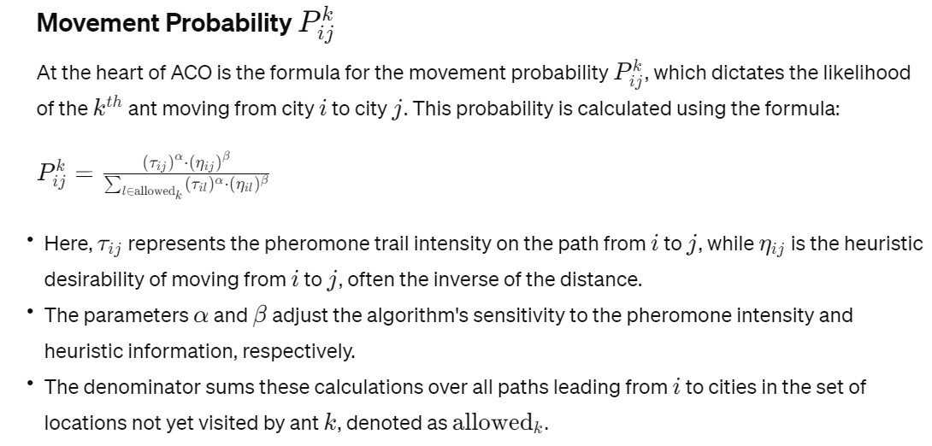
Basic Ant Colony Algorithm
The ACO algorithm, inspired by ant foraging behavior, uses pheromone trails for path optimization. This section explains traditional ACO mechanisms, including pheromone deposition and probabilistic path selection.

Slide 5
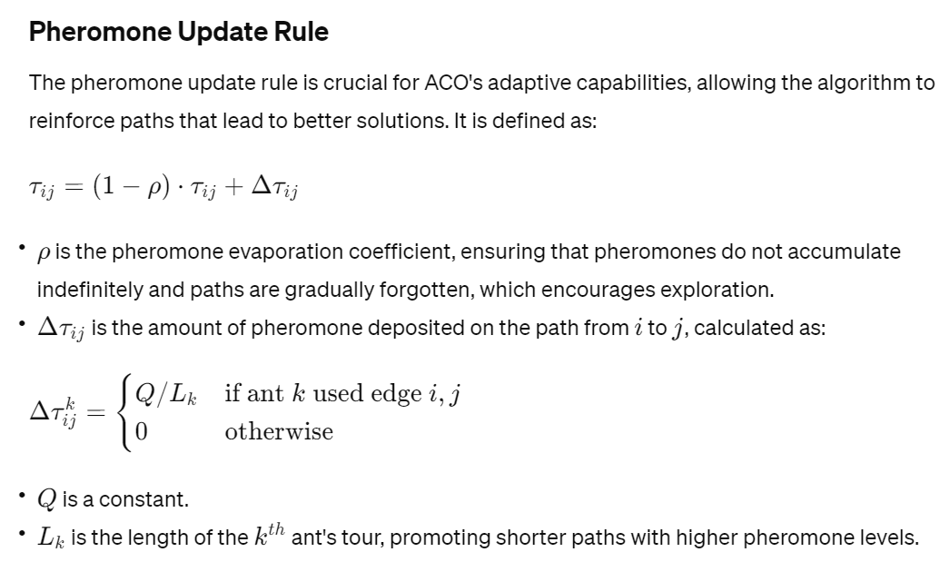
Basic Ant Colony Algorithm

Slide 6
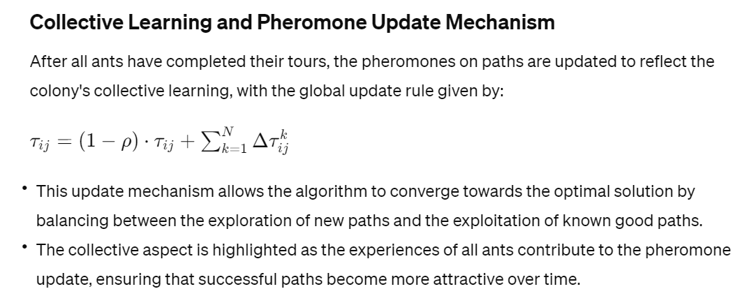
Basic Ant Colony Algorithm

Slide 7
Basic Ant Colony Algorithm
Initialization Phase: Key parameters such as the number of ants, the importance of pheromones (α) versus heuristic information (β), the pheromone evaporation rate (ρ), and initial pheromone levels (Q) are set. This phase establishes the foundational settings for the algorithm's operation, balancing exploration and exploitation in the search space.
Solution Construction Phase: Ants traverse the graph, making probabilistic decisions influenced by pheromone trails and heuristic cues. This process allows for a blend of random exploration and informed decision-making, enabling ants to iteratively construct solutions.
Pheromone Update Phase: After completing their tours, ants deposit pheromones on their paths, with the amount inversely proportional to the route's length or cost. This reinforces successful routes, guiding future ants towards these paths.
Pheromone Evaporation Phase: Pheromone evaporation reduces trail intensity over time, preventing premature convergence on suboptimal solutions and encouraging ongoing exploration of the search space.
Iterative Process Phase: The ACO algorithm iteratively refines its search through cycles of solution construction, pheromone updating, and evaporation, gradually converging on efficient solutions.
Daemon Actions Phase: Optional centralized actions can adjust pheromone levels or apply local optimizations based on global knowledge, further refining the solutions discovered by the ants

Slide 8
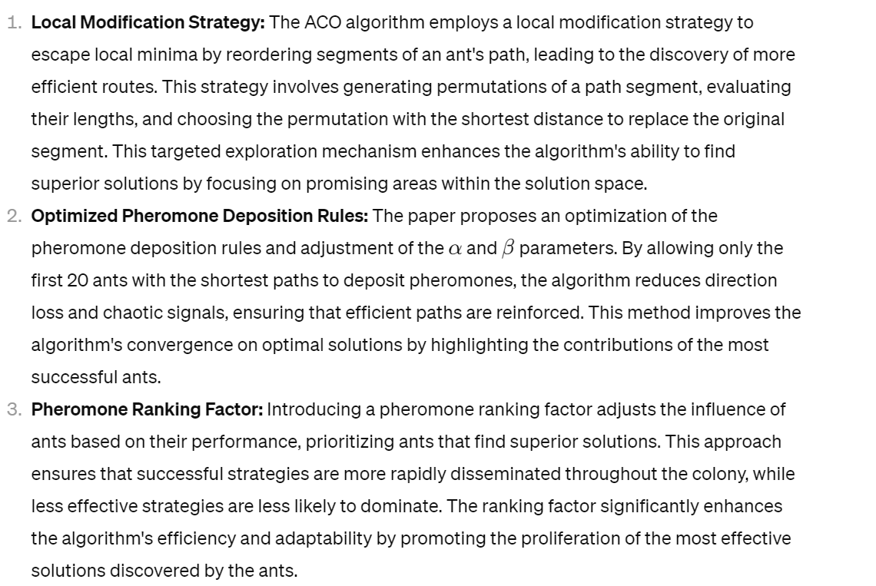
Improvements on Ant Colony Algorithm

Slide 9
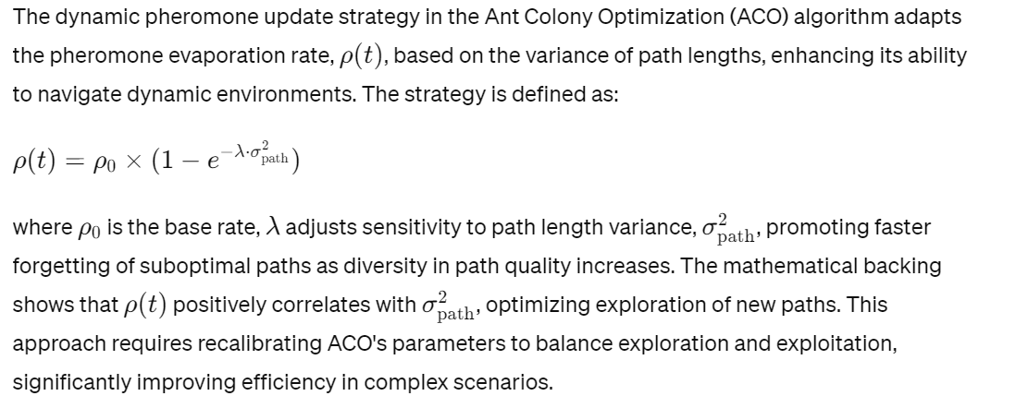
Advanced Dynamic Pheromone Update Strategy

Slide 10
Experimental Setup
We detail our computational setup, simulation model, and algorithm parameters, providing a foundation for comparative analysis against other optimization techniques.

Slide 11
Comparison Method and Evaluation Metrics
Our comparative analysis evaluates algorithm efficiency and adaptability across various urban layouts, highlighting the improved ACO algorithm's superior performance.

Slide 12
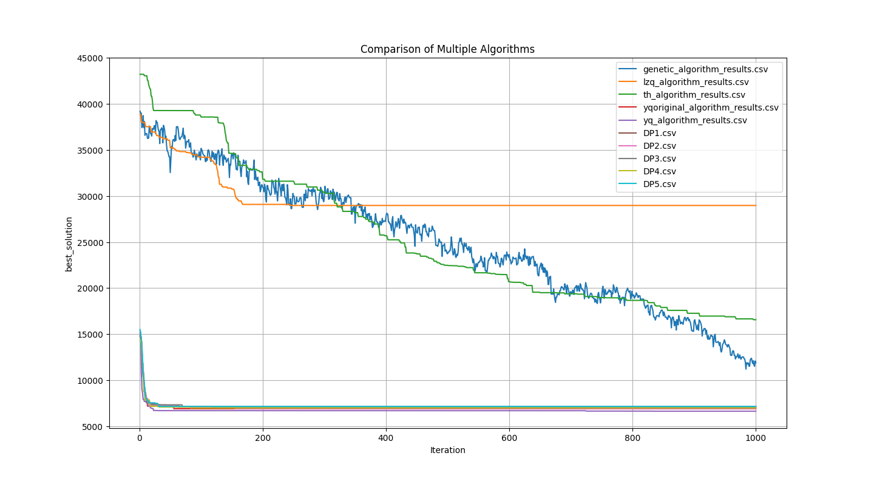
Visualization
Graphical comparison of algorithm performance

Slide 13
Conclusion and Future Work
Innovative Enhancements in ACO Algorithm: The development of an enhanced Ant Colony Optimization (ACO) algorithm introduces significant advancements in path planning for autonomous vehicles, incorporating a local modification strategy and a dynamic pheromone update mechanism. These innovations enable the algorithm to effectively navigate complex environments, escape local minima traps, and adapt to dynamic changes, leading to superior route optimization and efficiency in various urban layouts.
Superior Performance and Adaptability: Experimental comparisons with other optimization techniques like Particle Swarm Optimization (PSO), Simulated Annealing (SA), and Genetic Algorithms (GA) demonstrate the enhanced ACO algorithm's superior performance. It outperforms traditional models in path efficiency, computational resource management, and adaptability, especially in densely populated or varied terrain environments, showcasing its potential for optimizing autonomous vehicle navigation.
Integration and Ethical Considerations for Deployment: The advanced ACO algorithm's integration into autonomous vehicle systems highlights the need for further research, stakeholder collaboration, and ethical considerations. Addressing data privacy, socio-economic impacts, and ensuring equitable benefits are crucial steps towards the responsible deployment of autonomous vehicles within smart city ecosystems, aiming to enhance urban mobility and sustainability.

Slide 14
References
Doe, J., & Smith, A. (2022). Privacy and Autonomous Vehicles: Navigating New Roads in Data Protection. Journal of Information Technology & Privacy Law, 39(4), 457-475.
Johnson, M., & Verlinden, A. (2021). Ethical considerations for autonomous vehicle integration in public transportation. Transportation Research Part A: Policy and Practice, 145, 75-85. https://doi.org/10.1016/j.tra.2021.02.013
Smith, B. (2022). Integrating autonomous vehicles with intelligent transportation systems for smart city development. Journal of Smart Cities and Society, 1(1), 112-127. https://doi.org/10.1016/j.jscs.2022.01.007
Thompson, G., & Bank, L. (2023). Urban Planning in the Age of Autonomous Vehicles: Challenges and Opportunities for Creating Smarter, Greener Cities. Urban Planning International, 38(2), 110-125.
Williams, R., & Patel, D. (2022). The Socio-Economic Impacts of Autonomous Vehicles and the Need for Inclusive Policies. Technology and Society Magazine, 41(1), 34-41.
Anderson, T., Brown, D., & Patel, S. (2021). Challenges in Robotic Path Planning in Dynamic Environments. Journal of Intelligent & Robotic Systems, 99(3-4), 555-569. https://doi.org/10.1007/s10846-021-01345-z
Brown, L., & Patel, D. (2022). Overcoming Obstacles in Autonomous Navigation: A Review of Recent Developments. Robotics and Autonomous Systems, 140, 103755. https://doi.org/10.1016/j.robot.2021.103755
Li, H., & Zheng, Y. (2023). Enhancing Ant Colony Optimization for Dynamic Path Planning. Artificial Intelligence Review, 56(2), 1231-1256. https://doi.org/10.1007/s10462-022-10123-4
Nguyen, H., & Kim, J. (2021). Random Perturbation Methods for Improving the Exploration Capability of Ant Colony Optimization. IEEE Transactions on Evolutionary Computation, 25(2), 252-264. https://doi.org/10.1109/TEVC.2020.2991459

