Slide 1
Group #2
Collective Intelligence

Slide 2
Recommender
Unpack the data
Author and term searches
Flask interface

Slide 3
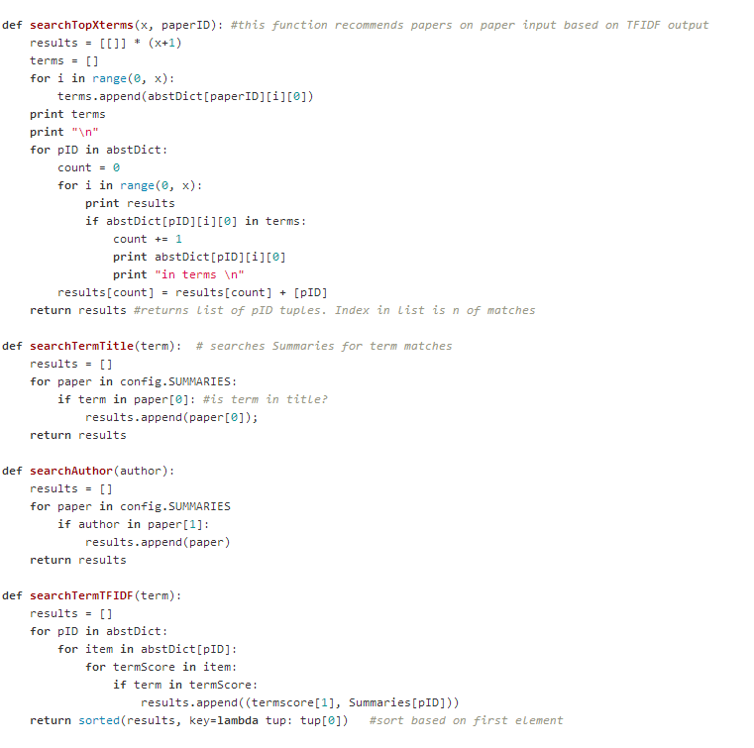

Slide 4
Flask
Flask interface query is sent to a search function
Return value is sent back and displayed by Flask (HTML)
Search functions call more complex algorithms

Slide 5
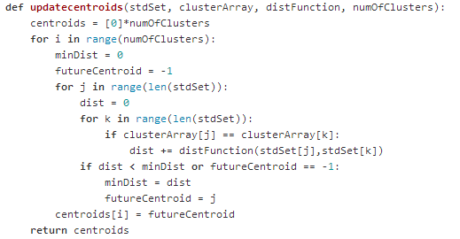
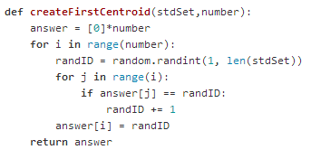
Clustering
K-means clustering adapted to papers
Parameters: data, distance function, n clusters

Slide 6
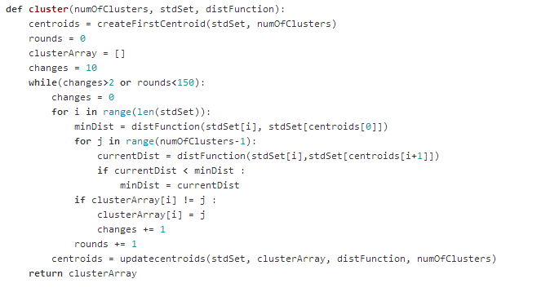
Update clustering until no more changes or maximum rounds reached.

Slide 7
TF IDF
Skip words smaller than 5 letters and blacklisted words

Slide 8
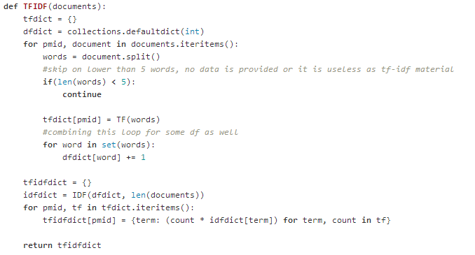
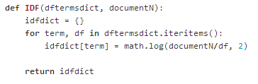
Count term frequency
Put term with inverted frequency in document dictionary
Invert frequency for idf-dict

Slide 9
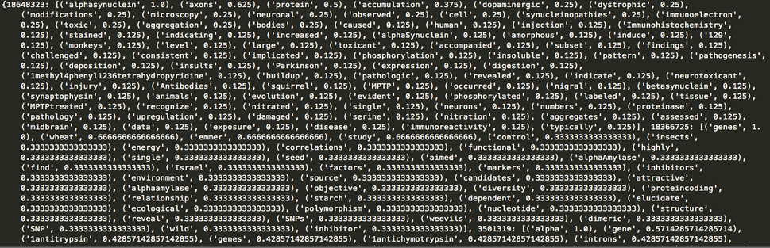

Slide 10
Pagerank
Start all ranks at value 1
Create citedBy set by inverting citations
Update ranks based on citations
Iterate untill no changes or maximum rounds reached.

Slide 11
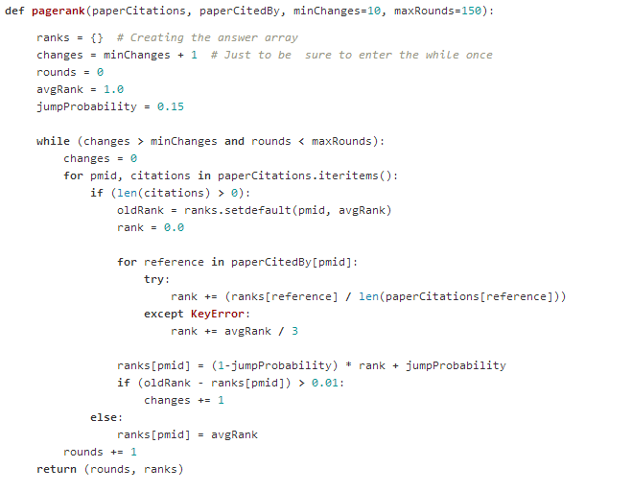

Slide 12
Features

