Slide 1
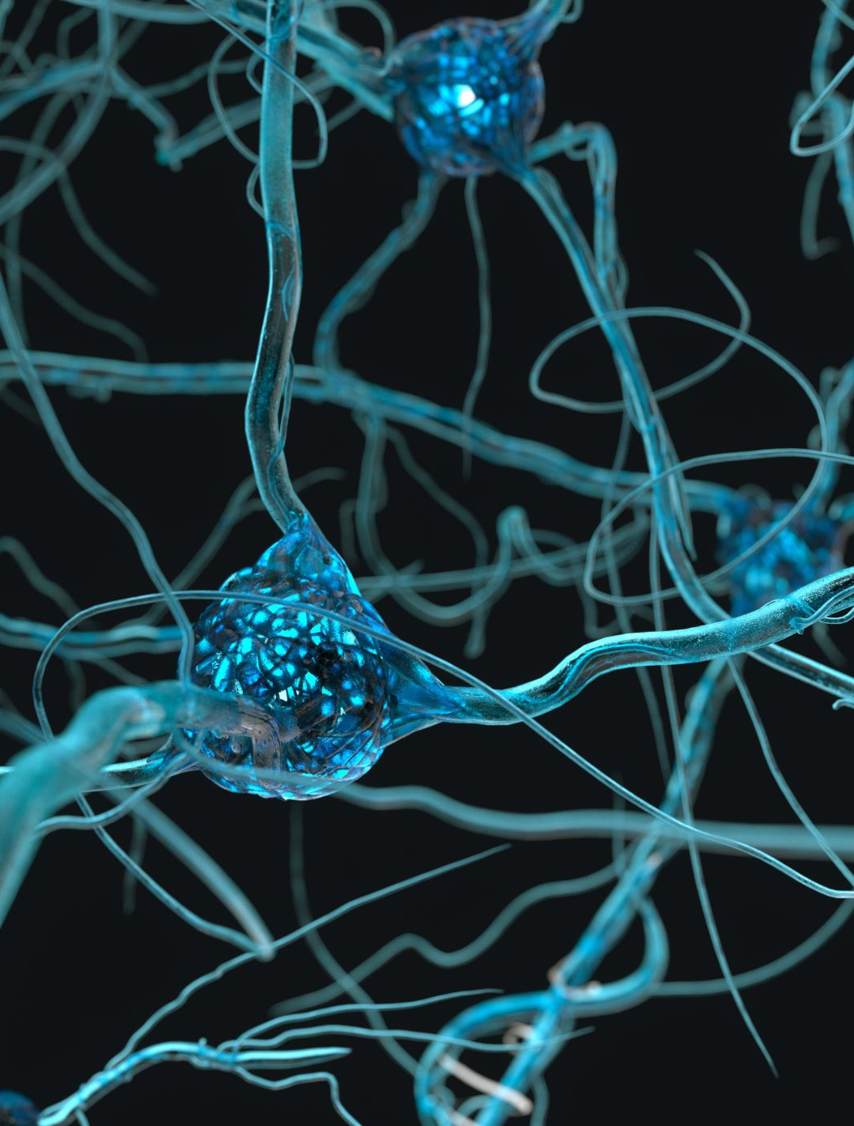
Neural Circuitry
Nino Koci

Slide 2
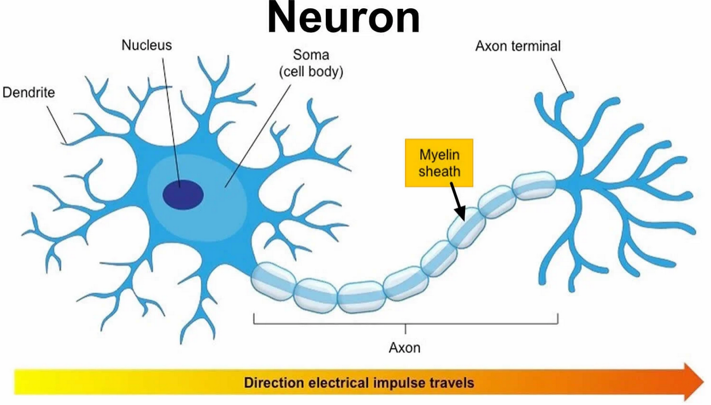
What is a Neuron
A type of cell that is specialized with sending signals within the nervous system
Neurons have many shapes and sizes. However, all neurons contain specific structures that allow them to propagate signals
Notes:
Image Courtesy of:https://www.simplypsychology.org/myelin-sheath.html

Slide 3
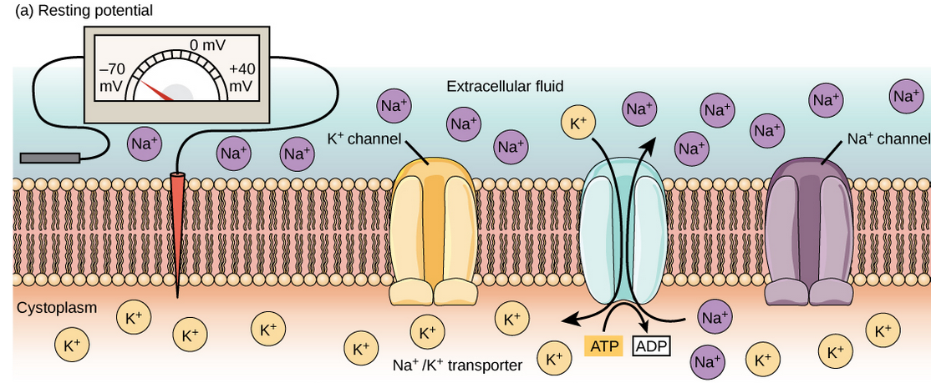


Neuronal Properties
Neurons are unique in that they maintain ion gradients
  High K⁺ and Cl⁻ inside, High Na⁺ outside
The cellular phospholipid bilayer separates these ions
  Each ion has its potential that we can measure through the Nerst equation
  This creates a membrane potential that can be measured through the Goldman equation
For these ions to diffuse and achieve equilibrium, they require the assistance of ion channels
  These channels are voltage-gated and will only open once the membrane potential changes
Notes:
Image 1 curtesy of: https://courses.lumenlearning.com/wm-biology2/chapter/resting-membrane-potential/
Image 2 courtesy of: https://www.physiologyweb.com/calculators/nernst_equation_calculator.html
Image 3 courtesy of: https://www.physiologyweb.com/calculators/ghk_equation_calculator.html

Slide 4
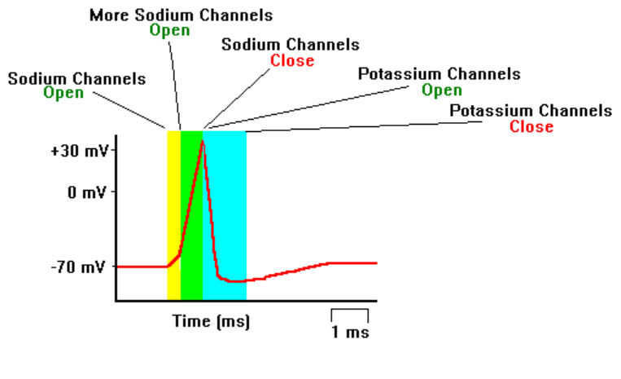
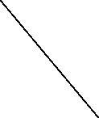
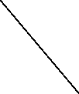
Action Potentials
Neurons propagate action potentials to send signals
Depolarization occurs as Na⁺ enters the cell
  The membrane becomes more positive
At peak Na⁺ voltage-gated channels deactivate and K⁺ voltage-gated channels open
  Na⁺ channels lock once the membrane potential is high
After the peak, the cell polarizes until it hyperpolarizes when the K⁺ exits the cell
Potential is re-established through the Na⁺/K⁺ pump
Depolarization
Repolarization
Hyperpolarization
Notes:
Image courtesy of: https://faculty.washington.edu/chudler/ap.html

Slide 5
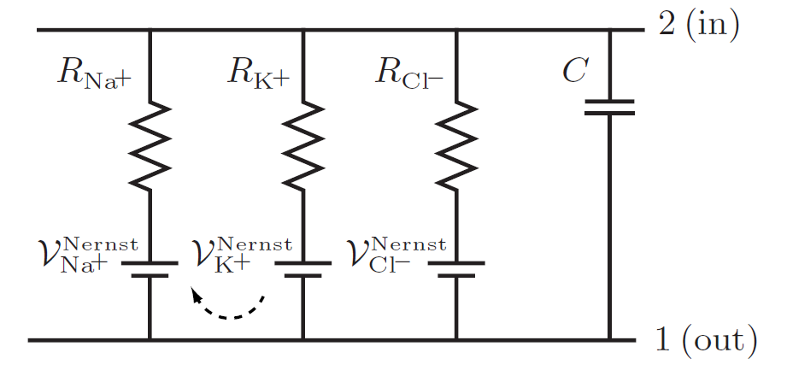
How does this Translate into Circuits?
We can translate the neuronal properties into the same proprieties that a circuit would have
  Voltage(V) is equivalent to the membrane potential, driving the energy in the membrane like a battery
  Ion channels determine the flow of ions and can stand for resistance(R) or conductance (g=1/R)
  Since the membrane separates the charges and acts like a capacitor, it can stand for capacitance(C)
  Ionic flow stands for current(I)
Notes:
Image from Nelson Fig.12.3.b

Slide 6
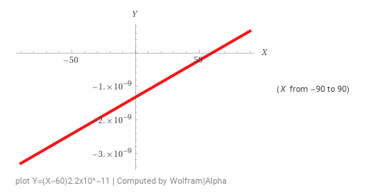
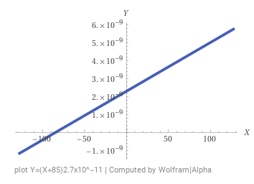
Driving Force
Each ionic current(I_{ion}) is influenced by diffusion equilibrium (E_{ion})and the membrane potential (V_{m})
  Ohms law: I=V/R=gV I_{ion}=g_{ion}V_{m}
  At equilibrium: I_{ion}=g_{ion}E_{ion}
  Combine: I_{ion}=(V_{m}-E_{ion})g_{ion}
I_{Na+} vs. V_{m} plot
This combination is the driving force of an ion
I_{K+} vs. V_{m} plot
Notes:
K⁺conductivity reference: Sakmann B, Trube G. Conductance properties of single inwardly rectifying potassium channels in ventricular cells from guinea-pig heart. J Physiol. 1984 Feb;347:641-57. doi: 10.1113/jphysiol.1984.sp015088. PMID: 6323703; PMCID: PMC1199469
Na⁺ conductance reffrence: Milburn T, Saint DA, Chung SH. The temperature dependence of conductance of the sodium channel: implications for mechanisms of ion permeation. Recept Channels. 1995;3(3):201-211. PMID: 8821793.
Equlibrium potentials from: https://openbooks.lib.msu.edu/neuroscience/chapter/membrane-potential/

Slide 7
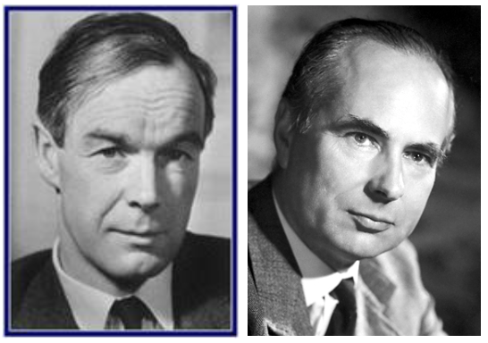
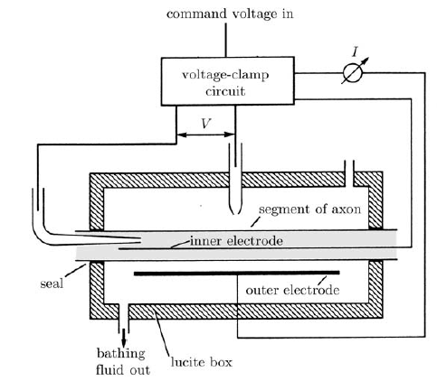
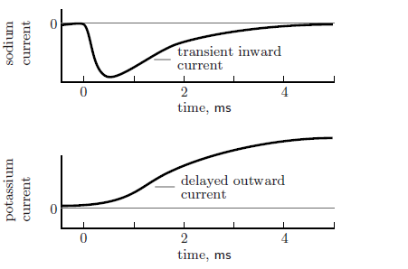
Hodgkin & Huxley
Tested the strength of the currents present in the giant squid axon through voltage clamping
They discovered that there is an initial interior Na⁺ current that is then followed by an exiting K⁺ current
Therefore, Na⁺ ions will begin to enter and depolarize the neuron until its deactivated
K⁺ ions leave following the opening of their voltage-gated channels
Notes:
The top Figure is a courtesy of: https://mrgreene09.github.io/computational-neuroscience-textbook/Ch4.html
The bottom Figures (left to right) are from Nelson Fig.12.11 and 12.13.c 12.13.d

Slide 8
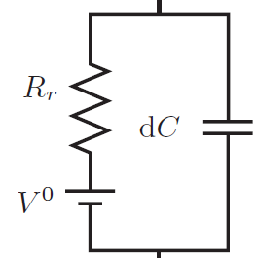

Single RC Circuit
Let’s consider the membrane as a RC circuit
We have the membrane as a capacitor(C), and ions will flow out due to the leakiness of the membrane(1/R_{r}=g_{r})
We know that we will have three currents
  Capacitive(I_{C}) and Leak(I_{r}) leave, and Sodium(I_{Na+})goes into the cell I_{C}+I_{r}= I_{Na}
Now, let’s calculate the potential when the driving current flows
  I_{Na}=C_{m} ($\frac{dV}{dt}$)+V_{m}g_{r} $\frac{\text{I}\text{Na}}{gr}$= $\frac{Cm}{gr}$($\frac{dV}{dt}$)+V_{m}
  Assume steady state: ($\frac{dV}{dt}$) =0 $\frac{\text{I}\text{Na}}{gr}$=V_{max}
  Substitute $\frac{Cm}{gr}$for τ and solve for ($\frac{dV}{dt}$)
  V_{m}(t)=V_{max}[1-($e^{−t/\text{τ}}$)](the capacitor is charging)
Notes:
Image from Nelson Fig.12.4.b

Slide 9
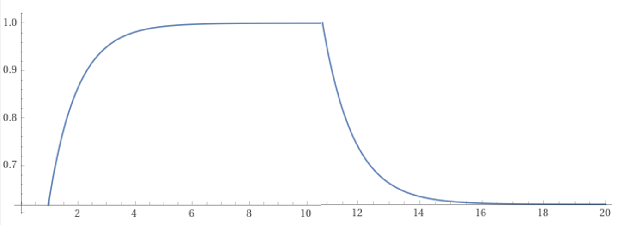

Single RC Circuit(cont.)
Assume the ion flow is successful and there is now no more sodium flow(I_{Na}=0)
  0=C_{m}($\frac{dV}{dt}$)+V_{m}g_{r}=$\frac{Cm}{gr}$($\frac{dV}{dt}$)+V_{m}
  Substitute C_{m}/g_{r} for τ
  Solve for ($\frac{dV}{dt}$) V_{m}(t)= V_{max}[$e^{−t/\text{τ}}$], the capacitor is discharging
The τ constant will be the innate time factor that will determine how long the membrane potential can increase, or decay while maintaining its potency
  In charging when t=τ, V₀ reaches to 63% of V_{max}
  In discharging when t=τ , V_{max} decays to 37%
Plot V_{m} vs. time(t)
V_{m}
63% charge, t=τ
37% decay, t=τ
t(ms)
Notes:
Plots used to make figure:
plot of y=V0 * (1-exp(-t/tau)) for t=0 to 11
plot of y=V0 * exp(-(t-10)/tau) for t=10 to 20

Slide 10
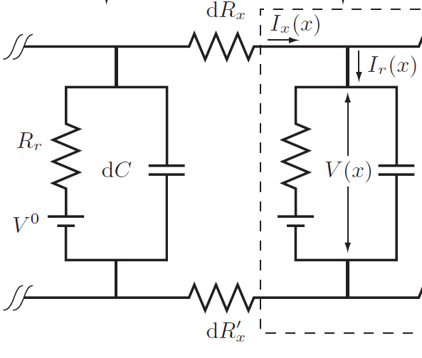
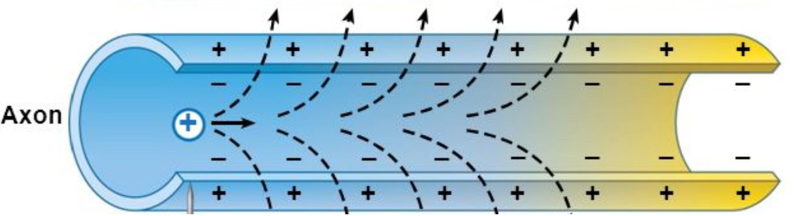

The Neuron as a Cable
Let’s consider the neuron a cylindrical cable with multiple connected RC circuits, with the cytoplasm acting as a buffer that offers resistance
Let’s derive an equation based on a junction(Nelson eq.12.6)
  I_{x}(x) − I_{x}(x+dx) = − dI= 2πr(j_{q,r}(x) +C_{m}($\frac{dV}{dt}$)) dx
Let’s solve the equation and assume j_{q,r}=g_{r}(V_{m}-V₀)
  r²πκ ($\frac{d2V}{dx2}$)=2πr(g_{r}(V_{m}-V₀)+C_{m}($\frac{dV}{dt}$)) (Nelson Eq. 12.7)
  $\frac{\text{r}\text{κ}}{\text{2}gr}$ ($\frac{d2V}{dx2}$)=(V_{max}-V₀)+ $\frac{Cm}{gr}$($\frac{dV}{dt}$) λ²($\frac{d2V}{dx2}$)=(V_{m}-V₀)+τ($\frac{dV}{dt}$)
  Where $\frac{\text{r}\text{κ}}{\text{2}}$is the axial cytoplasmic conductance and g_{r} is the total membrane conductance for ions
Notes:
Top Image from Nelson Fig.12.4.b
Bottom image as a courtesy from:http://pittmedneuro.com/synaptic.html

Slide 11
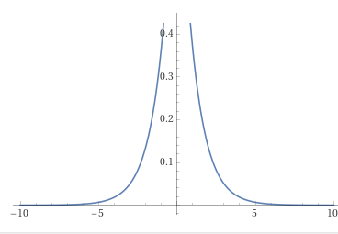

The Neuron as a Cable(cont.)
Since we know τ, let’s look at how λ impacts voltage
  λ²($\frac{d2V}{dx2}$)=(V_{m}-V₀)+τ($\frac{dV}{dt}$), assume τ=0 and solve for $\frac{d2V}{dx2}$
  V_{m}=V₀ ($e^{−|x|/\text{λ}})$
λ, like τ, will represent a space constant innate within a cell that determines how far will the membrane potential go while maintaining its potency
  In this case, λ will represent the distance(x) when V_{m} decays to 37% of its original value
Plot V_{m} vs. distance(x)
V_{m}
37% decay, x=λ
-x
x
Notes:
Plot of the figure from wolfram: plot V0 * exp(-|x|/lambda) from x=-10 to 10

Slide 12
Putting this Together
We can now establish a good model that explains the conductivity of a current inside a neuron
We can see from our space and time factors (λ and τ) that when the initial current carries the Na⁺ ions come in, they behave similarly to a diffusion response and spread passively in the membrane
  Passive spread derivation: v(x, t) = (e^{−t/τ})(t^{-1/2})(e₋^{x^2/(4tλ2/τ)}) (Nelson Eq.12.10)
Through passive spread, these ions can be quick in traveling and depolarizing a cell and, therefore, initiating future action potentials down the cell

Slide 13
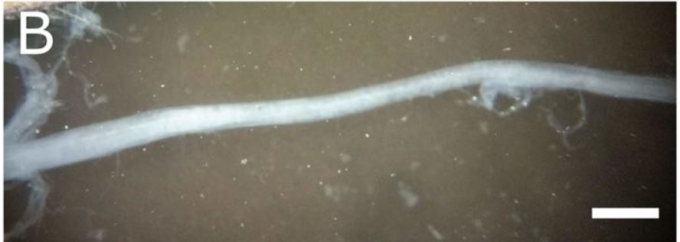
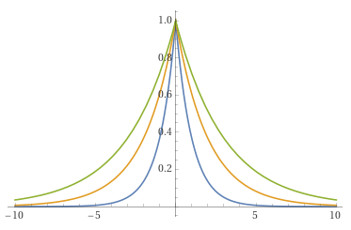

Biological Optimizations: Giant Squid Axon
Why do squid have such fast responses?
Squids have large axons that carry the signal fast
We know that the λ constant will increase with an increase in cytoplasmic conductivity as $\frac{\text{r}\text{κ}}{\text{2}}$increases
  g_{r} also increases, but this is countered by an increase in Na⁺ channels too
This would make the charge move further down the axon without any cytoplasmic interference or risk of losing potential due to leakiness
  Na⁺ can move further along the axon and depolarize the membrane faster and with greater coverage
Plot V_{m} vs. distance(x) for different λ values
V_{m}
λ
2λ
3λ
37% decay, x=λ
-x
x (nm)
Notes:
Image 1:Montanino, A., Deryckere, A., Famaey, N. et al. Mechanical characterization of squid giant axon membrane sheath and influence of the collagenous endoneurium on its properties. Sci Rep 9, 8969 (2019). https://doi.org/10.1038/s41598-019-45446-y, Fig.2.B
Plot for the bottom figure from wolfram:plot of y=V0 * exp(-|x|/lambda) and y=V0 * exp(-|x|/2 lambda) and y=V0 * exp(-|x|/3 lambda) for x=-10 to10

Slide 14
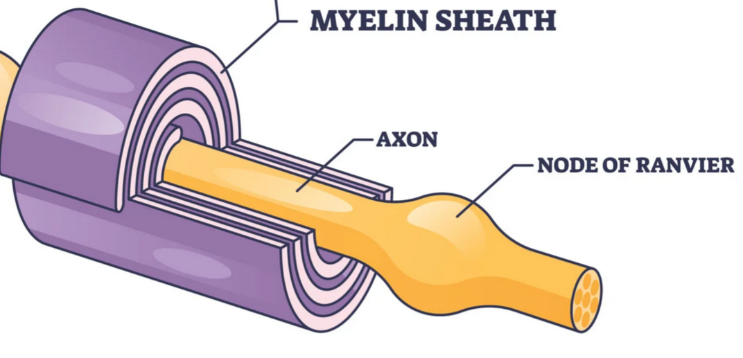
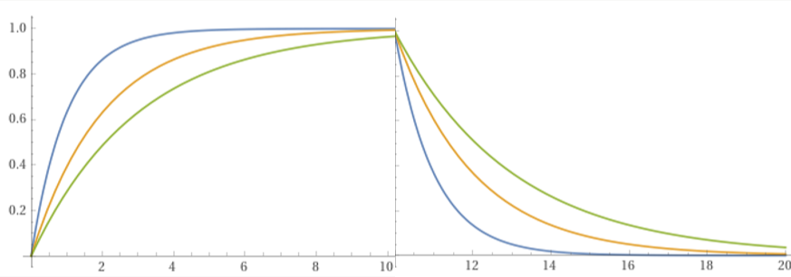
Biological Optimizations: Myelin
Let’s consider our cells compared to the squid
  If our optical neuron were on scale with the giant squid axon, it would end up being 1m long
How do we solve this issue? Myelin
Myelin is a coating of cells in a neuron that leaves small relay junctions to generate APs
Schwann cells act like parallel capacitors and insulation, increasing C_{m} and g_{r} and, therefore, τ
With a higher τ value, the current can propagate faster without losing its potency
In disorders that involve loss of myelin, like multiple sclerosis, patients often experience sudden paralysis as the signal is not fast enough to relay
Plot V_{m} vs. time(t) for different τ values
V_{m}
τ
2τ
3τ
63% charge, t=τ
37% decay, t=τ
T(ms)
Notes:
Image Courtesy of:https://www.simplypsychology.org/myelin-sheath.html
Plots for the bottom figure from wolfram: plot of y=V0 * (1-exp(-t/tau)) and y=V0 * (1-exp(-t/2tau)) and y=V0 * (1-exp(-t/3tau)) for t=0 to 11
plot of y=V0 * exp(-(t-10)/tau) and y=V0 * exp(-(t-10)/2tau) and y=V0 * exp(-(t-10)/3tau) for t=10 to 20

Slide 15
Acknowledgments
I would like to thank my group for helping me assemble this presentation (You guys rock!!!!)
I would also like to thank my mom, sis, and gf for sitting through and hearing me prepare for this presentation
I also would like to thank Professor Cebe for supporting and permitting me to present this fascinating topic
Finally, I would thank Dr. Barry Trimmer for giving me much background on this topic in Neurobiology

Slide 16
References
https://www.simplypsychology.org/myelin-sheath.html
https://www.physiologyweb.com/calculators/nernst_equation_calculator.html
https://www.physiologyweb.com/calculators/ghk_equation_calculator.html
https://openbooks.lib.msu.edu/neuroscience/chapter/membrane-potential/
https://courses.lumenlearning.com/wm-biology2/chapter/resting-membrane-potential/
https://mrgreene09.github.io/computational-neuroscience-textbook/Ch4.html
http://pittmedneuro.com/synaptic.html
Nelson Biological Physics: Energy, Information, Life Chapter 12
Montanino, A., Deryckere, A., Famaey, N. et al. Mechanical characterization of squid giant axon membrane sheath and influence of the collagenous endoneurium on its properties. Sci Rep 9, 8969 (2019). https://doi.org/10.1038/s41598-019-45446-y
Sakmann B, Trube G. Conductance properties of single inwardly rectifying potassium channels in ventricular cells from guinea-pig heart. J Physiol. 1984 Feb;347:641-57. doi: 10.1113/jphysiol.1984.sp015088. PMID: 6323703; PMCID: PMC1199469
Milburn T, Saint DA, Chung SH. The temperature dependence of conductance of the sodium channel: implications for mechanisms of ion permeation. Recept Channels. 1995;3(3):201-211. PMID: 8821793.

