Slide 1
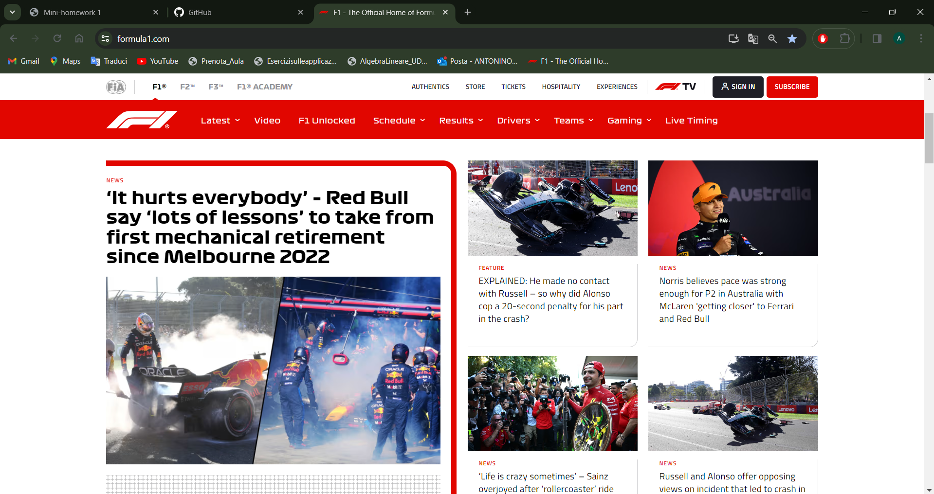
https://www.formula1.com/

