Slide 1
Clonezilla

Slide 2


Slide 3
What is Clonezilla?
Clonezilla is a partition and disk imaging/cloning program.
It helps you to do system deployment, bare metal backup and recovery.
There are several types of Clonezilla available:
Clonezilla live is suitable for single machine backup and restore.
Clonezilla SE (server edition) is for massive deployment, it can clone many computers simultaneously.

Slide 4
Features
Both MBR and GPT partition formats of hard drive are supported.
Clonezilla live can be booted on a BIOS or UEFI machine.
Supports many file systems
For these file systems, only used blocks in partition are saved and restored.
For unsupported file system, sector-to-sector copy is done by dd.
Multicast is supported in Clonezilla SE, which is suitable for massive clone.
The image file can be on local disk, ssh server, samba server, NFS server or WebDAV server.
By using another free software drbl-winroll the SID of cloned MS windows machine can be automatically changed.

Slide 5
Limitations
The destination partition must be equal or larger than the source one.
Differential/incremental backup is not implemented.
Online imaging/cloning is not implemented. The partition to be imaged or cloned has to be unmounted.

Slide 6
Versions …
Clonezilla live
Clonezilla Server

Slide 7
Clonezilla Live
The Live image of Clonezilla can be copied to a USB stick. As Clonezilla boots into your RAM memory it can easily copy data on your hard disk to an external drive.
Download Clonezilla Live STABLE iso
Write on a boot media:
CD
USB flash drive
Boot the machine you want to clone with created boot media
Notes:
https://www.balena.io/etcher/
<number>

Slide 8
Prepare backup drive and boot Clonezilla
Connect your backup drive to your machine, making sure it is larger than the internal hard drive.
Insert your Clonezilla Live USB and boot your computer. You may need to change the BIOS/UEFI settings of your computer to load from the external disk.
When Clonezilla first loads, press 'Enter' to accept the default settings.

Slide 9
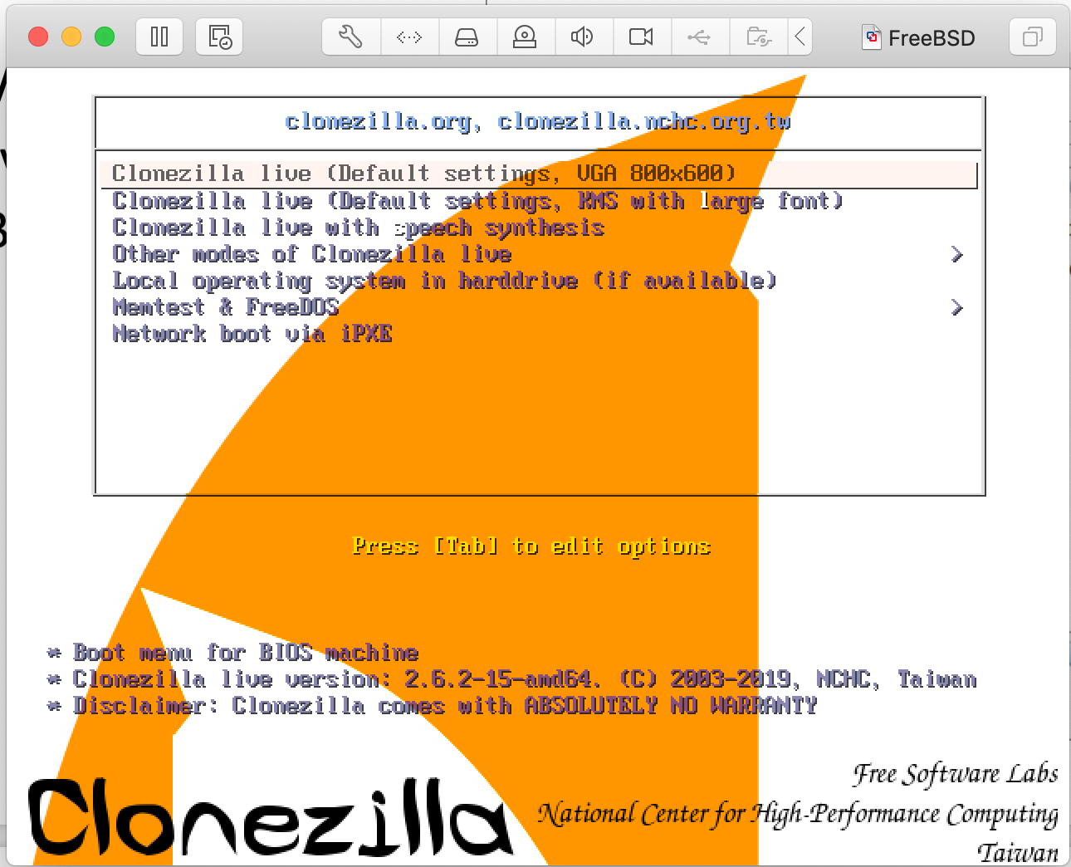
Demo on VirtualBox
Add iso
Change startup disk
Start machine

Slide 10
Start the wizard
Clonezilla will first ask you to choose your language.
The following screen will ask about keymap options.
The following screen will ask if you want to 'Start Clonezilla' or 'Enter Shell’.
Press 'Enter' to start Clonezilla itself.

Slide 11
Choose mode
Clonezilla will now ask you to choose its operating mode:
If you want to make a copy of your hard drive as a disk image, choose the first option 'device-image'. This will allow you to create an image file, which you can then save to a directory on an external drive.
If the focus is on creating an exact copy of your hard drive on another drive, you can do this by selecting the second option 'device-device'. As the name suggests, this allows you to directly clone the partitions of one drive to another.

Slide 12
Mode Device-image
Chose location where image will be written
local_dev
Do you have an extra disk to write the image on?
enter_shell
sudo su –
lsblk
fdisk /dev/…
n, p, 1, enter, enter, w
mkfs.ext4 /dev/…
exit, exit
Notes:
Restart system with extra disk
Enter_shell: lsblk
<number>

Slide 13
Define parameters
Clonezilla will ask you to choose your parameters before running the wizard.
If you simply want to make a direct copy of a partition or drive then choose 'Beginner Mode’.
The 'Expert' mode allows you to define more advanced options such as running in text only mode, or cloning everything except the boot loader.
Choose expert mode => savedisk

Slide 14
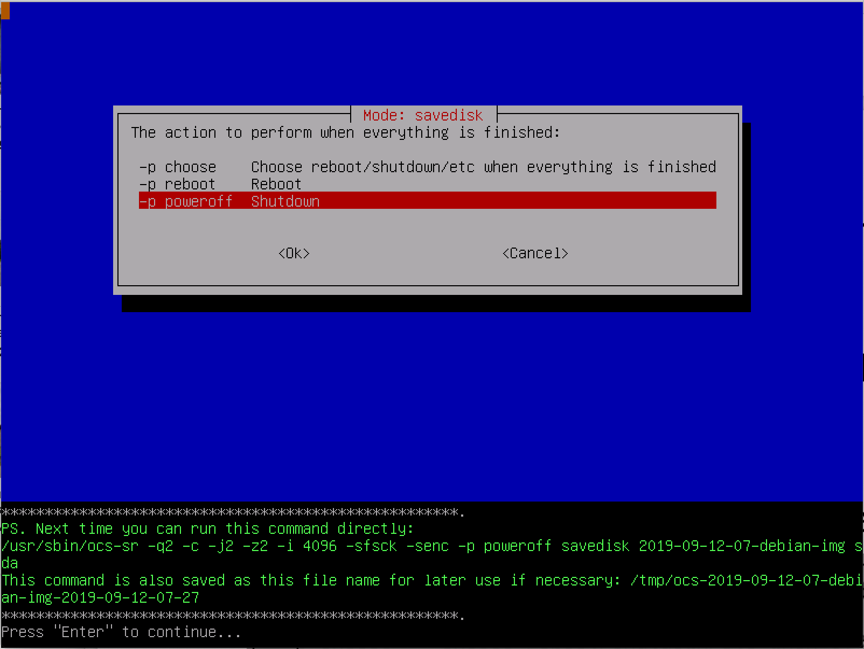

Slide 15
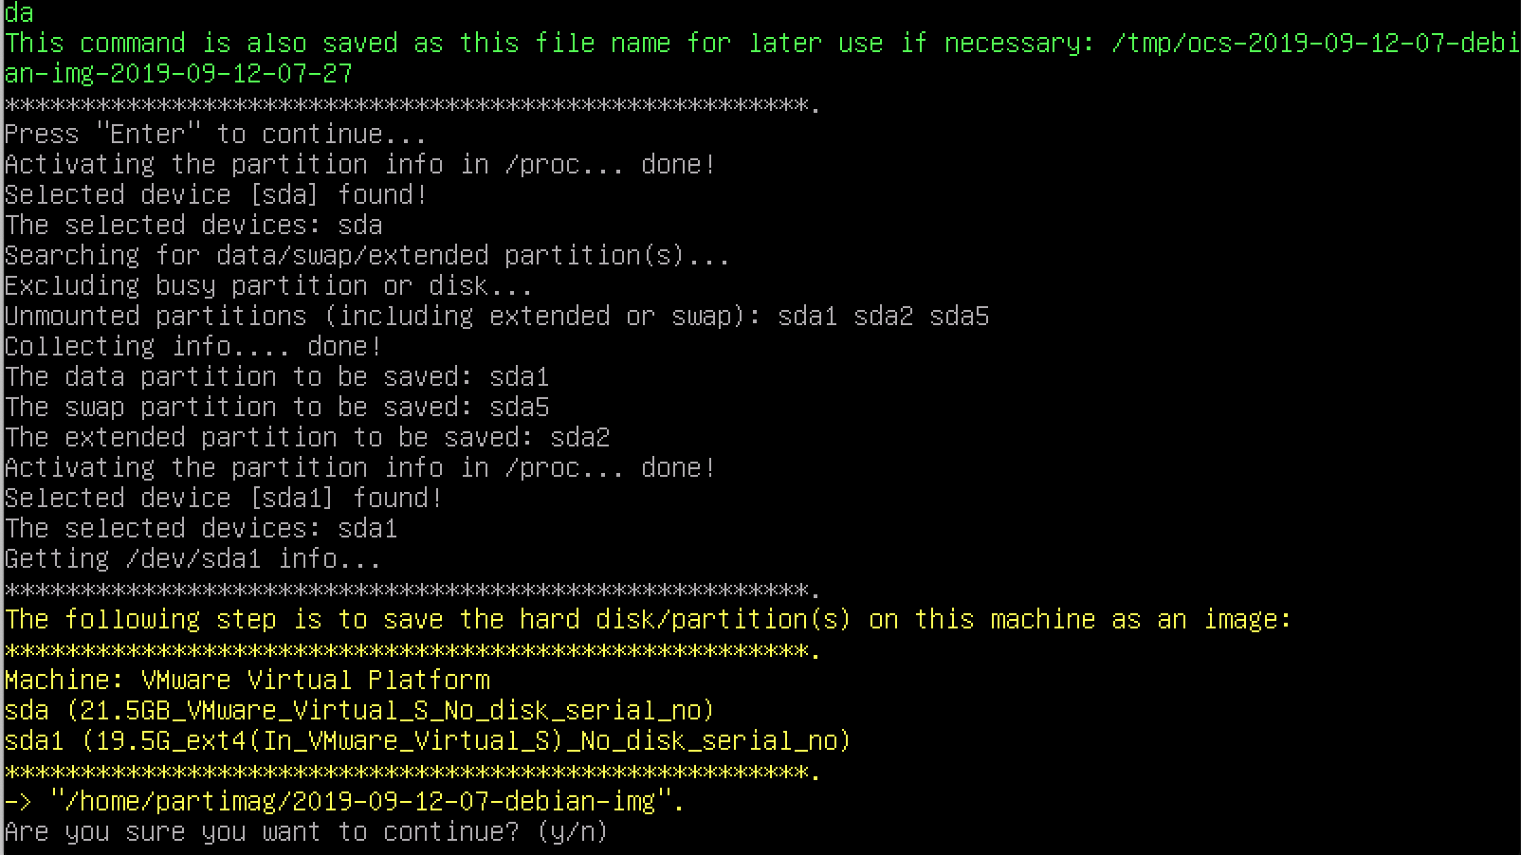

Slide 16

Backup in the making

Slide 17


Slide 18


Slide 19
Restore
Remove OS disk
Attach new disk
Restore to newly attached disk

Slide 20
Versions …
Clonezilla live
Clonezilla Server

Slide 21
Clonezilla Server
Two kinds of Clonezilla server are available
Clonezilla server edition
Clonezilla lite server
In Clonezilla live is a lite server mode which you can use to deploy the clients. What you need is to boot a machine with Clonezilla live and run it as lite server
Notes:
<number>

Slide 22
Clonezilla Server
Two kinds of Clonezilla server are available
Clonezilla server edition
Clonezilla lite server
In Clonezilla live is a lite server mode which you can use to deploy the clients. What you need is to boot a machine with Clonezilla live and run it as lite server
Notes:
<number>

Slide 23
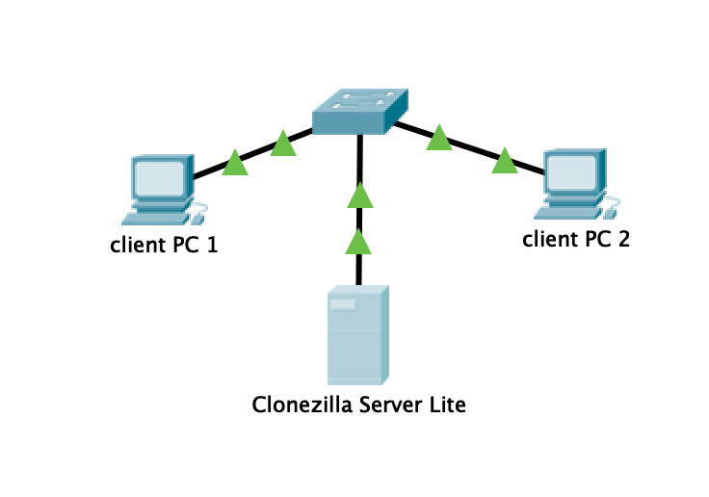
Topology
Make sure the Clonezilla Server Lite has a default gateway.
So use a NAT Network in this topology, not a Host-only Network.

Slide 24
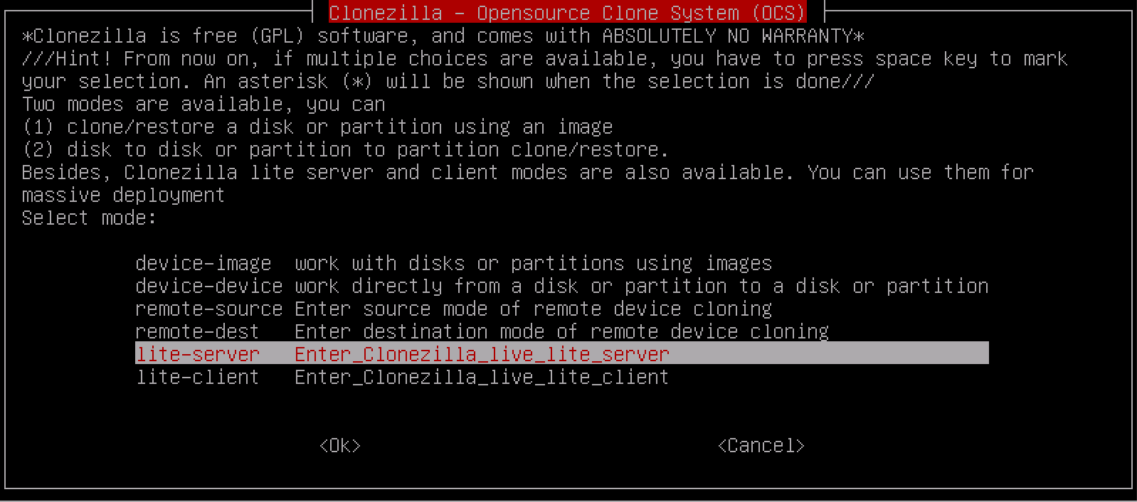
Clonezilla lite server: configure server
Start server
How to boot your client machines => both
Use existing DHCP server
Remember server IP address
Choose massive-deployment
Notes:
https://clonezilla.org/show-live-doc-content.php?topic=clonezilla-live/doc/11_lite_server
<number>

Slide 25
Choose broadcast => OK?
clients-to-wait => OK?
Notes:
https://erg.abdn.ac.uk/users/gorry/course/intro-pages/uni-b- mcast.html
<number>

Slide 26
Clonezilla lite server: configure client 1
Start from network

Slide 27
Clonezilla lite server: configure client 2
Start from live-CD

Slide 28
Clonezilla server edition
A DRBL server must first be prepared in order to use Clonezilla to do massively cloning. This can be done in two ways:
Use DRBL Live without installation it on a server. Enter X-window, click "Clonezilla SE" icon to do the runtime configuration.
Install and configure DRBL on a GNU/Linux system.

Slide 29
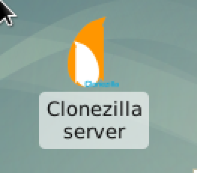
DRBL Live
Run “forcevideo-drbl-live”
But keep default settings …
Configure “Clonezilla server”
Start clients via network boot
Not really a difference with “Clonzilla lite server”

Slide 30
Ubuntu with DRBL-server
https://drbl.org/installation/
Install and configure DRBL on a GNU/Linux system (Ubuntu)
Server with two NICs
First with NAT to Internet
Second only internal network
No NAT
DHCP done by Ubuntu (so not done by virtualization software)
Disabled during install of Ubuntu

Slide 31
Install Ubuntu
Normal Ubuntu installation
Update and upgrade server
Install and enable ssh-server
Use NetworkManager or networkd to configure NICs
First NIC => DHCP on
Second NIC => Fixed IP, no DHCP

Slide 32
Install DRBL (Diskless Remote Boot in Linux)
wget -q http://drbl.org/GPG-KEY-DRBL -O- | sudo apt-key add –
Add “deb http://free.nchc.org.tw/drbl-core drbl stable” in /etc/apt/sources.list
apt update
apt install drbl

Slide 33
Configure DRBL
sudo su -
# drblsrv -i (Setup DRBL)
# drblpush -i (Configure Clonezilla)
Note!!! If newer packages are installed in the server after this step, you have to run "drblpush -i" or "drblpush -c /etc/drbl/drblpush.conf" (This will loaded the previously saved settings) again so that newer packages will be deployed to clients. Note!!! It is not recommended to turn on the system update automatically. Since If newer packages are installed in the server automatically, without running "drblpush -i", the programs for client might not be compatible with that newer in server. If you want to turn on system update automatically, remember to follow the above step to update the files in client automatically.
Notes:
<number>

Slide 34
How to use Clonezilla server edition ?
https://clonezilla.org/clonezilla-SE/#clonezilla-se
Clone a system and restore it to an other machine. Use the TUI to manage the Clonezilla Server.
Write two scripts. One to configure Clonezilla server to clone a system. The other to restore the image to an other system.
Hint: http://www.geekyprojects.com/cloning/setup-a-clonezilla-server-on-ubuntu/
Notes:
<number>

Slide 35
Is Clonezilla Server the only one out there?
No
https://fogproject.org/

