Slide 1
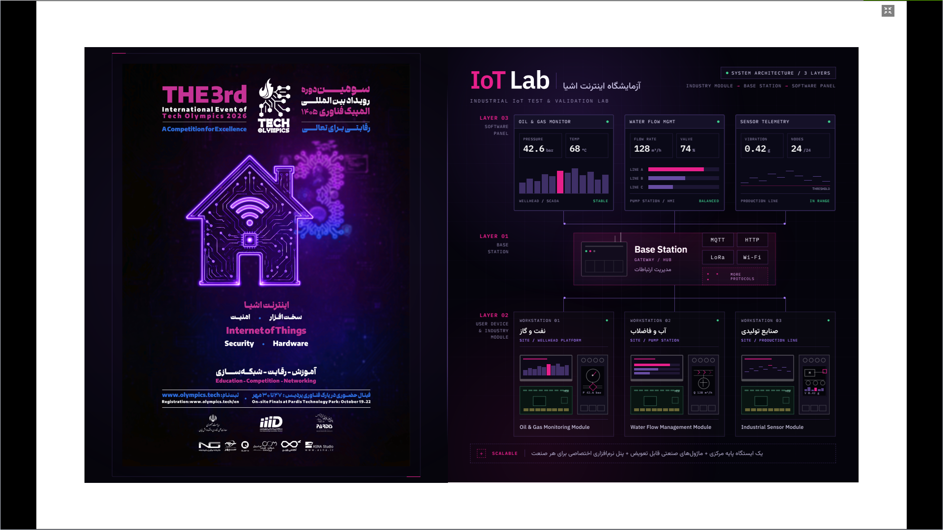
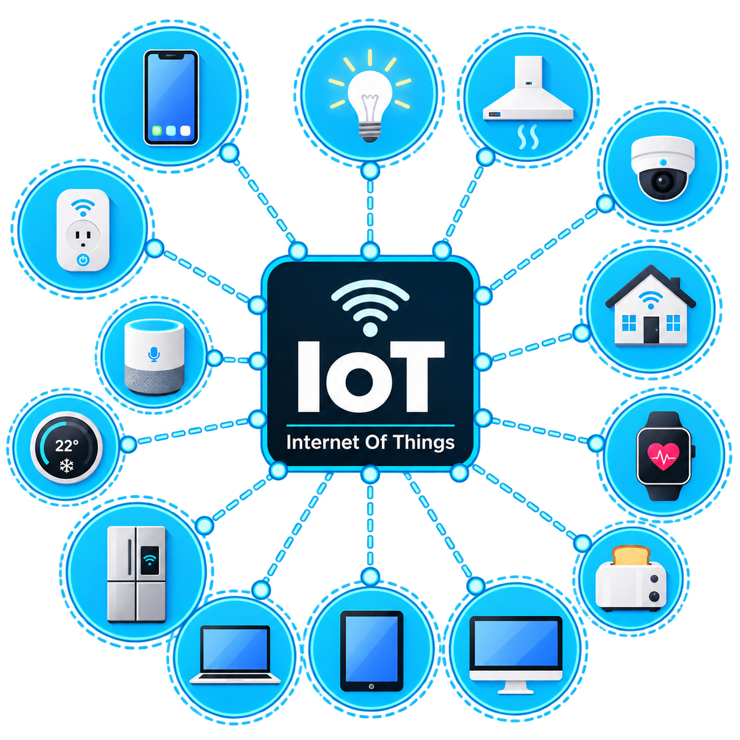
NGT Training Department
Advanced Internet of Things (IoT)
Duration : 120 min
Instructor: M.M.Naseri

Slide 2
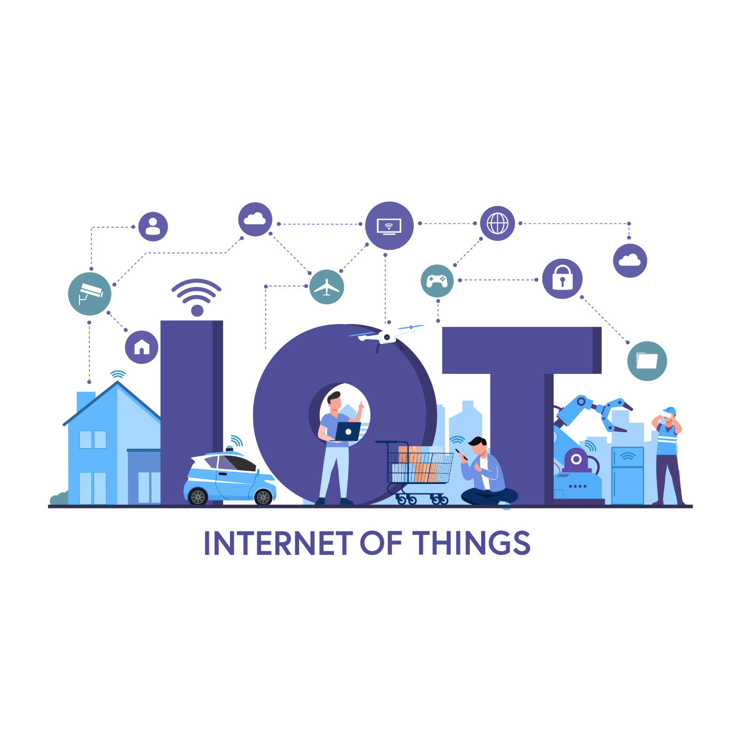
Advanced Internet of Things (IoT)
NGT. Training Department
Course Overview
This advanced IoT course focuses on two core areas of modern IoT systems:
Network & Data CommunicationAdvanced
Firmware, Middleware & Edge Computing
The course moves beyond basic electronics and microcontroller fundamentals, focusing on reliability, scalability, security, and real-world IoT deployment.

Slide 3
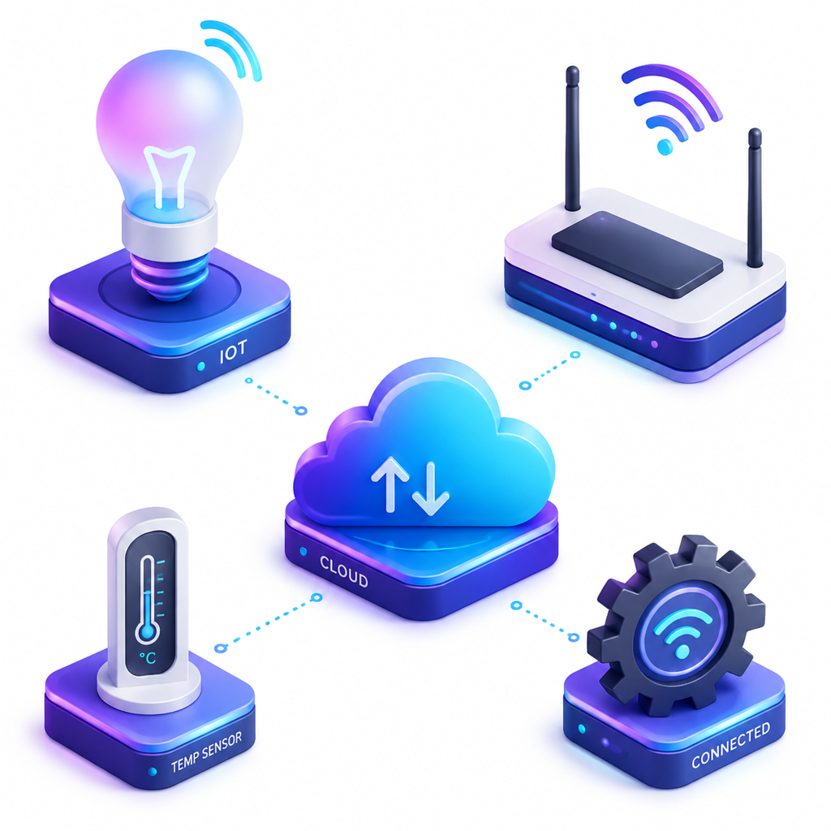
Advanced Internet of Things (IoT)
NGT. Training Department
Course Modules
1. Network Layer
IoT Communication ProtocolsLPWAN & Cellular NetworksIoT Network Security
2. Firmware & Edge Computing
Professional Firmware
ArchitectureRaspberry Pi & Remote
AccessData & Telemetry Management
OTA Updates & Maintenance
Hands-on IoT Workshop

Slide 4
Advanced Internet of Things (IoT)
NGT. Training Department
Advanced Internet of Things (IoT)
What is the Internet of Things (IoT)?
Core Definition: Bridging physical assets to digital networks
Key Loop: Sense →Process → Transmit → Actuate
Value: Telemetry, predictive maintenance, and autonomous control

Slide 5
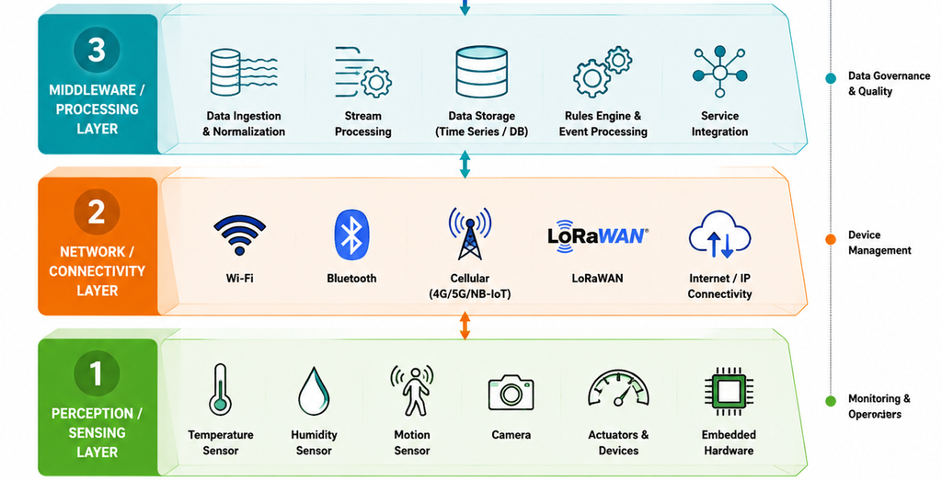
Advanced Internet of Things (IoT)
NGT. Training Department
Advanced Internet of Things (IoT)
Standard 3-Layer IoT Architecture
Perception Layer (Edge): Sensors, Actuators & Microcontrollers (ESP32).
Network Layer (Transport): Wi-Fi, Cellular, LoRaWAN & Protocols (MQTT).
Application Layer (Cloud/Platform): Storage, Dashboards & Analytics.

Slide 6
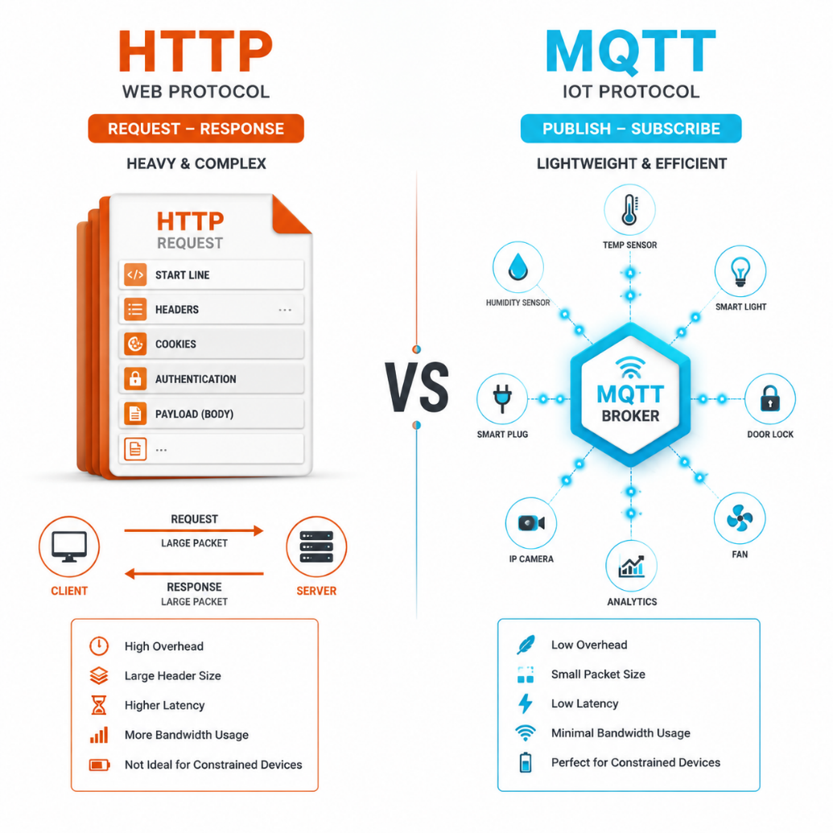
Advanced Internet of Things (IoT)
NGT. Training Department
Advanced Internet of Things (IoT)
Traditional Web (HTTP) vs. IoT Protocols (MQTT)
HTTP (Request/Response): Heavy overhead, high latency, client-driven.
MQTT (Publish/Subscribe): Ultra-lightweight (2-byte header), low power, real-time.
Constraint-Friendly: Ideal for battery-powered nodes and unstable networks.

Slide 7
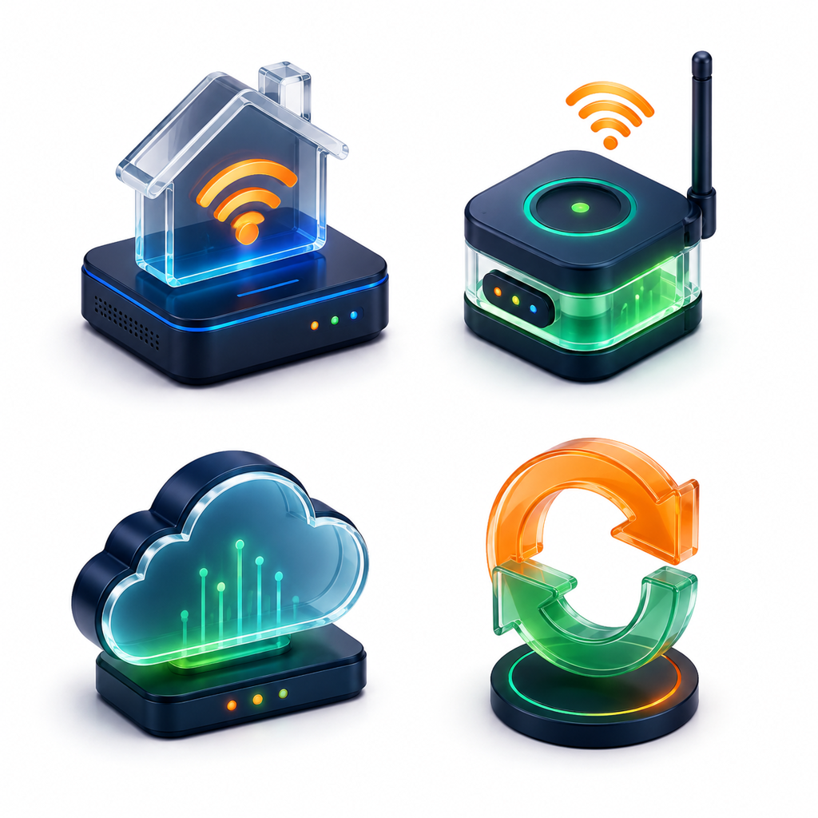
Advanced Internet of Things (IoT)
NGT. Training Department
Advanced Internet of Things (IoT)
The Complete Data Lifecycle
Physical World: Temperature, Vibration, Voltage change.
Signal Conditioning: Analog/Digital conversion on MCU.
Packet Framing: JSON / Binary serialization.
Cloud Routing: Ingestion broker → Storage → Real-time Action.

Slide 8
Advanced Internet of Things (IoT)
NGT. Training Department
Hardware Landscape and ESP32
Edge Processing: MCU vs. MPU
ESP32 SoC: Architecture & Specs
ESP32 Pinout Classification
Critical Hardware Pitfalls

Slide 9
Advanced Internet of Things (IoT)
NGT. Training Department
Hardware Landscape and ESP32
Edge Processing: MCU vs. MPU
MCU (ESP32 / STM32): Real-time, ultra-low power, bare-metal / RTOS, low cost.
MPU / SBC (e.g., Raspberry Pi): Full Linux OS, high compute (AI/Vision), high power consumption.
IoT Design Rule: Use MCUs for deterministic sensing; use MPUs for heavy Edge AI/Gateways.

Slide 10
Advanced Internet of Things (IoT)
NGT. Training Department
Hardware Landscape and ESP32
ESP32 SoC: Architecture & Specs
Compute: Dual-Core Xtensa 32-bit LX6 @ up to 240 MHz.
Memory: 520 KB internal SRAM + External SPI Flash (4MB/8MB/16MB).
Wireless: Integrated Wi-Fi 802.11 b/g/n (2.4 GHz) + Bluetooth v4.2 / BLE.
Power Management: Active, Light-sleep, Deep-sleep (10𝜇𝐴), ULP coprocessor.

Slide 11
Advanced Internet of Things (IoT)
NGT. Training Department
Hardware Landscape and ESP32
ESP32-S3 SoC: Architecture & Specs
Compute: Dual-Core Xtensa® 32-bit LX7 @ up to 240 MHz + Vector Instructions (AI Acceleration).
Memory: 512 KB internal SRAM, 384 KB ROM + Octal/Quad SPI Flash & PSRAM (up to 16MB/32MB).
Wireless: 2.4 GHz Wi-Fi (802.11 b/g/n) + Bluetooth 5 (LE) with Long-Range & Mesh support.
Power Management: Advanced Deep-sleep (7–8𝜇𝐴), dynamic frequency scaling.

Slide 12
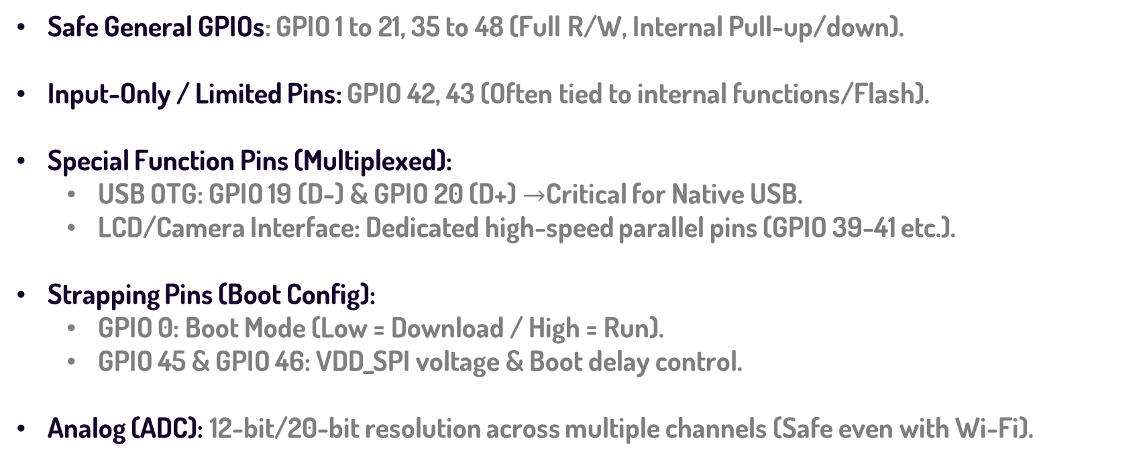
Advanced Internet of Things (IoT)
NGT. Training Department
Hardware Landscape and ESP32
ESP32-S3 Pinout Classification
Safe General GPIOs: GPIO 1 to 21, 35 to 48 (Full R/W, Internal Pull-up/down).
Input-Only / Limited Pins: GPIO 42, 43 (Often tied to internal functions/Flash).
Special Function Pins (Multiplexed):
  USB OTG: GPIO 19 (D-) & GPIO 20 (D+) $→$Critical for Native USB.
  LCD/Camera Interface: Dedicated high-speed parallel pins (GPIO 39-41 etc.).
Strapping Pins (Boot Config):
  GPIO 0: Boot Mode (Low = Download / High = Run).
  GPIO 45 & GPIO 46: VDD_SPI voltage & Boot delay control.
Analog (ADC): 12-bit/20-bit resolution across multiple channels (Safe even with Wi-Fi).

Slide 13
Advanced Internet of Things (IoT)
NGT. Training Department
Hardware Landscape and ESP32
Critical Hardware Pitfalls
Strapping Pins (Boot Traps):
GPIO 0: Low = Flash Bootloader mode / High = Normal SPI Boot.
GPIO 2 & GPIO 12: Level affects boot voltage and flashing stat.
ADC Limitations (ADC1 vs. ADC2):
ADC1 (GPIO 32 to 39): Safe to use anytime.
ADC2 (GPIO 0, 2, 4, 12-15, 25-27): Disabled when Wi-Fi is active!

Slide 14
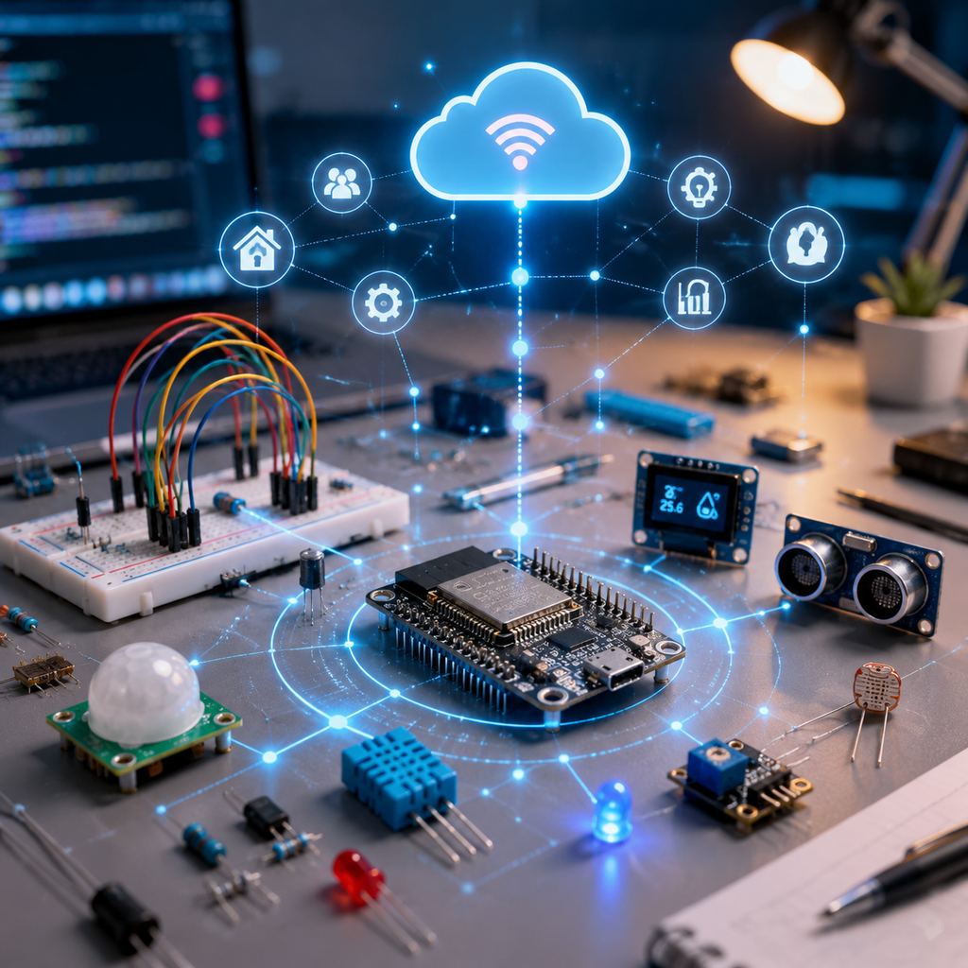
Advanced Internet of Things (IoT)
NGT. Training Department
Essential Electronics for IoT
Logic Level Matching: The Silent Killer
Power Integrity & Stability
I2C & Bus Fragility
Industrial Noise & Protection

Slide 15
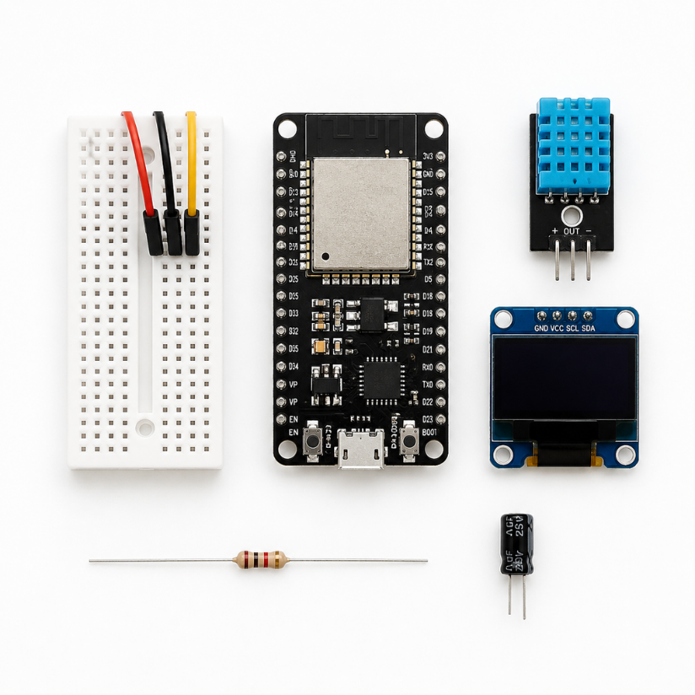
Advanced Internet of Things (IoT)
NGT. Training Department
Essential Electronics for IoT
Logic Level Matching: The Silent Killer
The Trap: Mixing 3.3V (ESP32) and 5V (Arduino/Sensors) logic.
The Risk: Permanent damage or “ghost” resets due to threshold ambiguity.
The Solution: Bidirectional Level Shifters (MOSFET-based) or Voltage Dividers.
Pro Tip: Never trust a 5V sensor signal directly into an ESP32 GPIO!

Slide 16
Advanced Internet of Things (IoT)
NGT. Training Department
Essential Electronics for IoT
Power Integrity & Stability
The Problem: Wi-Fi TX spikes (up to 500mA) cause voltage drops.
The Symptom: Random resets, Wi-Fi disconnects, “Brownout Detector” errors.
The Fix: Bulk Capacitor (100𝜇𝐹 to 470𝜇𝐹electrolytic) near the SoC.
Decoupling Capacitor (0.1𝜇𝐹 ceramic) on every power pin.
Good power trace width (avoid thin tracks for VCC/GND)

Slide 17
Advanced Internet of Things (IoT)
NGT. Training Department
Essential Electronics for IoT
I2C & Bus Fragility
The Reality: I2C is NOT designed for long cables.
The Pull-up Rule: Essential for Open-Drain pins
Troubleshooting:
Use 2.2kΩ to 4.7kΩ pull-up resistors.
If cable length > 1 meter: Use an I2C Extender or switch to RS485/CAN.
Check bus speed (400kHz vs 100kHz).

Slide 18
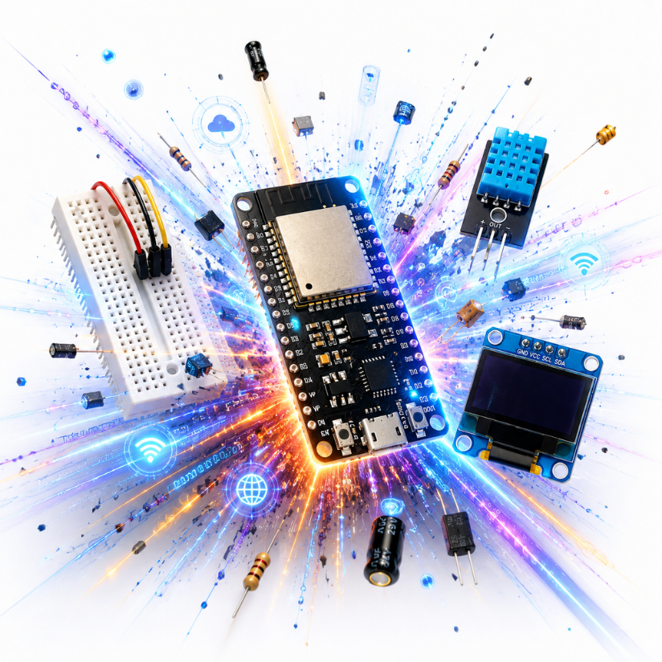
Advanced Internet of Things (IoT)
NGT. Training Department
Essential Electronics for IoT
Industrial Noise & Protection
EMI Sources: Motors, Relays, Inverters, AC lines.
Protection: Use Opto-couplers for Relay control & TVS Diodes for ESD.
Wiring Best Practices:
Keep Signal wires away from Power/AC lines.
Use Twisted Pair for differential signals.

Slide 19
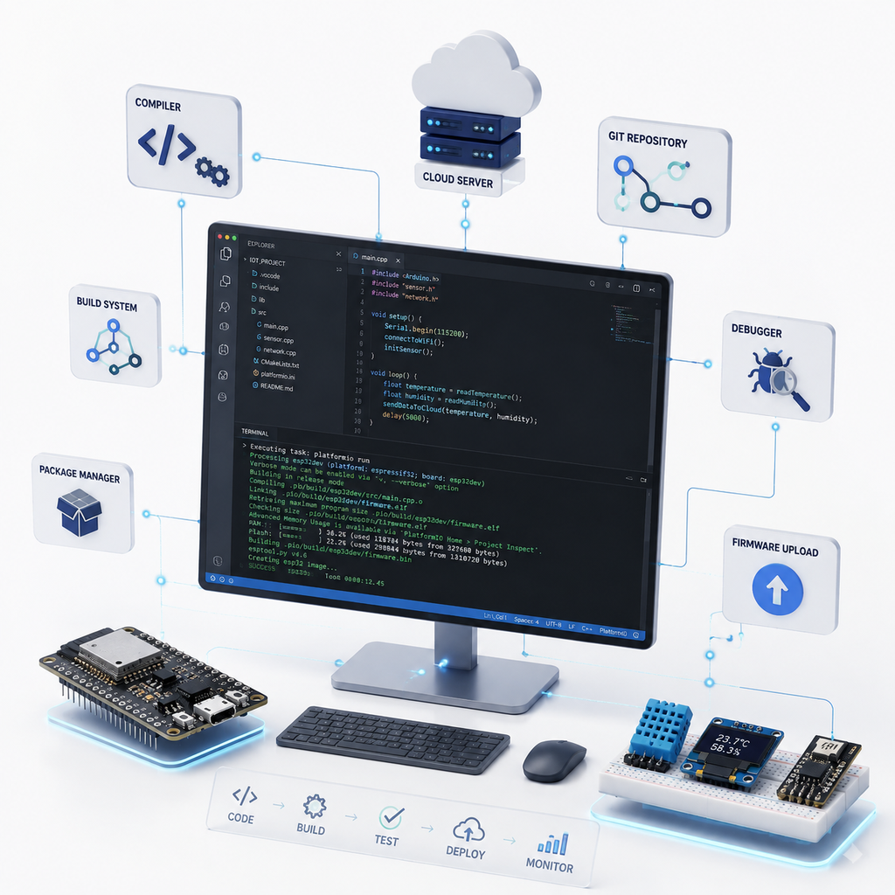
Advanced Internet of Things (IoT)
NGT. Training Department
Development Environment and Toolchain
Development Toolchains: The Big Picture
Sketch Anatomy: The Core Structure
Library Management: Scaling Complexity
The Hidden Process: Building & Flashing

Slide 20
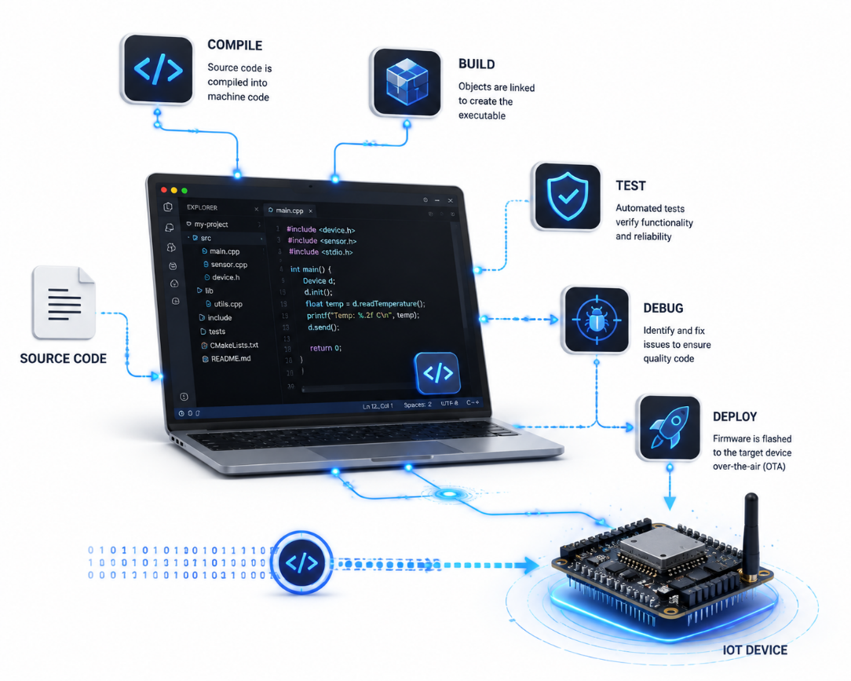
Advanced Internet of Things (IoT)
NGT. Training Department
Development Environment and Toolchain
Development Toolchains: The Big Picture
Pro Environments: VSCode + PlatformIO, ESP-IDF (Espressif IoT Development Framework) →Used in production & large-scale firmware.
Beginner Friendly: Arduino IDE (Integrated Development Environment) →Fast setup, minimal friction.
The Golden Rule: The underlying C++ logic, APIs, and hardware registers are identical!
Our Strategy: Master the fundamentals in Arduino IDE first,
then scale to advanced IDEs.

Slide 21
Advanced Internet of Things (IoT)
NGT. Training Department
Development Environment and Toolchain
Sketch Anatomy: The Core Structure
Sketch: The term for an Arduino program.
void setup(): Initialization block (Runs once on reset).
void loop(): The main engine (Runs infinitely).
MCU (Microcontroller Unit): The target hardware (ESP32).
Digital/Analog Pins: Defining I/O interfaces via pinMode().

Slide 22
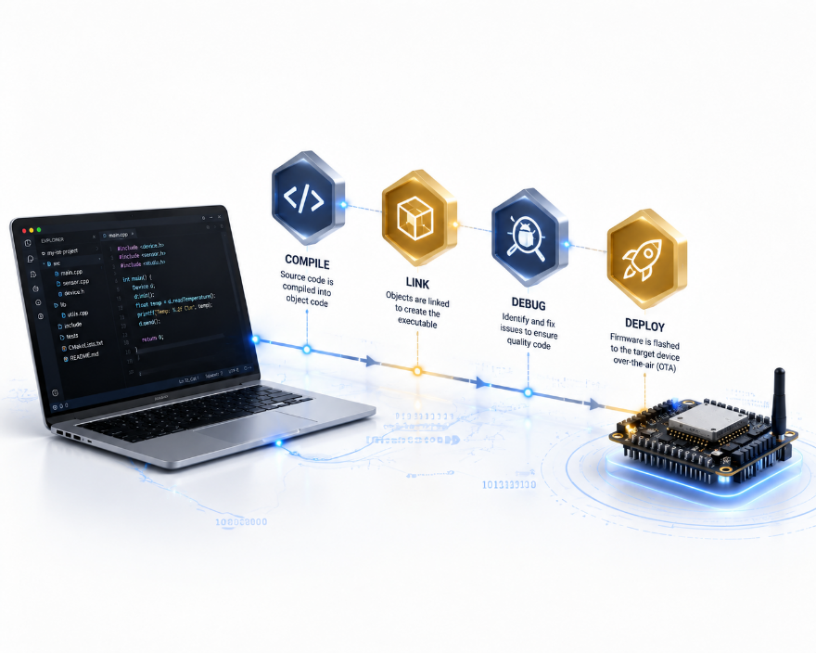
Advanced Internet of Things (IoT)
NGT. Training Department
Development Environment and Toolchain
Library Management: Scaling Complexity
What is a Library? A collection of code that hides complexity (Abstraction).
API (Application Programming Interface): The “interface” to use complex hardware (e.g., MQTT, Sensor Drivers).
Library Manager: How to install, manage, and update code packages.
Rule: Don’t reinvent the wheel! Use verified libraries.

Slide 23
Advanced Internet of Things (IoT)
NGT. Training Department
Development Environment and Toolchain
The Hidden Process: Building & Flashing
Compilation: Translating human-readable C++ to machine code (Binary).
Flash Memory: Where your program lives on the ESP32.
Serial Monitor: The window into your device’s soul (Debugging).
Baud Rate: The speed of communication (e.g., 115200).

Slide 24
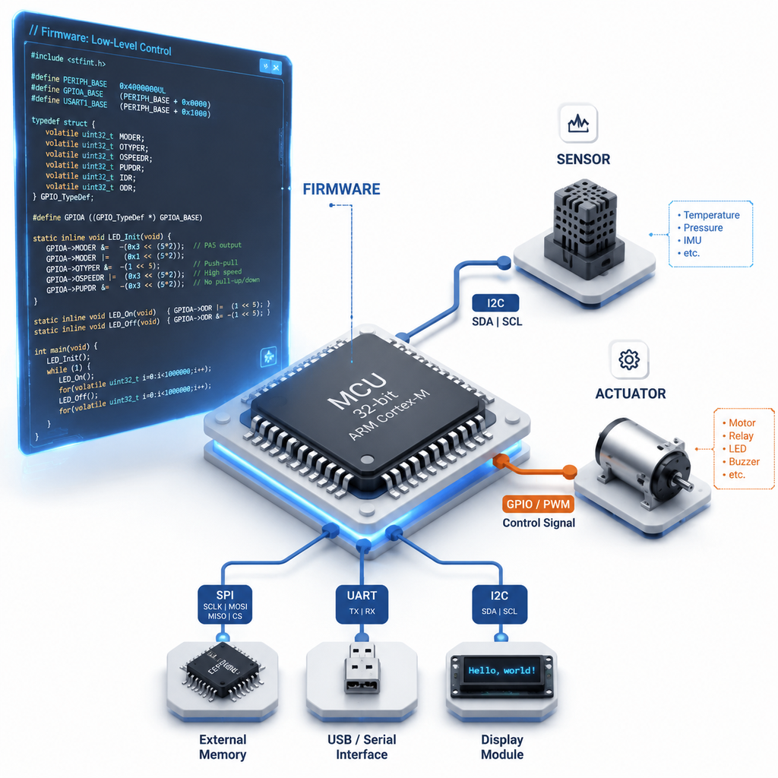
Advanced Internet of Things (IoT)
NGT. Training Department
Firmware Fundamentals and Interfacing
Interfacing : Digital vs. Analog Signals
Execution Logic: The Pitfall of delay()
Digital Buses: How Chips Talk to Chips
Controlling the Real World: Actuator Interfacing

Slide 25
Advanced Internet of Things (IoT)
NGT. Training Department
Firmware Fundamentals and Interfacing
Interfacing : Digital vs. Analog Signals
Digital I/O (GPIO): Discrete states →HIGH (3.3V) / LOW (0V).
Inputs: Push buttons, PIR motion sensors, Limit switches.
Outputs: LEDs, Relay triggers, Buzzer signals.
Analog Inputs (ADC ): Continuous voltage (0 to 3.3V).
Resolution: 12-bit ADC on ESP32-S3 →Values from 0 to 4095.
Sensors: LDR (Light), Potentiometer, Analog soil moisture.
Analog Outputs (PWM): Simulating analog voltage via duty cycle.
Use Cases: LED Dimming, Motor speed control, Servo positioning.

Slide 26
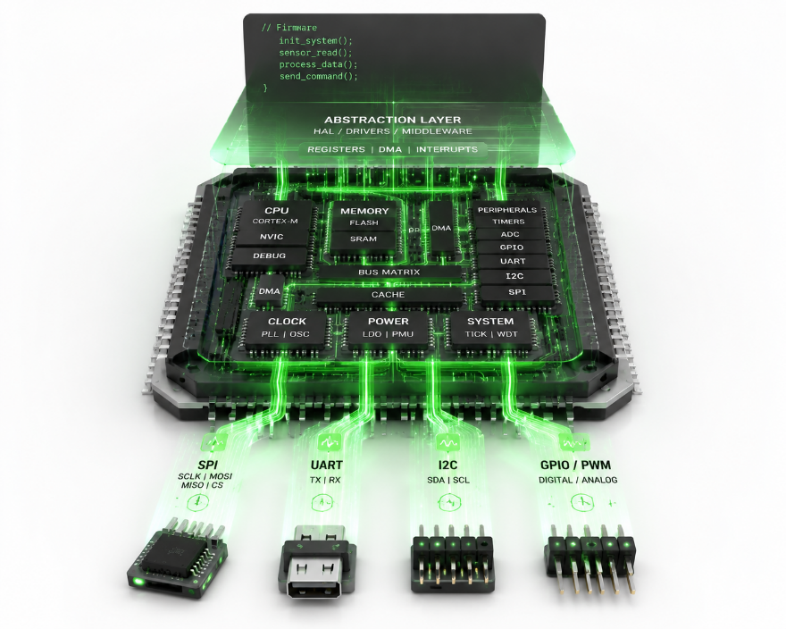
Advanced Internet of Things (IoT)
NGT. Training Department
Firmware Fundamentals and Interfacing
Execution Logic: The Pitfall of delay()
Blocking Code (delay()): Halts the MCU entirely.
❌ Missed sensor events & interrupts.
❌ Wi-Fi/MQTT connection drops (Watchdog timer timeouts).
Non-blocking Code (millis()): Asynchronous time tracking.
The “Stopwatch” concept →Check elapsed time without freezing the CPU.
Industry Best Practice: In real-time IoT firmware, never block the main loop!

Slide 27
Advanced Internet of Things (IoT)
NGT. Training Department
Firmware Fundamentals and Interfacing
Digital Buses: How Chips Talk to Chips
UART (Universal Asynchronous Receiver-Transmitter):
2 Wires: TX (Transmit) & RX (Receive).
Used for: Debugging (Serial Monitor), GPS modules, GSM/LTE modems.
I2C (Inter-Integrated Circuit):
2 Wires: SDA (Data) & SCL (Clock) + Shared Bus (Address-based).
Used for: Low-speed sensors (Temperature, Humidity, OLED displays).
SPI (Serial Peripheral Interface):
4 Wires: MOSI, MISO, SCK, CS. High-speed synchronous protocol.
Used for: SD Cards, TFT Color Displays, High-speed ADCs.

Slide 28
Advanced Internet of Things (IoT)
NGT. Training Department
Firmware Fundamentals and Interfacing
Controlling the Real World: Actuator Interfacing
The MCU Limitation: ESP32 pins provide max ~20mA at 3.3V →Cannot power motors/relays directly!
Transistors & MOSFETs: Electronic switches acting as current amplifiers.
Relays: Electromechanical switching for high-voltage AC loads (Mains 220V).
Flyback Diodes & Optocouplers:
Protecting the MCU from high-voltage inductive spikes (Back-EMF).
Galvanic isolation prevents noise and destruction.

