Slide 1

Fake News Detection
Submitted by: Nipam Gogoi
Vishvendra ingh

Slide 2
INTRODUCTION
News media has become a channel to pass on the information of what’s happening in the world to the people living. Often people perceive whatever conveyed in the news to be true. There were circumstances where even the news channels acknowledged that their news is not true as they wrote. But some news has a significant impact not only on the people or government but also on the economy. One news can shift the curves up and down depending on the emotions of people and political situation.

Slide 3
CONCEPTUAL BACKGROUND OF THE DOMAIN PROBLEM
The widespread problem of fake news is very difficult to tackle in today’s digital world where there are thousands of information sharing platforms through which fake news or misinformation may propagate. It has become a greater issue because of the advancements in AI which brings along artificial bots that may be used to create and spread fake news. The situation is dire because many people believe anything they read on the internet and the ones who are amateur or are new to the digital technology may be easily fooled.
Fake news detection on social media is still in the early age of development, and there are still many challenging issues that need further investigations. It is necessary to discuss potential research directions that can improve fake news detection and mitigation capabilities.

Slide 4
ANALYTICAL PROBLEM FRAMING
It is a binary classification problem with Fake news labelled as 1 and Real news labelled as 0.
We have 20800 news records in the dataset.
There are some missing values in the dataset but are negligible in numbers.
There are in total 5 features in the dataset.
Since the dataset contains text data, we need to use Natural Language processing techniques for predicting fake news.

Slide 5

VISUALIZATION AND DATA INTERPRETATION

Slide 6
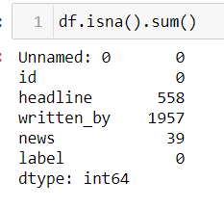
Missing Data

Slide 7
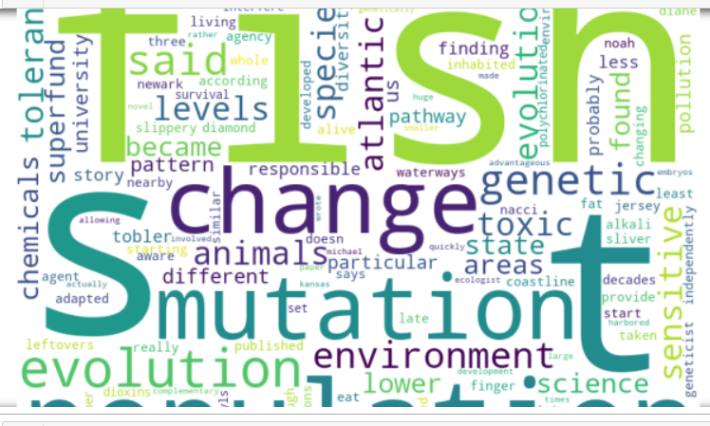
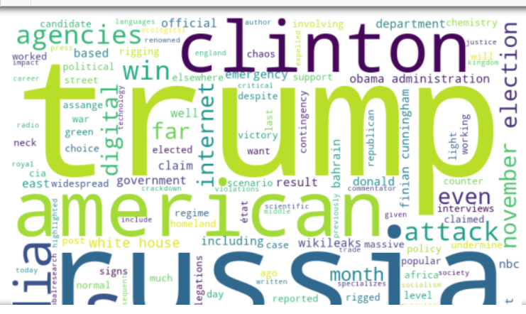
WORDCLOUDS - REAL NEWS vs FAKE NEWS
REAL
FAKE

Slide 8
VARIOUS MODELS USED FOR VALIDATION
Logistic Regression
Random Forest Model
Ada-Boost Classifier
K Nearest Neighbour

Slide 9
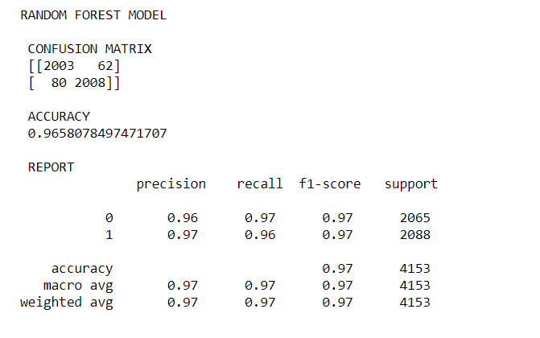
FINAL MODEL

Slide 10
KEY FINDINGS
Most of the Fake News were associated with US election campaigns with Keywords like Trump, US, Senate etc showing up in the entire dataset.
Top 10 writers generating highest number of fake news are:
'admin', 'Pakalert', 'Eddy Lavine', 'Starkman', 'Gillian', 'Alex Ansary', 'Editor', 'noreply@blogger.com (Alexander Light)', 'Anonymous', 'Dave Hodges'.
It was a balanced Dataset. All the models trained using Sklearn performed well with best performance by Random Forest with 97 percent accuracy as well as 97 percent f1 score.

Slide 11
THANK YOU

