Slide 1

IMAGE SCRAPPING & classification
Submitted by: Nipam Gogoi
Vishvendra ingh

Slide 2
INTRODUCTION
Images are one of the major sources of data in the field of data science and AI. This field is making appropriate use of information that can be gathered through images by examining its features and details. The idea behind this project is to build a deep learning-based Image Classification model on images that will be scraped from e-commerce portal. This is done to make the model more and more robust.

Slide 3
CONCEPTUAL BACKGROUND OF THE DOMAIN PROBLEM
This task is divided into two phases: Data Collection and Mode Building.
We need to scrape images from e-commerce portal, Amazon.com. The clothing categories used for scraping will be:
Sarees (women)
Trousers (men)
Jeans (men)
You need to scrape images of these 3 categories and build your data from it. That data will be provided as an input to your deep learning problem. You need to scrape minimum 200 images of each categories. There is no maximum limit to the data collection. You are free to apply image augmentation techniques to increase the size of your data but make sure the quality of data is not compromised.

Slide 4
ANALYTICAL PROBLEM FRAMING
The Image Data is collected from Amazon.com using webscrapping.
We have used deep convolutional neural networks in the project.
3 Categories in the Dataset: Jeans, Trousers and Sarees.
300 images for each category in the dataset. Total 900 training images.
Total 129 test images.

Slide 5
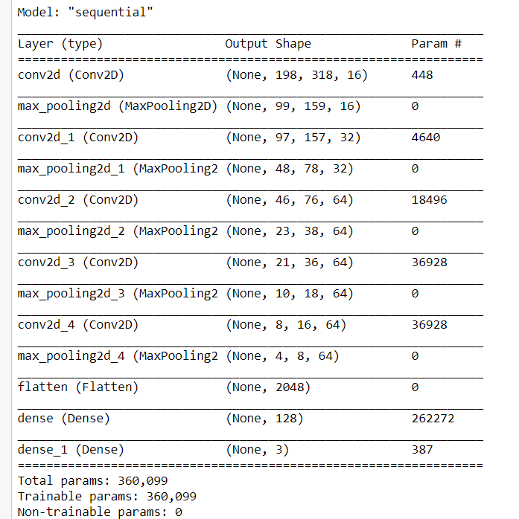
MODEL SUMMARY

Slide 6

VISUALIZATION Model performance

Slide 7
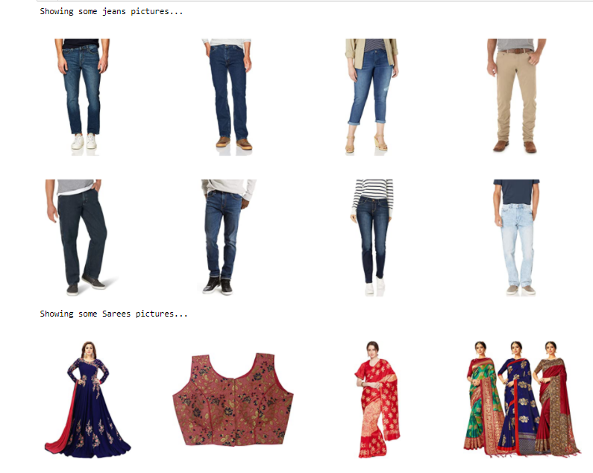
SAMPLE IMAGE DATA

Slide 8
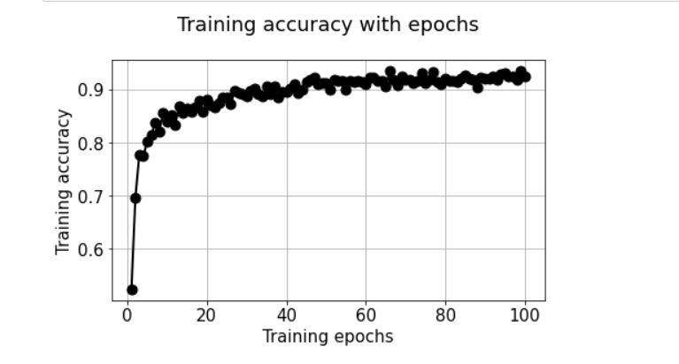
Training accuracy with epochs

Slide 9
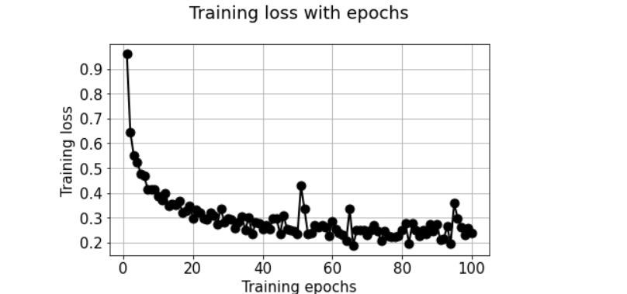
Training loss with epochs

Slide 10
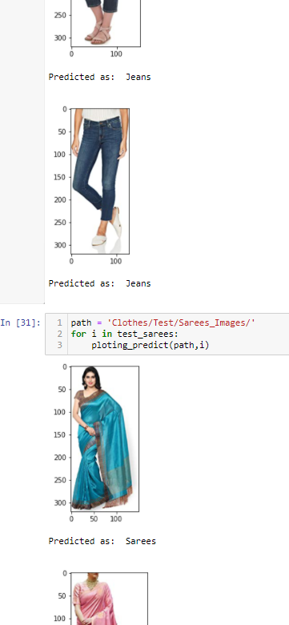
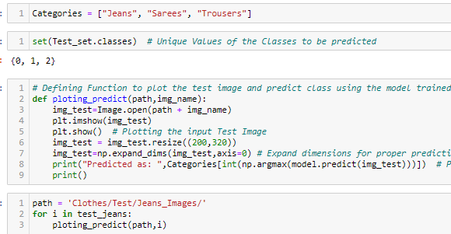
PREDICTIONS

Slide 11
CONCLUSION
The Image Data was collected using Web Scrapping from Amazon for Jeans, Sarees and Trousers.
We have used Deep Learning model – Convolutional Neural Network for the project
The model is working well and was able to classify the three clothing items properly with 92% overall accuracy.
We can improve the classification of Jeans and Trousers by increasing the training dataset. For Sarees it was accurately predicted in test data.
Since in all three categories there were some extra/unnecessary items other than the main items hence, it could have been removed and we could have got better result. Moreover, training data could have been increased.

Slide 12
THANK YOU

