Slide 1



Usability
Sadman Salim Nipun
2 0 - 4 4 3 4 5 - 3
American International University –Bangladesh
Dept. of CSE

Slide 2
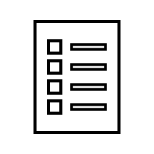
Table of Contents
01
Affordance
02
Visibility
03
M apping
04
S ystem Image
05
Gulf of Execution
06
Gulf of Evaluation

Slide 3




Affordance

Slide 4





Affordance
Affordance is a concept in design that refers to the properties of an object or environment that suggest or facilitate possible actions or uses. In other words, affordances are the qualities
of an object or environment that
provide clues or hints about how it
can be interacted with.

Slide 5
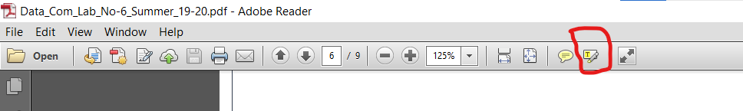
Affordance issue with Adobe R eade r
Looking at that icon, firstly I thought it would let me edit the texts available in the whole pdf. But the matter is, it is the icon for just highlighting the text, nothing else.

Slide 6
Visibility

Slide 7





Visibility
Visibility is a concept in human factors and ergonomics that refers to the degree to which
information or objects can be seen or perceived by an individual in each environment. In a physical sense, visibility is affected by factors such as lighting, contrast, distance, and obstruction.

Slide 8


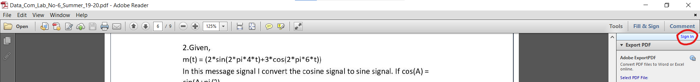

Visibility issue with Adobe R eade r
Sign in is one of the most important features of Adobe reader. But such an important feature is placed in a corner that it is not well visible. It is barely found in this reader.

Slide 9
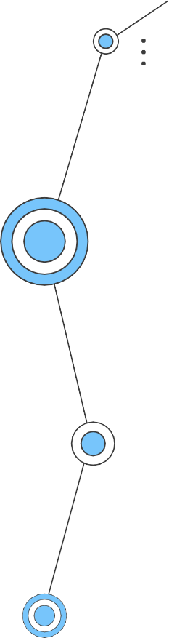
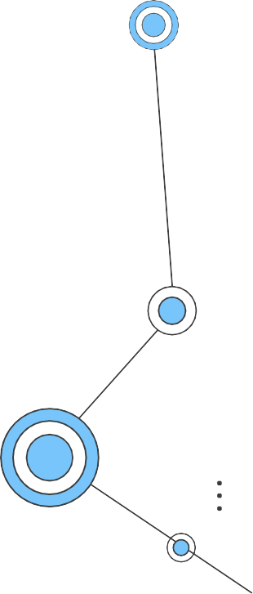
Mapping

Slide 10


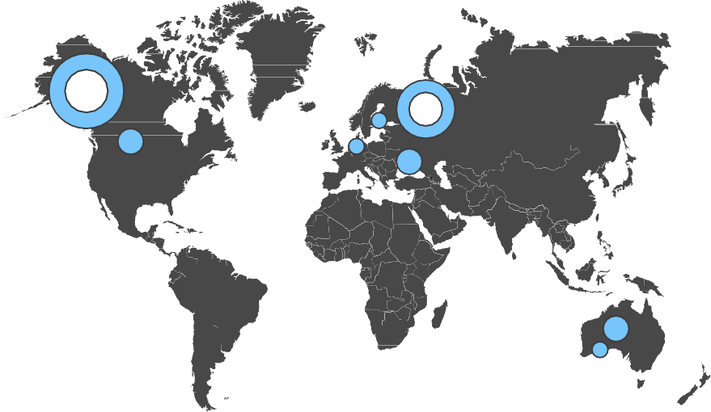

Mapping
Mappings refer to the relationship between controls or inputs and the resulting actions or outputs. In other
words, mappings are the associations between the
physical or virtual controls that users interact with and the effects those interactions have on the system.​

Slide 11
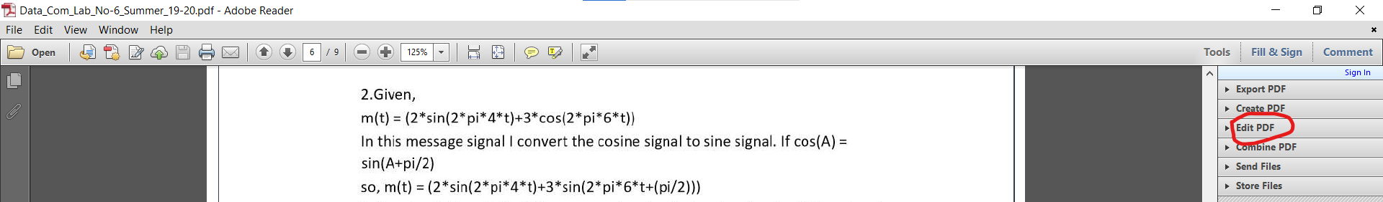
Mapping issue with Adobe R eade r
PDF can be edited in various formats from the “ Edit ” tab next to the file section. Moreover, on the right side of the tabs, “ Edit PDF ” always appears. There is no need this tab separately here. This is a mapping issue I reckon.

Slide 12
S ystem I mage

Slide 13



System Image
The visible portion of a device, including the physical design, manuals, and instructions, is called the s ystem image. On l y through the s ystem ima ge does the designer communicate with the user.

Slide 14
System Image issue with Adobe R eade r
This is the S i gn or s ig nature icon A dobe reader . This allows to sign, add a text or put a signature in the document. The icon is so small that it is neither easy to see nor understand. Here is the deficiency of system image is noticeable.

Slide 15
Gulf of Execution &
Gulf of Evaluation

Slide 16
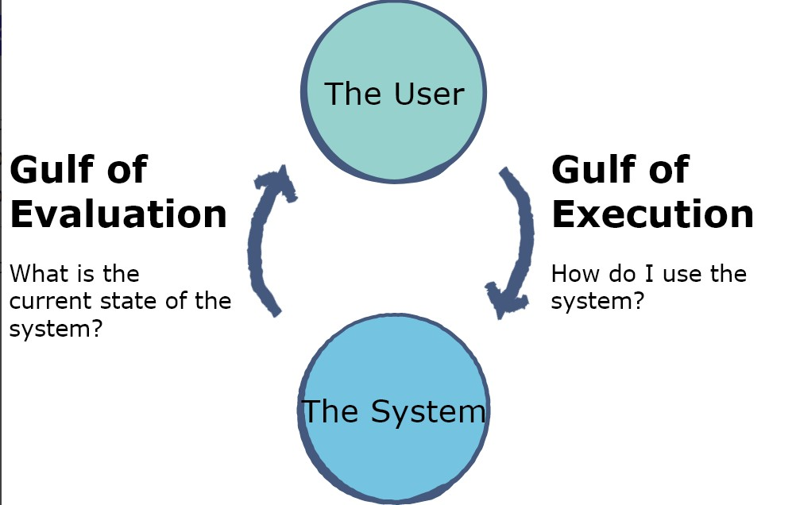
Gulf Of Execution & Gulf of Evaluation
Gulf of Execution is a term used in human-computer interaction (HCI) to describe the gap between a user's intentions and the available actions or operations to achieve those intentions when interacting with a system.​.
Gulf of Evaluation is a term used in human-computer interaction (HCI) to describe the gap between the output of a system and the user's understanding of that output. ​

Slide 17



Gulf Of Evaluation & Execution issue with Adobe R eade r
After seeing this button at first I thought it was for sending a message or feedback. But after clicking, it shows it is used for adding “ sticky note ”. There is a gap here in terms of user intent and expectations.

Slide 18
Thank You

