Slide 1
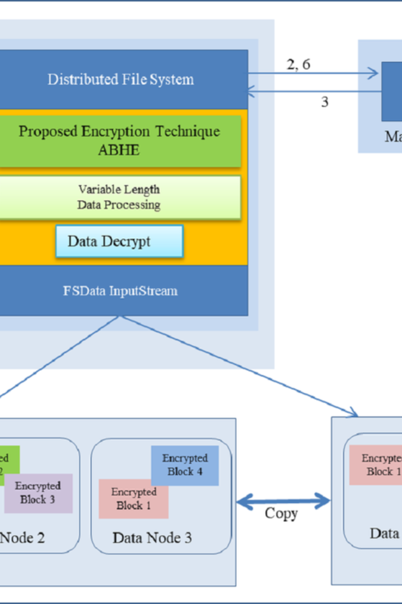


Introduction to HDFS
HDFS, short for Hadoop Distributed File System, is a distributed file system designed to store and process huge datasets reliably and fault-tolerantly. It is a core component of the Apache Hadoop software framework.
by Maggidi Nipun sai

Slide 2
Creating Directories in HDFS
Easy Directory Creation
Organizing Data
Using HDFS commands, directories can be created effortlessly, providing a structured layout for data storage.
Directories help in efficiently managing and organizing large datasets in HDFS for easier access and retrieval.

Slide 3
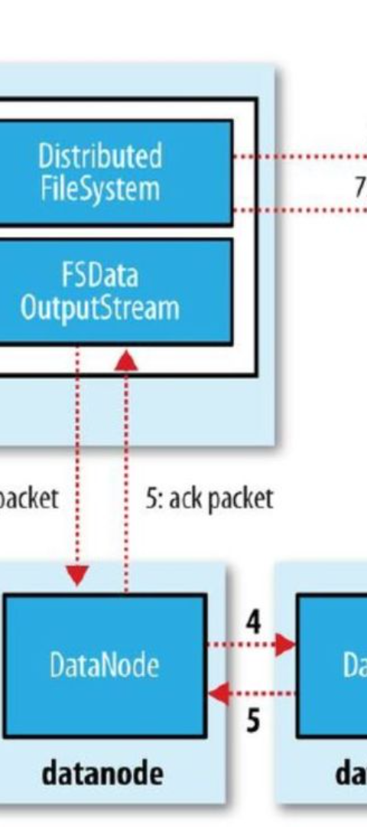
Moving Files in HDFS
1
Seamless Transfers
2
Reliable Data Relocation
Files can be moved within HDFS using simple commands, ensuring smooth data migrations.
The move operation preserves data integrity, ensuring files are successfully transferred without corruption.

Slide 4
Verifying the File Transfer
1
2
Check Integrity
Ensure Accuracy
Verify file integrity to confirm successful transfers and data reliability.
Confirm that the transferred files match the original, ensuring precision.

Slide 5
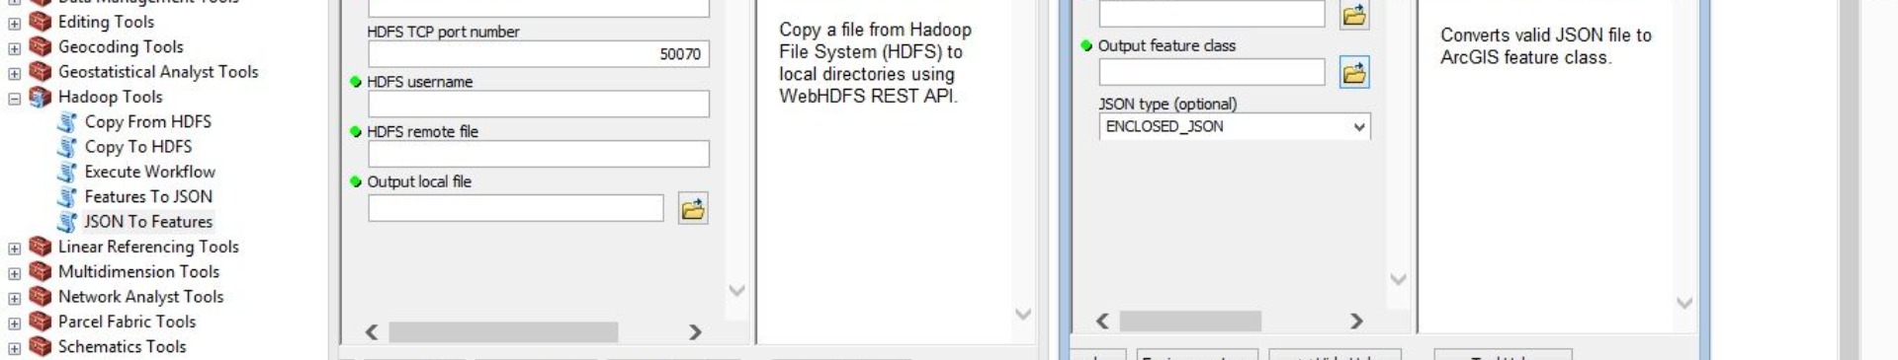


Deleting Files from HDFS
Select File for Deletion
Execute Deletion Command
Identify the specific file or files that need to be deleted within HDFS.
Use the appropriate command to delete the specified files from the Hadoop Distributed File System.

Slide 6
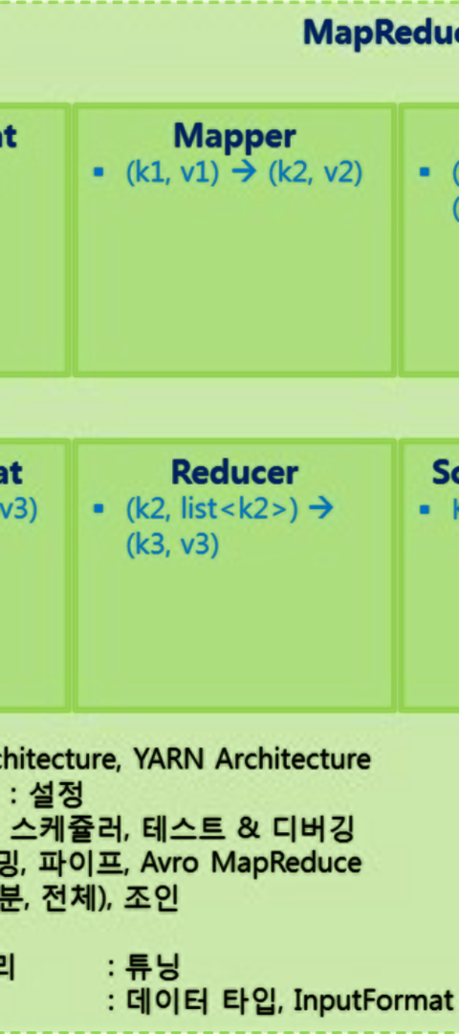
HDFS Commands Summary
Convenient Utilities
Powerful Functionality
HDFS commands provide a range of convenient utilities for efficient management of the file system.
From file manipulations to storage optimizations, HDFS commands offer powerful functionality for users.

Slide 7

HDFS Best Practices
1
Replication Strategies
2
Storage Optimization
Implement effective data replication strategies to ensure high data availability and fault tolerance.
Apply best practices for effective storage management to enhance performance and resource utilization.

Slide 8
Security Measures and Data Replication
Data Security
Implement robust security measures to safeguard data integrity and confidentiality within HDFS.
Data Replication
Utilize data replication to ensure data durability and fault tolerance, enhancing system reliability.

