Slide 1
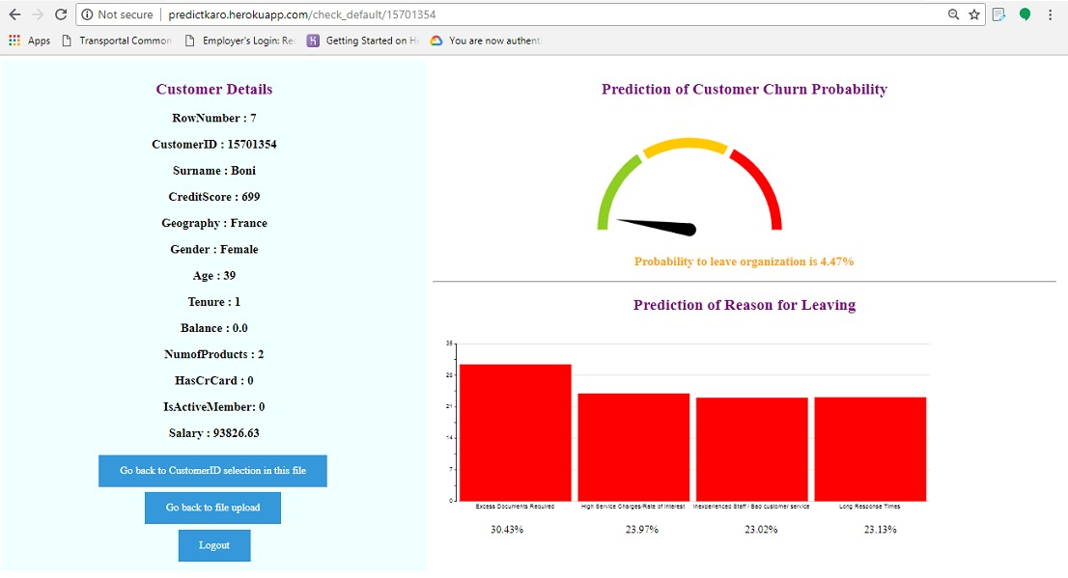
Project Title: Customer Churn Prediction and Reason for Leaving Prediction Using Machine Learning
Based upon Idea : Customer Retention in Loan Industry using Keras and Neural Networks
We have built a prototype to demonstrate prediction of probability of customer leaving the organization. The prototype is live on web at http://predictkaro.herokuapp.com . Use Username : dhfl and Password : dhfl on web app. In this presentation, we will explain everything about our prototype. We have developed user interface, design, graphs for ease of access and in depth analysis of customers. To understand how to use our prototype, directly skip to 8th slide or open readme file. We recommend you to start from next slide only as it will give you complete overview and features of our project before using it.
Screenshot of our working prototype
Proposed solution for improving customer retention in DHFL
By - Ashish Bhawnani, Rahul Chauhan, Akash Rana, Nipun Binjola

Slide 2
Index
The Problem : Customer Churn | 3
Retaining an existing customer vs Acquisition of new customer | 4
What our prototype will do along with its importance for DHFL | 5
Technologies and Programming Libraries used for implementing this project | 6
Explanation and use of main libraries | 7
How to access and use our prototype | 8-13
Scope and Use of Our Project | 14
End | 15

Slide 3
The Problem: Customer Churn
Banking is one of the highly competitive sector where customer relations is of the utmost importance for any bank. A customer with a bank is a customer for life. Home Loans are typically the longest relationship with any customer. Statistics prove that customers are more sophisticated & they need some offers and boosts to continue their relationship with organizations. Customer churn occurs when customers or subscribers stop doing business with a company or service.
We need to identify and create possible technical/non-technical solutions which helps the bank identifying about-to-withdraw customers and act accordingly to ensure that the bank can take the best-possible course of actions. In upcoming slides, we will provide complete details of our software which is going to solve this business challenge.

Slide 4
Retaining an existing customer vs Acquisition of a new customer
All the banking industry nowadays should measure customer churn rate and need a solution to predict customers which are on verge of leaving the organization. This is where the machine learning algorithms comes into the act as the saviour for financial organizations.
Machine learning can help predict customer churn. Customer churn is a critical metric because it is much less expensive to retain existing customers than it is to acquire new customers. Earning business from new customers means working leads all the way through the sales funnel, utilizing your marketing and sales resources throughout the process. Customer retention, on the other hand, is generally more cost-effective as you’ve already earned the trust and loyalty of existing customers.
For example:- If you lost 20% of your customers yearly, it would take 25% increase in new customer just to get you even again. What if you could reduce that churn rate to 10%? It would only take 11% increase in new customers to get you even again !

Slide 5
What our project will do along with its importance for DHFL
Our web application solution is developed to help DHFL to prevent takeover of it’s customer by other Banks/NBFCs. Our team intend to build a software based solution to predict the possibility of each user of breaking the relationship with DHFL and shifting to other financial institute. Also our web application will predict reasons to leave probabilty of each customer. If company knows the reason why customer will leave, company can take specific measures to retain that customer.
The software (web app) does the following things:
Create a user-friendly interface which will help DHFL with clear and easy-to-interpret visual data.
Predict probability of a current customer to leave DHFL ranging from 0 to 1 where 0 will denote that customer will never leave DHFL and 1 will denote that customer is definitely going to leave DHFL.
Show prediction of probability of a customer leaving DHFL along with its graph. Also show probability of different reasons of leaving for each customer and display Bar graph of each reason for in depth analysis. This bar graph shows that if probabilty of churn becomes true and customer really leaves, then what factors will contribute to his/her leaving the organization, i.e., reasons for leaving and it will show probability of each reason contributing to his/her withdrawal from services of organization.

Slide 6
Technologies and Programming libraries used for implementing this project
We are using Python 3.7 as our base programming language for building machine learning model to predict Customer retention. Our prototype backend is completely built in Python (Anaconda). Python has a powerful set of packages for wide range of data computing and prediction. We have deployed Python backend with help of Flask framerwork on web. The main packages and Python libraries that are used in this project are as follows:-
Tensorflow and Keras
Pandas
Matplotlib
Scikit-Learn
Flask
In upcoming slides, we will discuss the use and implementation of each library in our project. We have used a sample publicly available data to build our sample prototype. We will show in upcoming slides how to use our sample prototype, software and environment required to run prototype. Also screenshots are attached in next slides.

Slide 7
Explanation and Use of Main Libraries
Tensorflow and Keras for implementing Neural Network in data model
Prediction of whether a customer will stay with company or not will be done mainly with Keras library. This library is used to train our model to predict whether customer will leave or not. We have implemented Neural Network with the help of Keras Library. Keras is adopted widely by businesses in several application. In Keras, we will use Sequential model and Dense model for hidden layers in our project.
Pandas
All the preprocessing work on the data will be done with the help of this extremely powerful library. Manipulating numerical data for data analysis.
ScikitLearn (LabelEncoder, OneHotEncoder, Standard Scaler)
Except LightGBM machine learning model, no model can deal with categorical variables by itself. So we have to encode these string data to numerical data before passing it into model. So we will use LabelEncoder and OneHotEncoder to encode the data. In upcoming slides, we will show how to use these. We use StandardScaler to transform our data such that its distribution will have a mean value 0 and standard deviation of 1.
Flask
Flask is used for deployment on web. The flask_app.py is written in Flask which is main code deployed on web which uses H5 models built in Python.

Slide 8
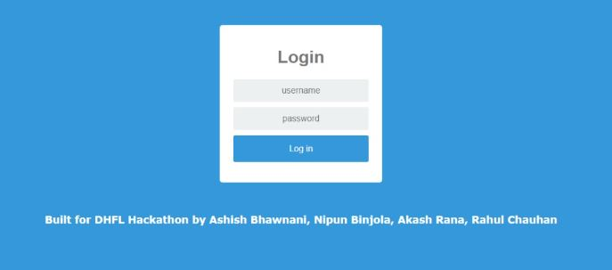
How to access and use our prototype
Using this prototype live !
This prototype to predict customer churn is live at http://predictkaro.herokuapp.com/ !! We have deployed whole machine-learning model on web for ease-of-access . Simply go to this url and login using the below username and password .
Username - dhfl
Password - dhfl
How to use the web-app - a walkthrough
Visit the link mentioned above to launch the fully functional web-application. On clicking the link, a page like this will appear:
Enter the login credentials provided above, note that entering wrong credentials will prevent user-login!

Slide 9
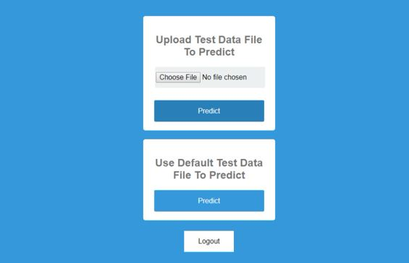
How to access and use our prototype
Now , user will have the choice of entering request data.
Through Default File , we have provided a sample testing file- testtestdefault1 for the user , which is in a specific format. Remember since our train data is in this format, test data should also be in same format.
As shown , the file requires these entries , along with an empty column of Exited which represents exiting probability from 0-1.
Now, on clicking Predict , a dropdown menu consisting of all employee-ids is available with a go-back option:

Slide 10
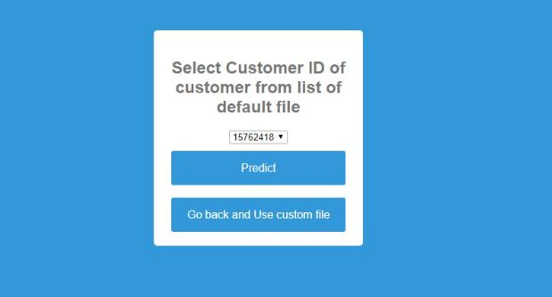
How to access and use our prototype
Select any customer from drop-down menu and click Predict -

Slide 11
How to access and use our prototype
A data-visualised graph showing churn-risk (low-medium-high) , alongwith top reasons for leaving and details of customers is shown.
Also through the feature of Upload test data , one can choose his/her own test requirements for prediction and analysis
As usual , you can select any customer for whom you want to calculate the risk. Keep in mind- The user testdata file must be of same format as that of the sample shown. It shows the prediction further. When done , customer can Logout anytime .

Slide 12
How to access and use our prototype
How to run locally
These instructions will get you a copy of the project up and running on your local machine for development and testing purposes. See deployment for notes on how to deploy the project on a live system.
Pre-requisites
Creating a virtual environment using Anaconda. If you need to create your workflows in Python and keep the dependencies separated out or share the environment settings, Anaconda distributions are a great option.
The following main Python-based libraries have been used :
Flask
Numpy
Pandas
Tensorflow
Keras
which will be installed during setting the environment.
Provided the requirements are already installed in your system , you can simply execute the .py script named flask_app.py However, for future deployment purposes it is essential to create a virtual environment.
Step 1 : Main Directory
Go to command prompt/terminal (for Linux users) and change to the project as the default directory. Example: If current path is C:\Users\name> change to C:\Users\name>cd Desktop\flasksite (if downloaded to Desktop)
As usual , you can select any customer for whom you want to calculate the risk. Keep in mind- The user testdata file must be of same format as that of the sample shown. It shows the prediction further. When done , customer can Logout anytime .

Slide 13
How to access and use our prototype
How to run locally
Step 2 : Create environment
Create a conda environment using conda create -n env This will create an empty Python environment with name env . Activate using activate env To exit from the virtual environment , simply execute deactivate env
Step 3 : Install required libraries
Anaconda distribution comes with many default downloaded libraries which the user can directly , however to efficiently manage the environment , manually install libraries. Please import all libraries imported in flask_app.py ! A simple way would be to use pip - Python default package managerpip install [nameOfPackage] Install the libraries specified in pre-requisites Example:
pip install flask
pip install numpy
Step 4 : Execute script
When all python dependencies are installed , simply execute the .py script named flask_app.py
python flask_app.py in the cmd prompt should do the task. Follow the link generated, and the flask code should be up and running !

Slide 14
Scope and Use of our Project
Our software will predict probabilities of each customers of leaving the organization. DHFL can use this software on their data of customers and it will predict probability of each customer of leaving their association with DHFL. We have trained other model to predict main reason of leaving along with probability of leaving of customer. So now our prototype predicts reason for leaving also along with probability of leaving. All this is depce
Once you know about the customers who are on the verge of leaving association with you and the probability of that customer of leaving, then you can use various promotional strategies targeted to impress or improve your relation with that customer. We have trained our model to predict the main probable reason of leaving of a current customer who is on risk of leaving. This way you can also know why that customer wants to leave whether due to high costs or due to bad support etc.
Also we have focused a lot on User Experience and User Interface, so team of DHFL can easily use our prototype to analyze about future prediction of a customer. Also meter and bar graphs are provided for each customer for in depth analysis and use in company. Our prototype is ready to be built on industry level.
It is easily deployable as we have shown by deploying on web. Since it is on web, maintenance is very less. It is built on Flask framework of Python so deployment is easy. Just we need to create environment on web, i.e., all machine learning and graph libraries, and our project is ready to work !

Slide 15
End
Thank you for giving us your valuable time. We hope that you liked our prototype and project. If you believe that our project can successfully bring a positive change in Customer retention in DHFL, We request you to grant us entry in next stage of competition. This is just a prototype. We have many ideas to improve this prototype to convert it into industry level real product having abilities to solve multiple business problems.
THANK YOU

