Slide 1



USB PHYSICAL
SECURITY
BATCH-23EO5
TEAM-12
ST#IS#6651
ST#IS#6652
ST#IS#6653
ST#IS#6654

Slide 2

USB PHYSICAL SECURITY SOFTWARE
The USB Physical Security Software is designed to enhance the security of computer systems by regulating USB access based on predefined policies and geofencing parameters.
The software integrates various security measures such as
Role-Based Access Control (RBAC)
Admin Policies and User Management
Geofencing
Dynamic USB Disabling
Auditing, and Logging

Slide 3

Problem Statement
Due to the increase in USB-related threats like BadUSB, organizations need to improve their security measures. USB drives can spread harmful code, unauthorized access, or corrupt data.
There are various security risks associated with uncontrolled USB access like data theft, malware, etc. This increases the need for enhanced control and monitoring software.

Slide 4

Features Overview
Apart from the core feature of providing an Interface to enable and disable the USB Ports, we went one step ahead and tried to provide More Granular control to the users of the software. These features include-
Role Based Login
Geofencing - The USB can only be accessed in a particular location
Admin Policy Control
Auditing and Logs of User Login/Logout and Duration
A Modern GUI built using Tkinter
SQLAlchemy for Robust Database features

Slide 5
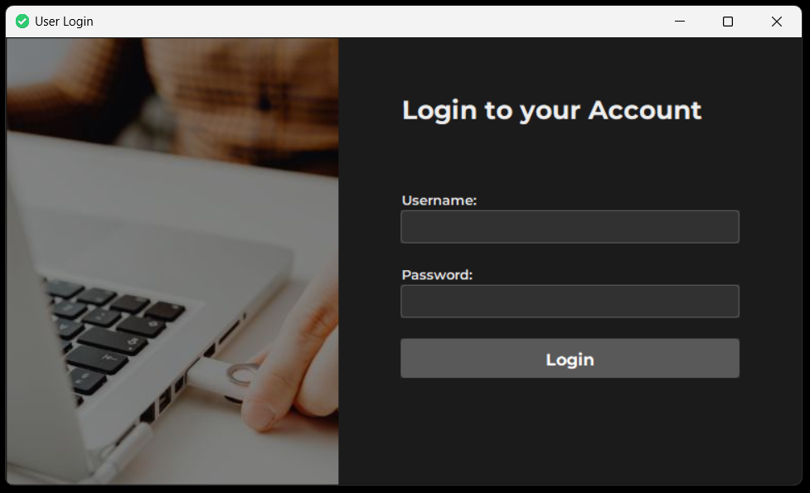
Role-Based Access Control (RBAC)
Role-Based Access Control (RBAC) is a security framework that restricts system access to authorized users based on their roles within an organization. Implementing RBAC in a USB physical security project involves controlling and monitoring access to USB ports and devices based on users' roles and permissions.

Slide 6
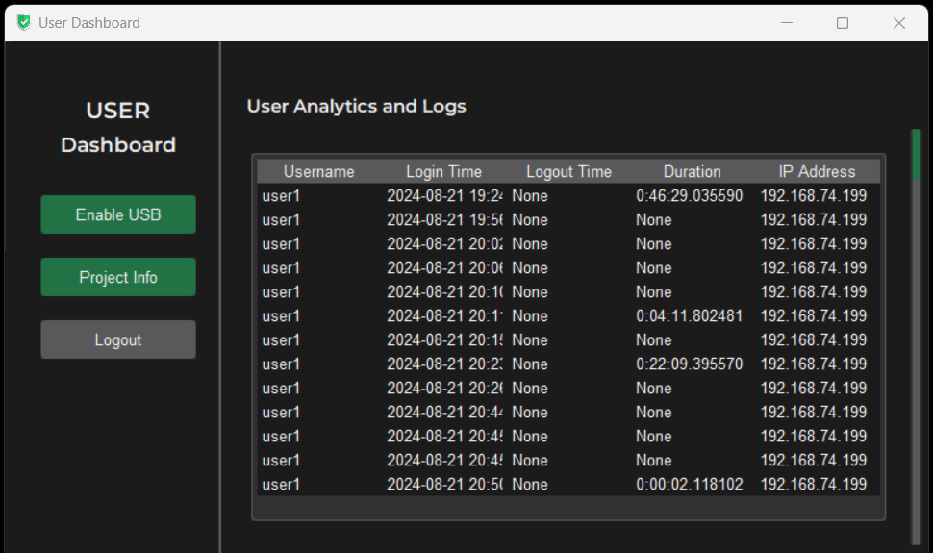
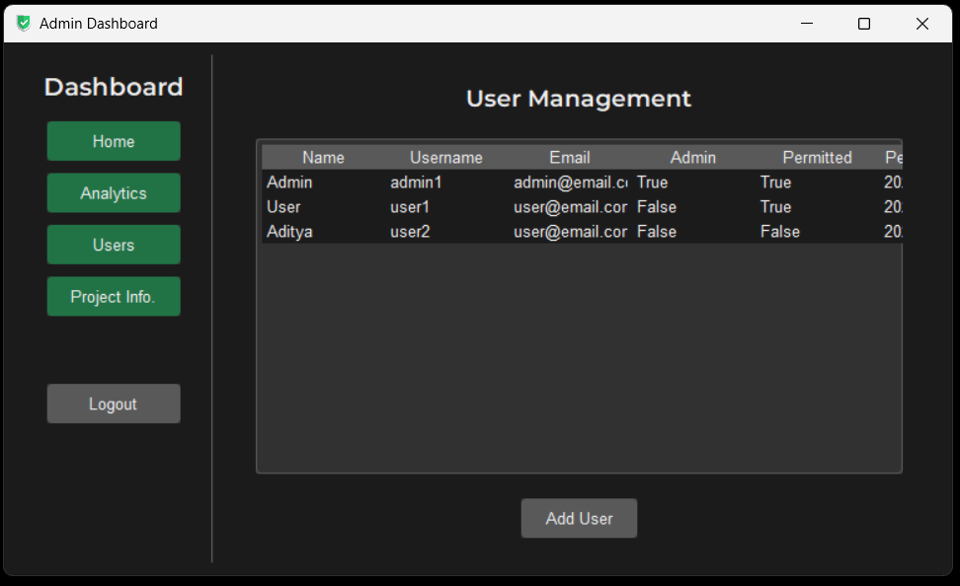
User and Admin Interfaces
Users can see their activity history and can proceed to enable the USB Ports
Admins can manage all the users and can set Ports on Disabled or Active state.

Slide 7
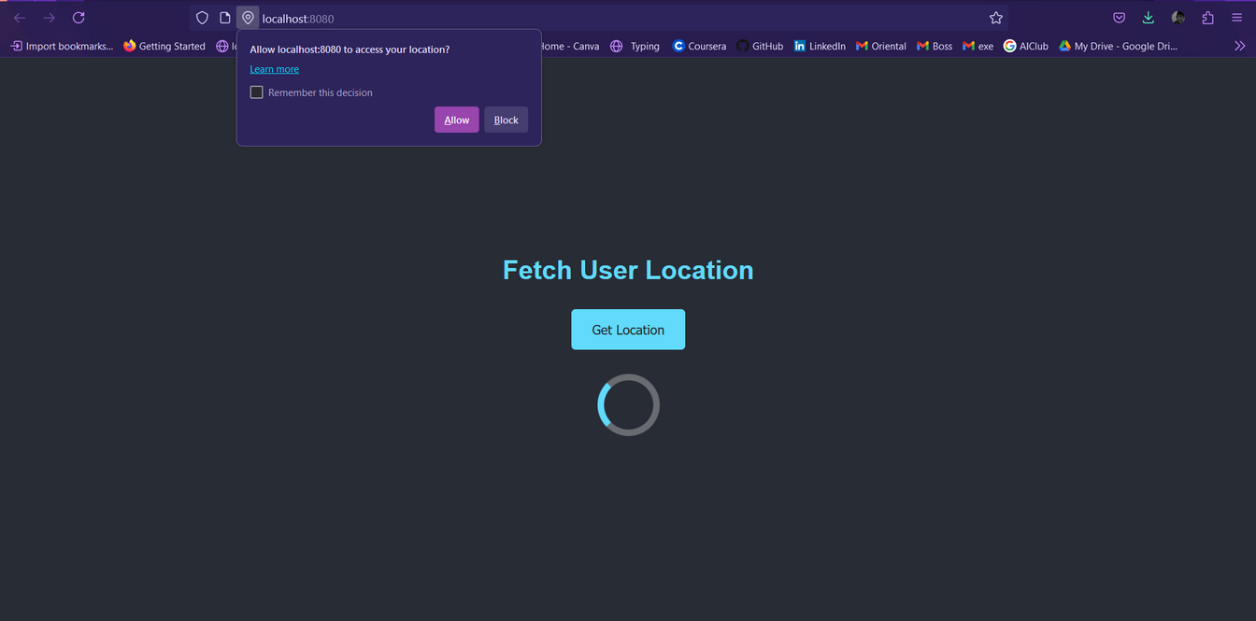
Geofencing in USB Access
Geofencing in USB access is a security mechanism that restricts or controls the use of USB devices based on the physical location of a device or user.
The location of the user is fetched using Browser’s Geolocation API and then that data is validated by comparing it with the values set by the Admin.

Slide 8
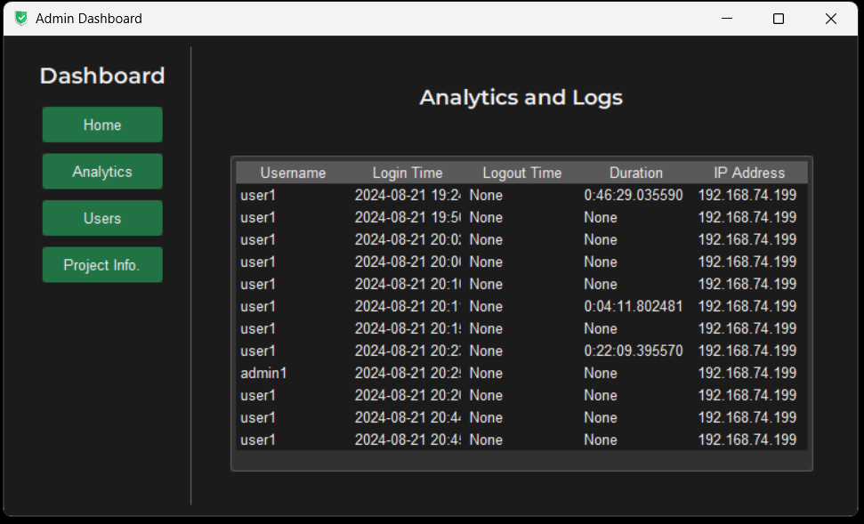

Auditing and Logs
Auditing and logging are crucial components of a USB physical security system. They provide visibility into USB device usage, help detect unauthorized activities, and ensure compliance with security policies and regulatory requirements.

Slide 9
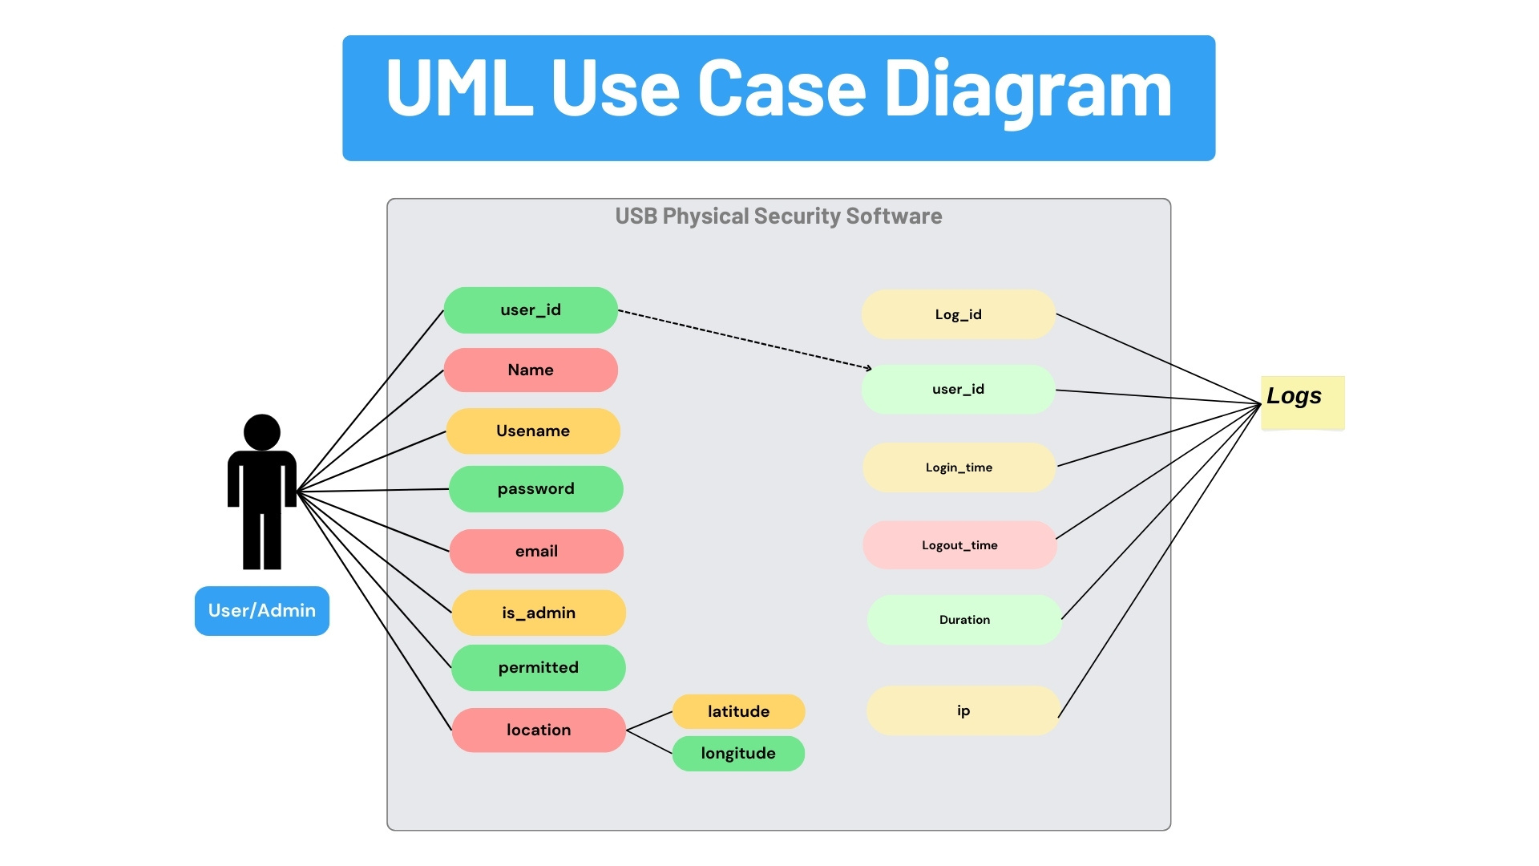
The Database
Structure
The model diagram looks like this, where the tables Users and Logs are related with User ID attribute.

Slide 10
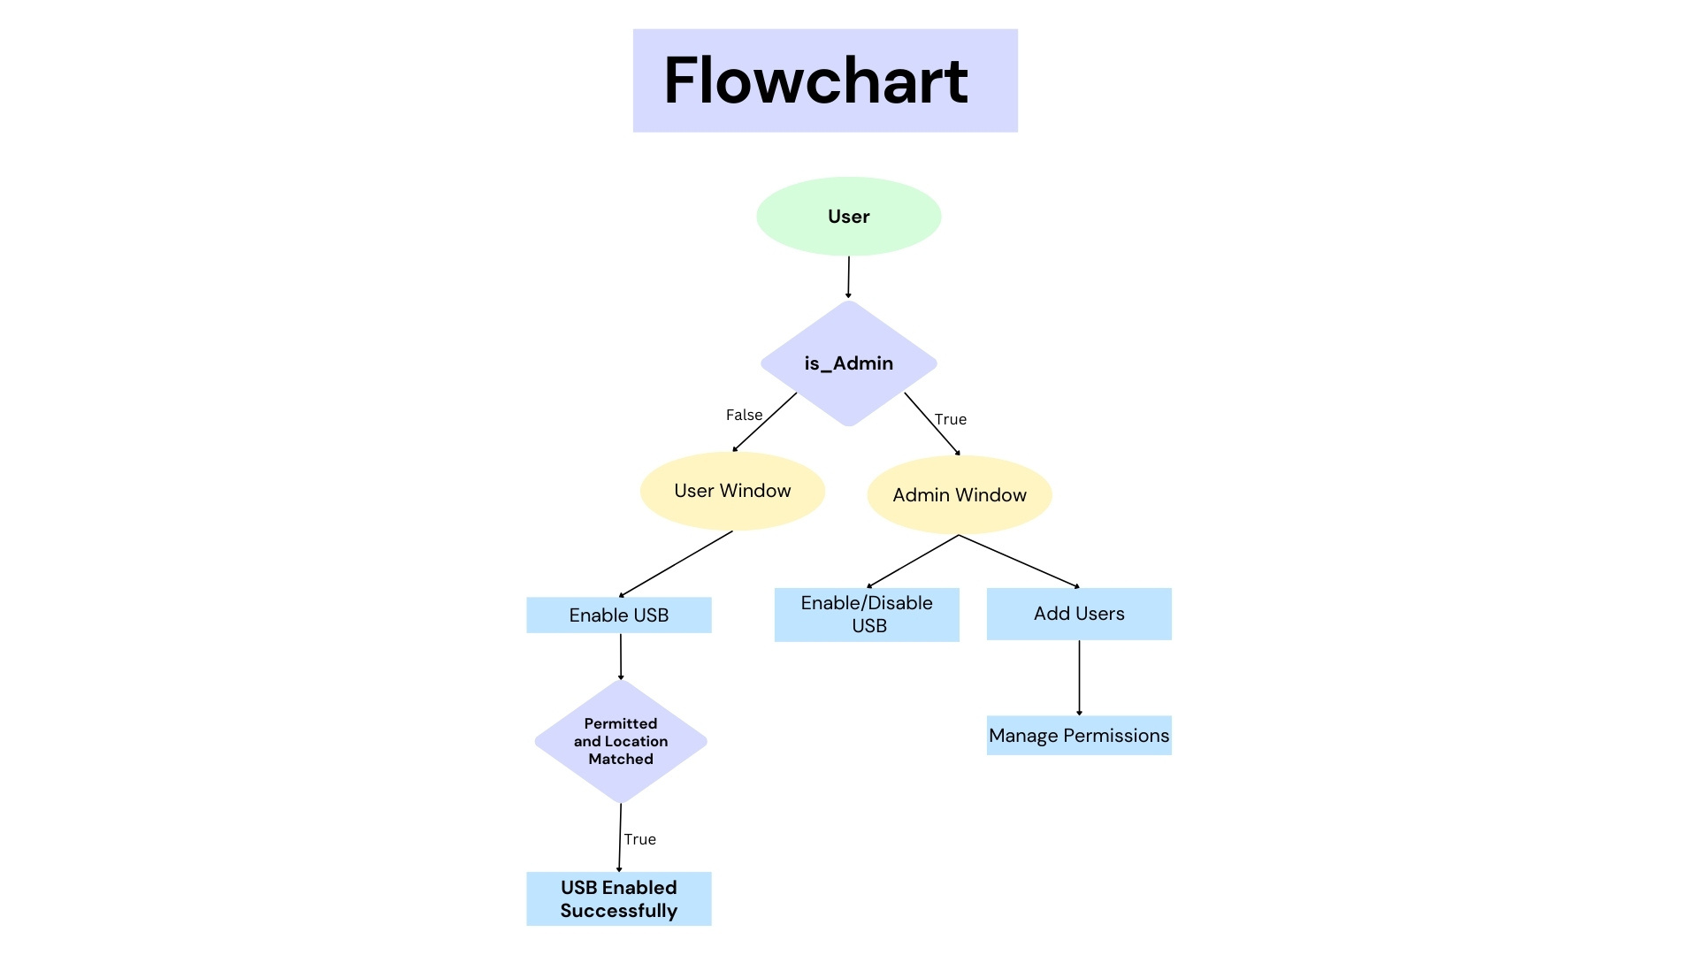
The Process Flow
When user logins from the login window, the system identifies it as User or Admin.

Slide 11
Future Enhancements
This is not it. We are planning to take this project to next level by implementing these ideas into the project.
Alerts for access outside allowed areas
USB Device Authentication - Biometric
USB device whitelisting
Secure Boot
Alerting and Visualization of Logs

Slide 12
Conclusion
In summary, the USB Physical Security Software provides a strong answer to the increasing difficulties of USB security in personal and organizational settings. Our software efficiently restricts unauthorized access and ensures constant USB usage monitoring through the use of Role-Based Access Control (RBAC), geofencing, and thorough auditing. The administrative features offer extensive authority, enabling customized user administration and regulation enforcement.
THANK YOU!

