Slide 1


Flight Delay Analysis using Apache Spark and Building Flight Delay Prediction Machine Learning Model
Presented By
1508 Sandeep Bayas
1520 Nipun Jaiswal
Prashant Karhale External guide
Center coordinator Akshay Tilekar

Slide 2
Introduction
Flight delays has become a very important consideration for air transportation all over the world .
These delays not only cause inconvenience to the airlines but for the passengers also .
So the primary goal of this project is to collect and analyze the data.
Provide insights from data to Business Stakeholders and help them for making a well-assessed decision to increase operation efficiency and growth in business.
Alongside building a predictive machine learning model to reduce inconvenience happens to passengers while travelling.

Slide 3
Proposed Methodology
Data Collection
Feature Selection
Model Selection
Model Training and Testing
Exploratory Data Analysis
Feature Engineering
Parameter Tuning

Slide 4
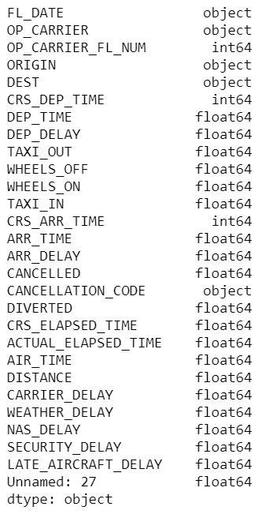
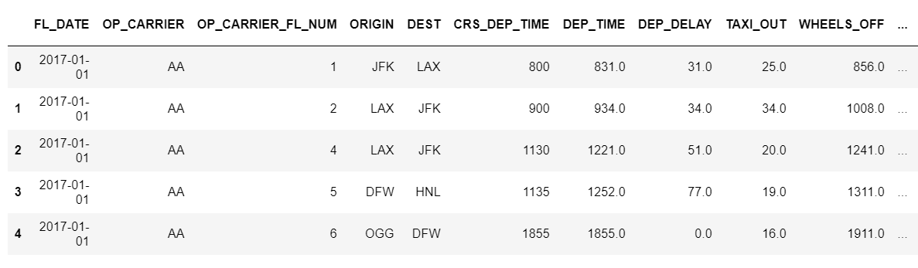
The dataset come from the website of bureau of transportation and statistics United States (www.bts.gov) OR you can get it on Kaggle also. The dataset provide information about flight records per airline across United States. which include 28 features and around 56 million rows.

Slide 5
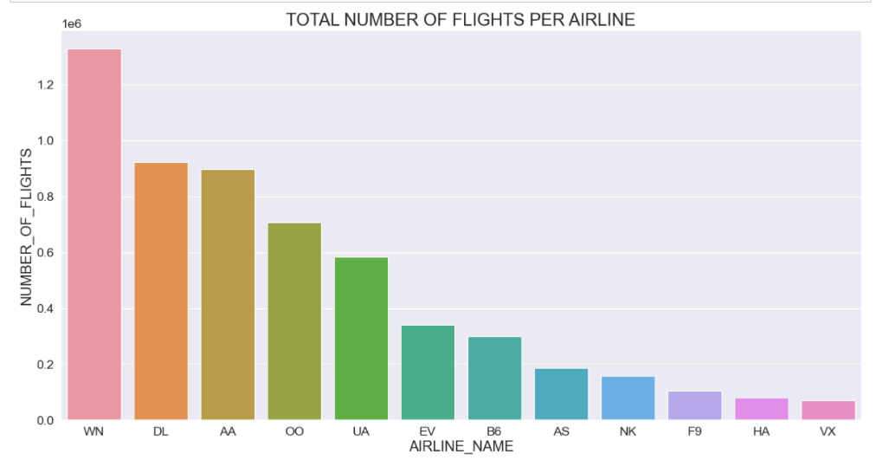
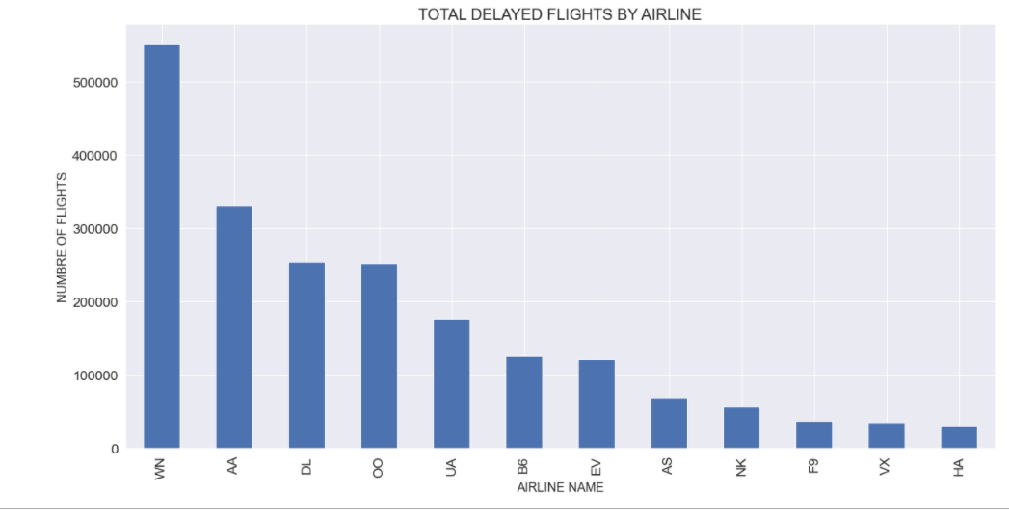
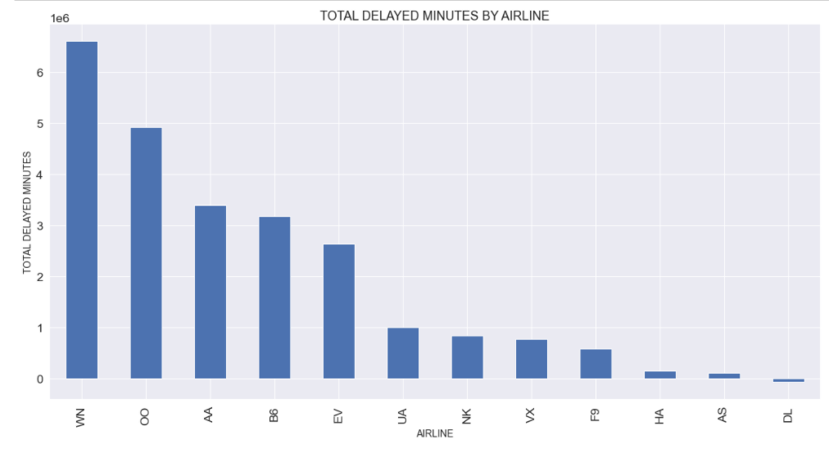
With reference of above plots we come to know that B6 (JetBlue Airways) operates less number of flights as compare to others(Top 5) . Along with there flights are delayed also in large number as compare to other 4 flight operators. So passengers must be cautious while selecting the airlines

Slide 6
Feature Engineering and Data Preprocessing
Putting NA where there is missing values
Remove unnecessary columns (as per the requirement)
Format or Binarize the target or unknown variable
Check datatypes, handle columns with Object / string type (either converting to number / removing them)
Removing columns which have all missing / NA values
Removing rows with missing / NA values greater than 50%
Filling missing / NA values using central tendencies

Slide 7
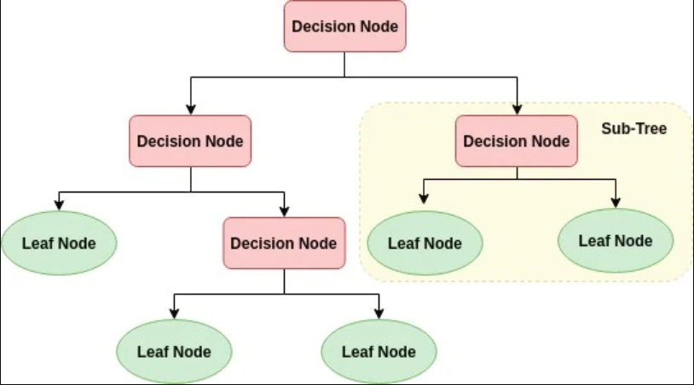
Decision Tree is a Supervised learning technique that can be used for both classification and Regression problems, but mostly it is preferred for solving Classification problems.
In a Decision tree, there are two nodes, which are the Decision Node and Leaf Node. Decision nodes are used to make any decision and have multiple branches, whereas Leaf nodes are the output of those decisions and do not contain any further branches.
Decision Trees usually mimic human thinking ability while making a decision, so it is easy to understand.

Slide 8
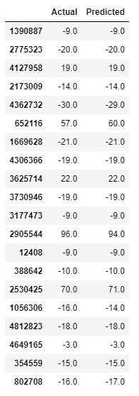
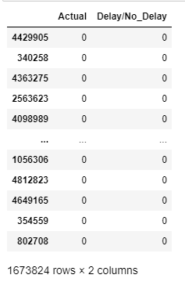
After applying Decision Tree algorithm on our dataset i.e both classification as well as regression model we got predicated and actual values as follows(Actual and Predicted).

Slide 9
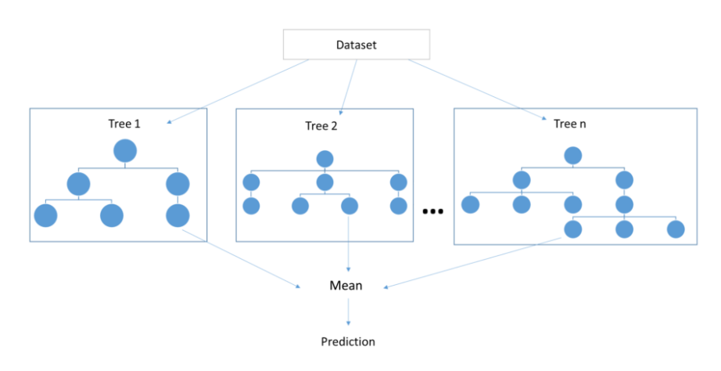
Random Forest :
Random forest is a supervised learning algorithm .
The forest it builds, is an ensemble of decision trees, usually trained with the bagging method.
The general idea of the bagging method is that a combination of learning models increases the overall result.
Random forest adds additional randomness to the model, while growing the trees. Instead of searching for the most important feature while splitting a node, it searches for the best feature among a random subset of features. This results in a wide diversity that generally results in a better model.

Slide 10
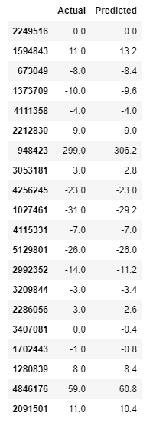
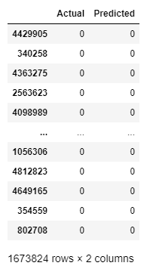
After applying Decision Tree algorithm on our dataset i.e both classification as well as regression model we got predicated and actual values as follows(Actual and Predicted).

Slide 11
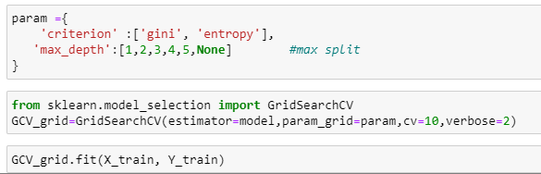
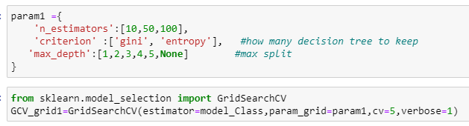
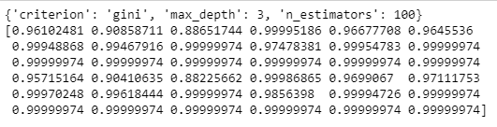

Hyperparameters are important because they directly control the behavior of the training algorithm and have a significant impact on the performance of the model is being trained
A hyperparameter is a hyperparameters whose value is used to control the learning process and increase the model performance by choosing best parameters

Slide 12
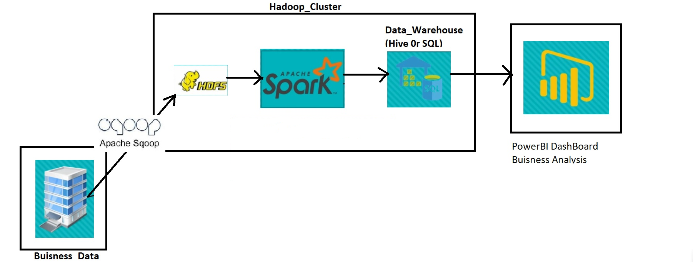
Big Data Methodology:
Generally in most of the organizations the crucial data is stored in RDBMS systems (OLTP) and we cant perform analytics there.
So here we need to import this data from RDBMS to HDFS using Sqoop and performing analysis inside Hadoop cluster.after analyzing the data the output stored into data warehouse(MySQL) and finally we collect the data from warehouse into visualization tool Powerbi for doing the visualizations

Slide 13
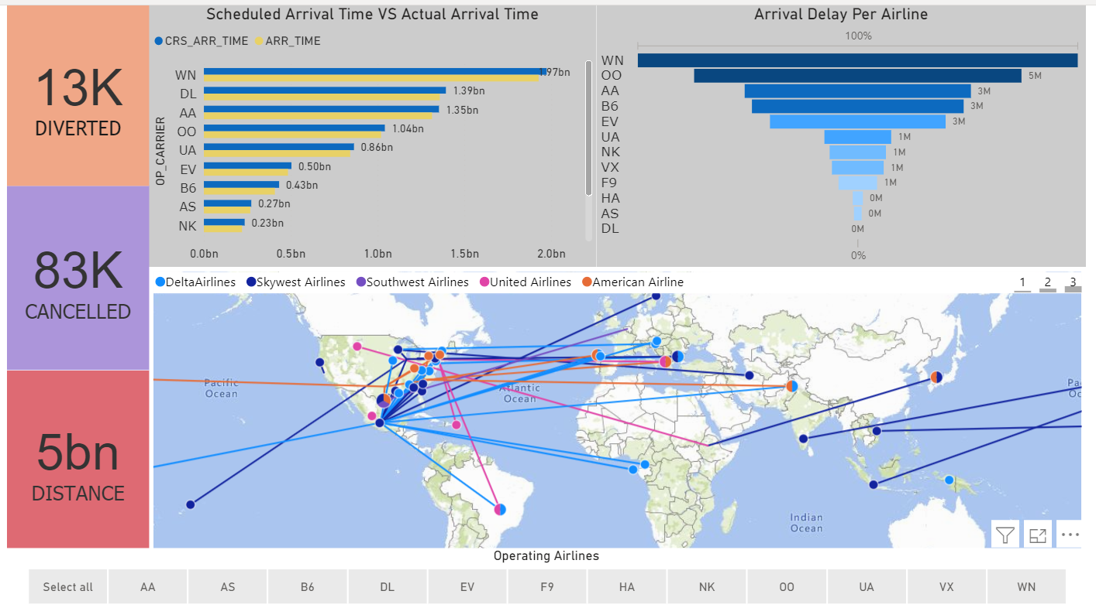

Slide 14
Conclusion
Here we utilized machine learning capabilities to predicting the flight delays. This model is based on a simple classification and regression techniques using Decision Tree and Random Forest algorithms.
The model has achieved an overall 98% testing accuracy on publicly accessible dataset,
It is concluded from accuracy that Random Forest is highly suitable for solving this kind of problem statements.
For storing and processing this kind of large datasets Spark with Hadoop cluster doing a great job by harnessing the capabilities of Parallel processing. And for better insights and visuals from data Powerbi has done the great job.

Slide 15
Future Scope
Integrating the ml model with application to predict the real time flight delays
With new advancement in the field of Deep learning we can use Neural Networks algorithm on the flight and weather data.
As neural Network works on pattern matching methodology.
Also the scope of the project is very much confined to flight and weather delay of US so here we can also take into count of other countries like India, Japan and many more

Slide 16
Thank You

