Slide 1
Ansible
Copyright © 2022 Accenture. All rights reserved.

Slide 2
Table of Contents
Configuration Management
Example of Configuration Management
Introduction to Ansible
Ansible – Components
Control Node
Managed nodes (hosts)
Inventory
Sample hostfile
Modules
Tasks and Playbooks
Playbook - Example
Task Execution
Desired State and Idempotency
Ansible – YAML basics
Key-Value pair
Representing List
List inside dictionaries
List of Dictionaries
YAML Tags in Playbook
Ansible Roles
Utilizing roles in playbooks
Exercise on how to create readable playbook
Exercise:2
Best Practices – Version control
Best Practices – Readability
Best Practices – Roles
Best Practices – Access Rights
Best Practices – Debugging
Ansible tower
Advantages of Ansible
Copyright © 2022 Accenture. All rights reserved.

Slide 3
Configuration Management
Configuration management is the process of maintaining the systems in a desired state.
It ensures that systems performance is consistent with expectations over time.
It keeps a record of detailed information, which typically includes the exact versions and updates that have been applied to installed software packages and the locations and network addresses of hardware devices.
It prevents undocumented changes from working their way into the environment, which might result in system downtime, instability or failure.
It prevents performance issues, system inconsistencies and compliance issues
Copyright © 2022 Accenture. All rights reserved.

Slide 4
Example of Configuration Management
If you want to install the latest version of python in the enterprise, it is not feasible to go and update each and every machine manually.
So, with ansible playbooks and inventory, you can install python on all the machines in one go.
We write a playbook to update python, list all the IP addresses of the nodes in Inventory and run the playbook from the Control node and it will be installed in all the managed nodes listed in the inventory.
Copyright © 2022 Accenture. All rights reserved.

Slide 5
Introduction to Ansible
Ansible is simple open-source IT engine which automates application deployment, intra service orchestration, cloud provisioning and many other IT tools.
It is easy to deploy as it is agentless.
Automation jobs are described using playbooks, which are written in simple YAML language.
YAML is a data serialization language and is commonly used for configuration files and is easy to read, understand and write.
Copyright © 2022 Accenture. All rights reserved.

Slide 6
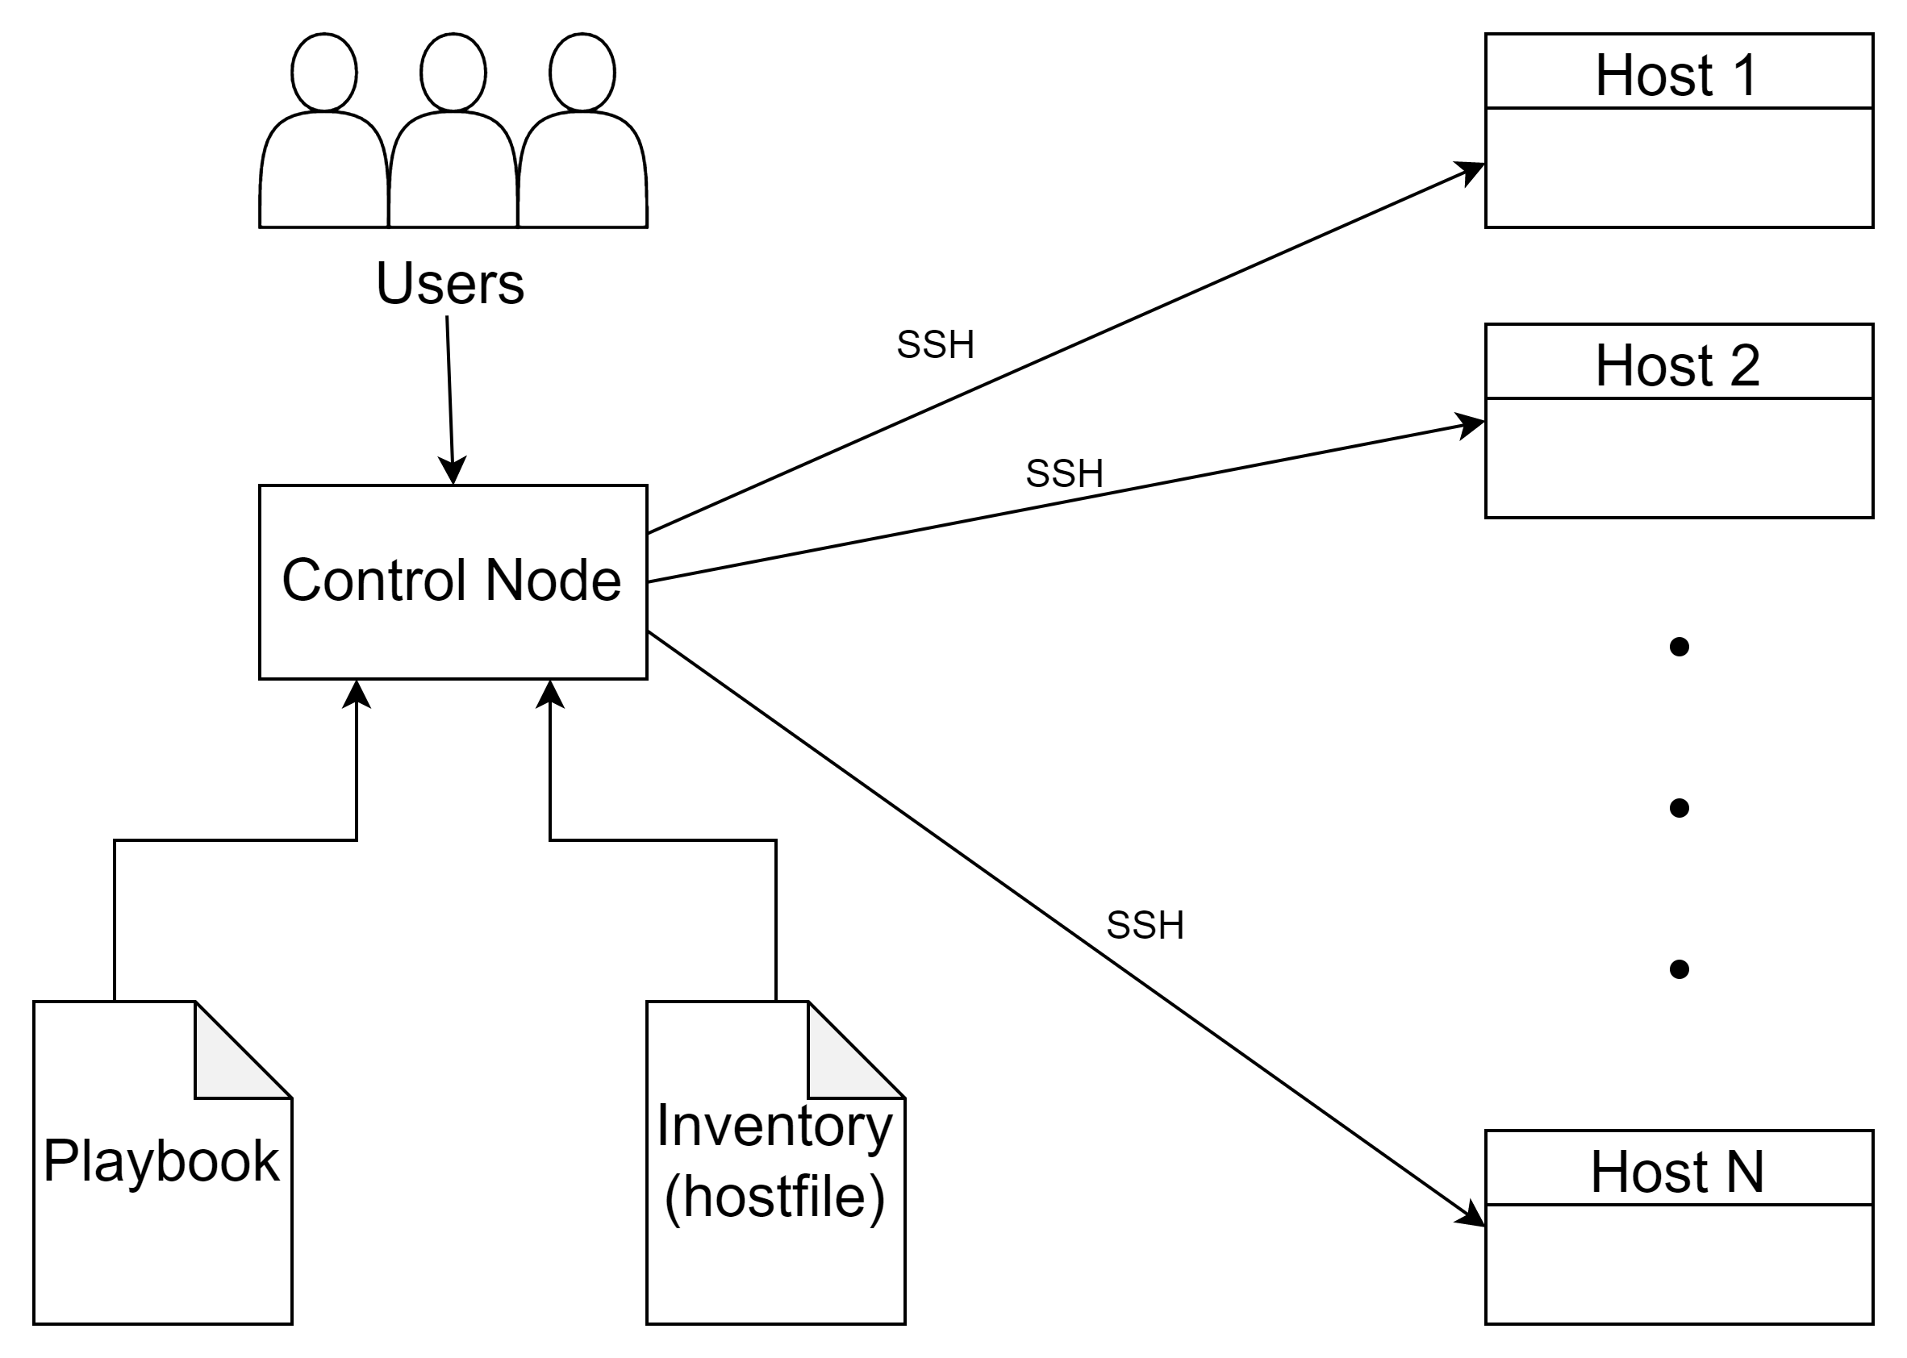
Ansible – Components and How it works
Copyright © 2022 Accenture. All rights reserved.

Slide 7
Control node as the name suggests, controls the entire execution of the playbook, which lists the tasks in order.
Inventory provides the list of hosts where ansible modules need to be run.
Control node connects to the hosts using SSH, pushed out small programs called ‚Ansible Modules‘ onto the hosts and executes these modules on host machines.
Ansible removes these modules from the host machine once the modules are installed.
Control node connects to host machine , executes the instructions and if it’s successfully installed removes the code which was copied on the host machine which was executed.
Copyright © 2022 Accenture. All rights reserved.

Slide 8
Control node
Any machine with Ansible installed is called a control node.
Ansible commands and playbooks can be run by using ‚ansible‘ or ‚ansible-playbook‘ command from any control node.
Windows machine cannot be used as a control node.
Python installation on control node is a prerequisite.
We can have multiple control nodes.
Copyright © 2022 Accenture. All rights reserved.

Slide 9
Managed nodes (hosts)
Managed Nodes are the Network devices/Servers which are managed by Ansible.
As ansible is agentless, it is not required to install any agent on hosts for the control node to communicate with the host. Communication is established over a secure shell (SSH) connection.
Copyright © 2022 Accenture. All rights reserved.

Slide 10
Inventory
Inventory also commonly called as hostfile, gives ansible the list of hosts that it can connect to.
It can specify information such as IP address for each managed node.
Generally managed nodes are organised into groups for easier scaling.
Hosts can exist in more than one group.
Nested groups can also be created.
Copyright © 2022 Accenture. All rights reserved.

Slide 11
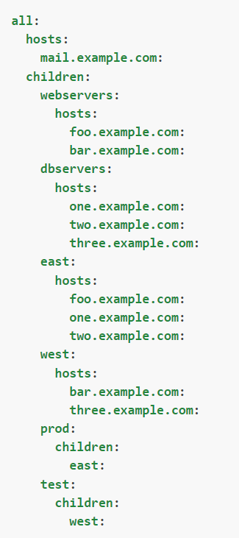
Sample hostfile
As can be seen here, some hosts are present in multiple groups.
Nested groups are utilized to simplify prod and test in this host file.
The hostfile can be written in simple YAML language.
Image ref: https://docs.ansible.com/ansible/latest/user_guide/intro_inventory.html
Copyright © 2022 Accenture. All rights reserved.

Slide 12
Modules
Modules are the units of code Ansible executes.
Each module has a particular use, from administering users on a specific type of database to managing VLAN interfaces on a specific type of network device.
Single module can be invoked with a task.
Multiple modules can be invoked with a playbook.
Modules are grouped into collections. An example of collection is google.cloud, which is a collection for google cloud and has all the modules related to GCP here, for example gcp_cloudscheduler_job_module which creates a GCP job, gcp_compute_instance_module which creates a GCP instance.
Copyright © 2022 Accenture. All rights reserved.

Slide 13
Tasks and Playbooks
Tasks are the basic units of action in Ansible.
Playbooks are ordered lists of tasks, so that these tasks are run in order provided repeatedly.
Playbooks can include variables as well as tasks.
Playbooks are written in YAML and are easy to read, write, share and understand.
A playbook runs in order from top to bottom.
Within each play, tasks also run in order from top to bottom.
Playbooks with multiple ‘plays’ can orchestrate multi-machine deployments, running one play on your webservers, then another play on your database servers, then a third play on your network infrastructure, and so on.
Copyright © 2022 Accenture. All rights reserved.

Slide 14
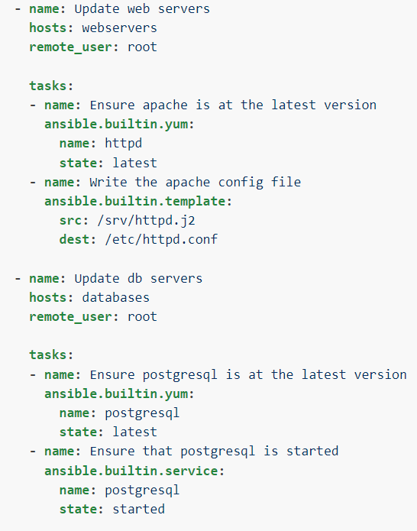
Playbook - Example
In this example, 2 plays are present, one for updating web servers and another for updating db servers.
In this playbook, each play is set with a remote_user, which is the user account for SSH connection.
There are several other playbook keywords which influence the way Ansible behaves. For example, ‚force_handlers‘ will force notified handler execution for hosts even if they failed during the play.
If a task fails on a host, Ansible takes that host out of the rotation for the rest of the playbook.
ref: https://docs.ansible.com/ansible/latest/user_guide/intro_inventory.html
Copyright © 2022 Accenture. All rights reserved.

Slide 15
Task Execution
By default, Ansible executes each task in order, one at a time, against all machines matched by the host pattern. Each task executes a module with specific arguments. When a task has executed on all target machines, Ansible moves on to the next task.
This default behavior can be modified with the help of strategies. The default behavior is a linear strategy. Other strategies include debug strategy and free strategy.
Also to make use of the processing power available, number of forks can be increased.
When a playbook is run, Ansible returns information about connections, the name lines of all your plays and tasks, whether each task has succeeded or failed on each machine, and whether each task has made a change on each machine.
At the bottom of the playbook execution, Ansible provides a summary of the nodes that were targeted and how they performed.
Copyright © 2022 Accenture. All rights reserved.

Slide 16
Desired State and Idempotency
Most Ansible modules check whether the desired final state has already been achieved and exit without performing any actions if that state has been achieved, so that repeating the task does not change the final state. Modules that behave this way are often called ‘idempotent.’
In general terms, it means whether you run a playbook once, or multiple times, the outcome should be the same.
Not all modules behave this way, so if unsure, testing the playbook in sandbox environment is advised.
Copyright © 2022 Accenture. All rights reserved.

Slide 17
Ansible – YAML basics
Ansible used YAML syntax for writing playbooks and hostfiles. It‘s easy to understand, read and write.
Every YAML file optionally starts with „---“ and ends with „...“ .
We will discuss various ways of representing YAML data in the coming sections.
Indentation is of primary importance in YAML.
Copyright © 2022 Accenture. All rights reserved.

Slide 18
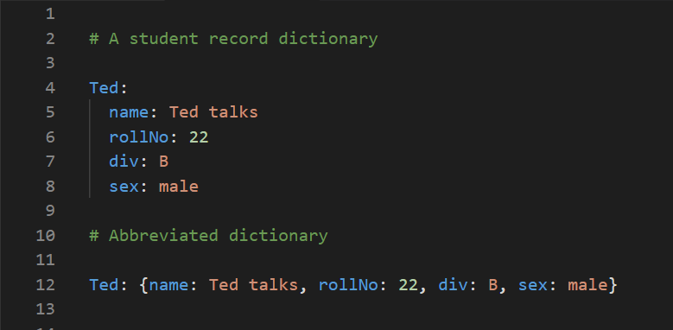
Key-Value pair
YAML used a simple key-value pair to represent the data. The dictionary is represented in key: value pair. Note that there exists a space between : and value.
Example:
Copyright © 2022 Accenture. All rights reserved.

Slide 19
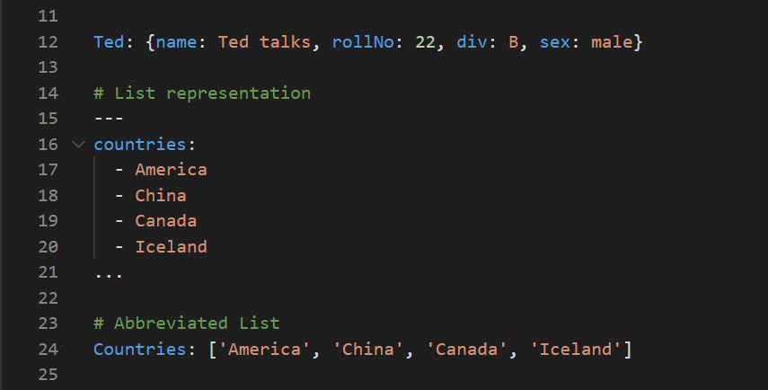
Representing List
Lists can also be represented in YAML.
Every element(member) of list should be written in a new line with same indentation starting with “- “ (- and space).
Lists can also be represented as abbreviations.
Example:
Copyright © 2022 Accenture. All rights reserved.

Slide 20
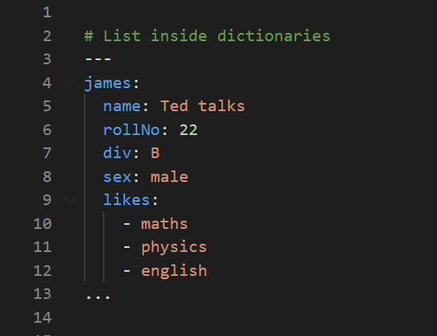
List inside dictionaries
We can use list inside dictionaries, i.e., value of key is list.
Example:
Copyright © 2022 Accenture. All rights reserved.

Slide 21
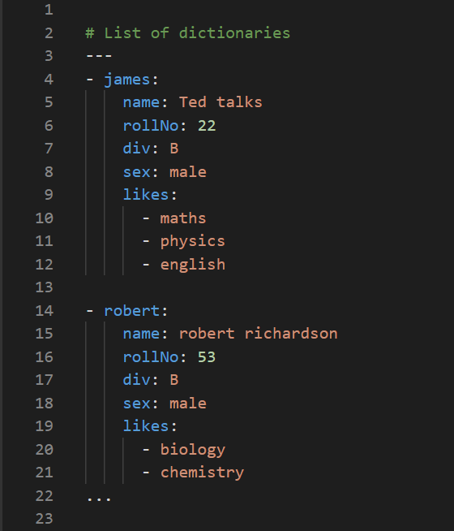
List of Dictionaries
A list of dictionaries can also be represented in YAML.
Example:
Copyright © 2022 Accenture. All rights reserved.

Slide 22
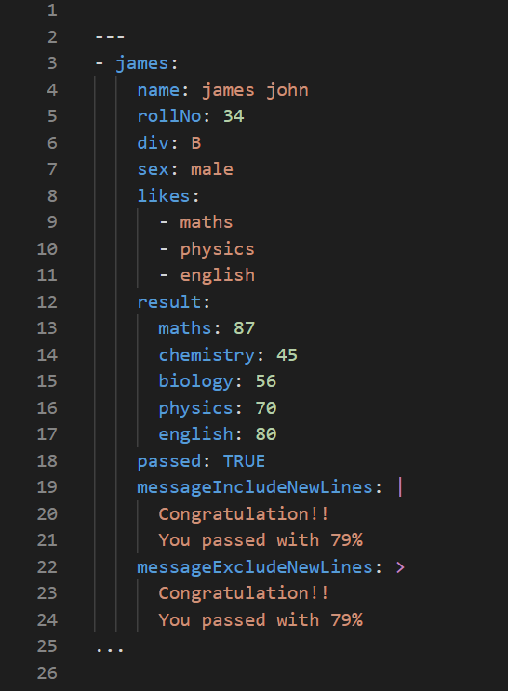
YAML uses “|” to include newlines while showing multiple lines and “>” to suppress newlines while showing multiple lines. Due to this we can read and edit large lines.
In both the cases indentation will be ignored.
Example:
Copyright © 2022 Accenture. All rights reserved.

Slide 23
YAML Tags in Playbook
name: This tag specifies the name of the Ansible playbook and gives an idea of what this playbook will be doing. Any logical name can be given to the playbook.
hosts: This tag specifies the lists of hosts or host group against which we want to run the task. The hosts field/tag is mandatory. It tells Ansible on which hosts to run the listed tasks. The tasks can be run on the same machine or on a remote machine. One can run the tasks on multiple machines and hence hosts tag can have a group of hosts’ entry as well.
Copyright © 2022 Accenture. All rights reserved.

Slide 24
YAML Tags in Playbook
vars: Vars tag lets you define the variables which you can use in your playbook. Usage is similar to variables in any programming language.
tasks: All playbooks should contain tasks or a list of tasks to be executed. Tasks are a list of actions one needs to perform. A tasks field contains the name of the task. This works as the help text for the user. It is not mandatory but proves useful in debugging the playbook. Each task internally links to a piece of code called a module. A module that should be executed, and arguments that are required for the module you want to execute
Copyright © 2022 Accenture. All rights reserved.

Slide 25
Ansible Roles
Roles provide a framework for fully independent, or interdependent collections of variables, tasks, files, templates, and modules.
Roles allows you to logically break the playbook into reusable components.
This simplifies writing complex playbooks, and it makes them easier to reuse.
Each role is basically limited to a particular functionality or desired output, with all the necessary steps to provide that result either within that role itself or in other roles listed as dependencies.
Roles are small functionality which can be independently used but have to be used within playbooks and cannot be executed directly.
Copyright © 2022 Accenture. All rights reserved.

Slide 26
Utilizing roles in playbooks
For example we want to install tom-cat and start tom-cat on hosts, this can be logically split into 2 roles, install-tomcat and start-tomcat roles.
Any logical entity which can be reused as a reusable function, that entity can be moved to role.
If not for the roles, the content of the main.yml of the respective role has to be copied in the playbook yml file.
Copyright © 2022 Accenture. All rights reserved.

Slide 27
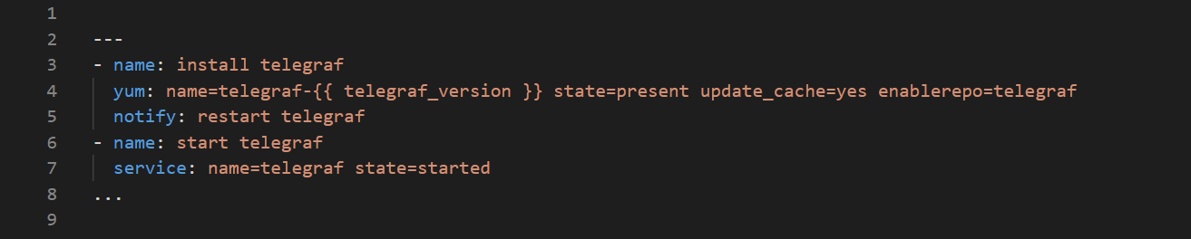
Exercise on how to create readable playbook
A sample playbook code is given below, take a look at it. Is it okay, if not present your ideas on how it can be made better.
Copyright © 2022 Accenture. All rights reserved.

Slide 28
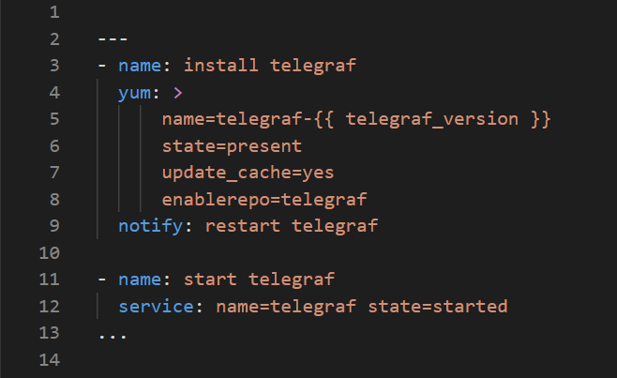
Is this okay, if not what can be made better
Copyright © 2022 Accenture. All rights reserved.

Slide 29
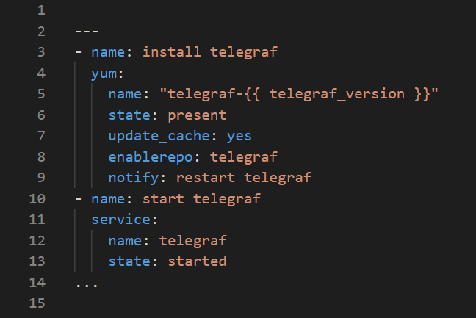
A good playbook is always easy to read and understand.
Copyright © 2022 Accenture. All rights reserved.

Slide 30
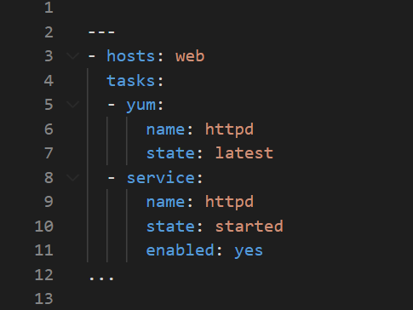
Exercise:2
What do you understand from the code below? What is missing? How can it me made better?

Slide 31
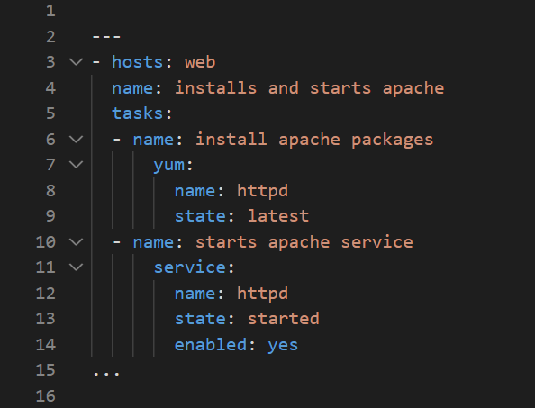
This code details the name of the task being performed and it makes it easy to read and understand.
Copyright © 2022 Accenture. All rights reserved.

Slide 32
Ansible – Best Practices – Version control
Treat Ansible content like code and version control your ansible content.
Iterate your playbooks, i.e. Start with a basic playbook and static inventory, then refactor and modularize(resuable).
Create a style guide for consistency: Tagging, Whitespace, Naming of Tasks, Plays, Variables, and Roles and Directory Layouts.
Organize your code using dedicated git repositories for completely separated teams/ tasks, if possible have a git repository per role.
Copyright © 2022 Accenture. All rights reserved.

Slide 33
Ansible – Best Practices - Readability
Give inventory nodes human-meaningful names rather than IPs or DNS hostnames.
Group hosts for easier inventory selection and less conditional tasks -- the more the better.
Proper variable names can make plays more readable and avoid variable name conflicts
Avoid collisions and confusion by adding the role name to a variable as a prefix.
Copyright © 2022 Accenture. All rights reserved.

Slide 34
Ansible – Best Practices - Roles
Roles enable you to encapsulate your operation, like playbooks -- keep roles purpose and function focused and store roles each in a dedicated Git repository.
Include roles via roles/requirements.yml file, import via ansible-galaxy tool and limit role dependencies.
Get roles from Galaxy, but be careful and adopt them to your needs. Galaxy provides thousands of roles, pick trusted and well known authors.
Copyright © 2022 Accenture. All rights reserved.

Slide 35
Ansible – Best Practices – Access Rights
Root access is harder to track than sudo - use sudo wherever possible.
Ansible can be run as root only but login and security reasons often request non-root access.
Use become method - so Ansible scripts are executed via sudo (sudo is easy to track)
Best: create an Ansible only user
Don’t try to limit sudo rights to certain commands - Ansible does not work that way!
Copyright © 2022 Accenture. All rights reserved.

Slide 36
Ansible – Best Practices – Debugging
Check logging on target machine.
Debugging tasks can clutter the output, apply some personalized messages in the debug part of the playbook for decluttering
Copyright © 2022 Accenture. All rights reserved.

Slide 37
Ansible tower
Ansible tower is developed to employ these best practices in real life.
Extends the limits of Ansible to meet enterprise needs: Scalability, API, RBAC, audits, etc
Tower has inbuilt help.
Tower can import a repository multiple times with different branches.
Use feature or staging branches in your Git, import them all separately, address them separately and is useful for testing of new features but also to move changes through stages.
Tower automatically imports Roles during Project update.
Copyright © 2022 Accenture. All rights reserved.

Slide 38
Ansible tower
Do not copy roles into your playbook repository, just create a roles/requirements.yml and the tower will automatically import the roles during Project installation.
Mix roles from various sources.
Fix version in roles/requirements.yml to have auditable environment.
Use dynamic & smart inventories , to combine multiple inventory types and let tower take care of syncing and caching.
Use smart inventories to group nodes.
Copyright © 2022 Accenture. All rights reserved.

Slide 39
Ansible tower
Tower job templates provide multiple options and Keep jobs simple, focused – similar to playbooks or roles.
Add labels to them to better filter and for idempotent jobs, create “check” templates as well - and let them run over night.
Combine with notifications - and get feedback when a “check” failed .
Multiple playbooks can be combined into one workflow keeping the jobs simple and workflows complex.
React to problems via workflow.
Combine playbooks of different teams, different repositories and re-sync inventories during the play.
Copyright © 2022 Accenture. All rights reserved.

Slide 40
Ansible tower
Use surveys to get variable values, use good, meaningful variable names, provide a default choice and remember Multiple choice is better than free text.
Tower provides tenants, teams, and users - use them for separation.
Provide automation to others without exposing credentials.
Let others only see what they really need and use personal view instead of full Tower interface.
Tower credentials should only be used by Tower - not by others.
Set up a separate user and password/key for Tower that way, automation can easily be identified on target machines.
The key/password can be ridiculously complicated/secure and store key/password in a safe for emergencies.
Copyright © 2022 Accenture. All rights reserved.

Slide 41
Ansible tower
Tower can send notifications if a job succeeds, fails or always - as mail, IRC, web hook, and so on.
Let Tower notify you and your team if something breaks.
Send mails/web-hooks automatically to a ticket systems and monitoring if there is a serious problem.
Send all logs from Tower to central logging (Splunk, Loggly, ELK, REST)
Send results from Ansible runs - but also from Tower changes.
Copyright © 2022 Accenture. All rights reserved.

Slide 42
Advantages of Ansible
Simple | Powerful | Agentless
Human readable automation | App Deployment | Agentless architecture
No special Coding skills needed | Configuration management | Used openSSH and WinRM
Tasks are exexcuted in order | Workflow Orchestration | No agents to exploit or update
All teams can use it | Network Automation | Get started immediately
Get productive quickly | Orchestrate app life cycle | More efficient and secure
Copyright © 2022 Accenture. All rights reserved.

