Slide 1
Data
Quality
Maintenance
Tool
Name
Patel Nipun
Enrollment No.
2504070500009
Department
MSc / Data Science
MSc Data Science | Sem 2
Semester
Project Presentation 2025–26
2nd Semester
Topic: Data Quality Maintenance Tool

Slide 2
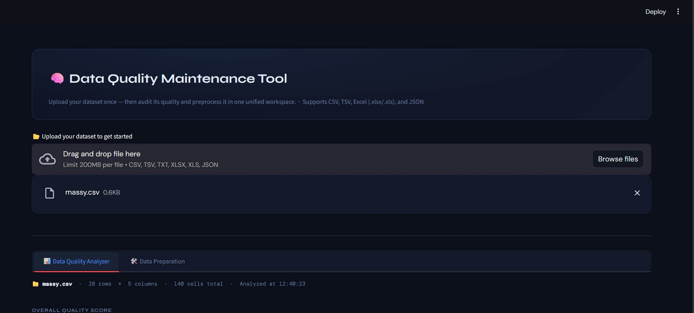
01 | Introduction
Data Quality Maintenance Tool
What is it?
App Screenshot
A comprehensive, interactive web-based application for auditing and preprocessing datasets before machine learning or data analysis workflows.
The Problem
Real-world datasets contain missing values, duplicate records, outliers, and inconsistent formats that directly degrade model performance and analysis accuracy.
Our Solution
A unified 6-step preprocessing pipeline that guides users from raw data upload to clean, export-ready CSV — with zero coding required.
28
5
6
4
Rows
Cols
Steps
Formats
Built With
Python · Streamlit · Pandas · Scikit-learn · Plotly — packaged as a single-file application.

Slide 3
02 | Abstract
Data Quality Maintenance Tool
The Data Quality Maintenance Tool is a Streamlit-based interactive application that streamlines the data preprocessing pipeline for data scientists and analysts. It provides an end-to-end solution for ingesting raw datasets, analyzing quality issues, and applying structured transformations — all within a unified, no-code interface.
Quality Scoring
Issue Detection
Auto-calculates a data quality grade (A–F) based on completeness, duplicates, and outlier density.
Identifies missing values, duplicates, statistical outliers (IQR), and type inconsistencies per column.
6-Step Pipeline
Export Ready
Guided preprocessing: deduplication → imputation → categorical cleaning → encoding → outlier handling → scaling.
Download the cleaned, preprocessed dataset as a CSV file, ready for immediate use in ML pipelines or BI tools.

Slide 4
03 | Objectives
Data Quality Maintenance Tool
1
No-Code Preprocessing
2
Data Quality Auditing
Provide a user-friendly interface to clean and preprocess datasets without any programming knowledge.
Automatically score and grade data quality by detecting missing values, duplicates, and outliers across all columns.
3
6-Step Pipeline
4
Visual Analytics
Guide users through a logical sequence: deduplication → imputation → categorical cleaning → encoding → outlier handling → scaling.
Offer interactive visualizations including histograms, bar charts, correlation heatmaps, and distribution plots.
5
Dataset Export
6
Multi-Format Support
Allow users to download the fully processed, clean dataset for direct use in machine learning or business intelligence tools.
Handle CSV, TSV, Excel (.xlsx/.xls), and JSON file formats within a single unified upload interface.

Slide 5
04 | Workflow Diagram
Data Quality Maintenance Tool
1
2
3
4
5
Upload
Dataset
Quality
Audit
Remove
Duplicates
Missing
Values
Categorical
Cleaning
▶
▶
▶
▶
CSV / TSV
XLSX / JSON
Score & grade
issues
Step 1
Deduplicate
Step 2
Imputation
Step 3
Normalize
6
7
8
9
Encode
Columns
Outlier
Handling
Feature
Scaling
Preview
& Export
Step 4
Label / OHE
Step 5
Cap / Remove
Step 6
Norm / Std
Download
Clean CSV

Slide 6
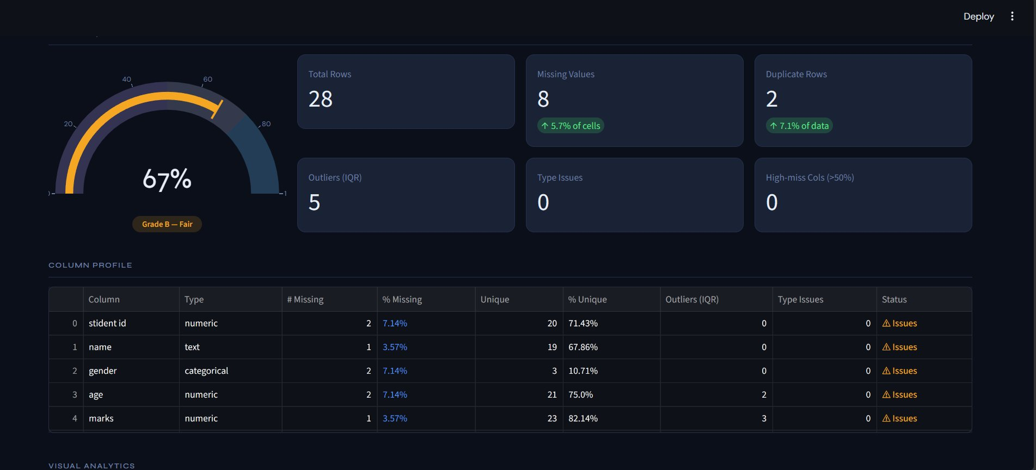
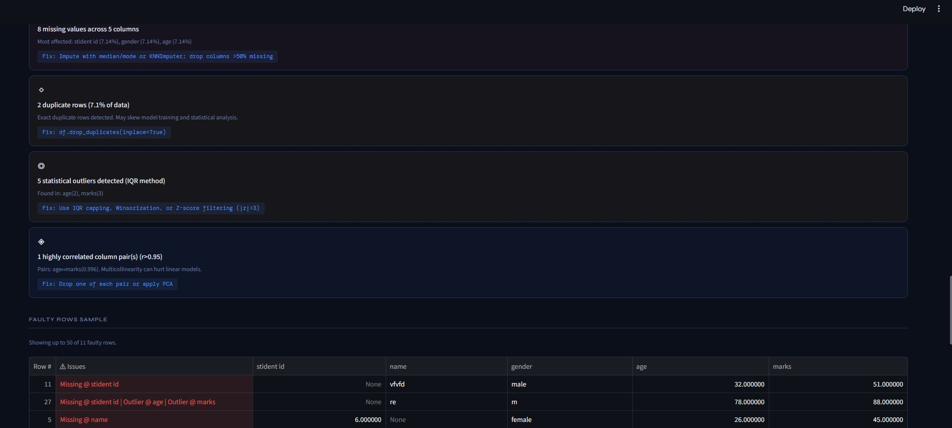
05 | Working of the Model (1 / 2)
Data Quality Maintenance Tool
File Upload & Data Summary
Overall Quality Score Dashboard
Step 0 — Upload: Supports CSV/TSV/XLSX/JSON up to 200MB. Data is instantly parsed, profiled (28 rows × 5 cols), and cached for the session.
Quality Score: A gauge (0–100%) grades the dataset A–F using missing %, duplicate count, outlier density, and type issue flags.
Issue Detection & Faulty Row Samples

Slide 7
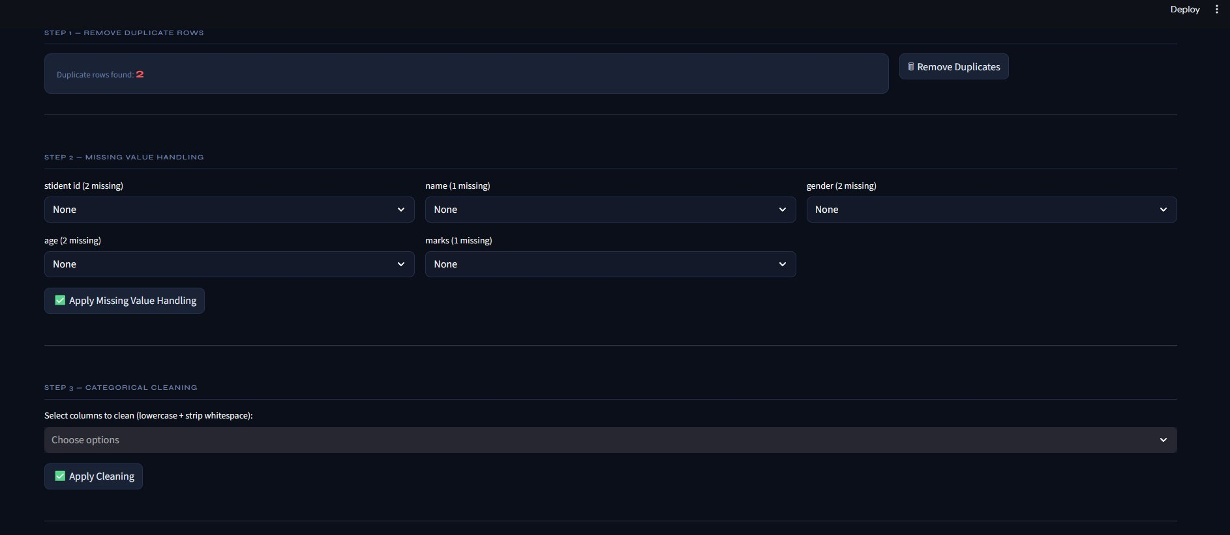
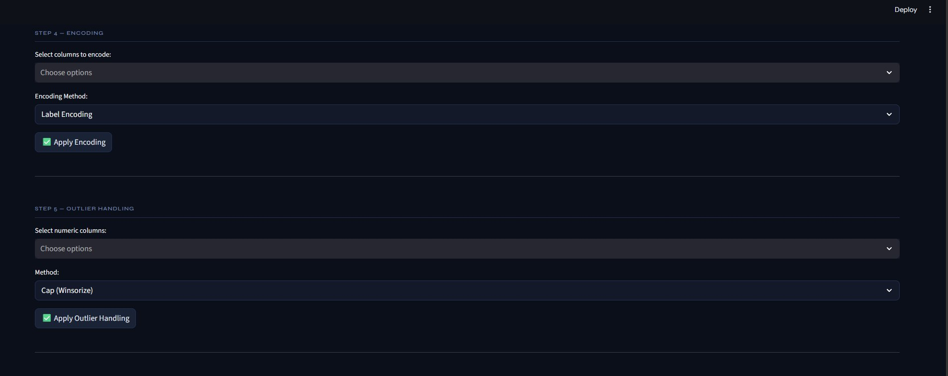
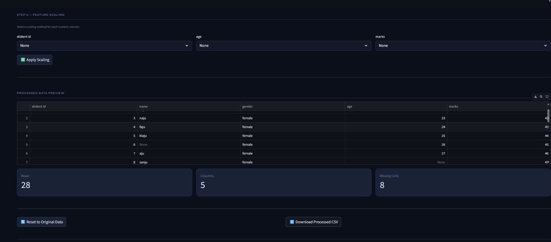
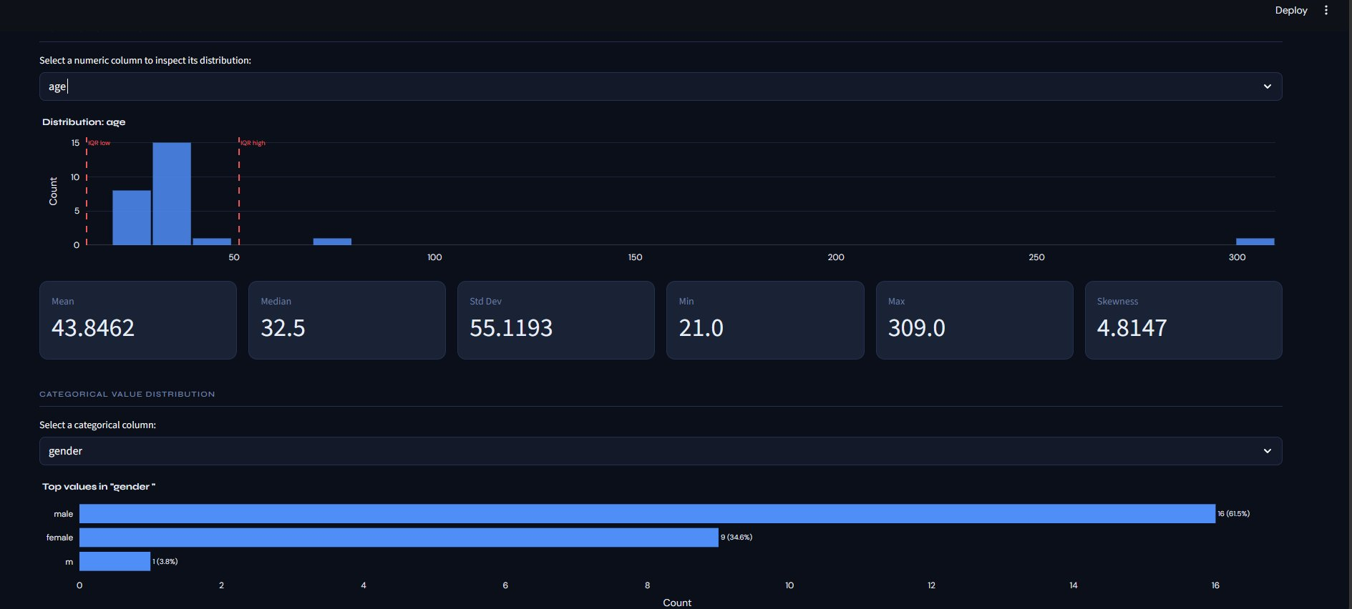
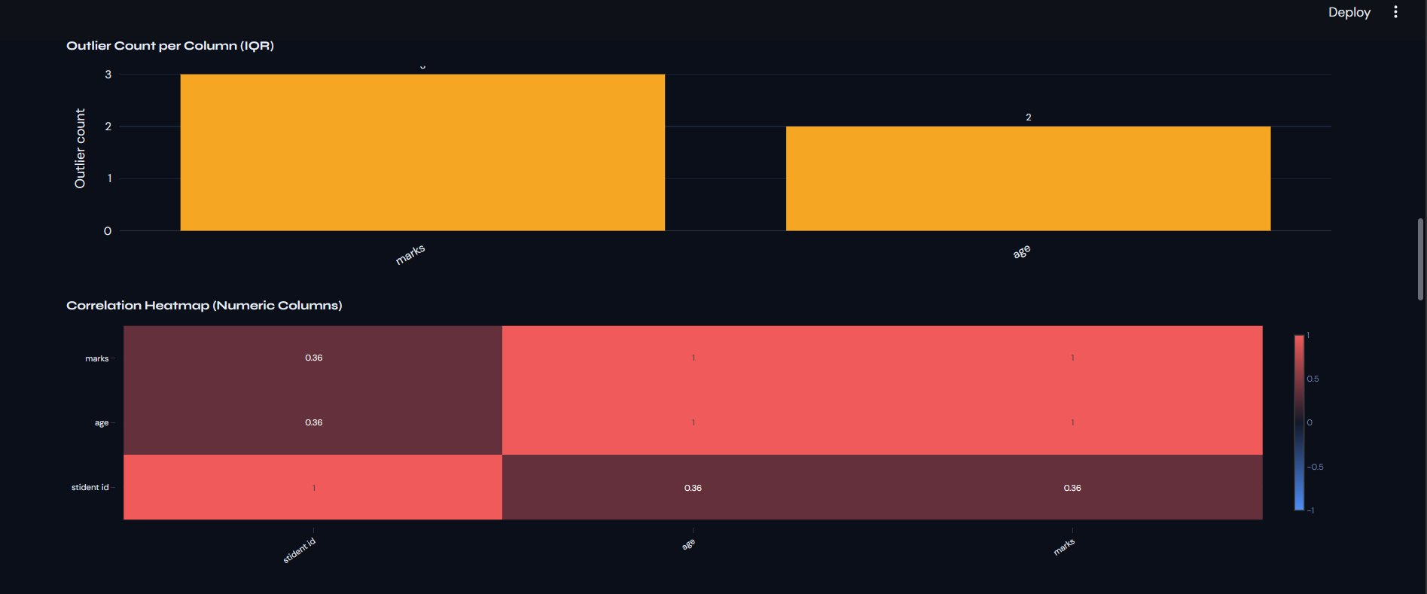
05 | Working of the Model (2 / 2)
Data Quality Maintenance Tool
Steps 1–3: Duplication, Missing Values & Categorical Cleaning
Steps 4–5: Encoding & Outlier Handling
Step 6 + Preview: Feature Scaling & CSV Export
Distribution & Categorical Charts
Outlier Count & Correlation Heatmap

Slide 8
06 | Advantages & Limitations
Data Quality Maintenance Tool
ADVANTAGES
LIMITATIONS
✓ No coding required — fully point-and-click interface
✗ 200MB file size cap — insufficient for large enterprise data
✓ Auto-detects column data types and suggests fixes
✗ No persistent storage — session data lost on refresh
✓ Quantified Quality Score: objective Grade A–F rating
✗ Fixed pipeline; custom user-defined steps not supported
✓ Supports CSV, TSV, Excel, and JSON file formats
✗ Lacks advanced imputation (MICE, deep learning-based)
✓ Interactive visual analytics: histograms, bar charts, heatmaps
✗ No time-series operations (lag, resampling, seasonality)
✓ All steps are reversible via 'Reset to Original Data'
✗ Export limited to CSV — no DB or cloud integration
✓ Reproducible 6-step cleaning workflow every time
✗ Single-user session; no multi-user collaboration

Slide 9
07 | Future Work
Data Quality Maintenance Tool
1
AI-Powered Auto-Cleaning
2
Cloud Storage Integration
Integrate an LLM that suggests optimal preprocessing strategies based on dataset context and ML task type.
Support direct read/write from Google Drive, AWS S3, Azure Blob, and BigQuery for enterprise workflows.
3
Pipeline Script Export
4
Time-Series Support
Generate a reproducible Python script of all applied steps, enabling automation and CI/CD integration.
Add lag features, rolling statistics, seasonality detection, and gap-filling for temporal datasets.
5
Multi-User Collaboration
6
Advanced Imputation Methods
Implement user accounts, shareable pipelines, and team-based annotation of data quality issues.
Incorporate MICE, KNN with domain tuning, and neural network-based imputation for improved accuracy.

Slide 10
08 | Conclusion
Data Quality Maintenance Tool
The Data Quality Maintenance Tool successfully demonstrates how a structured, no-code preprocessing pipeline can significantly reduce the time and expertise required to prepare real-world datasets for machine learning. By combining automated quality auditing with a guided 6-step transformation workflow, the tool empowers users at all skill levels to achieve clean, analysis-ready data.
Complete Pipeline: Achieved an end-to-end preprocessing pipeline covering all major data quality dimensions.
Quantified Quality: Scored dataset quality with an objective A–F grading system for transparent, reproducible reporting.
Visual Analytics: Interactive charts make data quality issues immediately visible and actionable for all users.
Real-World Validated: Tested on massy.csv (28 rows, 5 cols) — detected 8 missing values, 2 duplicates, and 5 outliers.
Thank You

