Slide 1
What distinguishes Indian streaming originals that launch to strong public attention?
998 originals across eleven services, 2018-2026; launch attention measured for 502 scripted titles. Attention is English-Wikipedia pageviews in the 28 days from release: public interest, not viewing.
Indian OTT Content Intelligence Observatory | Launch attention = Wikipedia pageviews, days 0-27: a proxy, not viewership | 1

Slide 2
A title billed first as drama starts at a disadvantage; sequels buy nothing
Versus drama, other things equal: action 2.36x (CI 1.47-3.80), horror 2.15x (CI 1.33-3.48), crime 2.04x (CI 1.22-3.42).
Lead-cast prominence: 1.35x (CI 1.10-1.64) per tenfold increase in prior-year pageviews.
Sequels, spin-offs and remakes: 0.76x (CI 0.38-1.54), no detectable association.
Tamil versus Hindi: 0.93x (CI 0.63-1.38), not distinguishable.
Hindi drama is over-supplied: 0.30x the Hindi median (CI 0.16-0.69), 21% of supply.
Indian OTT Content Intelligence Observatory | Launch attention = Wikipedia pageviews, days 0-27: a proxy, not viewership | 2

Slide 3
The proxy measures who went looking, not how long they watched
Validation check | n | Spearman rho | p
launch views vs IMDb vote count (all platforms) | 466 | 0.71 | 0.000
launch views vs IMDb average rating (attention is not quality) | 466 | 0.08 | 0.104
launch views vs weeks in Netflix India Top 10 (Netflix titles released from Ju | 54 | 0.12 | 0.376
median launch views: charted 370322 vs not charted 202645 (Mann-Whitney) | 54 |  | 0.073
Strong agreement with IMDb vote counts, none with IMDb rating, and none with weeks in Netflix's India Top 10. IMDb and Netflix data were used locally and are not redistributed.
Indian OTT Content Intelligence Observatory | Launch attention = Wikipedia pageviews, days 0-27: a proxy, not viewership | 3

Slide 4
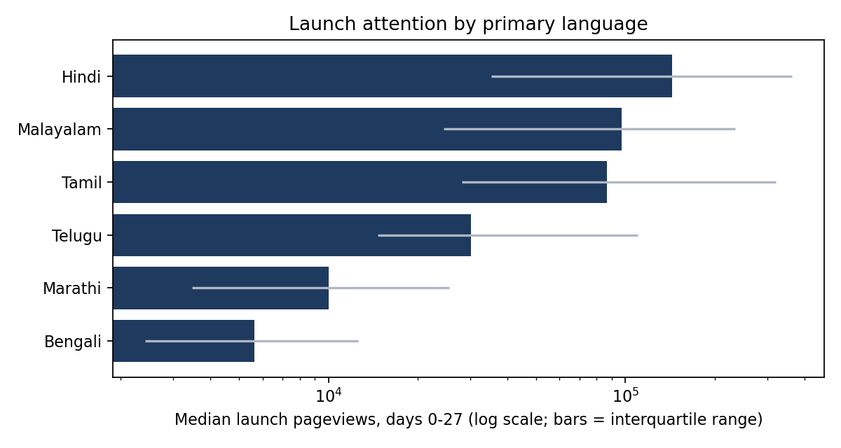
Attention differs sharply by language, and the proxy is part of the reason
Median launch attention: Hindi 143,885, Malayalam 97,356, Tamil 86,423, Telugu 30,237.
English Wikipedia under-counts regional-language audiences.
Comparisons below are made within language.
Indian OTT Content Intelligence Observatory | Launch attention = Wikipedia pageviews, days 0-27: a proxy, not viewership | 4

Slide 5
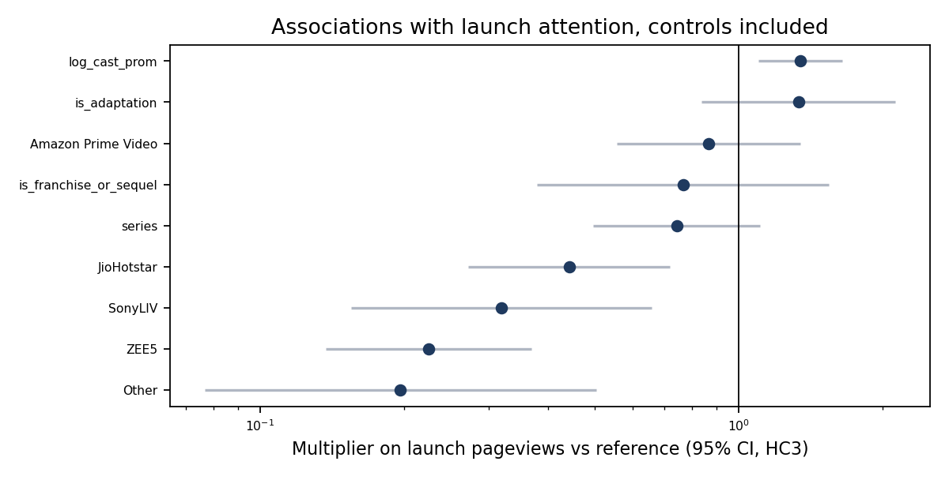
After controls: action, horror, crime and cast prominence stand out
Model explains 37% of the variance in log launch attention (n = 502).
Platform gaps reflect audience mix and Wikipedia coverage, not commissioning quality.
Associations, not causal effects.
Indian OTT Content Intelligence Observatory | Launch attention = Wikipedia pageviews, days 0-27: a proxy, not viewership | 5

Slide 6
A strong launch is predictable before release, mostly from platform and genre
Check (test set: 2024-2026 releases) | ROC AUC
Greenlight logistic model, all pre-release features | 0.84 (CI 0.77-0.91)
Platform base rates only | 0.75
Same model without platform | 0.81
Within Netflix titles only (n = 30) | 0.63
Strong launch = top quartile of 2018-2023 launches (315,557 pageviews). 156 test titles, 16% strong. Top-scored fifth of titles: 42% were strong launches. Use as a screen, not a viewing forecast.
Indian OTT Content Intelligence Observatory | Launch attention = Wikipedia pageviews, days 0-27: a proxy, not viewership | 6

Slide 7
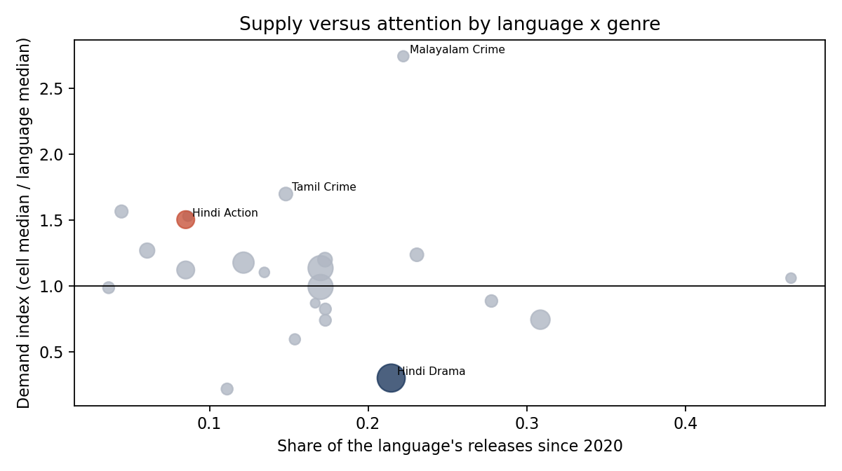
Hindi drama is over-supplied; Hindi action is thinly supplied
Hindi drama: 0.30x the Hindi median (CI 0.16-0.69), 21% of supply.
Hindi action: 1.51x the Hindi median (CI 1.05-3.79), 9% of supply.
23 cells compared: only the Hindi drama result survives a multiple-comparison correction.
Indian OTT Content Intelligence Observatory | Launch attention = Wikipedia pageviews, days 0-27: a proxy, not viewership | 7

Slide 8
Three opportunity briefs, graded by evidence
Strong: reallocate Hindi drama slots to projects with a sharper genre frame, known cast or event hook.
Moderate: Hindi action, thinly supplied with above-median launch attention on two cuts of the data.
Suggestive: Tamil features for national platforms; no detectable gap to Hindi, but wide intervals.
Details and risks: reports/content_opportunity_briefs.md
Indian OTT Content Intelligence Observatory | Launch attention = Wikipedia pageviews, days 0-27: a proxy, not viewership | 8

Slide 9
What this cannot tell you
Viewing, completion or subscriber impact: no platform publishes comparable figures.
Anything about the 418 scripted titles whose Wikipedia page did not exist at release.
Whether the fall in launch attention since 2023 is demand or declining Wikipedia use.
Causes. Every result here is an association.
Indian OTT Content Intelligence Observatory | Launch attention = Wikipedia pageviews, days 0-27: a proxy, not viewership | 9

