Slide 1









Multi Language
Invoice Extractor
Notes:
https://unsplash.com/photos/AXu2aZ3YgP8

Slide 2


Slide 3

INTRODUCTION
In today’s global business landscape, dealing with invoices in multiple languages can be a daunting task.
Manual extraction of data from diverse invoices often leads to inefficiencies and errors.

Slide 4

CHALLENGES

Slide 5

Two major type of challenges are:-
1. Language
Receiving invoices in different languages.
Misinterpretation of important information or instructions.
Increase in risk of errors, misunderstandings, and disputes.
2. Currency
invoices in different currencies.
May cause calculation errors if not detected.
Conversion from one currency to another is a solution.
There is a need for accuracy, speed, and language versatility in invoice extraction.

Slide 6

SOLUTION

Slide 7
LARGE LANGUAGE MODELS
(LLM)
A large language model (LLM) is a deep learning algorithm that can perform a variety of natural language processing (NLP) tasks
They are trained using massive datasets that enables them to recognize, translate, predict, or generate text or other content.
It uses semantic matching rather than keyword matching.

Slide 8
Key components of
large language models
Large language models are composed of multiple neural network layers
These layers work to process the input text and generate output content.
The Embedding Layer
Captures the semantic and syntactic meaning of the input
The Feedforward Layer
Multiple fully connected layers that transform the input
These layers enable the model to glean higher-level abstractions
The Recurrent Layer
Interprets the words in the input text in sequence.
It captures the relationship between words in a sentence.
The Attention Mechanism
Enables a language model to focus on single parts of the input text that is relevant to the task at hand.
This layer allows the model to generate the most accurate outputs.

Slide 9

KEY FEATURES

Slide 10

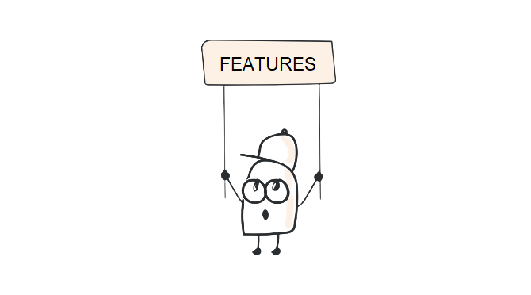
Multilanguage Support
Streamlit Interface
Google-GenerativeAI Integration
Python-Dotenv for Configuration Management

Slide 11

TECHNOLOGY STACK

Slide 12

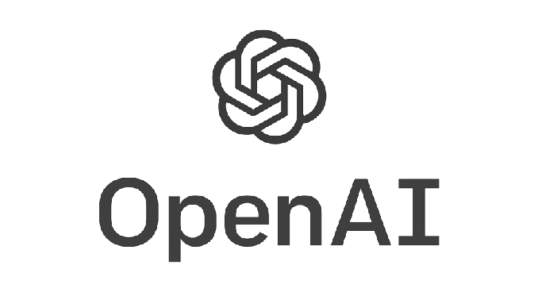
Open AI & Generative AI
With Google API key
OpenAI is an artificial intelligence research company that produces services such as ChatGPT.
Generative AI is a type of AI technology that can produce text, images, audio, and more, when prompted by a human–usually using natural language.
In this project generative AI is used to read the input in the given invoice and give appropriate output read by the generative AI functionalities using LLM.
Google API key is a unique key that is used to fetch 60 queries/min.
This API key is used to apply the generative AI functionality to the invoice image.

Slide 13

GITHUB
GitHub is a web-based platform that provides version control and collaborative features for software development projects.
It is a widely used platform where developers can host and review code, manage projects, and collaborate with others.
The filed pushed into the GitHub repository are used to view and share to the development community
These files uploaded are also used by the streamlit community cloud for hosting small applications on web like the one I have created.

Slide 14


streamlit
& streamlit Community cloud
Streamlit is an open-source Python library that is used for creating web applications for data science and machine learning projects.
It simplifies the process of turning data scripts into interactive web applications, allowing developers to create dashboards with minimal effort.
streamlit Community cloud helps to Deploy, manage, and share apps with the world directly from Streamlet — all for free.

Slide 15
Important Libraries used
dotenv
dotenv is a zero-dependency module that loads environment variables from a .env file
os
The OS module provides functions for creating and removing a directory, fetching its contents, changing and identifying the current directory, etc.
PIL (pillow)
It supports the variability of images such as jpeg, png, bmp, gif, ppm, and tiff.
google.generativeai
Generate text from text-and-images input (for Gemini only)
Streamlit
Open-source Python library that is used for creating web applications

Slide 16

USE CASE SCENARIOS

Slide 17
Global Enterprise with Multilingual Invoices
Government Agency Handling Multilingual Invoices
International E-commerce Platform
Cross-Border Logistics and Shipping
Legal Firm Handling International Clients
International Consulting Services
Healthcare Provider Dealing with Multilingual Invoices

Slide 18

BENEFITS

Slide 19
Global Accessibility
Enhanced Accuracy and Data Extraction
Efficient Invoice Processing
Versatility Across Industries
Cost Savings
User-Friendly Interface
Continuous Improvement and Adaptation
Reduced Error Rates

Slide 20

CONCLUSION

Slide 21
CONCLUSION
The Multilanguage Invoice Extractor represents a significant leap forward in the automation of invoice processing.
Its ability to handle invoices in multiple languages, coupled with the user-friendly interface and advanced language processing capabilities, makes it a valuable asset for businesses aiming to streamline their operations.

Slide 22

CREATED BY: NIPUN SHRIVATS
SECTION: E
ROLL NO: 2201260
ENROLMENT NO: PV-22010260

