Slide 1


SMART INDIA HACKATHON 2025
MAITRI
Problem Statement ID – SIH25175
Problem Statement Title – MAITRI : An AI Assistant for‎ ‎ ‎
Psychological & Physical Well-Being of Astronauts
Theme – Space Technology
PS Category – Software
Team ID – 638
Team Name – Space Hack

Slide 2
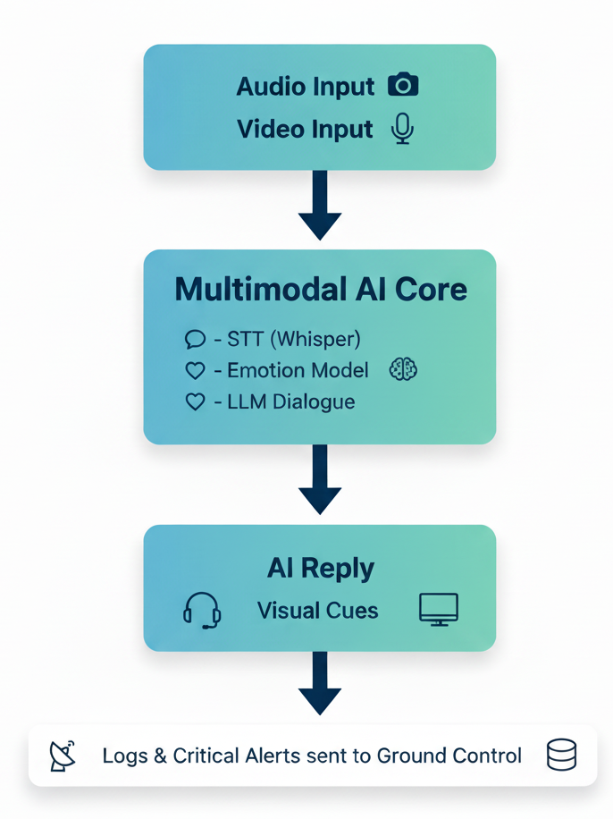
MAITRI : AI for Astronauts
Space Hack
MAITRI : AI Assistant for for Psychological & Physical‎ Well-Being of Astronauts
Problem Statement: Astronauts suffer mentally & physically, compromising health and mission productivity
Need: Multimodal AI Assistant to detect well-being from audio-video inputs.
MAITRI: AI Assistant for for Psychological & Physical‎ Well-Being of Astronauts
A multimodal AI assistant that can detect emotions (voice + facial cues), provide short adaptive conversations, and report critical issues to ground control.
Issues faced & concerns: Members on-board space station face isolation, sleep disruption, tight schedules and physical discomforts which can trigger psychological & physical issues.
Importance early support: Detecting subtle emotional and physical changes allows for early intervention, preventing minor issues from escalating into major concerns
Multimodal AI assistant for real-time emotion & well-being monitoring.
Detects emotions via voice tone & facial expressions.
Provides adaptive, supportive dialogue.
Offline-capable: runs on-board space station systems.
evidence backed, short adaptive conversations and alert ground team
Emotion Detection
Conversational Support
Physical Well-being
Monitoring Critical Alerts
Operates offline for on-board deployment

Slide 3
TECHNICAL APPROACH
Space Hack
Tech Stack
Frontend
Next.js / React → UI with live video + voice
WebRTC/WebSockets → live interaction stress/emotion indicators
Visualization Layer
Backend (On-board system)
Speech-to-Text → Whisper (offline models)
Emotion Detection → Voice: tone analysis (pitch, jitter, MFCC features) Face: DEEPFACE for expression recognition
Engine → small fine-tuned LLM (offline deployable, e.g., LLaMA / Phi-3-mini)
Text-to-Speech → lightweight TTS models (Coqui TTS / Edge-TTS

Slide 4
FEASIBILITY AND VIABILITY
Space Hack
• Multimodal emotion detection is a well-researched area
• Lightweight open-source STT/TTS models exist
• Runs offline without cloud dependency
• Suitable for long-duration space missions
• Scalable to other isolated environments (submarines, polar bases)

Slide 5
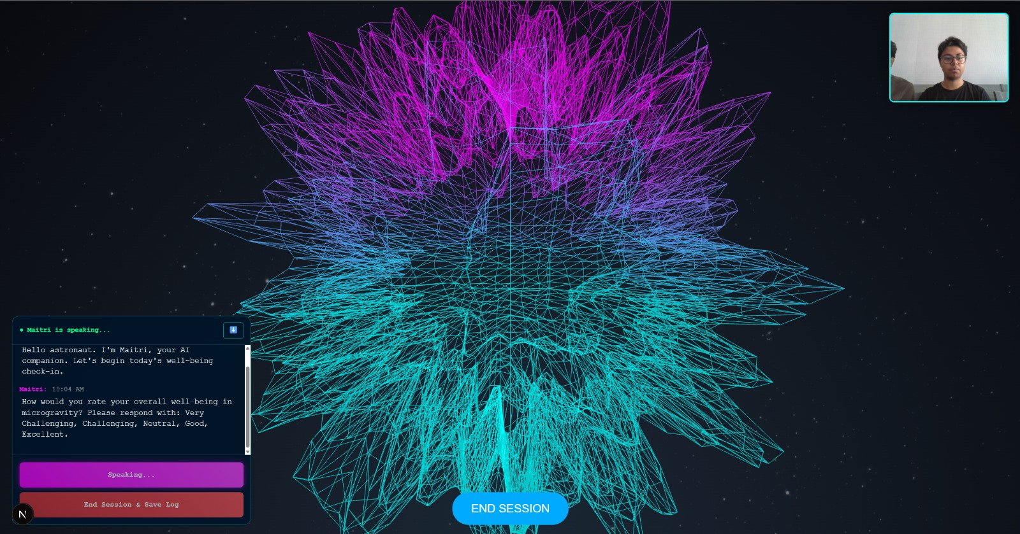
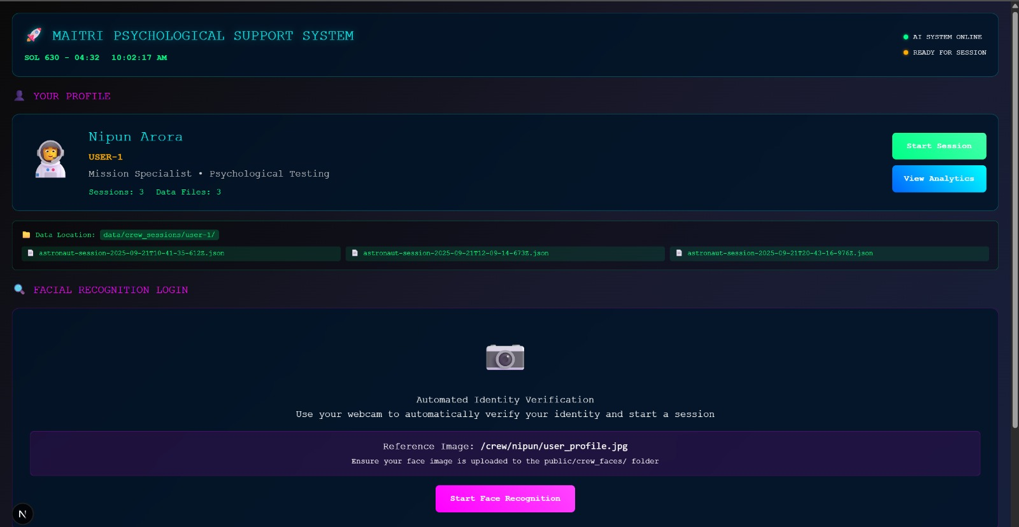
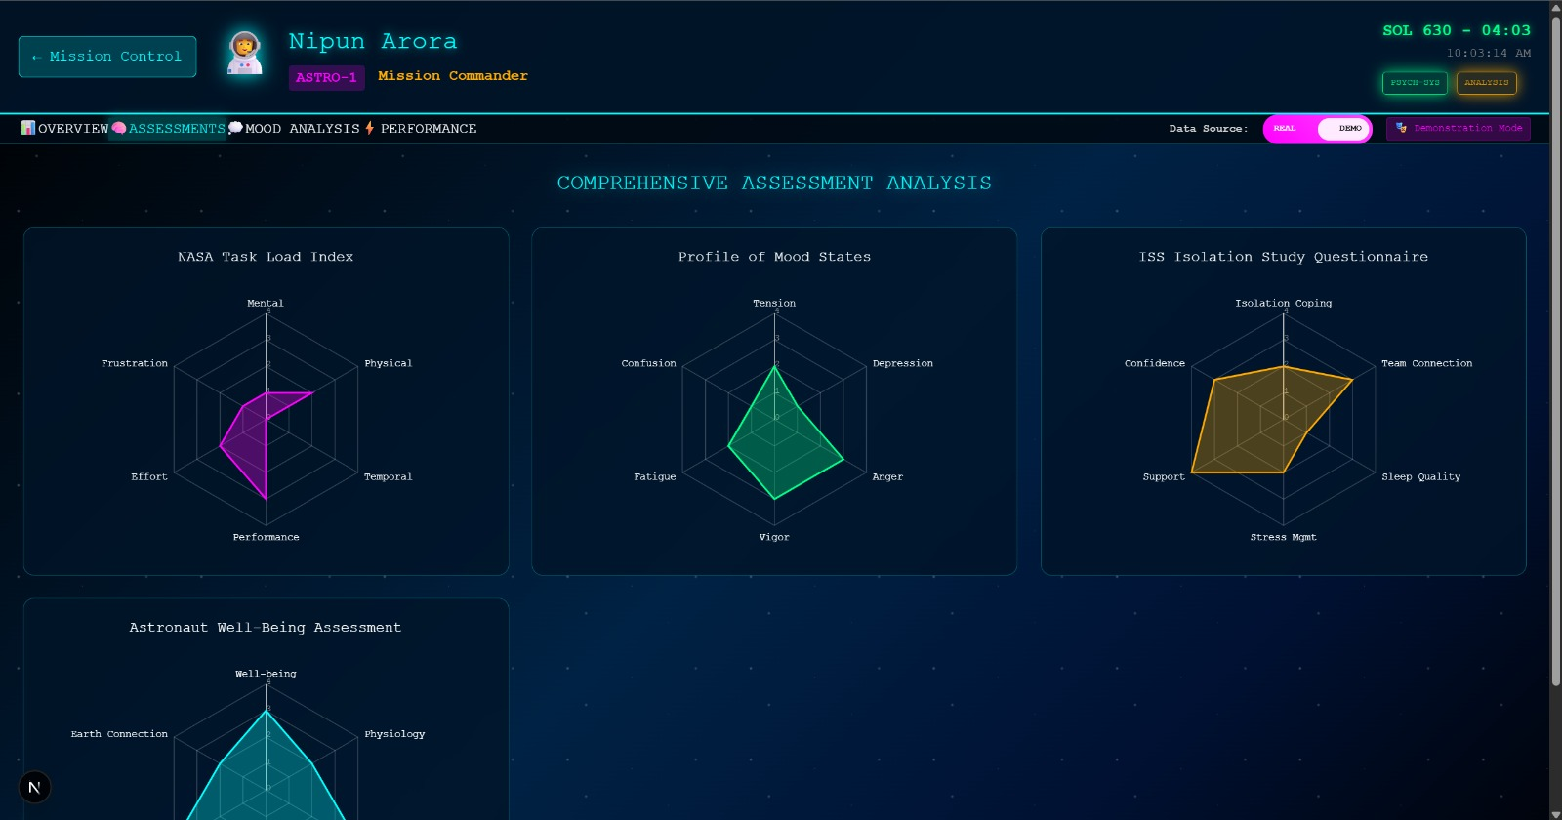
IMPACT AND BENEFITS
Space Hack
🔹 Psychological Benefits
Provides continuous emotional support during isolation. Reduces stress, anxiety, and sleep-related issues.
Acts as a non-judgmental companion for astronauts to express concerns.
Encourages mental resilience through adaptive conversations.
🔹 Operational Benefits
Detects early signs of mental fatigue or burnout, reducing mission errors. Helps maintain crew morale and focus during long-duration missions. Enables real-time reporting of psychological red flags to mission control. Reduces dependency on Earth-based counseling when communication delays exist.
🔹 Technological Benefits Runs completely offline, ensuring reliability in low-connectivity environments. Multimodal design (speech + vision) makes detection more accurate. Modular architecture → scalable to other domains (submarines, defense, healthcare).Integrates AI-driven counseling with evidence-based psychological practices.
🔹 Societal & Wider Benefits Technology spin-offs can help mental health monitoring on Earth (students, elderly, isolated workers).Potential use in extreme environments: Antarctica, submarines, deep-sea exploration. Supports India’s vision for indigenous space tech under Bhartiya Antariksh Station (BAS).Contributes to astronaut safety, mission success, and long-term habitability in space.

Slide 6
RESEARCH AND REFERENCES
Space Hack
Automated Psychotherapy in a Spaceflight Environment: Advantages, Drawbacks, and Unknowns pmc.ncbi.nlm.nih.gov
https://ieeexplore.ieee.org/document/10397747/
https://ntrs.nasa.gov/api/citations/20000021488/downloads/20000021488.pdf
https://www.dlr.de/en/latest/news/2025/alone-in-space-study-investigates-the-effects-of-isolation
https://www.nasa.gov/missions/station/iss-research/mental-well-being-in-space/

