Slide 1

SLIIT
AI-DRIVEN TEA QUALITY GRADING
Automated Freshness Assessment Using Computer Vision
Abeysekara A.M.N • Ms. Wishalya Tissera • Data Science
January 2025
Problem
Objectives
Method
Results
PROJECT ID • 25-26J-133
1
Notes:
[Sources] - AI-generated background (no external source). [/Sources]

Slide 2
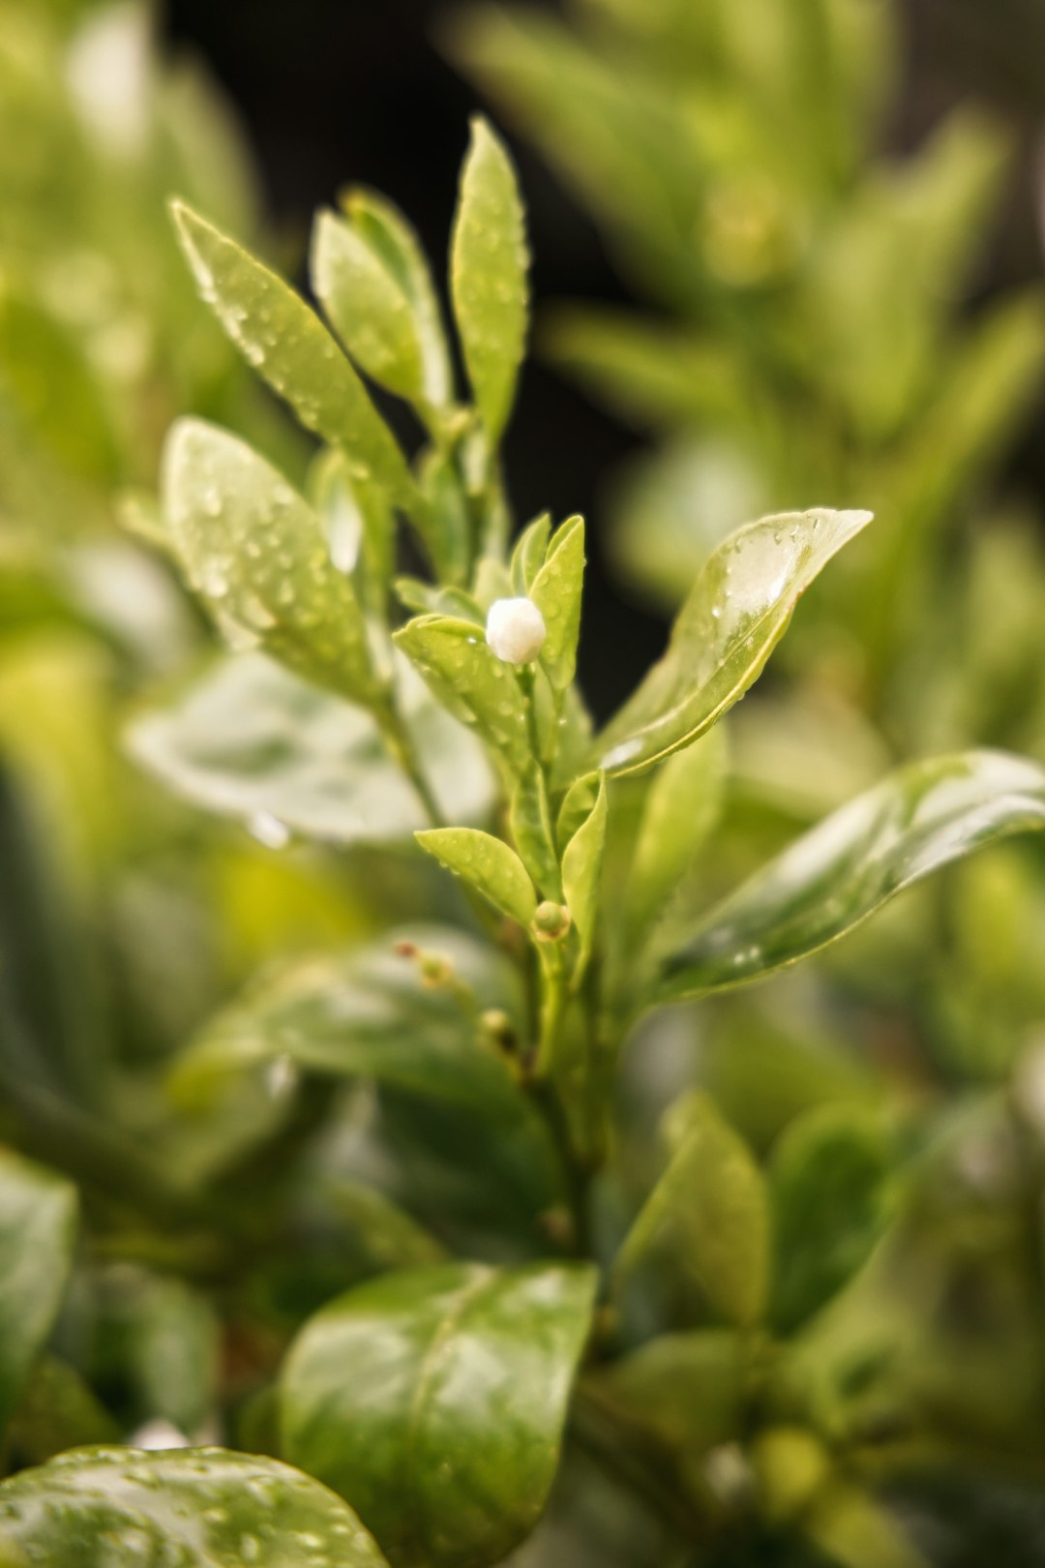
PROJECT OVERVIEW
AI-Driven Tea Quality Assessment for Mid-Country Sri Lanka
One‑line pitch: what you build + why it matters.
Domain
Users
Tea • Agriculture • Computer Vision
Farmers • Collectors • Factories
MEET OUR TEAM
Outcome
Stack
Abeysekara A.M.N • IT21212604
Fair plucker payment + Quality control
CNN / R‑CNN / YOLO + Web
PROJECT ID • 25-26J-XXX
2
Notes:
[Sources] - https://images.unsplash.com/photo-1582016448076-551e264dd1e3 (tea leaf photo, Unsplash). [/Sources]

Slide 3

OVERVIEW
SYSTEM OVERVIEW
Two-tier architecture: Mobile capture in field → Cloud AI inference → Weighted quality score
1
INPUT
2
AI ENGINE
3
OUTPUT
TeaVision App
(Field capture + validation)
YOLO + AdaBoost
(P+1/P+2/P+3 + damage)
Weighted Score
+ Grade + Payment
PROJECT ID • 25-26J-XXX
3
Notes:
[Sources] - AI-generated background (no external source). [/Sources]

Slide 4
RESEARCH PROBLEM
Write 2–3 crisp “why this matters” bullets (no fluff).
Manual grading is subjective → Plucker payment disputes and inconsistent quality
No field-level quality feedback → Pluckers unaware of quality until factory rejection
Existing ML systems focus on disease detection, NOT production quality grading (P+1/P+2/P+3)
PROJECT ID • 25-26J-XXX
4
Notes:
[Sources] - https://images.unsplash.com/photo-1582016448076-551e264dd1e3 (tea leaf photo, Unsplash). [/Sources]

Slide 5
OBJECTIVES
RESEARCH OBJECTIVES
Main Objective
Specific Objectives
Build an AI system that scores freshness and flags impurities from a bulk tea‑leaf photo.
Collect + annotate dataset with multi-label schema (P+1, P+2, P+3, damage_spot)
Train classical ML model (AdaBoost) for rapid quality screening
Train detector (R‑CNN/YOLO) for bulk images
Compute TRI-weighted quality score with damage penalties
PROJECT ID • 25-26J-XXX
5
Notes:
[Sources] - AI-generated background (no external source). [/Sources]

Slide 6
SYSTEM ARCHITECTURE
Hybrid Classical ML + Deep Learning Pipeline
INPUT
TeaVision Mobile
(Blur/exposure validation)
AI PIPELINE
Feature Extraction → ML
(R‑CNN/YOLO + CNN)
OUTPUT
Quality Score
+ Grade + Export
Model 1: AdaBoost (96.4% acc) - Rapid Screening
Model 2: YOLO - Object Detection (P+1/P+2/P+3/damage)
Scoring: Weighted formula (P+1=10, P+2=8, damage=-penalty)
UI: Flask Web App + TeaVision Kotlin App
PROJECT ID • 25-26J-XXX
6
Notes:
[Sources] - No external sources. [/Sources]

Slide 7
TECHNIQUES & TECHNOLOGIES
Techniques
Technologies
Multi-label annotation (overlapping polygons + damage bbox)
Feature extraction: Color (RGB/HSV/LAB), Texture (GLCM/LBP), Shape
Session-based train/test split to prevent data leakage
Classical ML: AdaBoost, Random Forest, SVM, KNN comparison
Object detection (Mask R‑CNN / YOLO)
Metrics: Macro F1, confusion matrix, per-class accuracy
Python • PyTorch/TensorFlow
OpenCV • Labeling tool
Flask/FastAPI • React
TFLite (mobile deployment)
PROJECT ID • 25-26J-XXX
7
Notes:
[Sources] - https://images.unsplash.com/photo-1582016448076-551e264dd1e3 (tea leaf photo, Unsplash). [/Sources]

Slide 8
EVALUATION RESULTS
Classical ML Pipeline Performance (275 images, 25 features)
Key Takeaways
Best: AdaBoost 96.4%
RF/GB also strong (94.5%)
YOLO training in progress
Need manual labels for validation
PROJECT ID • 25-26J-XXX
8
Notes:
[Sources] - Chart is template data (no external source). [/Sources]

Slide 9
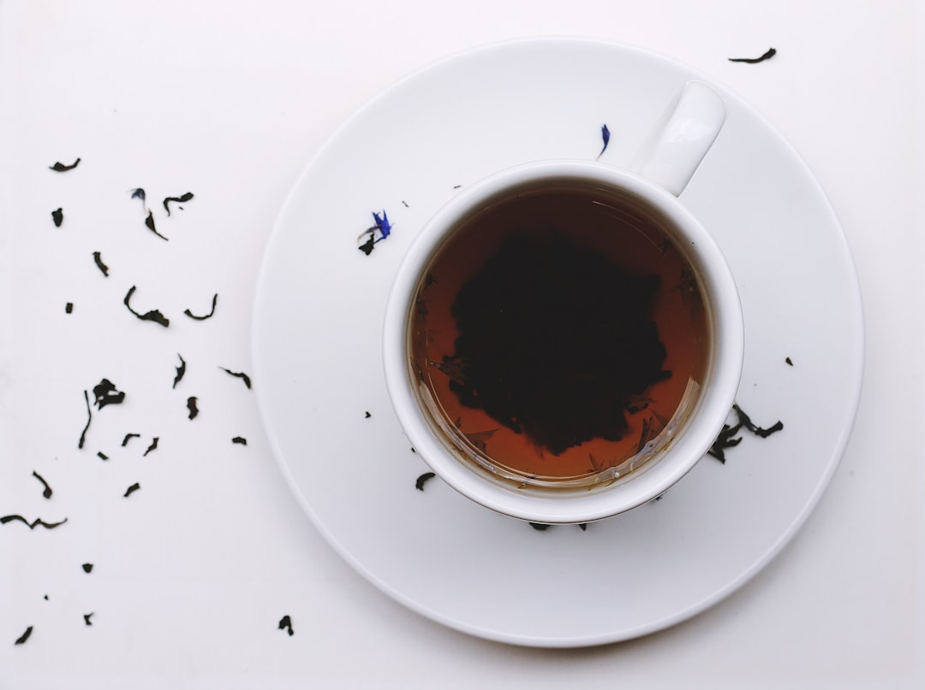
BUDGET & RESOURCES
Estimated monthly operational costs
Item
Monthly Cost
Justification
GPU/Colab Pro
LKR 4,000
Model training + inference
Cloud Storage
LKR 1,500
Dataset + model weights
Web Hosting
LKR 2,500
Flask API + Dashboard
Field Data Collection
LKR 4,000
Tea estate visits + validation
— keep it tasteful
Miscellaneous
LKR 2,000
Documentation + tools
PROJECT ID • 25-26J-XXX
9
Notes:
[Sources] - https://images.unsplash.com/photo-1498604636225-6b87a314baa0 (tea cup photo, Unsplash). [/Sources]

Slide 10
THANK YOU
Q & A
Contact: it21212604@my.sliit.lk
PROJECT ID • 25-26J-XXX
10
Notes:
[Sources] - AI-generated background (no external source). [/Sources]

