Slide 1

Smart Attendance Marking System

Slide 2

Group Members
E/15/233 – Muthucumarana P.N.N.
E/15/246 – Opanayake R.L.
E/15/385 – Weerasinghe S.P.A.P.E.

Slide 3

Introduction
Why ?
Manual attendance marking
Difficult to update
Time consuming
Solution
SAMS

Slide 4

How effective SAMS is..
Paperless automation solution
No calculations
Highly secured
Time saving
Avoid illegal activities
Automatically report generating
Managing Records for a period of time
Student can aware of their attendance progress easily
Teachers can check their schedules
SAMS

Slide 5

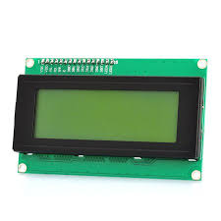





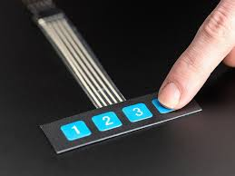


Block Diagram
------------------>
→
Fingerprint
Template
String
→
------->
→
Convert
→
Memory
module
→
→
Up
Enroll
Down
Select
Delete

Slide 6
Flow Chart
Teacher’s fingerprint
Student’s
fingerprint
Teacher identification
Students
identification
Admin
mode
Student
Attendance
Marking
Select
class
Attendance
Report generating

Slide 7

Web Technologies
PHP with MySQL
Why?
Relational
Data security
Compatible with micro controllers used

Slide 8


Power Requirements
Rechargeable battery
Security Requirements
Encrypted data in arduino
password encryption
(md 5)
Password access to sensitive
data

Slide 9
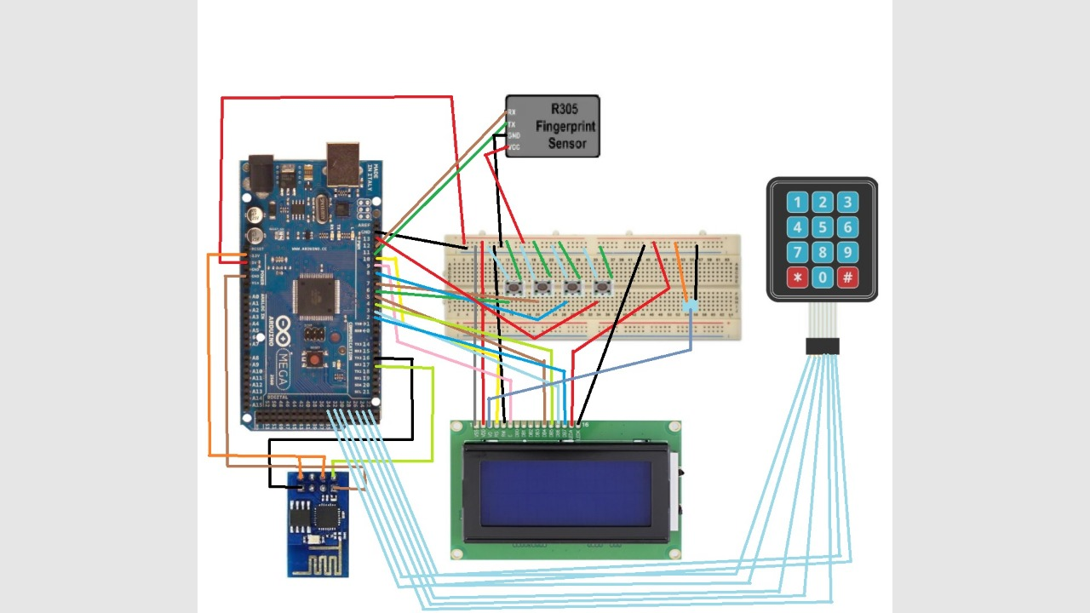
Circuit Diagram

Slide 10
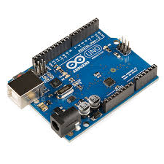
Technologies
Controller Platforms
Arduino
Open-source electronics prototyping platform
Flexible
Easy-to-use hardware and software

Slide 11

Network Technologies and Protocols
HTTP
Large bandwidth, low delay
Statelessness
Client/server, request/response communication
Connection oriented
TCP 3-way handshake, DNS lookup overheads
Security problems (using SSL/TLS with proxies)

Slide 12
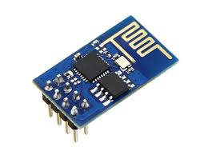
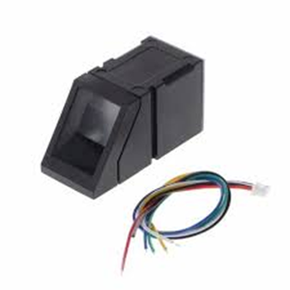
Sensors and Actuators
Esp8266 wifi module
High accuracy
Faster response time
200 fingerprints
ARM cortex M3 IC
R307FingerprintModule

Slide 13
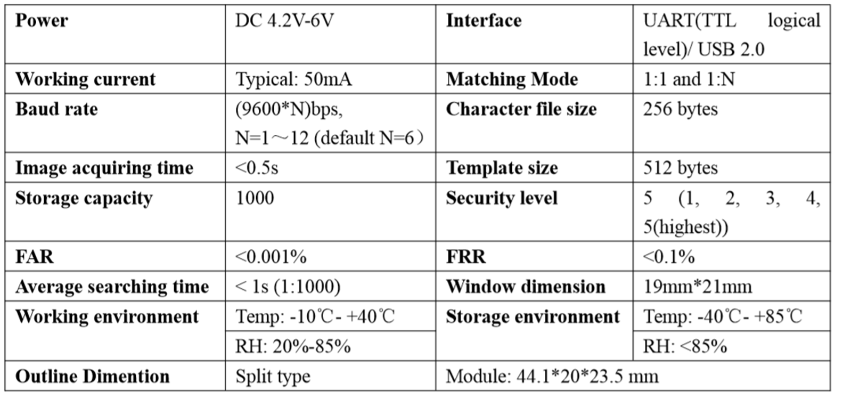
R307FingerprintModule

Slide 14
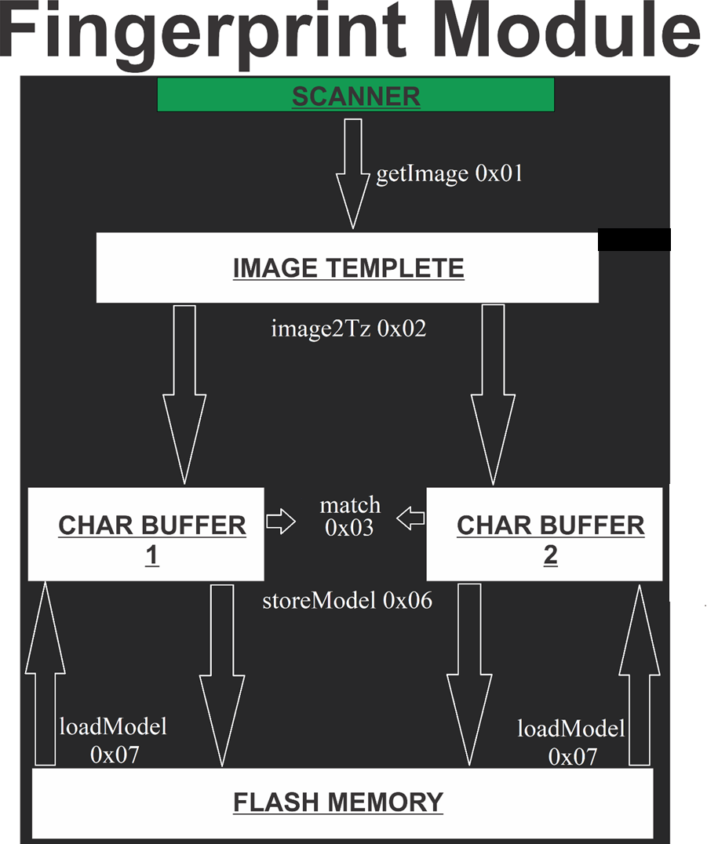

Slide 15
Testing
Load Testing
What to test : PHP Server
Input :HTTP Request Defaults .
The Number of Threads (users)=100
The Ramp-Up period (in seconds). =100
How long to reach the max users?
How many times or for how long to run the test=10
Testing environment : Localhost server
Tool used : apacheJmeter
Expected output :A summary report

Slide 16
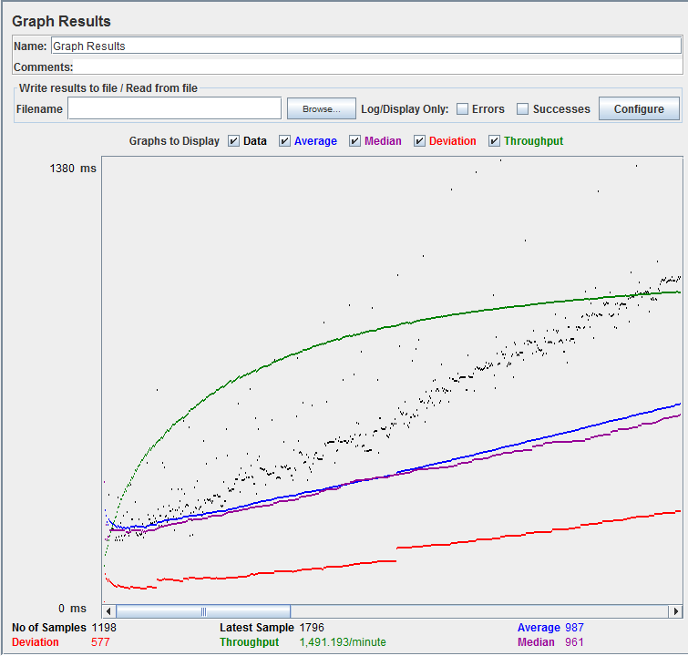
results
Throughput= 150.78 requests/min

Slide 17
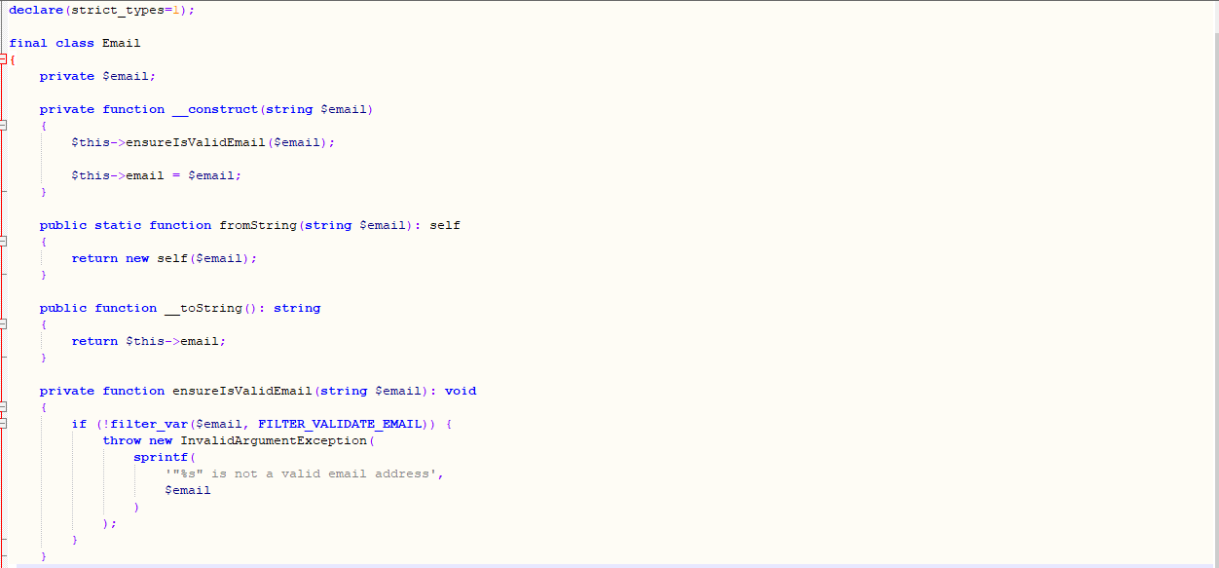
Phpunit testing sample code
Email send to admin (code)

Slide 18
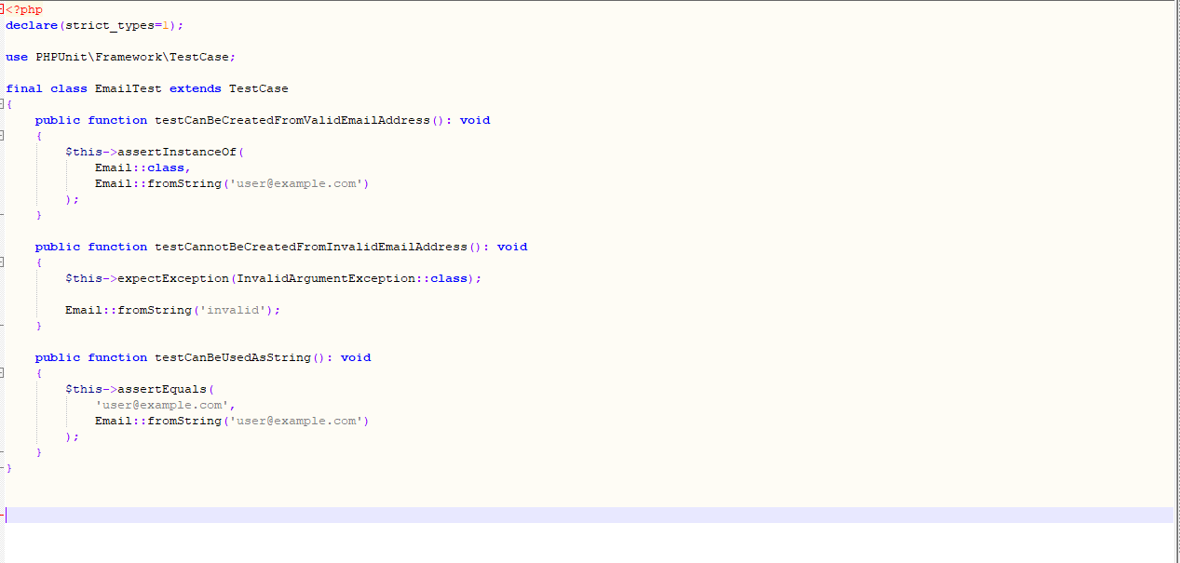
Sample test case

Slide 19
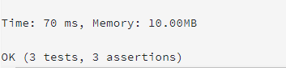
results
Conclusions
Email
✔ Can be created from valid email address
✔ Cannot be created from invalid email address
✔ Can be used as string

Slide 20
Functional Testing
What to test: State machine of the embedded system
What we test: Provide input to each state and check to see if it goes to the next proper state.
Input : Using key pad give the corresponding input.
Ex :–when in select mode state there are there inputs: enroll, search and upload
Expected output : Go to the correct state when gives the input.

Slide 21
Compatibility Testing
Input :
Used two finger prints within time measured as 5ms
Enrolled two users within 5ms.
Testing environment :
Temperature: -20 ℃ - +40 ℃
Relative humidity: 40% RH-85% RH (no condensation. Wifi enriched zone
Expected output : LCD outputs as successfully enrolled two users.
Results : Finger print sensor identified as two users enrolled separately

Slide 22

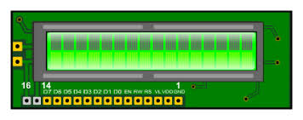
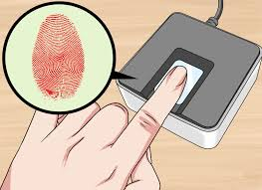

Demonstration
---------------------->
------------------------>

Slide 23


Slide 24


