Slide 1

Word Frequency Analysis Tool

Slide 2

Group Members
E/15/233 – Muthucumarana P.N.N.
E/15/246 – Opanayaka R.L.
E/15/261 – Perera M.S.V.

Slide 3
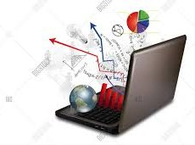
Objective
Find how frequent a particular word or set of words in a document collection
An
automated software
tool
--->

Slide 4
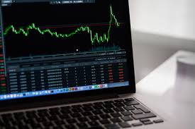
What is WFA
WFA – Word Frequency Analysis
Frequency – Number of word occurrences within a given text
Method to identify different language patterns

Slide 5
Uses of WFA
Get the best return for vocabulary learning effort
For plagiarism detection
Search engines use word frequency to establish the subject of web pages
For movie subtitle making
Establish the “signature” of a certain author or cultural level of writers
Notes:
Someone who uses English as a second language, can use this tool as a help
It can be used to improve vocabulary and to correct misspellings
Plagiarism detection also makes use of frequency analysis. Because comparison of a given text with the whole web contents is a major task
And the detection system dose not know where to look and where to start. Thus analyzing the word frequency can give some clue on the writing style and the authorship of a given text without indexing the whole thing

Slide 6
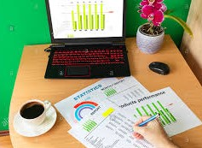
Requirements
Get frequency of the word
Graphical representation of word frequency
Frequency comparison for few different words

Slide 7
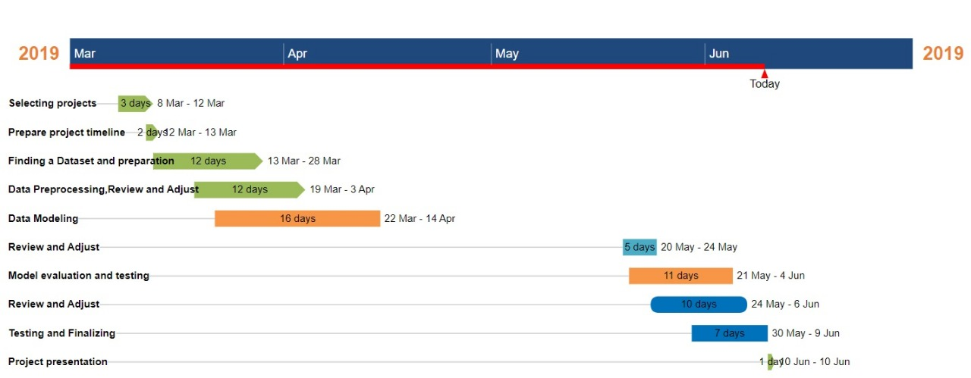
Timeline

Slide 8

Data source
Website – www.kaggle.com
Data extracted from imdb-movie-reviews-dataset.zip

Slide 9
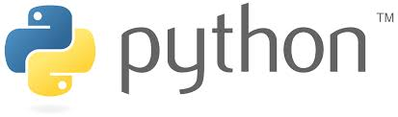

The Technologies Used
Python
Dash Protly

Slide 10
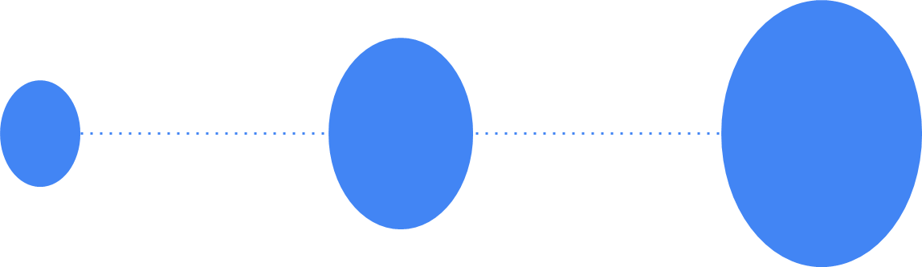
Completed Steps
|
|
|
|
|
|
|
|
|
|
|
|
Step 4
|
|
|
|
|
|
|
|
|
|
Step 3
Comparison of frequencies of few different words
|
|
|
|
|
|
|
|
|
Step 2
Representation of the output using a GUI
|
|
|
|
|
|
|
|
Step 1
Pre-processing of data
Finding a suitable dataset

Slide 11

Difficulties
Finding a dataset with year wise categorization
Unfamiliar with Dash

Slide 12


Slide 13
