Slide 1

MA 725 : 25 - OCT - 2022
Data Driven Reduced-Order Modeling Using Neural Networks
Rammini Nipuni Senani de Silva
Department of Mathematics
Clarkson University, Potsdam
desilvr@clarkson.edu
‹#›
Notes:
This presentation is about :
Data driven reduced order modeling using NN

Slide 2
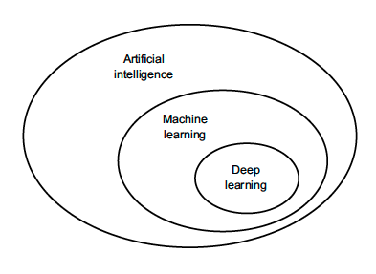
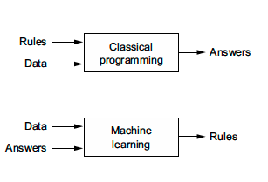
Neural Network: AI->ML -> DL
AI can be described as the effort to automate intellectual tasks normally performed by humans.
Machine Learning finds statistical structure in these examples that eventually allows the system to come up with rules for automating the task.
the central problem in machine learning and deep learning is to meaningfully
transform data: in other words, to learn useful representations of the input data at
hand—representations that get us closer to the expected output.
Learning, in the context of machine
learning, describes an automatic search process for data transformations that produce
useful representations of some data, guided by some feedback signal—representations
that are amenable to simpler rules solving the task at hand.
‹#›

Slide 3
Neural Network: ML vs DL
Machine learning vs Deep Learning
Learning, in the context of machine learning,
describes an automatic search process for data transformations that produce useful representations of some data, guided by some feedback signal—representations that are amenable to simpler rules solving the task at hand.
‘Deep’ in Deep Learning stands for idea of successive layers of representations.
How many layers contribute to a model of the data is called the depth of the model. Other appropriate names for the field could have been layered representations learning or hierarchical representations learning.
‹#›

Slide 4
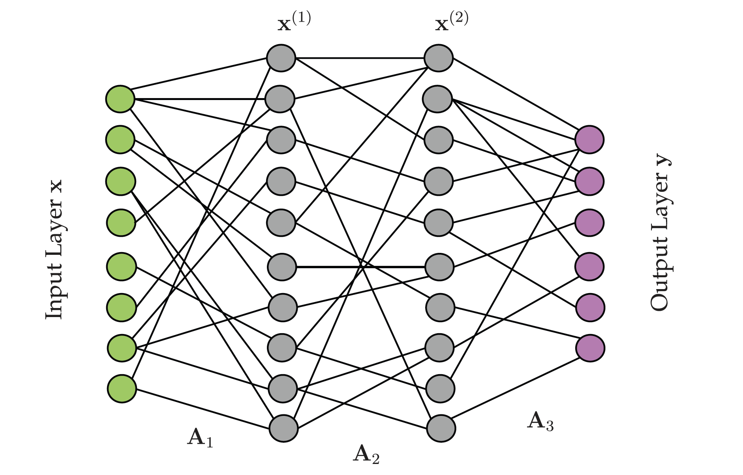
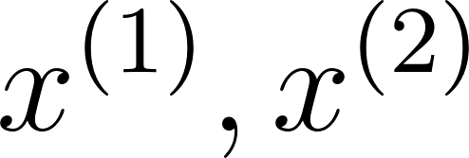
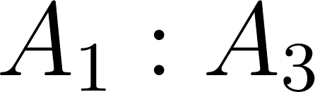
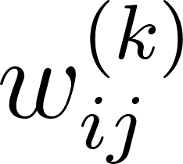
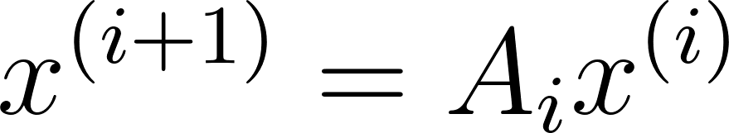
Neural Network : Definition
A neural network is a method in artificial intelligence that teaches computers to process data in a way that is inspired by the human brain.
It is a type of machine learning process, called deep learning, that uses interconnected nodes or neurons in a layered structure that resembles the human brain.
: Layers
: mappings
:
Mapping can be linear or nonlinear
‹#›
Notes:
Since the project is about the NN I will begin with little into about NN
A neural network is a method in artificial intelligence that teaches computers to process data in a way that is inspired by the human brain.
It is a type of machine learning process that uses interconnected nodes or neurons in a layered structure that resembles the human brain.
Basic structure of the nn contains:
Neurons,
Layers: input:where we feed data , output: where we get output , hidden,
A s are Mapping from one layer to another: A can be represent from a matrix
elements in the mapping are called the weights
Modeling Neural network means finding the proper weights to connect neurons together to give the desired output for the given input
Let’s talk about how a neural network work using an example

Slide 5

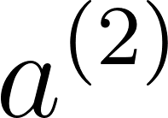

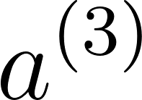
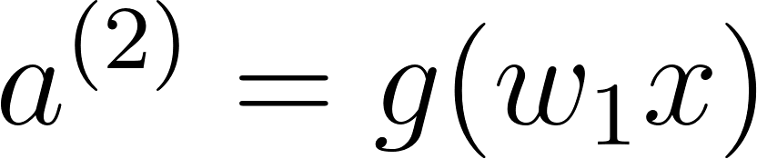
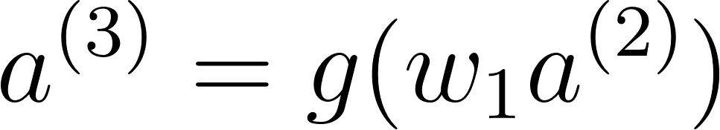
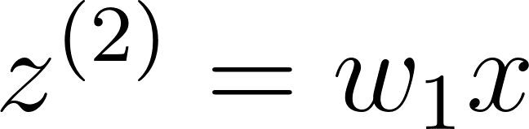
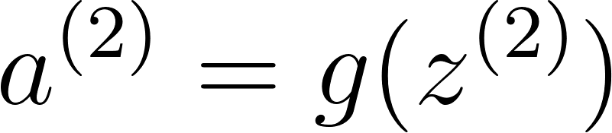
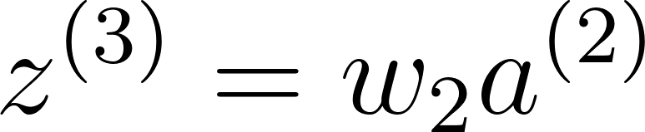
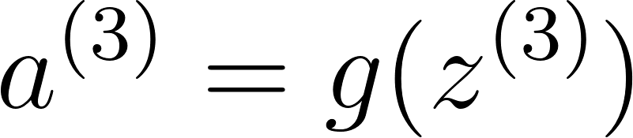
Simple Neural network
The simplest neural network: one input neuron, one hidden layer neuron, and one output neuron.
x
Input neuron
hidden neuron
Output neuron
linear combination activation
linear combination activation
x
Notes:
This is a simplest NN with 3 layers : input, i hidden layer and output layer containing single neuron in each layer. So mapping is also have a single weight.
Let me show you what happen inside of the simple NN
I've expanded each neuron to show 1) the linear combination of inputs and weights and 2) the activation of this linear combination
This is simply a series of functions where the output of one feeds as the input to the next.
This function g is called an activation function and it can make a NN linear or nonlinear.
Training NN modeling means training these weights so that it gives desired output using data.

Slide 6





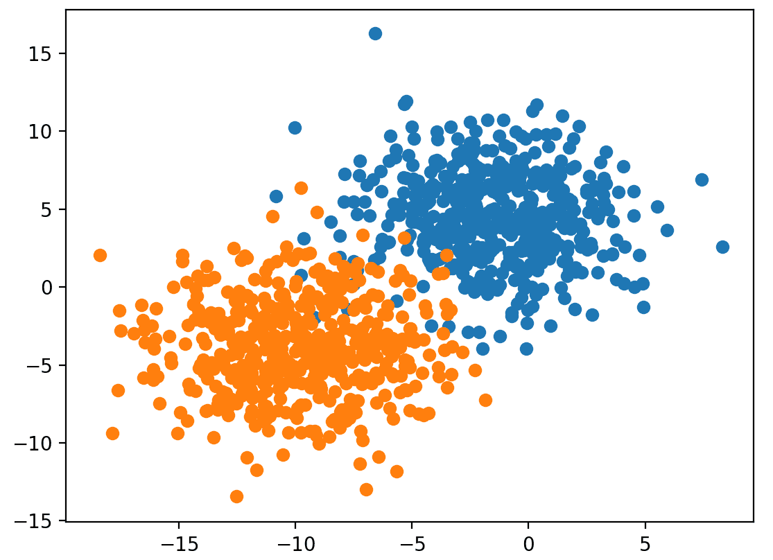
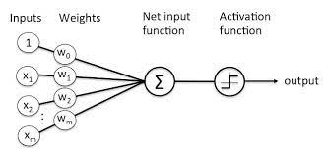
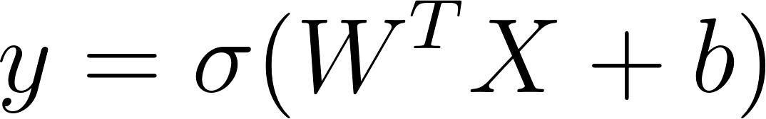
One -Layer Neural network
The decision rule for classification where input is x =
a>=0
: y=1
0
1
Target: Categorized two types of data
a<0
: y=0
Linear output
ReLU activation
(+)
(-)
‹#›
The Simplest Neural network: Perceptron
Notes:
Here target is Identify the given data is a cat or dog.
Let’s say data is 2D
This eq represent a 2D line
X1,x2 :describe given data that i need to classify as 0 or 1.
if we know these W1,w2,b so that it decide the classification of the data like
Upper part from the line belong to one category and part below the line belongs to other category
Suppose + for dogs , - for cats.
We can values A for given input x which can be + or -.
For classification what we do is we turn + outputs to 1 and - outputs to 0
This is the same way we do classification using a simple NN
This is the simple NN type with two layers one: input layer 2D, and other: output layer 1D
Main use of nn is classification and regression. This is a simple application of nn that use for classification.

Slide 7
One -Layer Neural network
The decision rule for classification where input is x =
a>=0
: y=1
Target: Categorized two types of data
a<0
: y=0
Linear output
ReLU activation
(+)
(-)
‹#›
The Simplest Neural network: Perceptron
Notes:
Main use of nn is classification and regression. This is a simple application of nn that use for classification.
Here target is Identify the given data is a cat or dog.
Lets sat data is 2D
This eq represent a 2D line
X1,x2 : elements of a data point gives to the input.
W1,w2,b :weights that mapped input data to next layers , in this case next layers is 1D
1st part of NN modeling is training these weights so that it gives this perfect line which categorize the data perfectly.
Upper part from the line belong to one category and part below the line belongs to other category
Suppose + for dogs , - for cats
2nd part: to see how NN categorize the new data once we know the decision rule/trained the NN:
This is what we try to see here.
Once Input data point is given , output a give a value, this is the linear output, to categorize data , we make + values 1 and - outputs 0
This convergence example for activation of NN: this specific activation called ReLU
This is the simple NN type with two layers one: input layer 2D, and other: output layer 1D

Slide 8
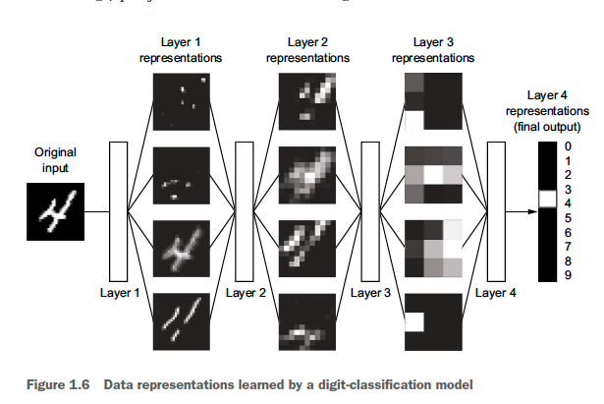
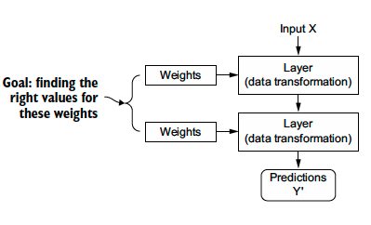
Neural Network: Train
Input X
adjusted
Weights
Layer 1 (Data Transformation)
Forward propagation
adjusted
Weights
Layer 2
(Data Transformation)
adjusted
Weights
Layer 3
(Data Transformation)
Optimizer
Prediction Y’
True Target Y
Loss Function
Back propagation
‹#›
Loss score
Notes:
How to train a NN.
Data: Train, validate, test
Assign random weights to each layers.
Loss function calculates how far is the nn output from the true target as a value:
Optimize how to minimize this loss score by changing weights using method called backpropagation. we send the error backwards to update the weights this is a small adjustment compared to earlier values.
We go over this loop over and over again until we get correct accuracy : minimum loss we can obtain.

Slide 9
Neural Network: Train
Input X
adjusted
Weights
Layer 1 (Data Transformation)
adjusted
Weights
Layer 2
(Data Transformation)
adjusted
Weights
Layer 3
(Data Transformation)
Optimizer
Prediction Y’
True Target Y
Loss Function
‹#›
Loss score
Notes:
How to train a NN.
Assign random weights to each layers.
Loss function calculates how far is the nn output from the true target as a value:
Optimize how to minimize this loss score by changing weights using method called backpropagation. we send the error backwards to update the weights this is a small adjustment compared to earlier values.
We go over this loop over and over again until we get correct accuracy : minimum loss we can obtain.

Slide 10
Neural Network: Train
Training data :The data builds up the learning algorithm.
Validation data: During training, validation data infuses new data into the model that it hasn’t evaluated before. Validation data provides the first test against unseen data, allowing to evaluate how well the model makes predictions based on the new data.
Test data: After the model is built, testing data once again validates that it can make accurate predictions.
Batch size : a number of samples processed before the model is updated.
The number of epochs : the number of complete passes through the training dataset.
Notes:
When training a NN we put full set of data into three category.
Training: use to train the model
Validate: During the training , use this data to evaluate model prediction against the true data in each training iterative
Test:After the model is build , use this data to check the accuracy of the model

Slide 11
My Project
Build a Neural Network model for a given dynamical system .
using Autoencoders and Neural Ordinary Differential Equations.
Linot, Alec J., and Michael D. Graham. "Data-driven reduced-order modeling of spatiotemporal chaos with neural ordinary differential equations." Chaos: An Interdisciplinary Journal of Nonlinear Science 32.7 (2022): 073110.
‹#›
Notes:
My project is to build a NN for a given dynamical system using autoencoders and Neural ODEs
The paper im referring to work on the project

Slide 12



What I have done so far
Project contains three parts…
Neural Network model to obtain reduce dimensional manifold data of the dynamical system
Neural Network model that mapped corresponding ODE model of the dynamical system data
By using part 1 and part 2 , predict the future time step values of the given system
‹#›
Notes:
Once the part 1, and 2 are done we will able to predict future time stem values in given system

Slide 13
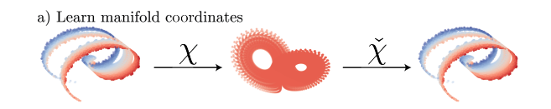
Part 1: Intro
Neural Network model to obtain reduce dimensional manifold data of the dynamical system
‹#›
Notes:
1st part is to find a NN model that gives reduced dimensional data representation to the original dynamical system data.
Why I want this step because,
Most dynamical system data are high dimensional so to analyse those data in given states are computationally expensive.
So, we need to find a way to compress the data without damaging the properties of it.
There are some well known techniques for this purposes which are not belongs to Deep learning such as PCA, DMD, SVD ..

Slide 14
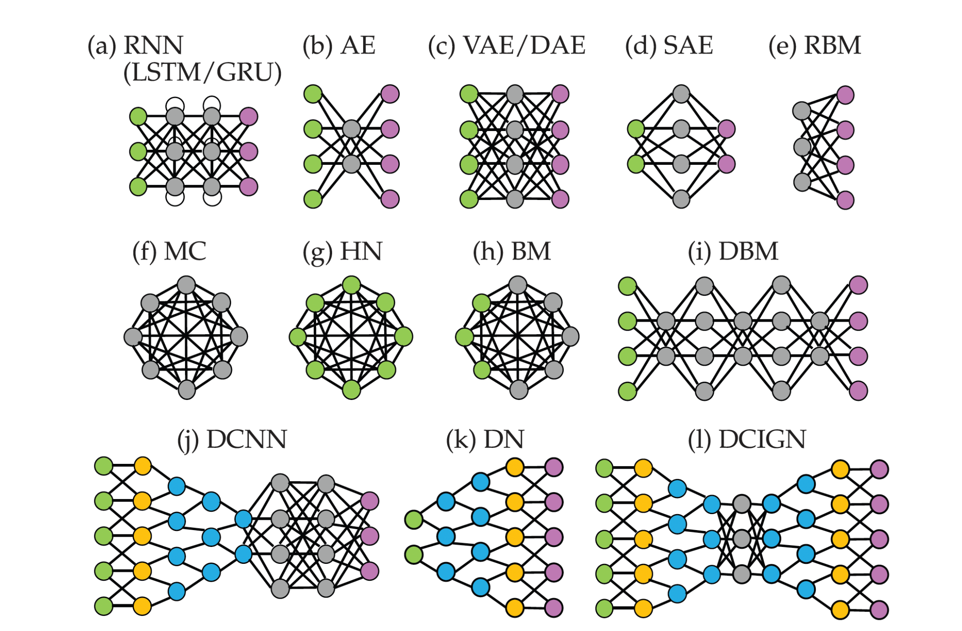
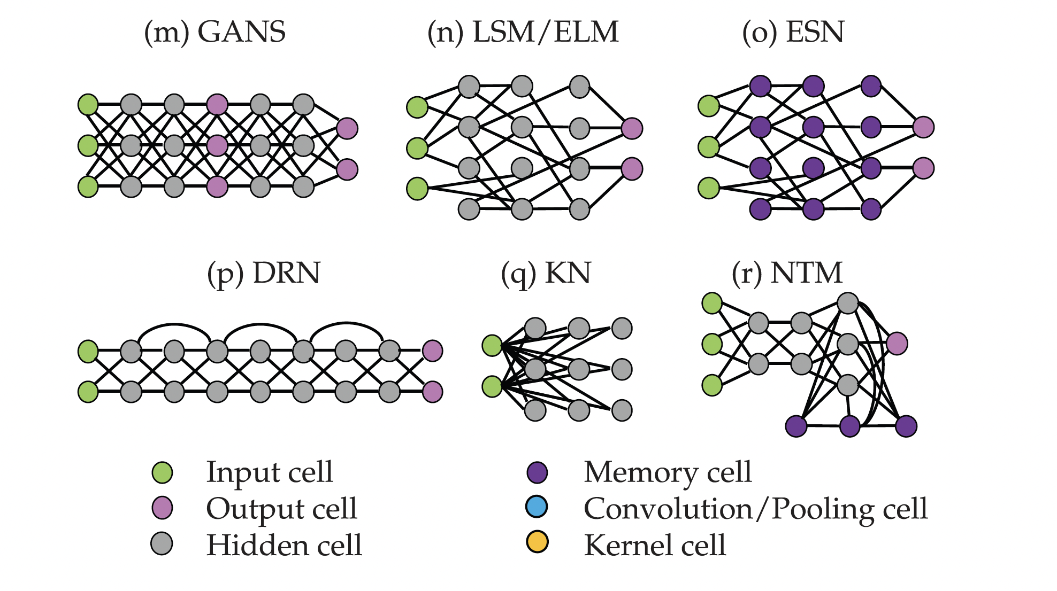
Part 1:Neural network types
‹#›
Notes:
To do this in a deep learning environment we use NN type called Autoencoders

Slide 15
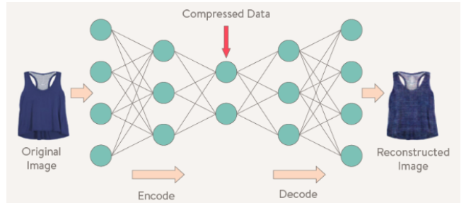
Part 1:Autoencoders
Autoencoder
An autoencoder is a neural network that is trained to attempt to copy its input to its output. Internally It has a hidden layer h that describes a code used to represent the input.
f
g
X Input Layer
h Latent Layer
X Output Layer
encoder
decoder
h=f(x)
g(f(x)):=x
‹#›
Notes:
An autoencoder is a neural network that is trained to attempt to copy its input to its output.
Important abt this is that,
Internally it has a hidden layer: we called it latent layer that has another representation in different manifold to the input data.
The map transform original data to this latent layer we called encoder, the map that do the reverse of it we called the decoder
This latent layer in autoencoder can be both high and low dimensional.
We are interested in autoencoders with low dimensional latent layer

Slide 16


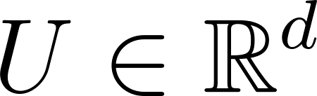
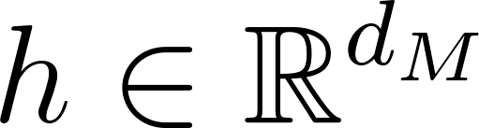
Undercomplete Autoencoder
Undercomplete Autoencoders
An autoencoder whose code dimension(latent layer dimension) is less than the input dimension is called the undercomplete autoencoder.
Constrain h to have lower dimension than U
Force it to capture most salient features of training data
Input Dynamical System U
Reduced dimensional manifold
Output Dynamical System U
Ambient space
Where h is the state representation in manifold coordinates
‹#›
Notes:
We called it under complete autoencoder
Constrain h to have lower dimension than U
Force it to capture most important features of training data
Ambient space: higher dimensional space where the object is originally defined.
Salient: most noticeable or important.

Slide 17
Autoencoder: Simulations
Data Set:
Taken from a single trajectory of each system
Evenly spaced points in the trajectory
Inputs of NN:
Considered all state variables of each data point
Data points are randomly selected from data set
Training set : 70% data set
Validation set: 15% data set
Test set : 15% data set
‹#›
Notes:
As for simulations , I have created few autoencoders for few systems
Let me remind you again that why we use auto..
To do computations we prefer low dimension and but for the representation we prefer original high dimension.
For all of the systems that i considered,
Data set was simulated taking a single trajectory of the system and point taken are evenly spaced.
When the data was feeded to the NN,
Data points were randomly selected from the data set.
Considered all state variables of each data point
70 of data set taken as training data
15 ..
Last 15

Slide 18
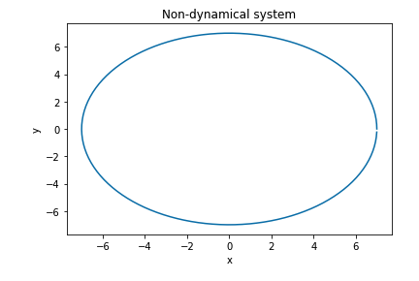
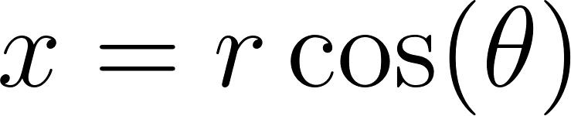
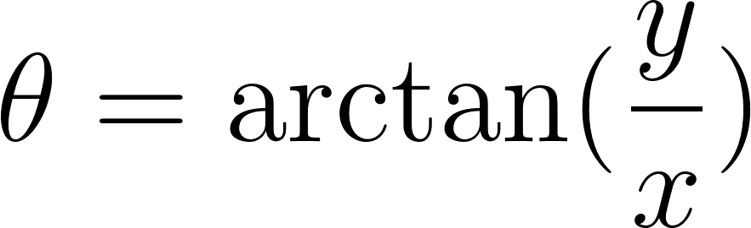
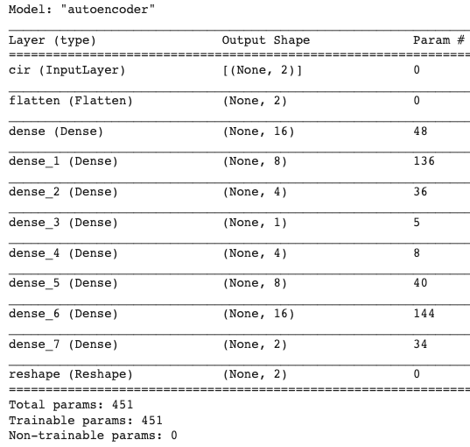
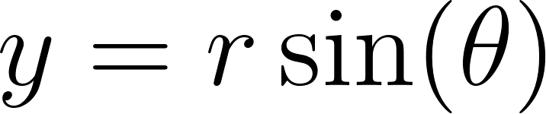
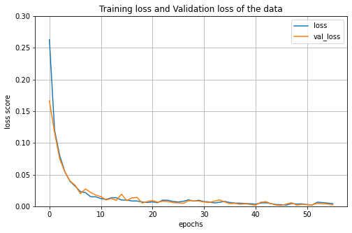
Autoencoder: Circle
2D → 1D → 2D
‹#›
Notes:
The first autoencoder was created for a circle
Since circle can be represent from both 2D data and 1D data.
This tabel shows the the structure of the autoencoder used to with 2D input, 1D latent layer, 2D output.
Thai graph shows the Training data loss and validation data loss of the data at each epoch.
That means the difference between NN output and true target when training the model and validating the model at each epoch.
Epoch means how many times full set of training data is used to train the model
Since the graph is converged autoencoder can guarantee a good autoencoder for circle

Slide 19
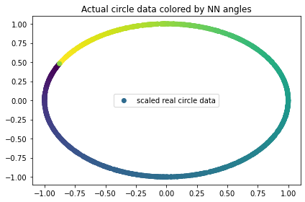
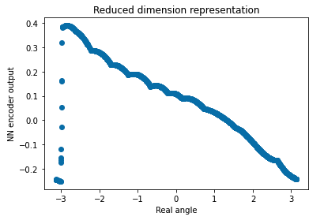
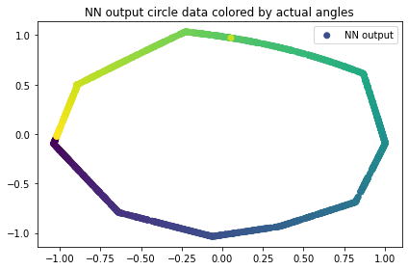
Autoencoder: Circle
2D → 1D → 2D
Data set : 10000 points
Loss function : Mean Square Error
Optimizer: Adam
‹#›
Notes:
I tested the model with
Test data which represent in this graph.
This is the showed encoder output .
To validate it is correct latent layer output , I mapped it with real angels . the graph is type of y=x , assure that this reduced order representation of input data is true.
Last graph shows the reconstruction of the original circle using decoder mapping

Slide 20
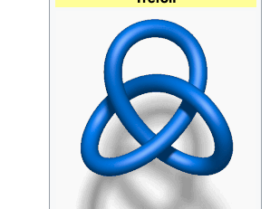
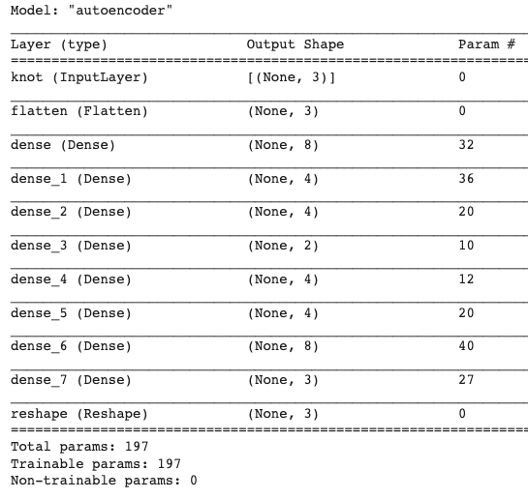
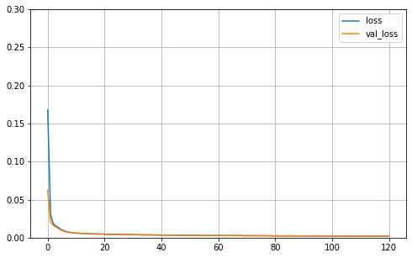
Autoencoder: Trefoil Knot
3D → 2D → 3D
Data set : 10000 points
Loss function : Mean Square Error
Optimizer: Adam
‹#›

Slide 21

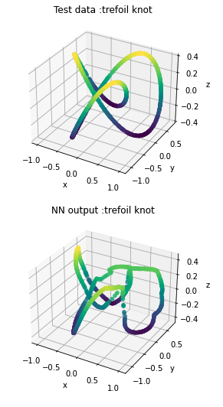
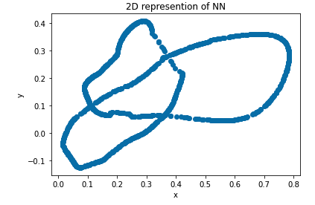
Autoencoder: Trefoil Knot
3D → 2D → 3D
‹#›
Notes:
This graphs shows results of the autoencoder that reduced trefoil knot dimension from 3d to 2d .

Slide 22
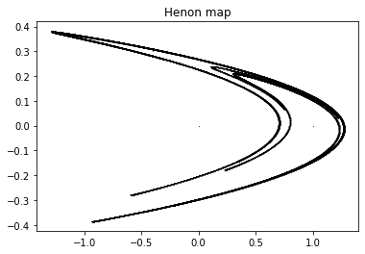
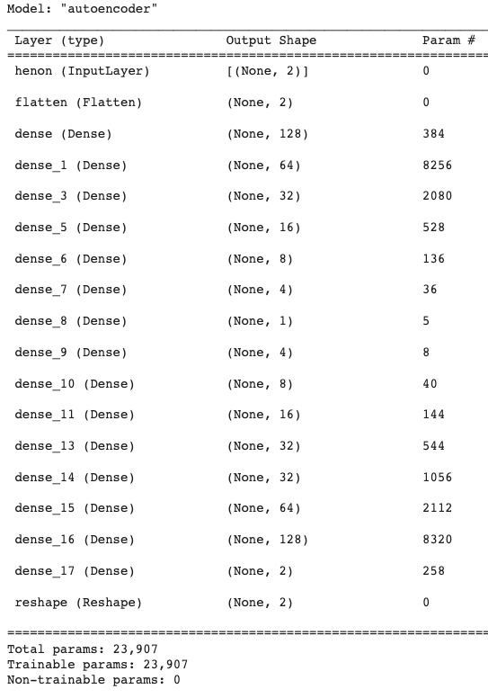
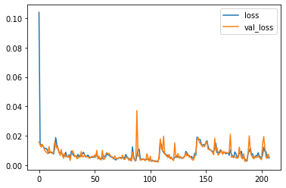
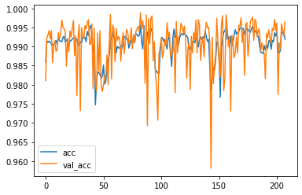
Autoencoder: Circle
2D → 1D → 2D
Data set : 100,000 points
Batch : 32
Loss function : Mean Square Error
Optimizer: Adam
‹#›

Slide 23
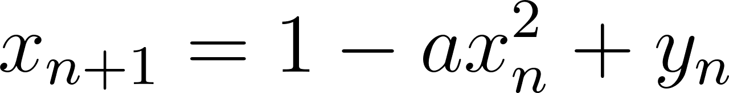
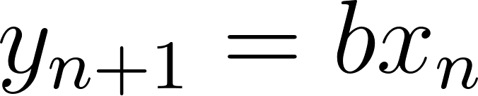
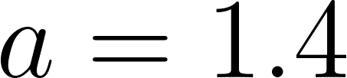
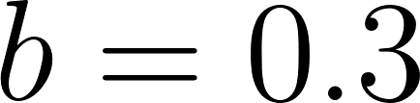
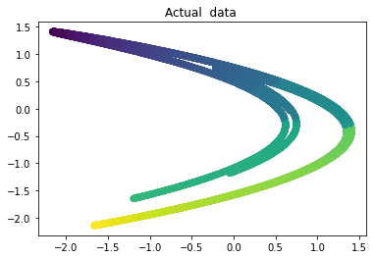
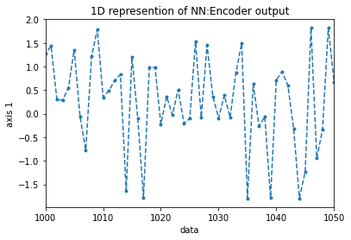

Part 1:Hénon Map
2D → 1D → 2D
‹#›
Notes:
This is the Henon map result.
Both these cases , reconstructing from low dim to high data was missing.
Reason I Think for that is : both henon and trefoil can not reduced to low dim since original dimensions are their low dimensions

Slide 24


Autoencoder: Lorenz system
4D → 3D → 4D
Data set : 10000 points
Batch : 32
Loss function : Mean Square Error
Optimizer: Adam
‹#›
Notes:
This is the last system simulated for autoencoders
Speciality here is:
Instead of taking original dimension as input , we created a 4D data set of lorentz system using this representations where alpha is a constant.
X,y,z are the original system data.
In 4D system become a spiral.
And took 4D system as input. And check weather we can have original 3D system in the latent layer .

Slide 25



Autoencoder: Lorenz system
4D → 3D → 4D
‹#›

Slide 26




Part 1:Lorenz system
4D → 3D → 4D
‹#›
Notes:
Once test data set applied to the trained autoencoder, latent layer representation….

Slide 27
Conclusion
Neural networks are one of the best ways to learn features of data with unknown models.
Our aim here is to create a neural network to predict future state of a given dynamical system.
Dimension reduction of the data is important along the process.
Autoencoders can learn mapping back and forth between high dimensional data and reduce dimensional data.
We use autoencoders to reduce the dimension of the given system data before we create the corresponding N-ODE model of the system.
‹#›
Notes:
As the conclusion ,

Slide 28
Thank You!
‹#›

