Slide 1
BLOCKCHAIN MEDICAL SYSTEM

Slide 2
GROUP MEMBERS
AMEETESH SHARMA – 2018A7PS0167H
NIPUN WAHI – 2018A7PS0966H
MIR AMEEN MOHIDEEN - 2018A7PS0487H

Slide 3
CONTENTS
Problem we aim to tackle
Classes used in our project
01
03
02
Solution to our problem
04
Final output and Result

Slide 4
01
PROBLEM WE AIM TO TACKLE

Slide 5
Data of patients is vulnerable and can be accessed/tampered by unauthorized users
Medical history of the patients when accessed by other agencies without consulting previous care provider, may lead to mistakes due to human error

Slide 6
02
SOLUTION TO OUR PROBLEM

Slide 7
Will use blockchain to make patient’s data more secure and immutable
Aim to prioritize patient agency, giving a transparent and accessible view of medical history
It is intended to store all of patient’s data in one place making it simpler for patients and doctors

Slide 8
03
CLASSES USED IN OUR PROJECT

Slide 9
StringUtil Class
We have defined StringUtil for utility functions related to strings and to make signatures for every transaction.
We are using ECDSA signatures which is provided by BountyCastleProvider which is in bcprov-jdk15to18-165.jar
It also verifies public and private key pairs of ECDSA signatures and also signs them

Slide 10
Block Class
It contains two important functions:
CalcHash:
It applies SHA256 defined in StringUtil class to the data
MineBlock:
It mines the block according to some difficulty value. Basically it keeps changing the nonce until it has some number of zeroes as prefix to the hash. The number of zeroes is the difficulty value.

Slide 11
Transaction Class
It holds all the details related to a transaction in the Blockchain like the sender’s and receiver’s public key, signature, data,etc

Slide 12
Wallet Class
Wallet class is what the user is. It contains the public and private key of the user.
It has a method called sendData which returns a new transaction taking in public key of the sender and receiver and data as output

Slide 13
BlockChain Class
It is the most important class and most of the work is done here.
The constructor calls the method createGenesisBlock which when initializing creates the genesis block.
It has an attribute called undoneTransaction which is an arraylist of transactions and holds the new transactions which aren’t in any block yet
After a certain number of new transactions a new block is created, the blockchain holds all the blocks in an arraylist.
It has methods like:
VerifyTransactions: Verifies all the transactions in the undone transactions arraylist using ECDSA signature verification.
CreateBlock: Creates a new block, puts all the undone transactions in it and mines the new block. Contd..

Slide 14
BlockChain Class
Contd..
VerifyTransactions: Verifies all the transactions in the undone transactions arraylist using ECDSA signature verification.
CreateBlock: Creates a new block, puts all the undone transactions in it and mines the new block. It creates new block only after verifying the transactions.
ViewUser: This method shows all the transactions of a user sent or received. Basically it loops through all the blocks and all the transactions in them and prints whose public key matches the user.

Slide 15
GUI Class
Responsible for the user interface.
Send reports: It has 2 drop downs to select sender and receiver and ‘submit’ button to send the report. The report is typed into the given area.
Create new user: A new user can be created by typing his/her name in the given textfield and click ‘create’.
View Report: All the sent and received reports of the user can be viewed by selecting the user from dropdown menu. The reports are stored into a text file upon clicking ‘View Report’ button.
Create block: A new block is added to the blockchain after 3transactions(reports0 are made. But a new block can be added with less than 3 reports on clicking this button.

Slide 16
Data Class
It writes the whole blockchain into a json file. So that the blockchain can be reffered to for future use.

Slide 17
04
FINAL OUTPUT AND RESULT

Slide 18
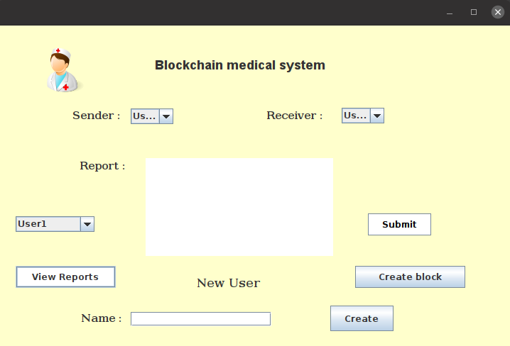
Upon running the program, the following window opens on the screen:

Slide 19
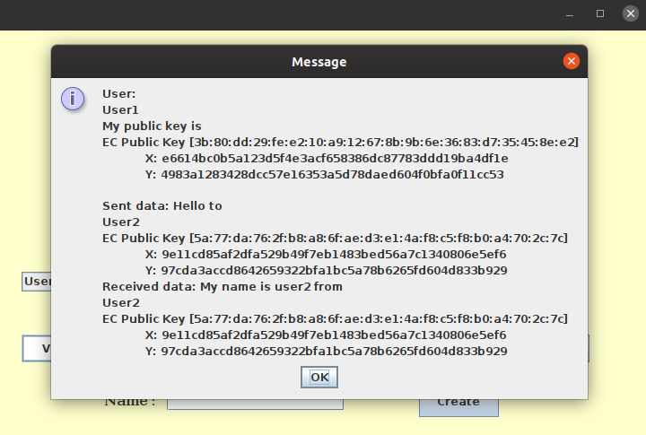
After creating a few user and writing some reports, we click on the createBlock button. Then when we select a user from the dropdown menu and click view reports, all the reports sent and received by the user is displayed:

Slide 20
THANK YOU!

