Slide 1
🏙
SmartCity
Civic Issue Reporting & Resolution Platform
Report it once. Track it live. Hold the city accountable.
Team HackInMotion · RICR-HIM-1041
github.com/Nipurnbandi/HackInMotion-RICR-HIM-1041
Notes:
SmartCity: citizens report civic problems on a map; the city fixes them under public scrutiny. Built end-to-end at HackInMotion.

Slide 2
Civic issues fall through the cracks
A pothole gets reported fifteen times — or not at all. Complaints vanish into phone lines and paper registers. Citizens never learn what happened, departments drown in duplicates, and nobody can see which part of the city government actually delivers.
15×
the same pothole reported again and again — every duplicate is queue noise
0
visibility for the reporter — no tracking ID, no status, no closure
What a city needs: one record per problem, visible progress, and accountability that is public by default.
?
public accountability — no one can compare how departments perform

Slide 3
One platform, three faces
📱
Citizen Portal
🖥️
Admin Command Center
🌍
Public Report Card
light · phone-first · English + हिन्दी
dark glass theme · data-dense
/transparency · no login required
5-step report wizard: pin on map, category, photo, description
Live city map — see & upvote what neighbours already reported
Track every report; confirm the fix or reopen the case
Priority work queue — one case per real-world problem
Live map, real-data analytics, department inbox
Resolution notes + proof photos, full audit trail
Every department scored 0–100, graded A+ to D
Resolution rate + within-SLA rate + speed
Computed live from the database — never curated

Slide 4
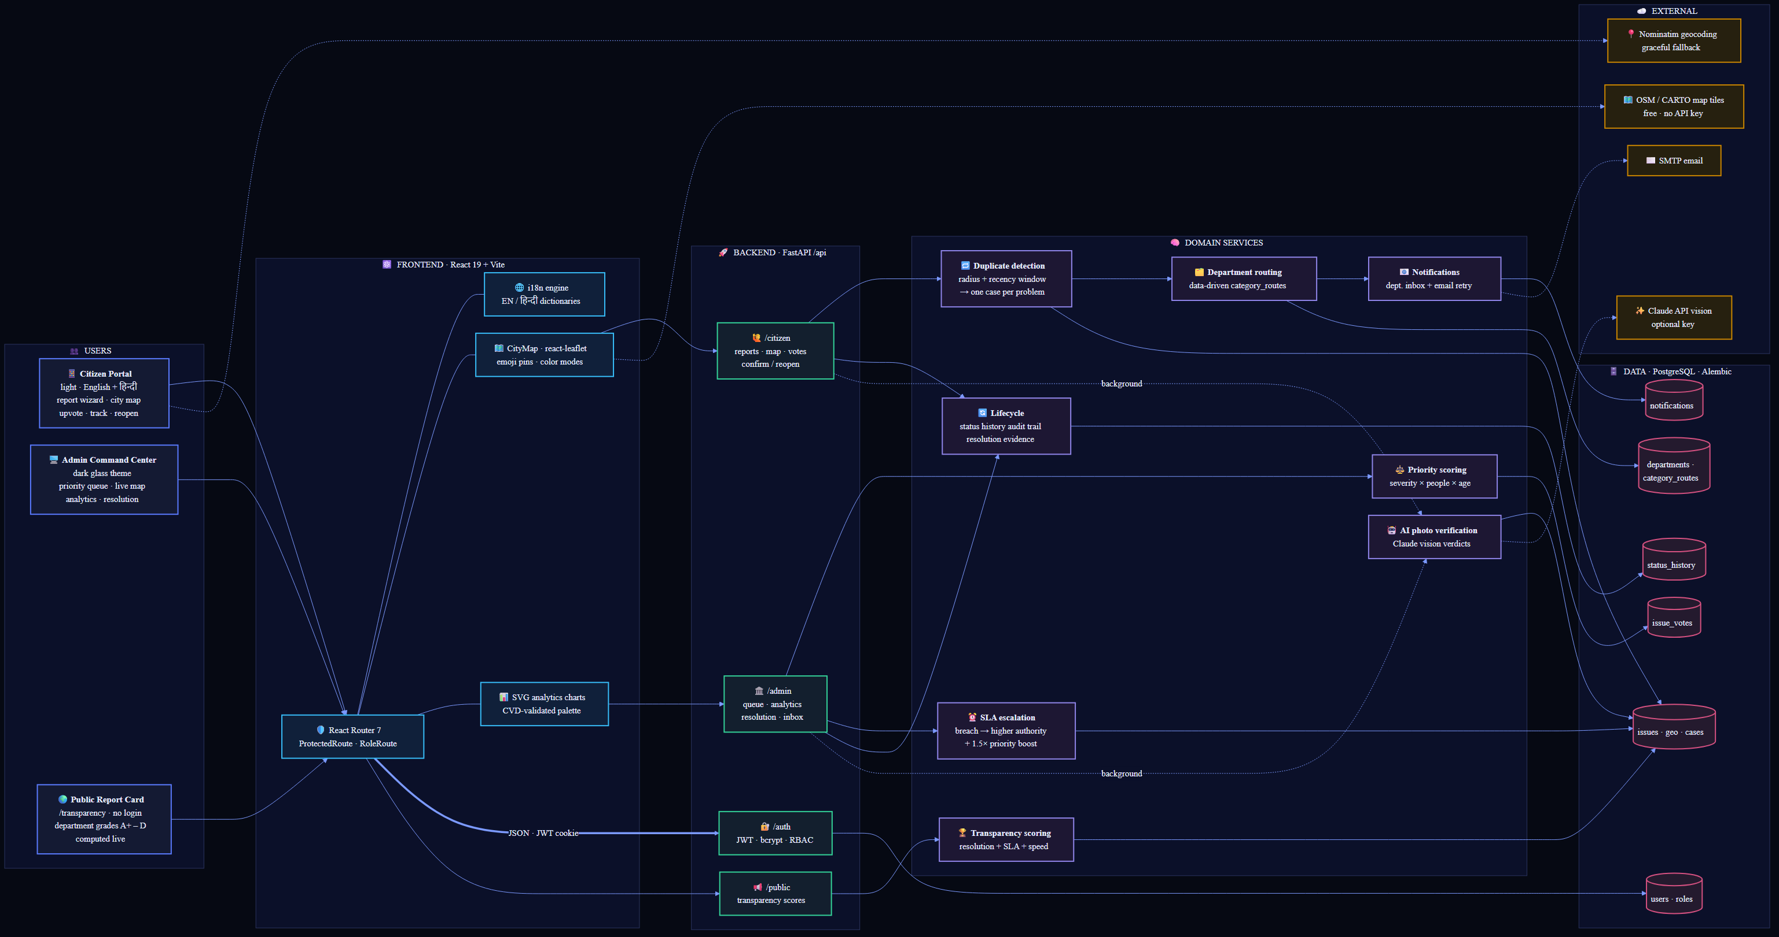
Architecture — every box is tested code
FastAPI · React 19 · PostgreSQL · Leaflet/OSM · Claude API — source: docs/architecture.mmd

Slide 5
Reporting an issue takes five taps
1
🗂️
2
📍
3
📷
4
✍️
5
🚀
→
→
→
→
Category
Pin on map
Photo
Describe
Submit
7 civic types
GPS or tap-to-pin
validated evidence
any language
tracking ID issued
🗺️
Maps stack — free, open, key-less
🤖
AI photo verification
Leaflet + React-Leaflet for rendering; OpenStreetMap tiles (CARTO dark for admin); OSM Nominatim reverse-geocodes the pin into an address
Chosen over Google Maps / Mapbox: zero API keys, zero billing, open data, provider swappable via env config
Geocoding failure never blocks a report — coordinates are used as fallback
Every photo is checked in the background: “does this actually look like a pothole?”
Proof-of-resolution photos checked against “does this show the fix?”
Verdict badges in the admin queue — submission never blocks, no key degrades gracefully

Slide 6
The brain — one case per real-world problem
🔁
Duplicate detection
🗂️
Department routing
⚖️
Priority scoring
Our own algorithm: per-category radius (25–80 m) + recency window (3–60 days). A match links the new report into the existing case — every reporter keeps their own tracking ID.
Data-driven category_routes table maps each category to its department and notifies its inbox + email. Add a category with a database row — no if/else chains.
Queue order = severity weight × people affected (reporters + upvotes) × days open. Mass-reported, long-ignored problems rise to the top automatically.
→
→
⏰
SLA escalation — nothing rots in a queue
Every category has a service-level limit (2 days for garbage overflow … 10 for damaged property). An idempotent sweep flags breached cases “⚠ SLA breached”, boosts them ×1.5 in priority, records the escalation in the audit trail, and notifies General Administration — the higher authority.

Slide 7
A lifecycle that closes the loop
Submitted
→
Under Review
→
In Progress
→
Resolved
→
Citizen confirms ✓ / reopens ↩
📜
Immutable status history
🧾
Resolution evidence
🔄
The reporter gets the last word
Every transition audited: who (citizen or administration), old → new status, note, photo, timestamp. The reporter sees the full trail — nothing disappears.
Admins attach resolution notes and proof-of-resolution photos, organized per department queue. AI cross-checks the proof photo against the original problem.
Once resolved, the citizen is asked: “does it look fixed to you?” Confirming closes the loop; reopening reopens the whole case — for every reporter linked to it.

Slide 8
See the whole city at a glance
🗺️
Live city map — citizens & admins
📊
Analytics — 100% real data
Every active case is an emoji pin, color-coded by status or category (toggle)
Popups: report count, department, tracking ID, date
Citizens upvote problems that affect them — votes feed priority; reporters can’t double-dip their own case
Resolved pins dim, rejected pins hollow — state never rides on hue alone (CVD-validated palette)
Dark CARTO tiles for the admin theme, light OSM for citizens
Splits by category, status and department, computed live on every load
Average resolution time — overall and per department comparison table
Hotspot detection: ~110 m map cells that keep collecting reports, ranked by volume
Hand-built SVG donut & bar charts sharing the map’s color language — no chart library, no fake numbers

Slide 9
Beyond the brief
🏆
Public transparency score
👍
Citizen upvoting
No-login report card grades every department A+ to D: 50% resolution rate + 30% within-SLA + 20% speed. Methodology printed on the page.
Support existing problems straight from the map. Votes raise the case's priority, so departments work on what actually hurts the most people.
🌐
English + हिन्दी
🤖
AI photo verification
One tap flips the whole citizen experience — wizard, categories, statuses, timeline — into Hindi, persisted per device. New language = one dictionary file.
Claude vision cross-checks report photos against categories and proof photos against the fix — background tasks, graceful without an API key.

Slide 10
Engineered, not hacked together
110
59
7
17
backend tests — RBAC, dedup, routing, lifecycle, SLA, votes, scoring, AI
frontend tests — wizard, dashboards, maps, lifecycle UI, i18n, badges
Alembic migrations — schema evolved feature by feature, never rebuilt
REST endpoints across auth, citizen, admin and public surfaces
🛠️
Stack & security
FastAPI · SQLAlchemy 2 · Alembic · PostgreSQL · Pydantic v2 | React 19 · Vite · React Router 7 · react-leaflet | Anthropic Claude API (vision)
RBAC enforced on the backend — every admin endpoint rejects citizens with 403 (and vice versa), covered by tests
JWT in HTTP-only cookies · bcrypt password hashing · uploads validated by magic bytes, size and type

Slide 11
Report it once.
Track it live.
Hold the city accountable.
Live demo: citizen portal · admin command center · /transparency
github.com/Nipurnbandi/HackInMotion-RICR-HIM-1041 · Team HackInMotion

