Slide 1
בשבי"ל
בנות שירות בודדות בישראל
Nir Cohen, Eddie Lavian, Tal Yehousha, Netanel Morli, Roy Shani @ JCE

Slide 2
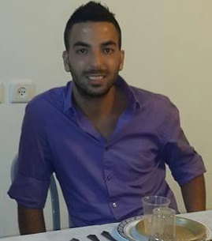
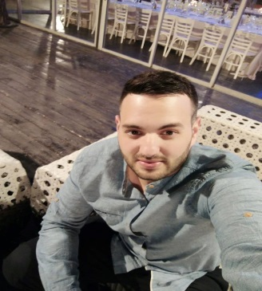
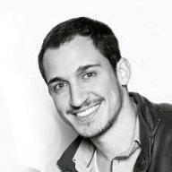
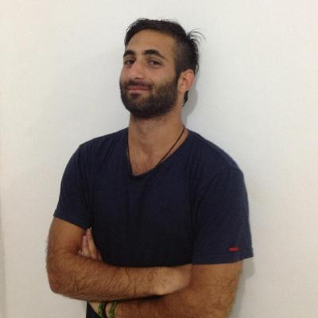
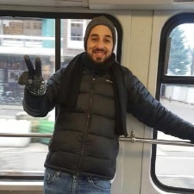
The Crew
The team members are Nir Cohen, Eddie Lavian,
Tal Yeshouha, Netanel Morli and Roy Shani. We are
students in software engineering in the third year, each of us specializing in another field.

Slide 3
Bishvil Crew

Slide 4
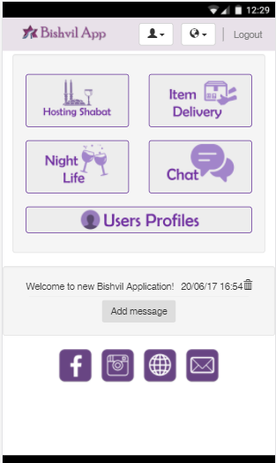
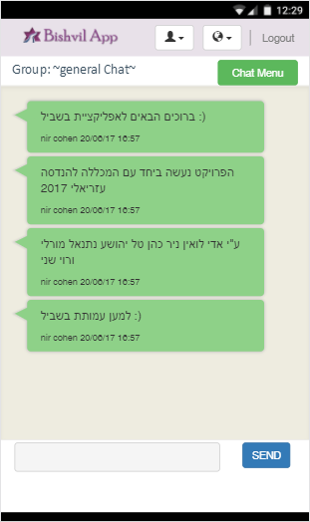
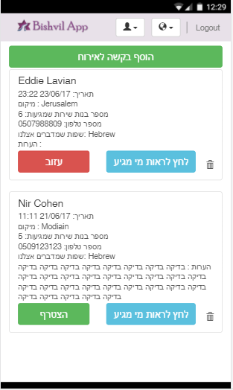
Challenges
To narrow the social gap between the service-girls
Create a social network to solve the needs of service girls
Provide a convenient interface for the management of the girls' community by the organization

Slide 5
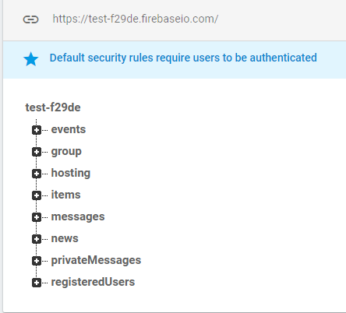
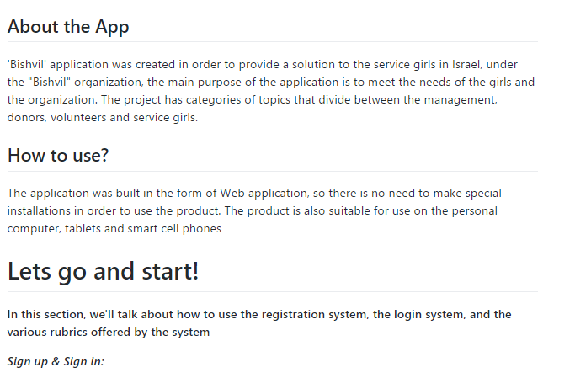
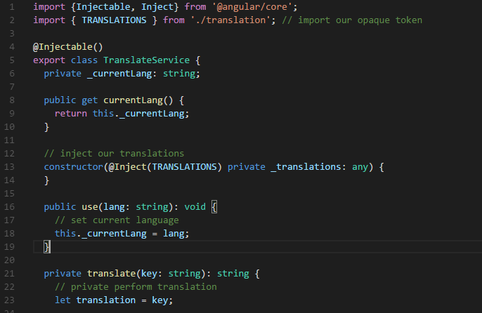
The Application
Hosting, Meetings, Items delivery
Chat Rooms
Roller messages
Register in RealTime
Language support

Slide 6
Thank you!
We enjoyed creating the project together with the association, for more details you are invited to contact one of the team members
Our live application : https://test-f29de.firebaseapp.com/
Nir Cohen – nircohen911@gmail.co, 0509272550
Eddie Lavian – eddielav1@gmail.com, 0507988809
Tal Yehousha – talyeh3@gmail.com, 0507811169
Netanel Morli – netanelm54@gmail.com, 0524732202
Roy Shani - Roysha1@gmail.com , 0547443119

