Slide 1
LetsGo A1.0

Slide 2
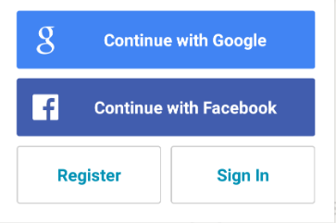
Landing Page (www.letsgo.com)
Lets Go, Lets travel with others like you!
Notes:
הפלטפורמה היא לרשומים בלבד, בשביל להיכנס אליה צריך להירשם.

Slide 3
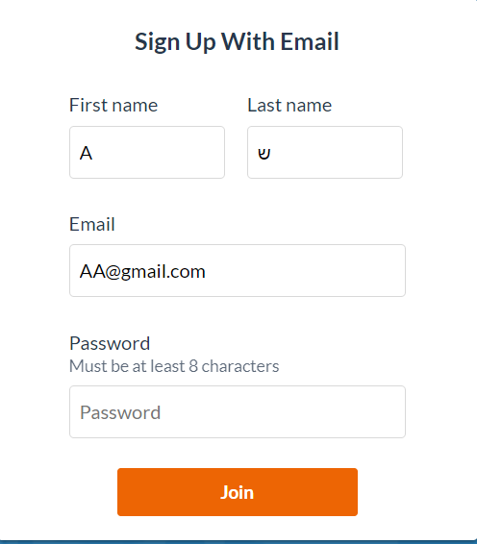
Register – Step 1

Slide 4
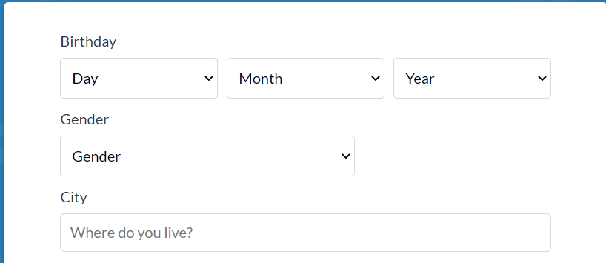

Register – Step 2

Slide 5
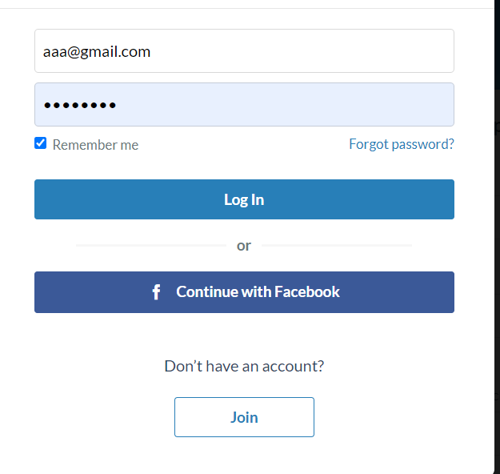
Sign In

Slide 6
How It Works
How Lets Go Works
You have friends all over the world, you just haven't met them yet.
LetsGo is a service that connects members to a global community of travelers.
Use LetsGo to find a partner for you trips and share your amazing trip’s ideas with other travelers.
There are always new places to explore with new friends!

Slide 7
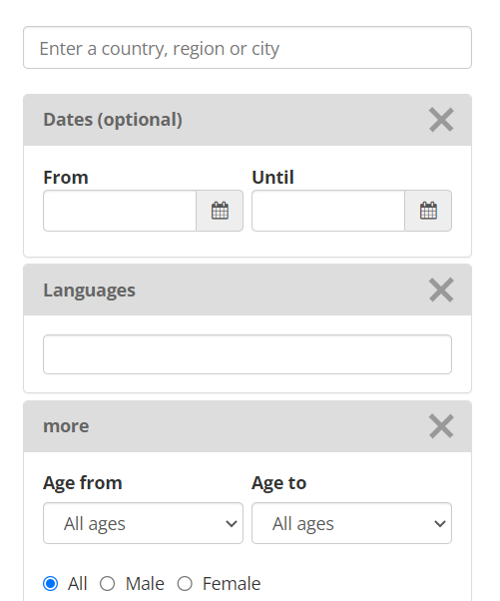
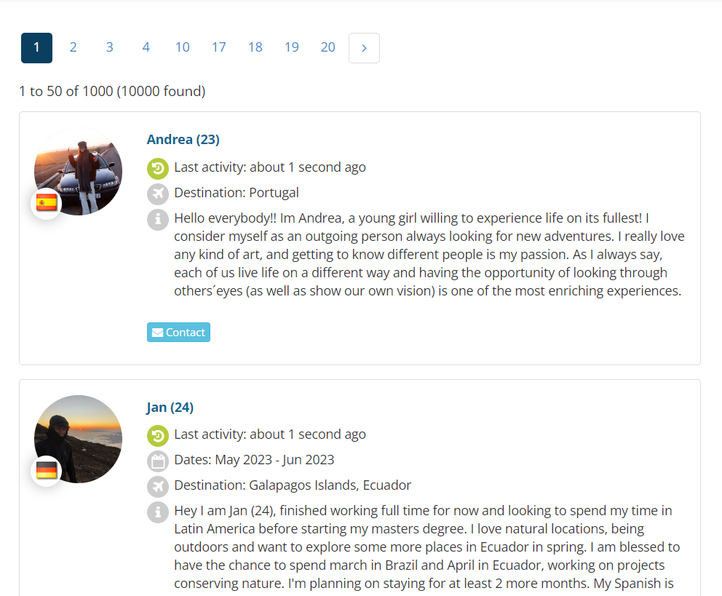


Explore
Months
Plan Your own Trip!

Slide 8
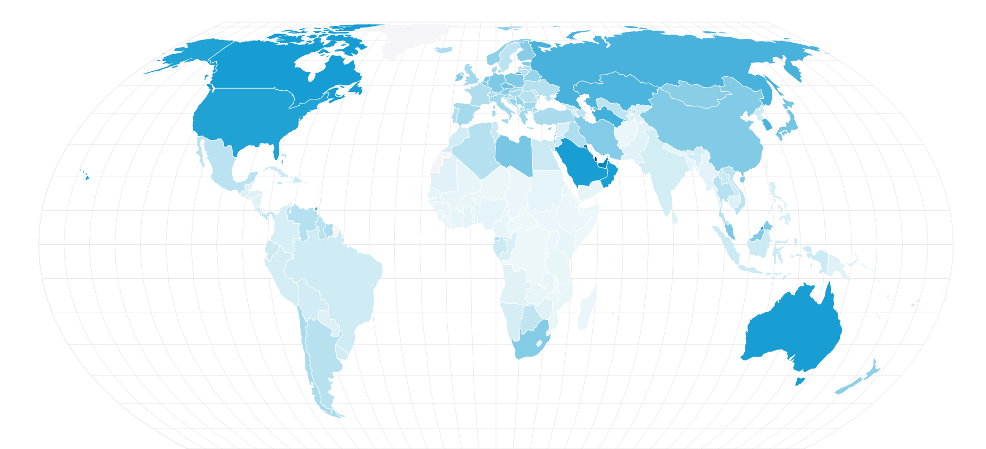
Your Map
Notes:
ארצות שסימנתי תיצבע בצבע, כך אוכל לדעת באילו מדינות כבר הייתי ואילו מדינות לא הייתי, סוג של משחוק.

Slide 9
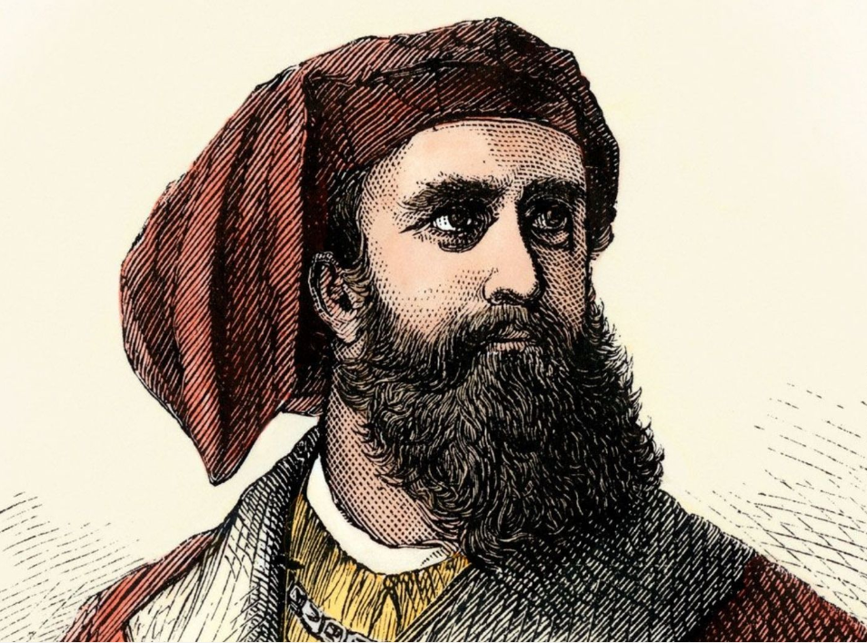
Your Profile
About me:
Hey , my name is Marco Polo, and I’ve been traveling since I was 17. l always like to experience new things and places I haven't visited. I consider myself a very social person, loves sport and art and has a passion for getting to know new people and cultures.
Profile Details:
Name:
Marco Polo
Age:
35 years
Residence:
Venice, Republic of Venice
Profession:
Merchant, Explorer, Writer
Mail- Address:
Marko-polo@gmail.com

Slide 10
Liked Trips
Notes:
כל הטיולים שסימנתי בלייק

Slide 11
Your Trip
Destination :
Medellín, Colombia
Buenos Aires , Argentina
Dates:
June 2023 – August 2023
info:
Hello everyone, my name is John Stockton, and I recently finished my degree in nutritional science, and now I am looking to spend the next two months in South America with an emphasis on Colombia and Argentina, before starting my master's degree. I like basketball, traveling, and playing the guitar in my spare time. I would love to find a partner to join me!
Notes:
ציון מדינות היעד , תקופת הטיול , והסבר קצר על המטייל ומטרות הטיול

