Slide 1

Smart Course Enrollment System
SUMMER INTERNSHIP REVIEW | IT3711
A Python Full Stack Web Application
Niraimathi M | 810023205046
B.Tech Information Technology, VII Semester
University College of Engineering (BIT Campus), Anna University, Tiruchirappalli
Internship at Astonish InfoTech Private Limited | 01 Jun to 30 Jun 2026
Notes:
Good morning. I am Niraimathi M, a seventh-semester B.Tech Information Technology student. This review covers my one-month summer internship at Astonish InfoTech and the project I built: the Smart Course Enrollment System.

Slide 2
Agenda
1
Company and Internship
6
Architecture and Database
Profile, duration and 30-day plan
Three-tier design and tables
2
Problem Statement
7
Workflow and Code
Limits of the existing system
Enrollment flow and key snippets
3
Objectives
8
Sample Output
What the project set out to do
Working screens of the application
4
Proposed System
9
Testing and Analysis
Six core modules
Observations and improvements
5
Technology Stack
10
Future Work and Conclusion
Tools, frameworks and database
Roadmap and key learnings
Notes:
The review follows the project from background to results: where I interned, the problem, the design, the working output, testing and what comes next.

Slide 3









About the Company
Services
Web Development
Software Development
Astonish InfoTech Private Limited is a software development and web solutions company in Tiruchirappalli (Trichy), Tamil Nadu. It builds responsive websites, ERP and CRM systems, mobile apps and cloud-ready solutions for startups, institutions and businesses.
Mobile App Development
ERP Solutions
CRM Solutions
Domain and Hosting
Industry: IT services, software and web development
Technical Domains
AI and ML
Embedded Systems
IoT Solutions
Location: Technology Park (BUTP), Kajamalai Campus, Trichy – 620 023
VLSI Support
Cloud Solutions
Cyber Security
Discuss
Design
Develop
Deploy
Requirement analysis
UI/UX and planning
Coding and testing
Launch and support
Notes:
Astonish InfoTech is a Trichy-based software and web solutions company. Its four-step process of Discuss, Design, Develop and Deploy is the same lifecycle I followed for my project.

Slide 4




Internship at a Glance
30
3
6
3
Working days
Architecture tiers
Core modules
Database tables
01 Jun to 30 Jun 2026
Presentation, logic, data
From browsing to dashboard
Categories, courses, enrollments
PROJECT ASSIGNED
MY RESPONSIBILITIES
Smart Course Enrollment System
Responsive UI with HTML, CSS and JavaScript
A Python full stack web application that digitizes course discovery, category filtering and online enrollment for training institutions.
Backend services with Python and FastAPI
MySQL integration and Jinja2 templates
FastAPI
Jinja2
MySQL
HTML/CSS/JS
Testing forms, validation and stored records
Notes:
The internship ran for 30 days in June 2026. I owned the project end to end: interface, backend, database integration and testing.

Slide 5
30-Day Work Plan
1
2
3
4
5
DAYS 1 – 5
DAYS 6 – 11
DAYS 12 – 17
DAYS 18 – 25
DAYS 26 – 30
Orientation and Requirements
Learning and Design
Foundation Build
Module Development
Testing and Report
Orientation and topic
Requirement gathering
Existing system study
Environment setup
FastAPI and Jinja2 study
Layered architecture
Schema and ER diagram
UI wireframes
Stylesheet and home page
FastAPI project structure
MySQL connection helper
Automatic database setup
Categories and catalog
Category filter
Enrollment form and POST
Login, dashboard, contact
Functional testing
Validation checks
Code review
Report and presentation
Notes:
The 30 days split into five phases. The first week was requirements and setup, then study and design, then building the foundation, the feature modules, and finally testing and documentation.

Slide 6








Challenges in the Existing System
Manual paperwork
Scattered information
Paper forms retyped into registers cause errors and duplicates
Instructor, duration, level and seats spread across brochures
Limited accessibility
Fragmented records
Enrollment only in office hours, in person or by phone
Learner data kept in separate files, slow to retrieve
No instant confirmation
Hard to track enrollments
Learners get no immediate proof that a request was recorded
Counting applicants per course or category is manual
Inefficient administration
Long waiting time
Summaries and reports need manual counting
Queues form at the counter during admission periods
Need: a centralized, digital and user-friendly course enrollment platform
Notes:
Most training centres still use paper forms and spreadsheets. These eight limitations, from scattered course information to long queues, motivated a centralized web platform.

Slide 7



Project Objectives
Build the Web Application
Design the Database
Enable Course Discovery
Develop with Python, FastAPI, Jinja2, HTML, CSS, JavaScript and MySQL
Relational design for categories, courses and enrollment records
View categories and courses with instructor, duration, level and seats; filter by category
Online Enrollment
Login and Dashboard
Reduce Manual Work
Validated online form that stores every request in the database
Login screen with input validation and a dashboard of summary figures
Cut paperwork and entry errors with a responsive, easy-to-use interface
Notes:
Six objectives guided the work. Together they cover the technology, the data model, the learner experience and the administrative benefit.

Slide 8






Proposed System and Core Modules
Home and Categories
Catalog and Filter
Category cards with icon, colour and an Open category link
Instructor, duration, level and seats; filter by category
Proposed System
A full stack web platform that digitizes and centralizes course enrollment for learners and staff.
Online Enrollment
Login
Validated form saved to the database with Pending status
Checks both fields and password length, then opens dashboard
Centralized MySQL database
Dashboard and Contact
Database Setup
Instant on-screen feedback
Responsive on desktop and mobile
Summary figures, latest enrollments, support contact details
Creates tables, upgrades old ones, loads sample data at start
Notes:
The proposed system has six modules, from browsing categories through to the dashboard, all on one centralized database.

Slide 9




Technology Stack
Frontend
HTML5
CSS3
JavaScript
Page structure
Dark theme, cards
Dynamic footer year
Backend
Python
FastAPI
Jinja2
Uvicorn
Core language
Routes and forms
Server-side pages
ASGI server
Database
MySQL
MySQL Connector
Pydantic
Relational storage
Python DB driver
Data model
Tools
VS Code
MySQL Workbench
Virtual env
Development IDE
Verify records
Isolated setup
Notes:
The application is Python end to end on the server, with FastAPI for routing, Jinja2 for templates, MySQL for storage and Uvicorn to serve it. I developed it in Visual Studio Code and verified data in MySQL Workbench.

Slide 10
Three-Tier Architecture
Request
SQL query
Presentation Layer
Business Logic Layer
Database Layer
Browser
FastAPI + Jinja2
MySQL
HTML5 templates
CSS3 dark gradient theme
JavaScript for footer year
Routing and form processing
Input validation
Template rendering
categories, courses, enrollments
One-to-many by foreign key
Auto-created on first start
HTML page
Result rows
Request flow
Browser request
Route handler
Validate input
Run SQL query
Render Jinja2
Send HTML page
Notes:
The browser sends a request, a FastAPI route validates it, runs a SQL query on MySQL, renders a Jinja2 template and returns the HTML page. This separation makes the system easier to maintain and extend.

Slide 11

Database Design
categories
courses
enrollments
id INT, PK
name VARCHAR(100), unique
description TEXT
image VARCHAR(100)
color VARCHAR(30)
created_at TIMESTAMP
id INT, PK
title VARCHAR(150)
category_id INT, FK
instructor VARCHAR(100)
duration VARCHAR(50)
level VARCHAR(50)
description TEXT
seats INT, default 50
created_at TIMESTAMP
id INT, PK
student_name VARCHAR(100)
student_email VARCHAR(100)
course_name VARCHAR(150)
category_name VARCHAR(100)
phone VARCHAR(30)
status default Pending
created_at TIMESTAMP
1 : N
by name
Foreign key courses.category_id → categories.id gives a one-to-many link. init_db() creates the tables, upgrades older enrollments tables and seeds 5 categories and 6 courses on first start.
Notes:
Three tables hold everything. Courses link to categories through a foreign key. Enrollments store the course and category by name, which is simple but is one of the improvements I list later.

Slide 12
Enrollment Workflow
1
Open form
2
Fill details
3
Browser check
4
POST request
Categories and courses load into the dropdown lists
Name, email, phone, category and preferred course
Required fields and email format are validated
Form data is submitted to the /enroll route
5
Server clean-up
6
Insert record
7
Success
8
Error path
Values are read and extra spaces are removed
New row saved in enrollments with status Pending
Page reloads with a confirmation message
Error is printed in the console and shown to the user
Notes:
This is the enrollment algorithm. The browser validates first, the server cleans the values and inserts a Pending record, and the learner immediately sees either a success or an error message.

Slide 13
Key Code Highlights
Parameterised filter query prevents SQL injection
Login validation checks input, then redirects
query = """SELECT c.*, cat.name AS category_name
FROM courses c
JOIN categories cat ON c.category_id = cat.id"""
params = ()
if selected_category:
query += " WHERE cat.name = %s"
params = (selected_category,)
if not username or not password:
error = "Please enter both username and password."
if len(password) < 4:
error = "Password should be at least 4 characters."
return RedirectResponse(url="/dashboard",
status_code=303)
Automatic database setup migrate and seed on startup
cursor.execute("CREATE TABLE IF NOT EXISTS enrollments (...)")
cursor.execute("SHOW COLUMNS FROM enrollments LIKE 'phone'")
if cursor.fetchone() is None:
cursor.execute("ALTER TABLE enrollments ADD COLUMN phone ...")
cursor.execute("SELECT COUNT(*) FROM courses")
if cursor.fetchone()[0] == 0: # insert sample data only once
Notes:
Three snippets show the engineering choices: parameterised queries so user input never becomes raw SQL, simple server-side login validation with an HTTP 303 redirect, and an init function that creates tables, upgrades older ones and seeds data.

Slide 14
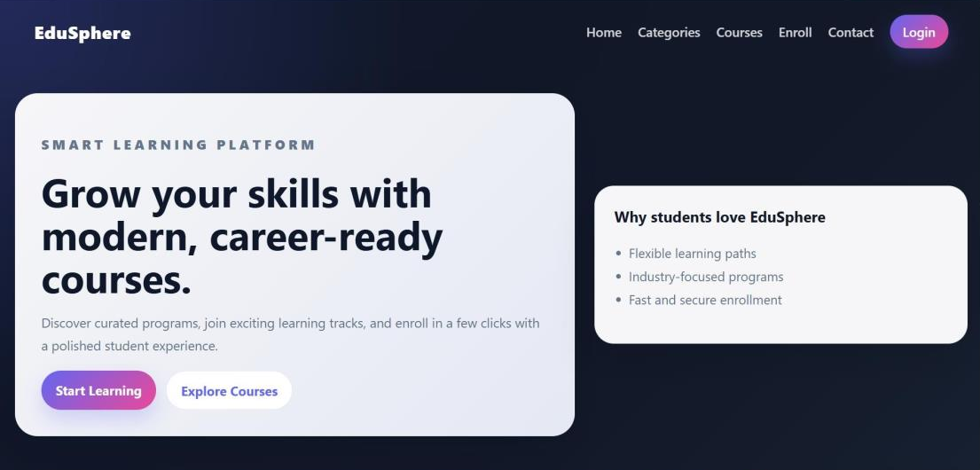
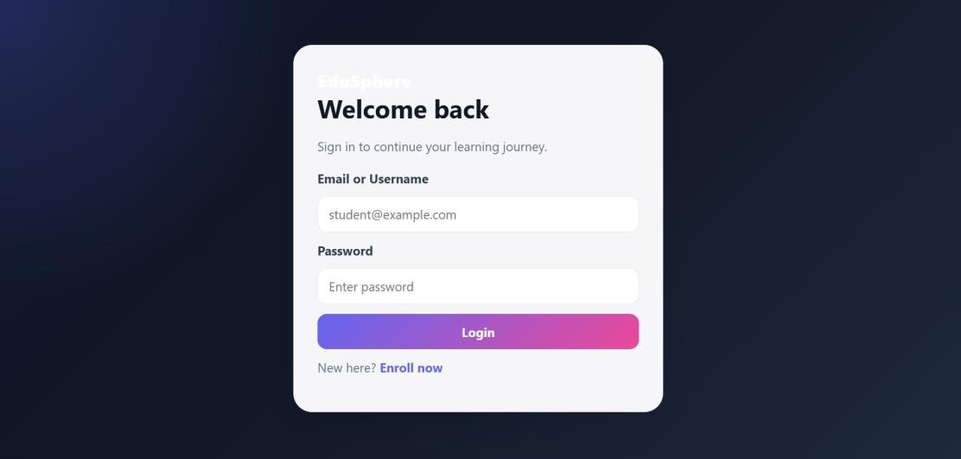
Sample Output: Home and Login
Home Page
Login Page
Landing page with the EduSphere brand, navigation links, the headline “Grow your skills with modern, career-ready courses”, Start Learning and Explore Courses buttons, and a benefits panel.
Email or username and password fields with a Login button and an Enroll now link for new users. Invalid input appears in an error box above the form.
Notes:
These are the home and login screens running locally on FastAPI with Uvicorn. The interface uses a dark gradient theme with card-based layout.

Slide 15
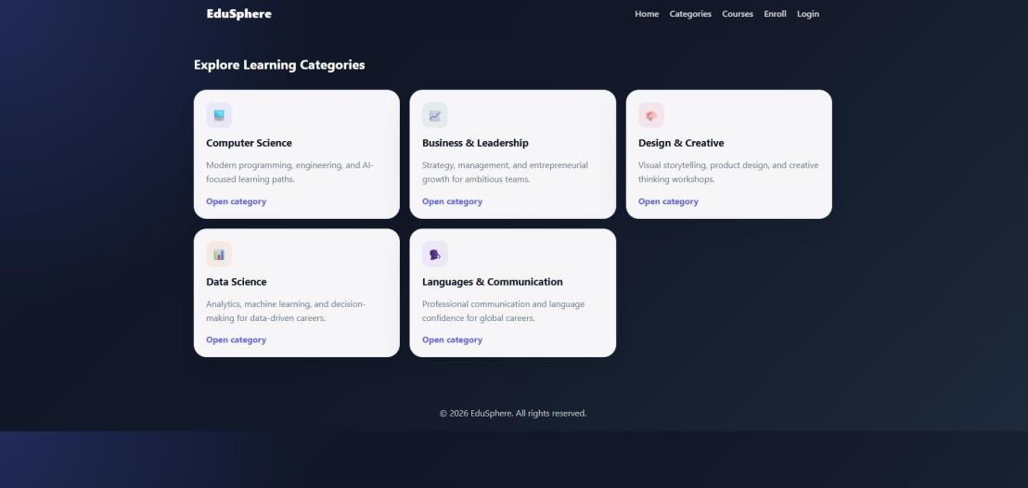
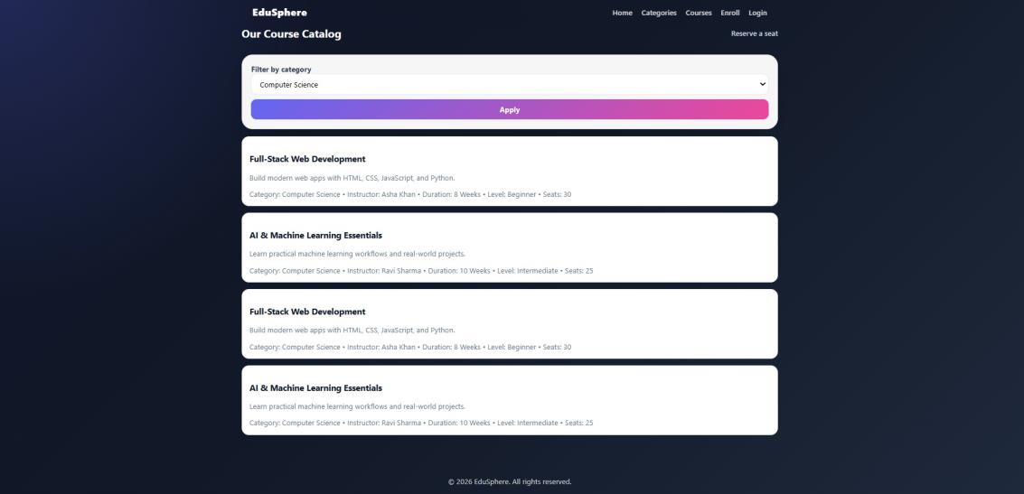
Sample Output: Categories and Courses
Categories Page
Course Catalog
Five category cards: Computer Science, Business & Leadership, Design & Creative, Data Science, and Languages & Communication. Each card has an Open category link to the filtered course list.
Course cards show title, description, category, instructor, duration, level and seats. The category filter is applied; Computer Science is selected in this output.
Notes:
Each category card links to the course catalog already filtered for that category. The catalog joins the courses and categories tables. In this capture each course appears twice because the sample data was seeded twice, which I document in the analysis.

Slide 16
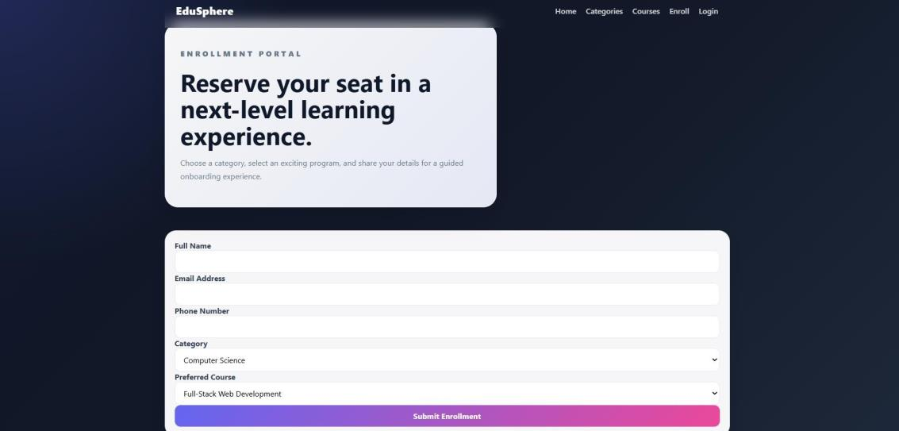
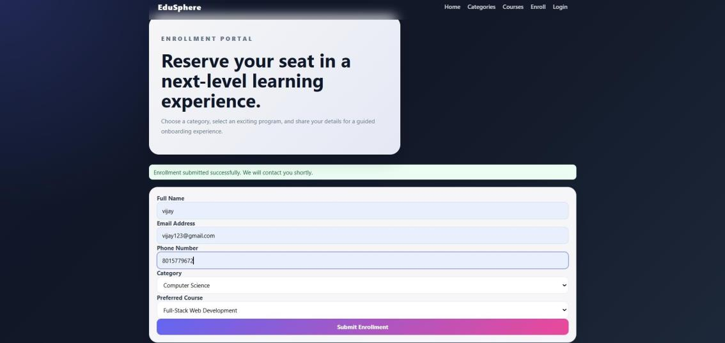

Sample Output: Enrollment
Enrollment Form
Successful Submission
Learners enter full name, email, phone, category and preferred course. Name and email are required and the email format is checked.
A valid submission is saved to the database and the page confirms: “Enrollment submitted successfully. We will contact you shortly.”
Status set to Pending
Timestamp recorded automatically
Confirmation shown instantly
Notes:
The learner fills a short form and gets confirmation immediately. Every new enrollment is stored with Pending status and an automatic timestamp so staff can review it later.

Slide 17

Testing and Analysis
Verified working
Improvements identified
Category browsing
Duplicate sample courses: seed data loaded twice
Course filtering by category
Login checks input only, not stored accounts
Enrollment submission
Login validation
Dashboard enrollment count capped at eight
Dashboard display
Category and course are chosen independently
Automatic database initialisation
Seat count is not reduced after enrollment
Edge cases tested
Database credentials are hard-coded in source
Empty fields, invalid email, short password, database not running
Result: less manual effort, more accurate enrollment records and one convenient platform
Notes:
Testing was done module by module, including edge cases such as empty fields and a stopped database. Testing also exposed six improvements, which feed directly into the future work.

Slide 18



Future Enhancements
Security and Access
Enrollment Features
Password hashing with session or JWT login
Role-based access for learners and admins
Database settings in environment variables
Admin panel to manage courses and approvals
Seat management with a waiting list
Duplicate prevention, dependent dropdowns
Engagement and Insight
Engineering and Deployment
Email and SMS confirmations
Razorpay or Stripe payment gateway
Search, pagination, analytics with CSV/PDF export
Pytest route tests with the FastAPI client
Docker and cloud deployment (AWS, Azure, GCP)
Android and iOS mobile application
Notes:
The roadmap addresses the limitations found in testing: real authentication, an admin panel, seat management, notifications and payments, plus automated tests and cloud deployment.

Slide 19


Conclusion and Key Learnings
What I Learned
Conclusion
Replaced paper-based registration with a centralized digital platform
Category browsing, catalog filter, enrollment, login, dashboard and automatic database setup were built and tested
A solid foundation for a complete enrollment management solution
Python web development
Database design and SQL
Forms and validation
Jinja2 template rendering
Responsive UI design
Testing and the SDLC
Notes:
In summary, the project replaced a manual process with a working, tested full stack application, and the internship gave me hands-on experience of the complete software development life cycle.

Slide 20

Thank You
Questions and Discussion
Niraimathi M | Summer Internship Review | Astonish InfoTech Private Limited
Notes:
Thank you. I would be happy to take any questions about the project, the technology choices or the internship.

