Slide 1
Reinforcement Learning Double Deep Q Learning
EE673 Term Project
Niraj Kumar (2020MCB1243), Archit Sood(2020MCB1230)

Slide 2
Introduction
Reinforcement Learning (RL) is a machine learning paradigm that seeks to train an agent solely based on the experiences it generates while interacting with an environment.
In a traditional RL problem, an agent explores different states by taking some action at each state. For example, the popular video game Super Mario is a famous RL environment.
The most popular RL algorithm is Q-Learning where the agent tries to learn the quality of each state-action pair.

Slide 3
Literature Review
The simple Deep Q-learning algorithm (DQN) is an extension of Q-learning algorithm using Deep Neural Network as a function approximator.
This DQN algorithm has some performance issues due to overestimation of action values and also due to maximisation bias.
Our base paper, presents a method which increases performance of DQN.
They use two Neural Networks instead of one and hence they name the algorithm as Double Deep Q Learning (DDQN).

Slide 4
Literature Review
The contribution of our base paper (Hado van Hasselt, Arthur Guez, David Silver, and Google DeepMind, Deep Reinforcement Learning with Double Q-learning) is very significant in RL community.
They have shown why Q-learning can be overoptimistic in large-scale problems, even if these are deterministic, due to the inherent estimation errors of learning.
By analysing the value estimates on Atari games they have shown that these overestimations are more common and severe in practice than previously acknowledged.
They have shown that Double Q-learning can be used at scale to successfully reduce this over optimism, resulting in more stable and reliable learning.
They have proposed a specific implementation called Double DQN that uses the existing architecture and deep neural network of the DQN algorithm without requiring additional networks or parameters.

Slide 5
Methodology
In DDQN, we do not update the networks after every episode, instead we update the Deep Networks after every f (say) episodes.
We propose that while taking steps in generating episodes during training, the agent goes to next state only after every f episodes.
That is, we take go to next state only when we are updating Deep Networks, otherwise we assume that the next state is current state itself.
This leads to learning optimal policy faster in Lunar Lander and Cart Pole environments.

Slide 6
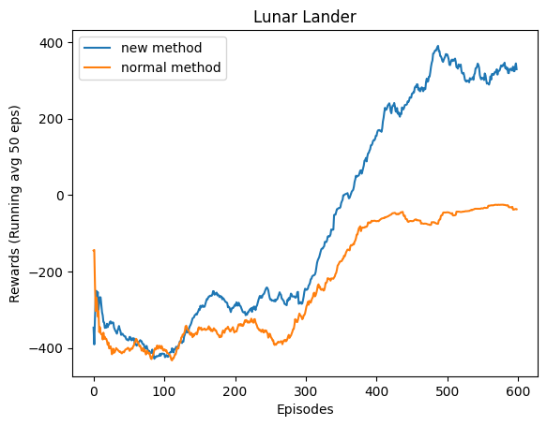
Results
Lunar Lander

Slide 7
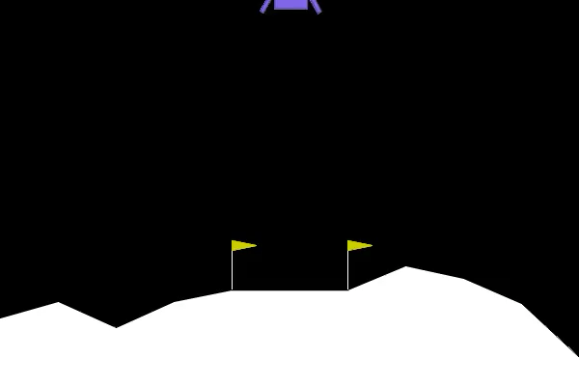
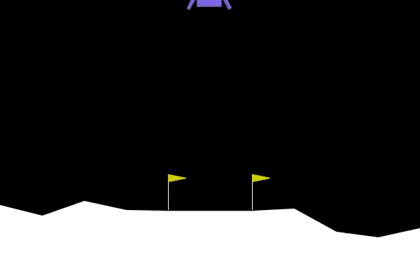
Results
Lunar Lander
Existing Algorithm
Proposed Approach
Reward: -44.65
Reward: 198.27

Slide 8
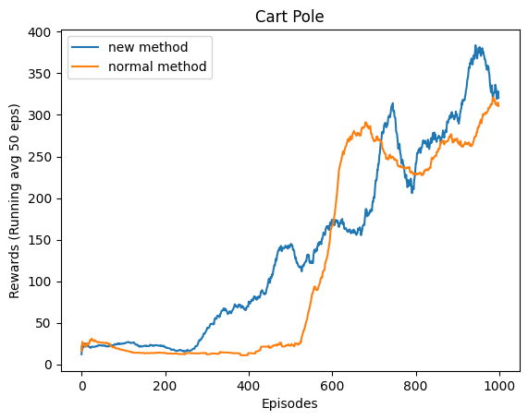
Results
Cart Pole

Slide 9
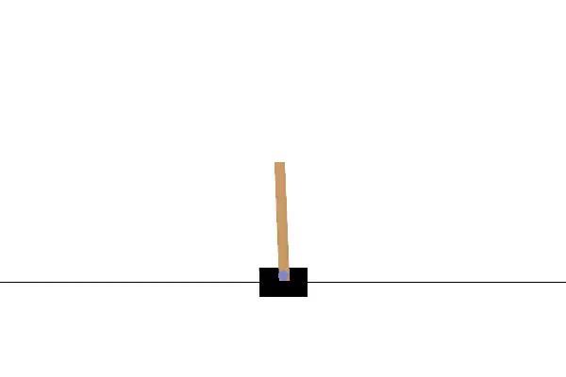
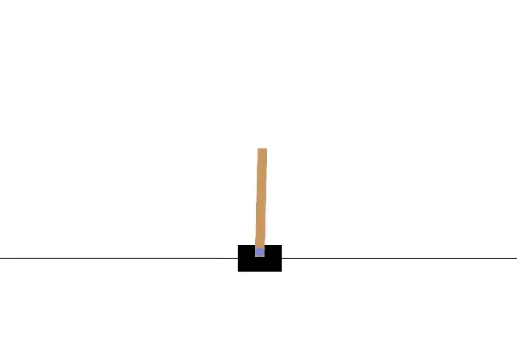
Results
Cart Pole
Existing Algorithm
Proposed Approach
Reward: 269.0
Reward: 500

Slide 10
Discussion
We saw that for Lunar Lander and Cart Pole environments, our proposed modification helps learn optimal policy faster.
Our algorithm seems to provide a more stable trajectory for the agents.

Slide 11
Conclusion
Our approach provides significant improvement over the baseline algorithm.
Due to computation limitation and other non-compatibility problems, we could not run our algorithm for other complex environments.

Slide 12
Future Work
Further research on more variety on environments is required.
Our approach can be further fine-tuned and perfected.

Slide 13
References
H. Van Hasselt, A. Guez and D. Silver, " Deep reinforcement learning with double Q -learning “, Proc. 13th AAAI Conf. Artif. Intell., pp. 2094-2100, 2016

Slide 14
Thank You

