Slide 1

MA205: COMPUTING LAB
PROJECT REPORT
NUMERICAL INTEGRATION: QUADRATURE METHODS (GAUSS HERMITE AND GAUSS LEGENDRE)

Slide 2
Information
Course Instructor
Prof. Manoranjan Mishra
Department of Mathematics
Indian Institute of Technology, Ropar
Rupnagar, Punjab - 140001
End Semester Project Report
Course : Computing Lab (MA205)
Session : 2021-W
Submitted by:
Name - Niraj Kumar
Entry number – 2020MCB1243
Branch – Mathematics and Computing

Slide 3
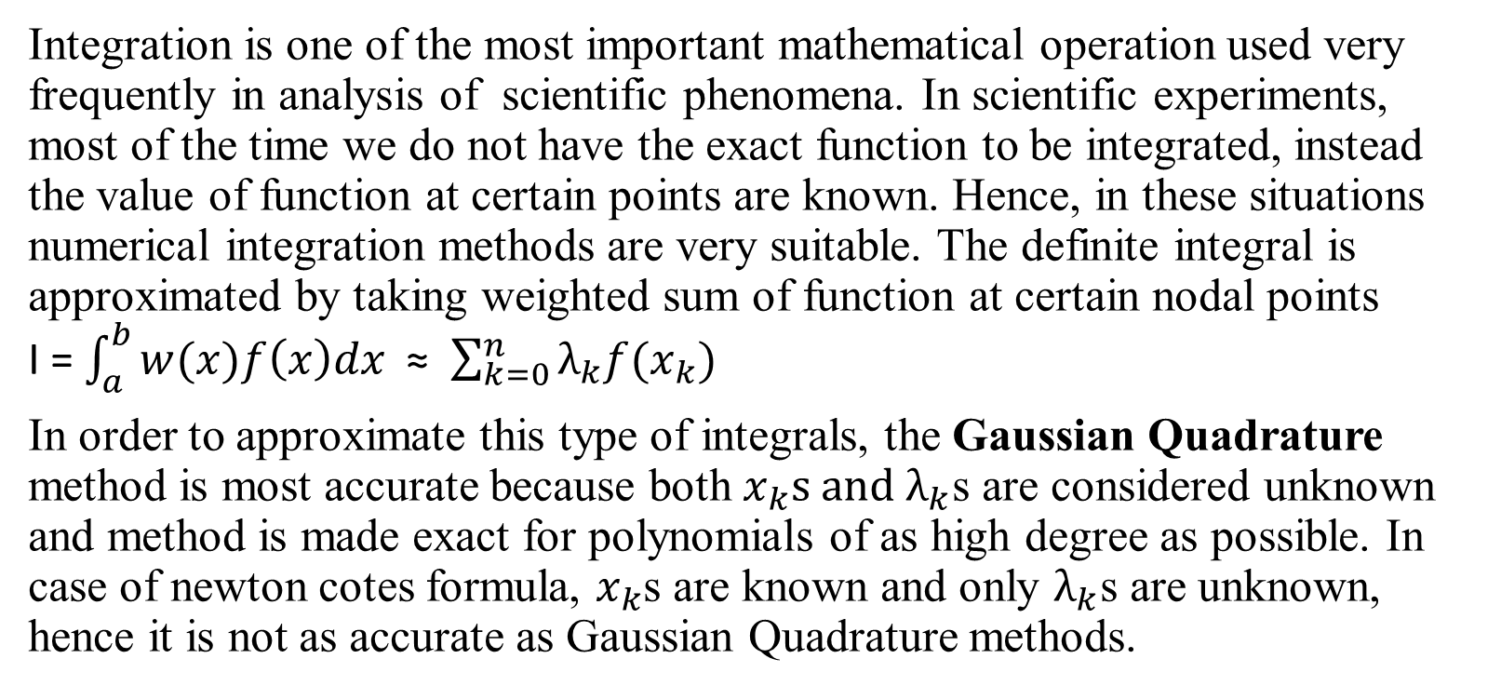
(1)Motivation behind the designing of the method
Integration is one of the most important mathematical operation used very frequently in analysis of scientific phenomena. In scientific experiments, most of the time we do not have the exact function to be integrated, instead the value of function at certain points are known. Hence, in these situations numerical integration methods are very suitable. The definite integral is approximated by taking weighted sum of function at certain nodal points I = $\int_{a}^{b}{w(x)f\left(x\right)dx}$ ≈ $\sum_{k=0}^{n}{λ_{k}f(x_{k})}$
In order to approximate this type of integrals, the Gaussian Quadrature method is most accurate because both $x_{k}s and λ_{k}$s are considered unknown and method is made exact for polynomials of as high degree as possible. In case of newton cotes formula, $x_{k}$s are known and only $λ_{k}$s are unknown, hence it is not as accurate as Gaussian Quadrature methods.

Slide 4
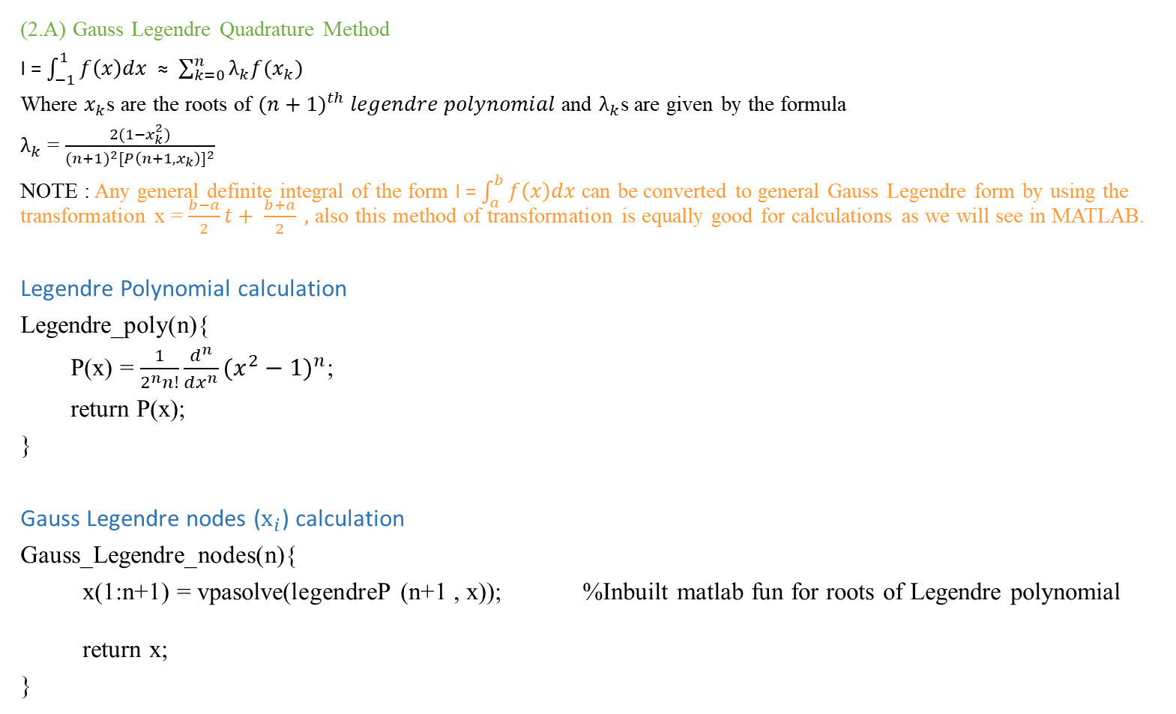
(2)Algorithms
(2.A) Gauss Legendre Quadrature Method
I = $\int_{−1}^{1}{f\left(x\right)dx}$ ≈ $\sum_{k=0}^{n}{λ_{k}f(x_{k})}$
Where $x_{k}$s are the roots of ${(n+1)}^{th} legendre polynomial$ and $λ_{k}$s are given by the formula
$λ_{k}$ = $\frac{2(1−x_{k}^{2})}{{(n+1)}^{2}{[P\left(n+1,x_{k}\right)]}^{2}}$
NOTE : Any general definite integral of the form I = $\int_{a}^{b}{f\left(x\right)dx}$ can be converted to general Gauss Legendre form by using the transformation x = $\frac{b−a}{2}t+ \frac{b+a}{2} ,$ also this method of transformation is equally good for calculations as we will see in MATLAB.
Legendre Polynomial calculation
Legendre_poly(n){
P(x) = $\frac{1}{2^{n}n!}{\frac{d^{n}}{dx^{n}}(x^{2}−1)}^{n}$;
return P(x);
}
Gauss Legendre nodes (${\text{x}}_{i}$) calculation
Gauss_Legendre_nodes(n){
x(1:n+1) = vpasolve(legendreP (n+1 , x)); %Inbuilt matlab fun for roots of Legendre polynomial
return x;
}

Slide 5

Gauss Legendre Weights (${\text{λ}}_{i}$) Calculation
Gauss_Legendre_weights (n , x){
P(n+1,x) = Legendre_poly(n+1);
for i = 0 to n
$x_{i}$ = x(i+1);
λ (i) = $\frac{2(1−x_{i}^{2})}{{(n+1)}^{2}{[P\left(n+1,x_{i}\right)]}^{2}}$; % formula reference L.V Fausett page no. 463
end
return λ;
}

Slide 6
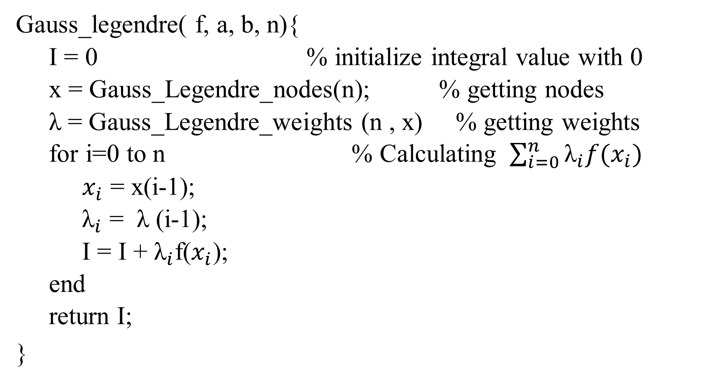
Gauss Legendre Quadrature final calculation
Gauss_legendre( f, a, b, n){
I = 0 % initialize integral value with 0
x = Gauss_Legendre_nodes(n); % getting nodes
λ = Gauss_Legendre_weights (n , x) % getting weights
for i=0 to n % Calculating $\sum_{i=0}^{n}{{\text{λ}}_{i}f(x_{i})}$
$x_{i}$ = x(i-1);
${\text{λ}}_{i}$ = λ (i-1);
I = I + ${\text{λ}}_{i}$f($x_{i}$);
end
return I;
}

Slide 7
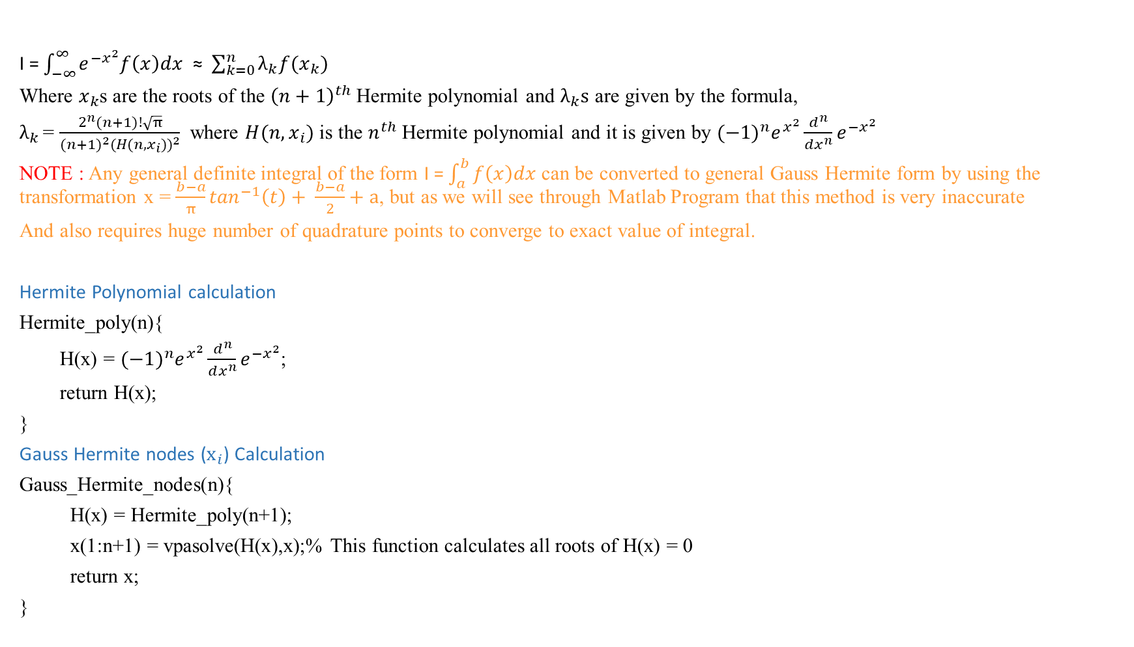
(2.B) Gauss Hermite Quadrature Method
I = $\int_{−∞}^{∞}{e^{{−x}^{2}}f\left(x\right)dx}$ ≈ $\sum_{k=0}^{n}{λ_{k}f(x_{k})}$
Where $x_{k}$s are the roots of the ${\left(n+1\right)}^{th}$ Hermite polynomial and $λ_{k}s$ are given by the formula,
$λ_{k }$= $\frac{2^{n}(n+1)!\sqrt{π}}{{{(n+1)}^{2}(H({n,x}_{i}))}^{2}}$ where $H({n,x}_{i})$ is the $n^{th}$ Hermite polynomial and it is given by ${(−1)}^{n}e^{x^{2}}\frac{d^{n}}{dx^{n}}e^{{−x}^{2}}$
NOTE : Any general definite integral of the form I = $\int_{a}^{b}{f\left(x\right)dx}$ can be converted to general Gauss Hermite form by using the transformation x = $\frac{b−a}{π}\tan^{−1}\left(t\right)+ \frac{b−a}{2}+a$, but as we will see through Matlab Program that this method is very inaccurate
And also requires huge number of quadrature points to converge to exact value of integral.
Hermite Polynomial calculation
Hermite_poly(n){
H(x) = ${(−1)}^{n}e^{x^{2}}\frac{d^{n}}{dx^{n}}e^{{−x}^{2}}$;
return H(x);
}
Gauss Hermite nodes (${\text{x}}_{i}$) Calculation
Gauss_Hermite_nodes(n){
H(x) = Hermite_poly(n+1);
x(1:n+1) = vpasolve(H(x),x);% This function calculates all roots of H(x) = 0
return x;
}

Slide 8

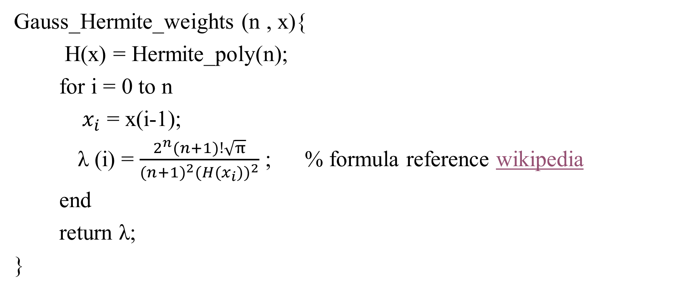
Gauss Hermite Weights (${\text{λ}}_{i}$) Calculation
Gauss_Hermite_weights (n , x){
H(x) = Hermite_poly(n);
for i = 0 to n
${ x}_{i}$ = x(i-1);
λ (i) = $\frac{2^{n}(n+1)!\sqrt{π}}{{{(n+1)}^{2}(H(x_{i}))}^{2}}$ ; % formula reference wikipedia
end
return λ;
}

Slide 9
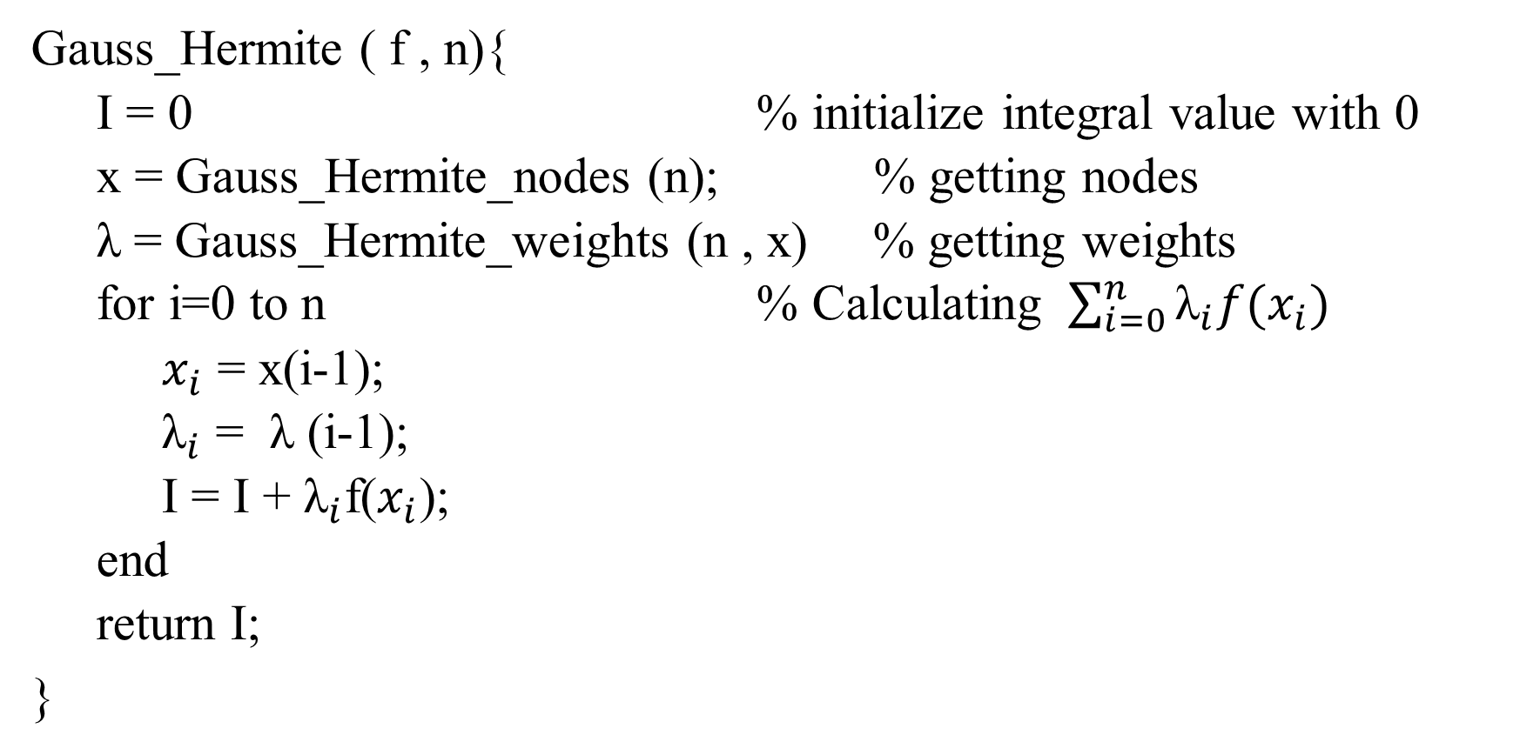
Gauss Hermite Quadrature final calculation
Gauss_Hermite ( f , n){
I = 0 % initialize integral value with 0
x = Gauss_Hermite_nodes (n); % getting nodes
λ = Gauss_Hermite_weights (n , x) % getting weights
for i=0 to n % Calculating $\sum_{i=0}^{n}{{\text{λ}}_{i}f(x_{i})}$
$x_{i}$ = x(i-1);
${\text{λ}}_{i}$ = λ (i-1);
I = I + ${\text{λ}}_{i}$f($x_{i}$);
end
return I;
}

Slide 10
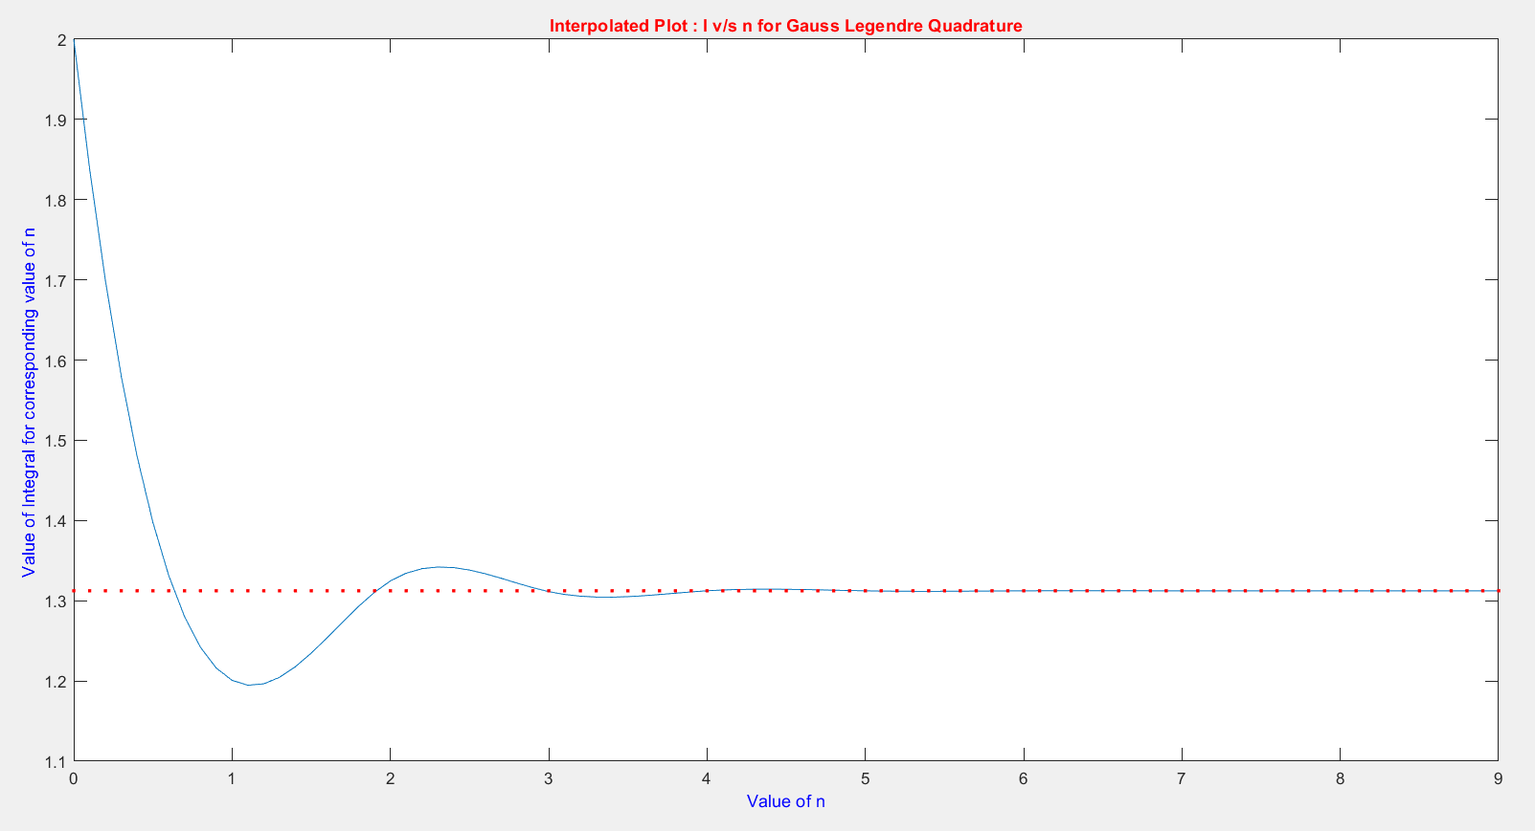
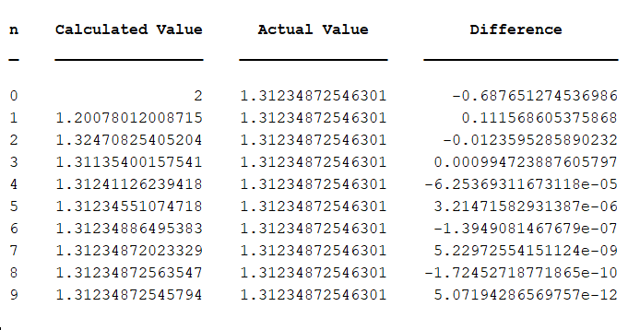

Illustration
Gauss Legendre Quadrature
Example 1 : I = $\int_{−1}^{1}{e^{−x^{2}}cos⁡(x)dx}$
Exact Value of I = 1.31234872546301
We can approximate I by Gauss Legendre Quadrature rule by taking different values of n.
The MATLAB output is given below

Slide 11
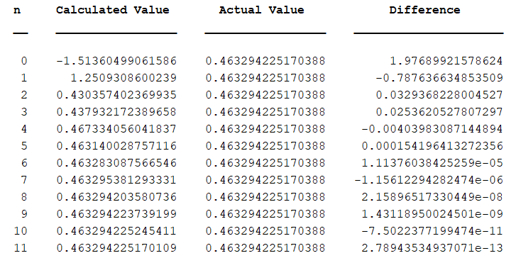
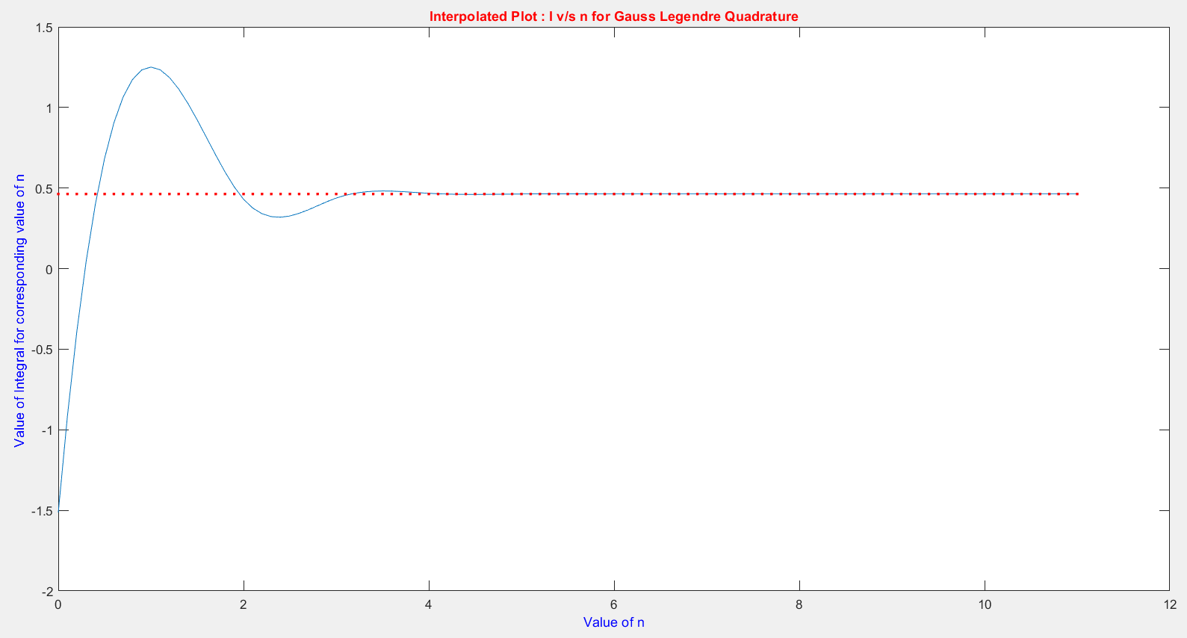
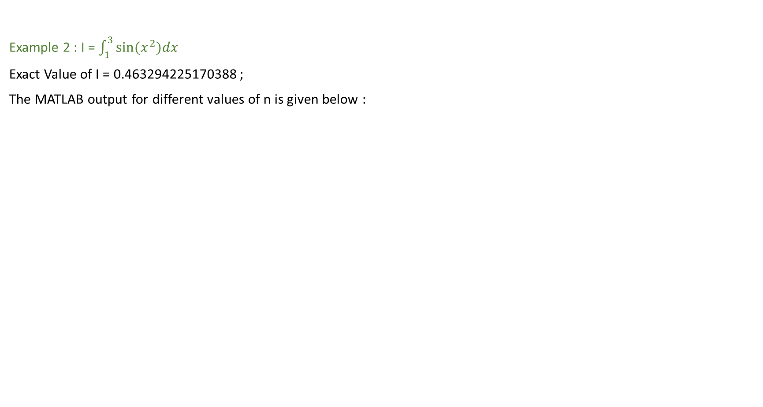
(1) Gauss Legendre Quadrature
Example 2 : I = $\int_{1}^{3}{sin(x^{2})dx}$
Exact Value of I = 0.463294225170388 ;
The MATLAB output for different values of n is given below :

Slide 12
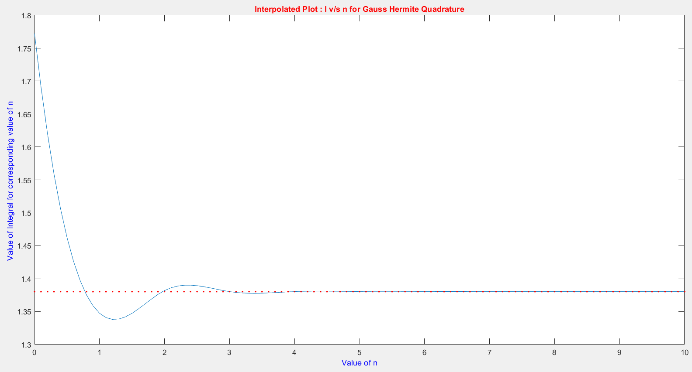
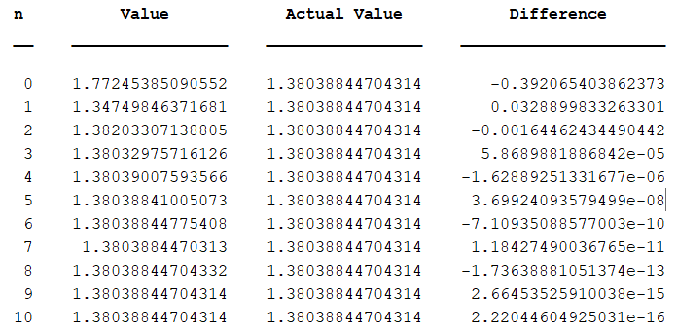

(2) Gauss Hermite Quadrature
Example 1 : I = $\int_{−∞}^{∞}{e^{{−x}^{2}}cos⁡(x)dx}$
Exact Value of I = 1.38038844704314
The MATLAB output for different values of n is given below

Slide 13
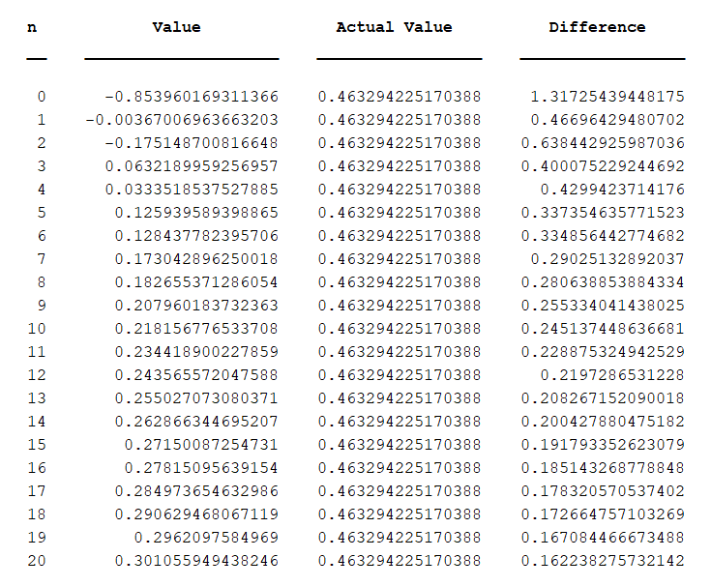
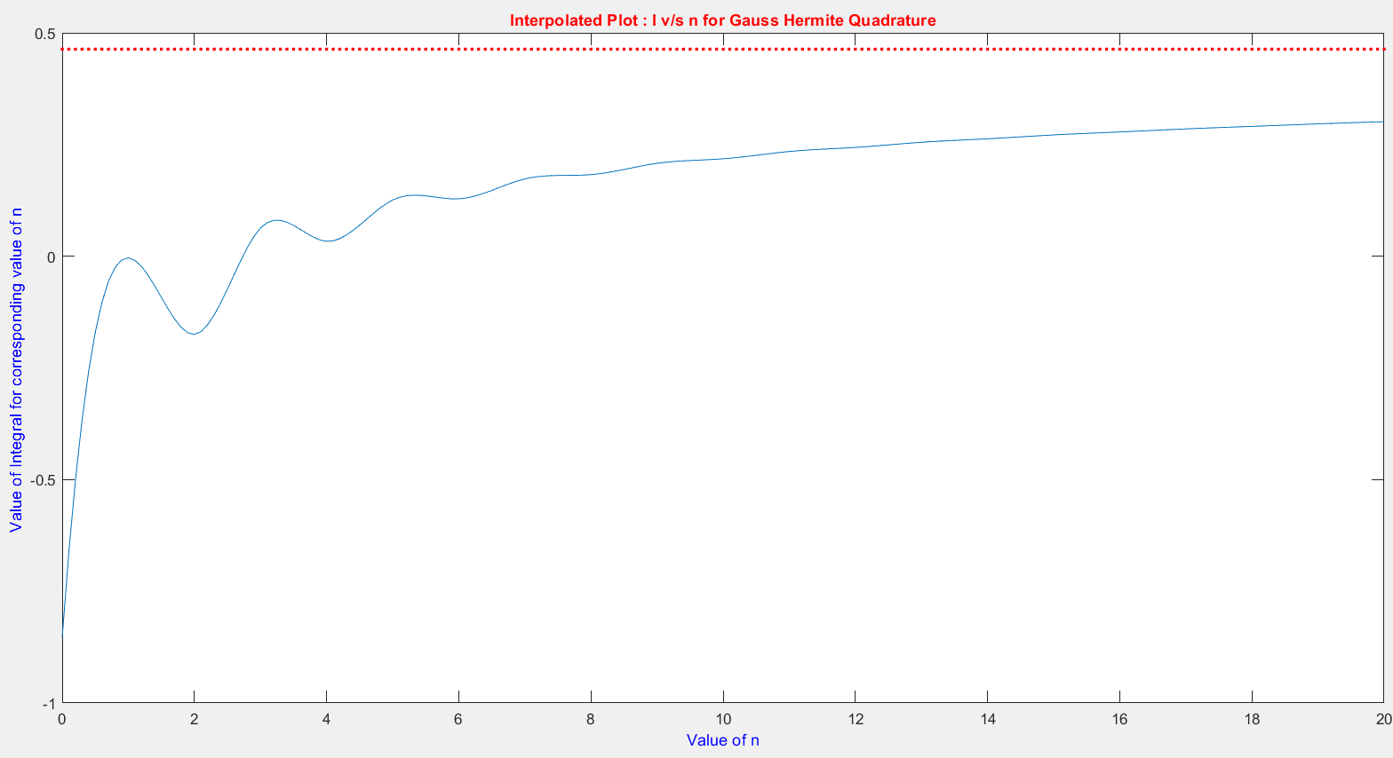

(2) Gauss Hermite Quadrature
Example 2 : I = $\int_{1}^{3}{sin(x^{2})dx}$ (same as 2nd example of gauss legendre)
The integral is first converted to limits from –inf to +inf using the transformation x = $\frac{b−a}{π}\tan^{−1}\left(t\right)+ \frac{b−a}{2}+a$; where a = 1 and b = 3.
Exact Value of I = 0.463294225170388
The MATLAB output for different values of n is given below

Slide 14
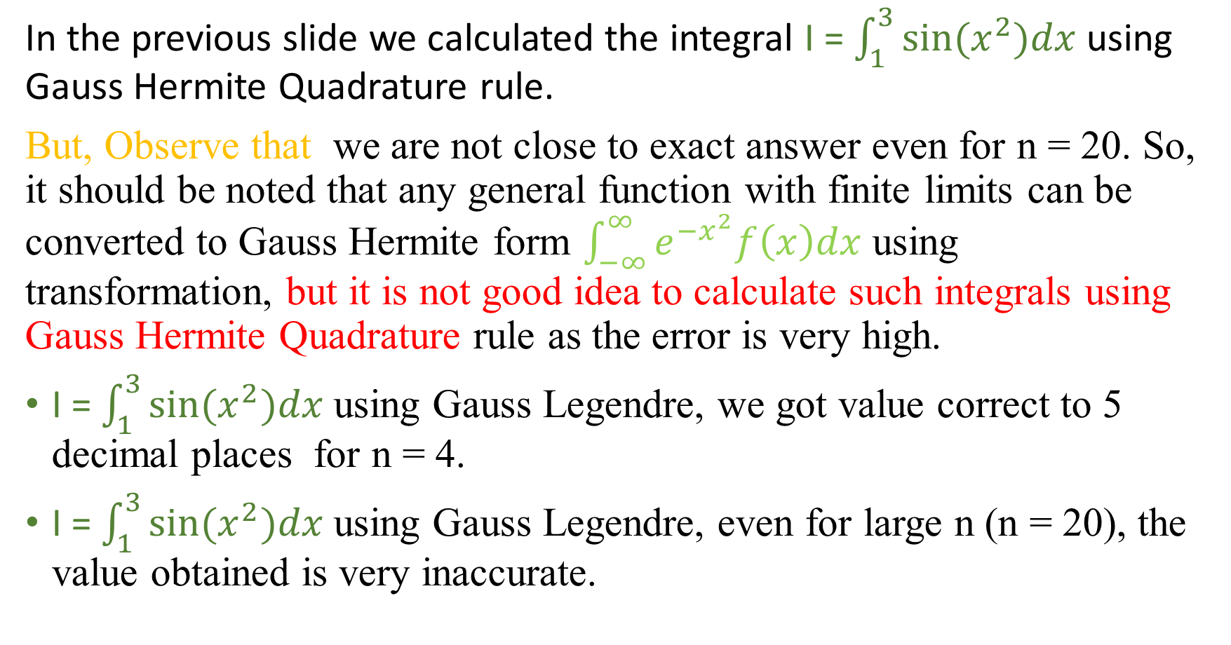
(2) Gauss Hermite Quadrature
In the previous slide we calculated the integral I = $\int_{1}^{3}{sin(x^{2})dx}$ using Gauss Hermite Quadrature rule.
But, Observe that we are not close to exact answer even for n = 20. So, it should be noted that any general function with finite limits can be converted to Gauss Hermite form $\int_{−∞}^{∞}{e^{{−x}^{2}}f\left(x\right)dx}$ using transformation, but it is not good idea to calculate such integrals using Gauss Hermite Quadrature rule as the error is very high.
I = $\int_{1}^{3}{sin(x^{2})dx}$using Gauss Legendre, we got value correct to 5 decimal places for n = 4.
I = $\int_{1}^{3}{sin(x^{2})dx}$using Gauss Legendre, even for large n (n = 20), the value obtained is very inaccurate.

Slide 15
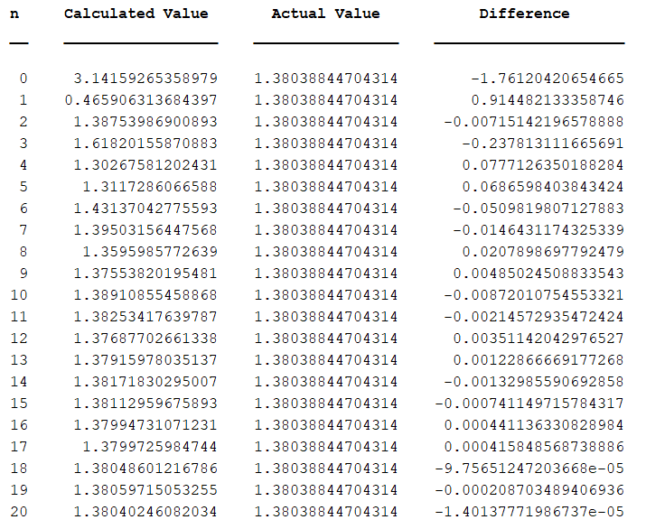
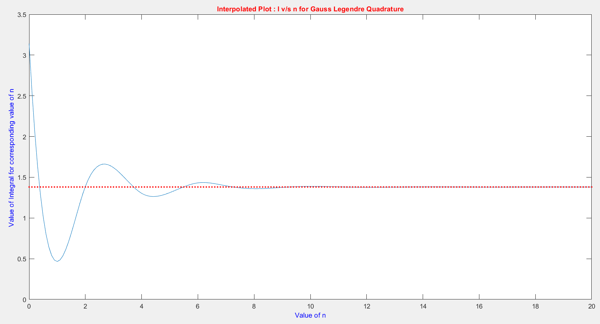
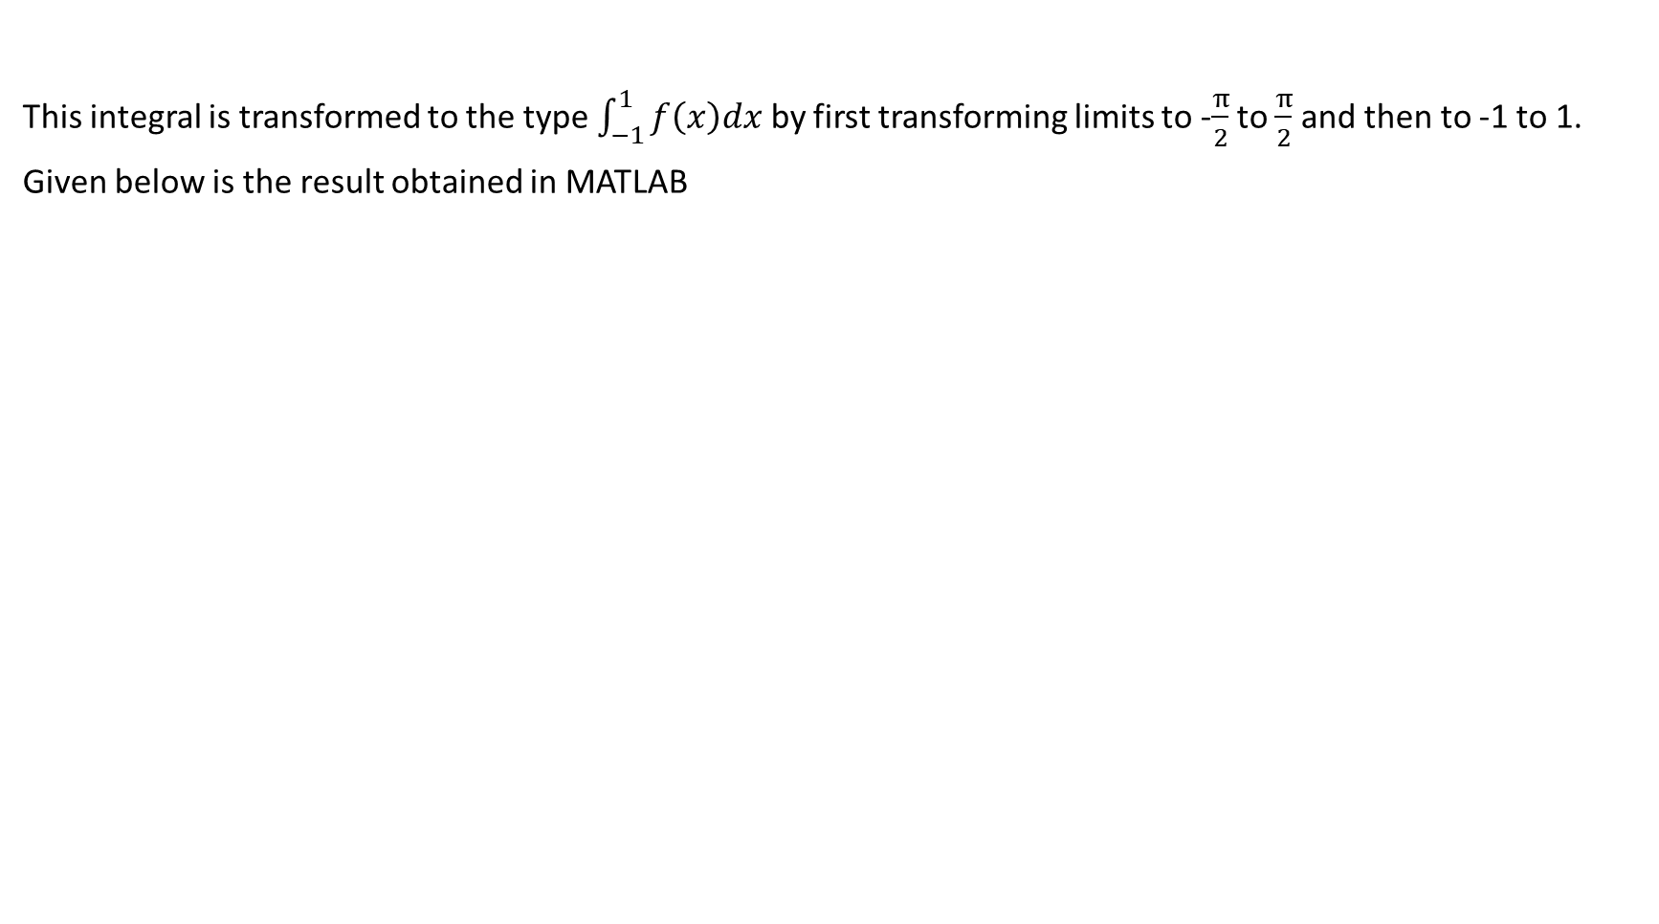
Calculation of I = $\int_{−∞}^{∞}{e^{{−x}^{2}}cos⁡(x)dx}$ using gauss legendre
This integral is transformed to the type $\int_{−1}^{1}{f\left(x\right)dx}$ by first transforming limits to -$\frac{π}{2}$ to $\frac{π}{2}$ and then to -1 to 1.
Given below is the result obtained in MATLAB

Slide 16
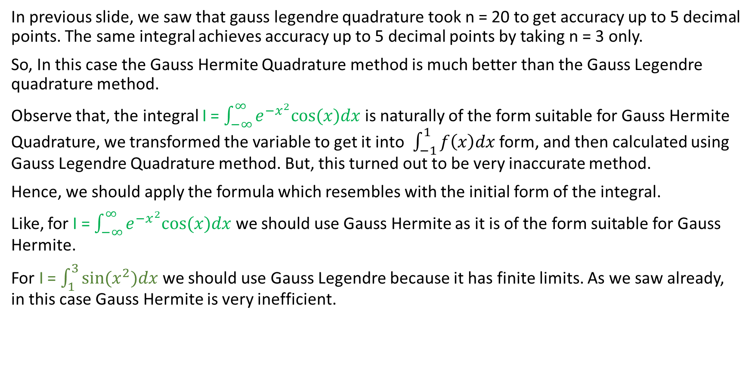
Choice between Gauss Hermite and Gauss Legendre Quadrature methods.
In previous slide, we saw that gauss legendre quadrature took n = 20 to get accuracy up to 5 decimal points. The same integral achieves accuracy up to 5 decimal points by taking n = 3 only.
So, In this case the Gauss Hermite Quadrature method is much better than the Gauss Legendre quadrature method.
Observe that, the integral I = $\int_{−∞}^{∞}{e^{{−x}^{2}}cos⁡(x)dx}$ is naturally of the form suitable for Gauss Hermite Quadrature, we transformed the variable to get it into $\int_{−1}^{1}{f\left(x\right)dx}$ form, and then calculated using Gauss Legendre Quadrature method. But, this turned out to be very inaccurate method.
Hence, we should apply the formula which resembles with the initial form of the integral.
Like, for I = $\int_{−∞}^{∞}{e^{{−x}^{2}}cos⁡(x)dx}$ we should use Gauss Hermite as it is of the form suitable for Gauss Hermite.
For I = $\int_{1}^{3}{sin(x^{2})dx}$ we should use Gauss Legendre because it has finite limits. As we saw already, in this case Gauss Hermite is very inefficient.

Slide 17
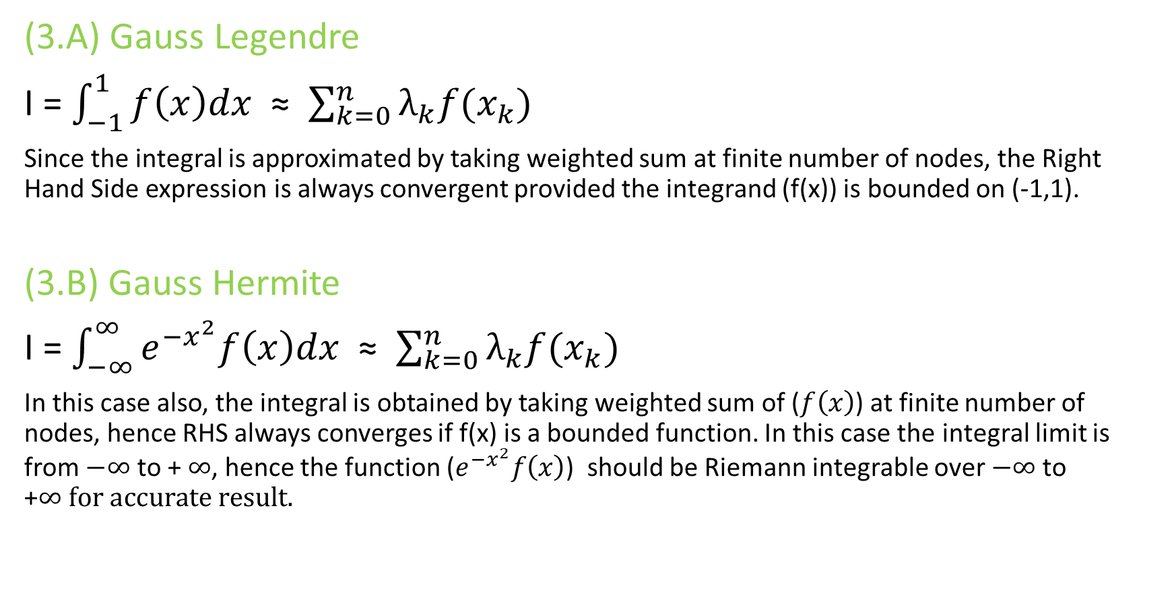
(3)Convergence criteria
(3.A) Gauss Legendre
I = $\int_{−1}^{1}{f\left(x\right)dx}$ ≈ $\sum_{k=0}^{n}{λ_{k}f(x_{k})}$
Since the integral is approximated by taking weighted sum at finite number of nodes, the Right Hand Side expression is always convergent provided the integrand (f(x)) is bounded on (-1,1).
(3.B) Gauss Hermite
I = $\int_{−∞}^{∞}{e^{{−x}^{2}}f\left(x\right)dx}$ ≈ $\sum_{k=0}^{n}{λ_{k}f(x_{k})}$
In this case also, the integral is obtained by taking weighted sum of ($f\left(x\right)$) at finite number of nodes, hence RHS always converges if f(x) is a bounded function. In this case the integral limit is from $−∞$ to + $∞$, hence the function ($e^{{−x}^{2}}f\left(x\right)$) should be Riemann integrable over $−∞$to +$∞ for accurate result.$

Slide 18
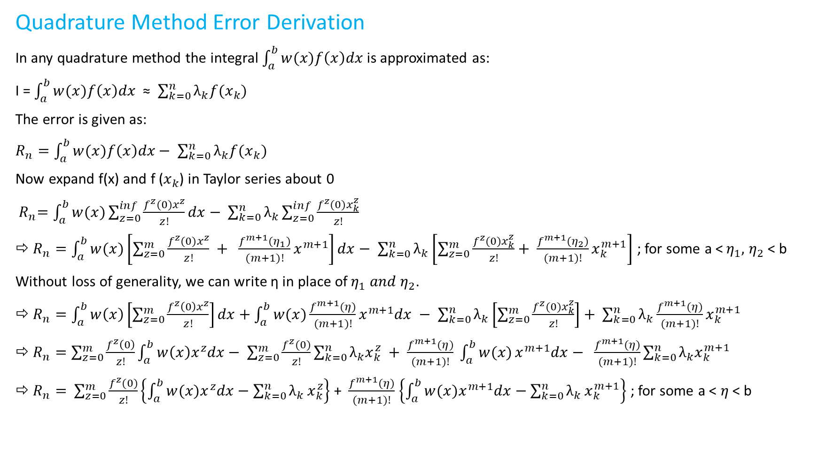
(4)Error Order
Quadrature Method Error Derivation
In any quadrature method the integral $\int_{a}^{b}{w(x)f\left(x\right)dx}$ is approximated as:
I = $\int_{a}^{b}{w(x)f\left(x\right)dx}$ ≈ $\sum_{k=0}^{n}{λ_{k}f(x_{k})}$
The error is given as:
$R_{n}=\int_{a}^{b}{w(x)f\left(x\right)dx− \sum_{k=0}^{n}{λ_{k}f(x_{k})}}$
Now expand f(x) and f ($x_{k}$) in Taylor series about 0
${ R}_{n}=\int_{a}^{b}{w(x)\sum_{z=0}^{inf}{\frac{f^{z}(0)x^{z}}{z!}}dx− \sum_{k=0}^{n}{λ_{k}\sum_{z=0}^{inf}{\frac{f^{z}(0)x_{k}^{z}}{z!}}}}$
${⇨ R}_{n}=\int_{a}^{b}{w(x)\left[\sum_{z=0}^{m}{\frac{f^{z}(0)x^{z}}{z!} + \frac{f^{m+1}(η_{1})}{(m+1)!}x^{m+1}}\right]dx− \sum_{k=0}^{n}{λ_{k}\left[\sum_{z=0}^{m}{\frac{f^{z}(0)x_{k}^{z}}{z!}+ \frac{f^{m+1}(η_{2})}{(m+1)!}x_{k}^{m+1}}\right]}}$ ; for some a <$η_{1},$ $η_{2}$ < b
Without loss of generality, we can write η in place of$η_{1} and η_{2}$.
${⇨ R}_{n}=\int_{a}^{b}{w\left(x\right)\left[\sum_{z=0}^{m}{\frac{f^{z}\left(0\right)x^{z}}{z!}}\right]dx+\int_{a}^{b}{{w(x)\frac{f^{m+1}(η)}{(m+1)!}x}^{m+1}dx} − \sum_{k=0}^{n}{λ_{k}\left[\sum_{z=0}^{m}{\frac{f^{z}(0)x_{k}^{z}}{z!}}\right]+ \sum_{k=0}^{n}{λ_{k}\frac{f^{m+1}(η)}{(m+1)!}x_{k}^{m+1}}}}$
${⇨ R}_{n}=\sum_{z=0}^{m}{\frac{f^{z}\left(0\right)}{z!}}\int_{a}^{b}{w\left(x\right)x^{z}dx− \sum_{z=0}^{m}{\frac{f^{z}(0)}{z!}\sum_{k=0}^{n}{λ_{k}x_{k}^{z}}} }+ \frac{f^{m+1}(η)}{(m+1)!} \int_{a}^{b}{w(x)}x^{m+1}dx− \frac{f^{m+1}(η)}{(m+1)!}\sum_{k=0}^{n}{{λ_{k}x}_{k}^{m+1}}$
${⇨ R}_{n}=$ $\sum_{z=0}^{m}{\frac{f^{z}(0)}{z!}}\left\{\int_{a}^{b}{{w(x)x}^{z}dx−\sum_{k=0}^{n}{λ_{k}}}x_{k}^{z}\right\}$ + $\frac{f^{m+1}(η)}{(m+1)!}$ $\left\{\int_{a}^{b}{{w(x)x}^{m+1}dx−\sum_{k=0}^{n}{λ_{k}}}x_{k}^{m+1}\right\}$ ; for some a < $η$ < b

Slide 19

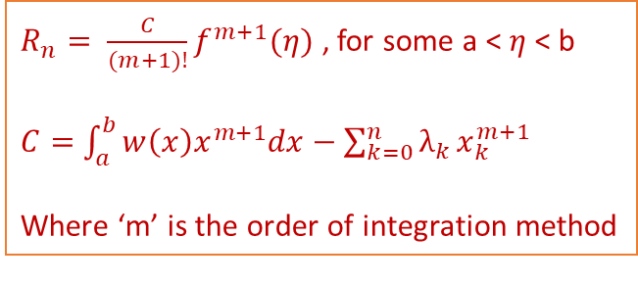
For a quadrature method of order m, we have $\int_{a}^{b}{{w(x)x}^{z}dx−\sum_{k=0}^{n}{λ_{k}}}x_{k}^{z}$ = 0, for z = 0, 1, 2 ..., m; because the integral is exact for polynomials of order up to m.
Clearly, the first m+1 term from z = 0 to m, of the power series expansion of $R_{n}$ is zero
${⇨ R}_{n}= \frac{f^{m+1}(η)}{(m+1)!}$ $\left\{\int_{a}^{b}{{w(x)x}^{m+1}dx−\sum_{k=0}^{n}{λ_{k}}}x_{k}^{m+1}\right\}$
$⇨ R_{n}= \frac{C}{(m+1)!}f^{m+1}(η)$ , for some a < $η$ < b
Where $C=$ $\int_{a}^{b}{{w(x)x}^{m+1}dx−\sum_{k=0}^{n}{λ_{k}}}x_{k}^{m+1}$ and ‘m’ is the order of integration method.
$R_{n}= \frac{C}{(m+1)!}f^{m+1}(η)$ , for some a < $η$ < b
$C=$ $\int_{a}^{b}{{w\left(x\right)x}^{m+1}dx−\sum_{k=0}^{n}{λ_{k}}}x_{k}^{m+1}$
Where ‘m’ is the order of integration method
This error formula is applicable for all type of methods wherever the integral is calculated using weighted sum. Like, Simpson’s rule,
Trapezoidal rule, Newton Cotes formula etc.

Slide 20
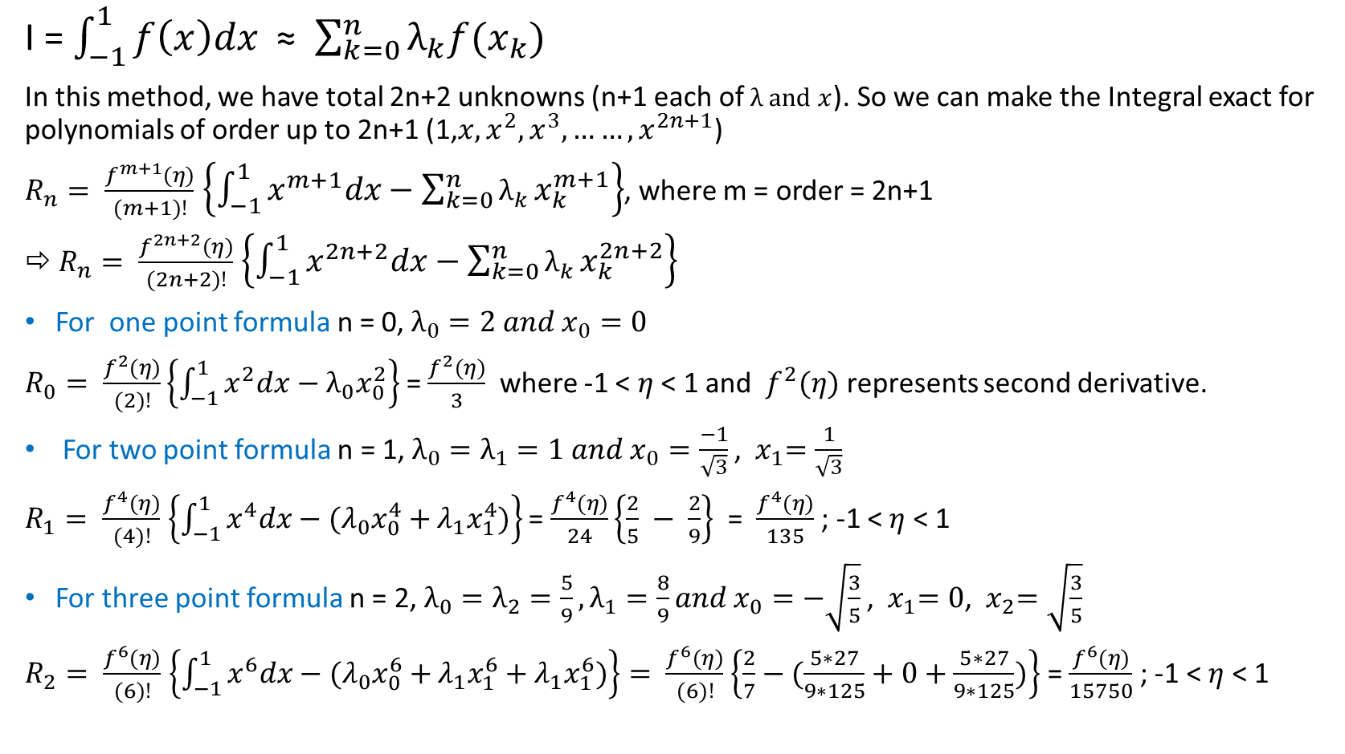
(4.A) Error Order of Gauss Legendre Quadrature Rule
I = $\int_{−1}^{1}{f\left(x\right)dx}$ ≈ $\sum_{k=0}^{n}{λ_{k}f(x_{k})}$
In this method, we have total 2n+2 unknowns (n+1 each of $λ and x$). So we can make the Integral exact for polynomials of order up to 2n+1 (1,${x,x}^{2},x^{3},……, x^{2n+1}$)
$R_{n}= \frac{f^{m+1}(η)}{(m+1)!}$ $\left\{\int_{−1}^{1}{x^{m+1}dx−\sum_{k=0}^{n}{λ_{k}}}x_{k}^{m+1}\right\}$, where m = order = 2n+1
${⇨ R}_{n}= \frac{f^{2n+2}(η)}{(2n+2)!}$ $\left\{\int_{−1}^{1}{x^{2n+2}dx−\sum_{k=0}^{n}{λ_{k}}}x_{k}^{2n+2}\right\}$
For one point formula n = 0, $λ_{0}=2 and x_{0}=0$
$R_{0}= \frac{f^{2}(η)}{(2)!}\left\{\int_{−1}^{1}{x^{2}dx−λ_{0}x_{0}^{2}}\right\}$ = $\frac{f^{2}(η)}{3}$ where -1 < $η$ < 1 and $f^{2}(η)$ represents second derivative.
For two point formula n = 1, $λ_{0}=λ_{1}=1 and{ x}_{0}=\frac{−1}{\sqrt{3}}$ , ${ x}_{1}=\frac{1}{\sqrt{3}}$
$R_{1}= \frac{f^{4}(η)}{(4)!}$ $\left\{\int_{−1}^{1}{x^{4}dx−{(λ}_{0}x_{0}^{4}+}λ_{1}x_{1}^{4})\right\}$ = $\frac{f^{4}(η)}{24}\left\{\frac{2}{5} − \frac{2}{9}\right\}$ = $\frac{f^{4}(η)}{135}$ ; -1 < $η$ < 1
For three point formula n = 2, $λ_{0}=λ_{2}=\frac{5}{9},λ_{1}=\frac{8}{9}and{ x}_{0}=−\sqrt{\frac{3}{5}}$ , ${ x}_{1}=0$, ${ x}_{2}=\sqrt{\frac{3}{5}}$
$R_{2}= \frac{f^{6}(η)}{(6)!}$ $\left\{\int_{−1}^{1}{x^{6}dx−{(λ}_{0}x_{0}^{6}+}λ_{1}x_{1}^{6}+λ_{1}x_{1}^{6})\right\}= \frac{f^{6}(η)}{(6)!}$ $\left\{\frac{2}{7}−(\frac{5∗27}{9∗125}+0+\frac{5∗27}{9∗125})\right\}$ = $\frac{f^{6}(η)}{15750}$ ; -1 < $η$ < 1

Slide 21
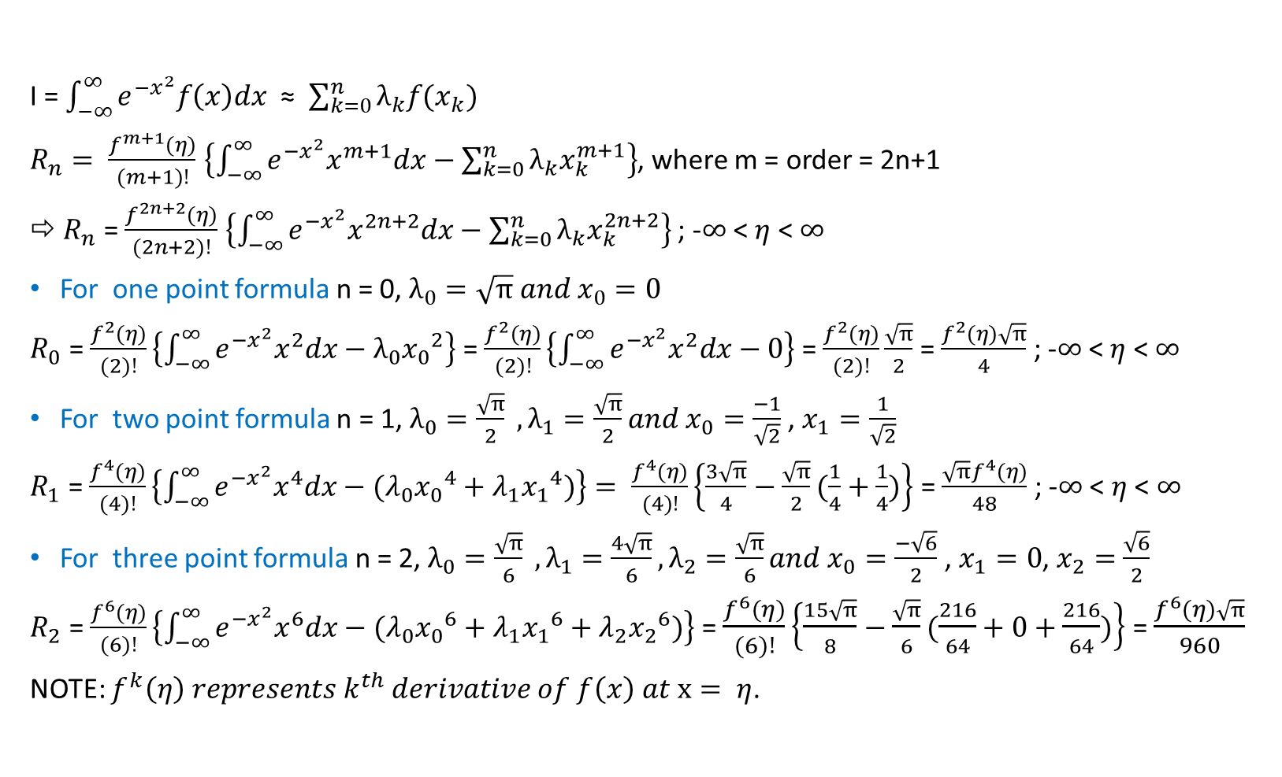
(4.B) Error Order of Gauss Hermite Quadrature Rule
I = $\int_{−∞}^{∞}{e^{{−x}^{2}}f\left(x\right)dx}$ ≈ $\sum_{k=0}^{n}{λ_{k}f(x_{k})}$
$R_{n}= \frac{f^{m+1}(η)}{(m+1)!}$ $\left\{\int_{−∞}^{∞}{e^{{−x}^{2}}x^{m+1}dx−\sum_{k=0}^{n}{λ_{k}x_{k}^{m+1}}}\right\}$, where m = order = 2n+1
${⇨ R}_{n}$ = $\frac{f^{2n+2}(η)}{(2n+2)!}$ $\left\{\int_{−∞}^{∞}{e^{{−x}^{2}}x^{2n+2}dx−\sum_{k=0}^{n}{λ_{k}x_{k}^{2n+2}}}\right\}$ ; -$∞$ < $η$ < $∞$
For one point formula n = 0, $λ_{0}=\sqrt{π} and x_{0}=0$
$R_{0}$ = $\frac{f^{2}(η)}{(2)!}\left\{\int_{−∞}^{∞}{e^{{−x}^{2}}x^{2}dx−λ_{0}{x_{0}}^{2}}\right\}$ = $\frac{f^{2}(η)}{(2)!}\left\{\int_{−∞}^{∞}{e^{{−x}^{2}}x^{2}dx−0}\right\}$ = $\frac{f^{2}(η)}{(2)!}\frac{\sqrt{π}}{2}$ = $\frac{f^{2}(η)\sqrt{π}}{4}$ ; -$∞$ < $η$ < $∞$
For two point formula n = 1, $λ_{0}=\frac{\sqrt{π}}{2} ,λ_{1}=\frac{\sqrt{π}}{2}and x_{0}=\frac{−1}{\sqrt{2}}$ , $x_{1}=\frac{1}{\sqrt{2}}$
$R_{1}$ = $\frac{f^{4}(η)}{(4)!}\left\{\int_{−∞}^{∞}{e^{{−x}^{2}}x^{4}dx−{(λ}_{0}{x_{0}}^{4}+λ_{1}{x_{1}}^{4})}\right\}= \frac{f^{4}(η)}{(4)!}\left\{\frac{3\sqrt{π}}{4}−\frac{\sqrt{π}}{2}(\frac{1}{4}+\frac{1}{4})\right\}$ = $\frac{{\sqrt{π}f}^{4}(η)}{48}$ ; -$∞$ < $η$ < $∞$
For three point formula n = 2, $λ_{0}=\frac{\sqrt{π}}{6} ,λ_{1}=\frac{4\sqrt{π}}{6},λ_{2}=\frac{\sqrt{π}}{6}and x_{0}=\frac{−\sqrt{6}}{2}$ , $x_{1}=0$, $x_{2}=$ $\frac{\sqrt{6}}{2}$
$R_{2}$ = $\frac{f^{6}(η)}{(6)!}\left\{\int_{−∞}^{∞}{e^{{−x}^{2}}x^{6}dx−{(λ}_{0}{x_{0}}^{6}+λ_{1}{x_{1}}^{6}+λ_{2}{x_{2}}^{6})}\right\}$ = $\frac{f^{6}(η)}{(6)!}\left\{\frac{15\sqrt{π}}{8}−\frac{\sqrt{π}}{6}(\frac{216}{64}+0+\frac{216}{64})\right\}$ = $\frac{f^{6}(η)\sqrt{π}}{960}$
NOTE: $f^{k}\left(η\right) represents k^{th} derivative of f\left(x\right) at x= η$.

Slide 22
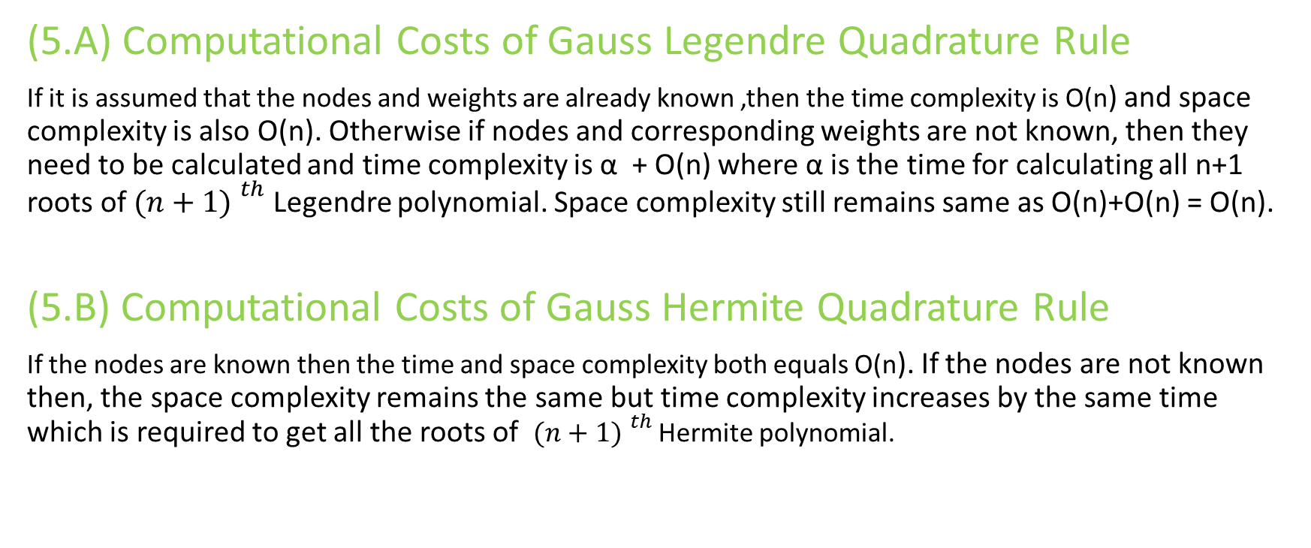
(5)Computational Costs
(5.A) Computational Costs of Gauss Legendre Quadrature Rule
If it is assumed that the nodes and weights are already known ,then the time complexity is O(n) and space complexity is also O(n). Otherwise if nodes and corresponding weights are not known, then they need to be calculated and time complexity is α + O(n) where α is the time for calculating all n+1 roots of ${(n+1) }^{th}$ Legendre polynomial. Space complexity still remains same as O(n)+O(n) = O(n).
(5.B) Computational Costs of Gauss Hermite Quadrature Rule
If the nodes are known then the time and space complexity both equals O(n). If the nodes are not known then, the space complexity remains the same but time complexity increases by the same time which is required to get all the roots of ${(n+1) }^{th}$ Hermite polynomial.

Slide 23
(6) Advantages and Disadvantages of Gauss Quadrature Methods
(6.A) Advantages:
Gauss Quadrature Methods are very accurate.
It uses less number of nodal points for similar accuracy compared to other methods like Newton Cotes. And due to this, there is less number of calculations and hence the propagation of round-off error is less in Gauss Quadrature Methods compared to other methods.
The order of convergence is much better for same number of nodes compared to Newton Cotes formula.
(6.B) Disadvantages:
Node points and the weights are to be calculated.
If we want to have large number of nodes (like 20 or more), then the calculation of nodes and weights become so expensive that overall performance of Gauss Quadrature becomes very bad compared to other methods like, Composite Simpson’s Rule.

Slide 24
(7)Real life model example
Gauss Hermite Quadrature is used in the determination of the molecular weight distribution of Linear Polymers by rheometry. (Link to research paper)
Numerical Quadrature method is used in solving Reverse Osmosis Model.(Link to research paper)
Numerical Quadrature method is used to determine the volume of the required reactor in the nitration of benzene mixed with acid. (Reference : Hougen and Watson’s “Chemical Process Principles,” Part 3, Kinetics and Catalysis, Illustration l.3)

Slide 25
References
Lectures of Numerical Analysis, Prof. Manoranjan Mishra, IIT Ropar, session: 2021-W
Numerical Methods By M.K.Jain,S.R.K.Iyengar & R.K.Jain
R. L. Burden, J. D. Faires_numerical_analysis_9th

