Slide 1


Chiranjeebi Khanal 1822747
Santosh Shahi 1916447
Roshan Bist 1915684
Niraj Chudali 1915677
Shared Power

Slide 2
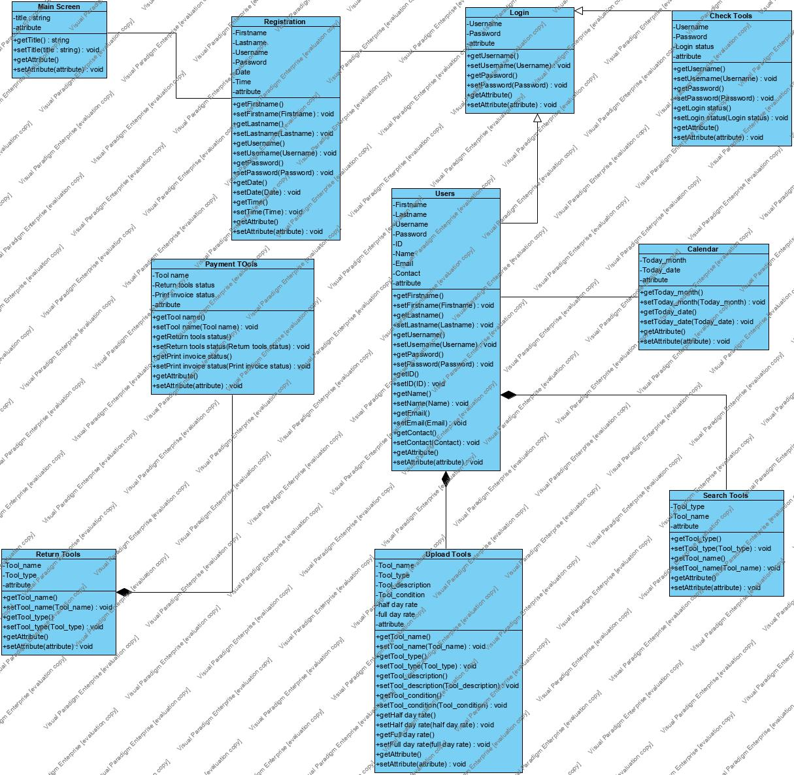

Slide 3
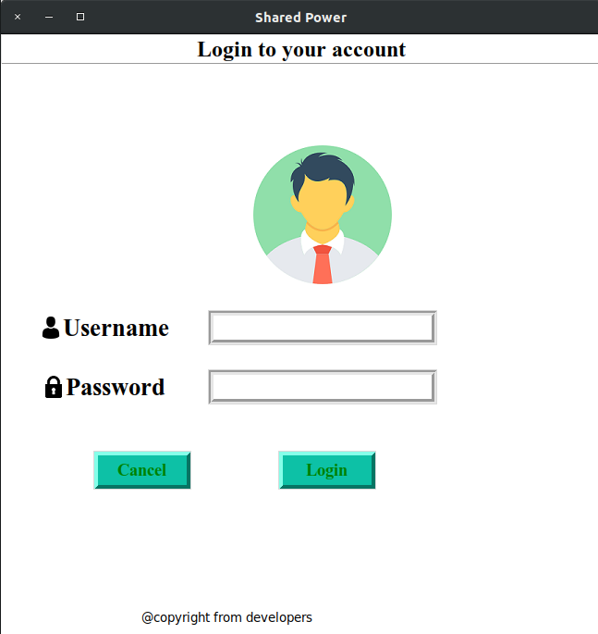
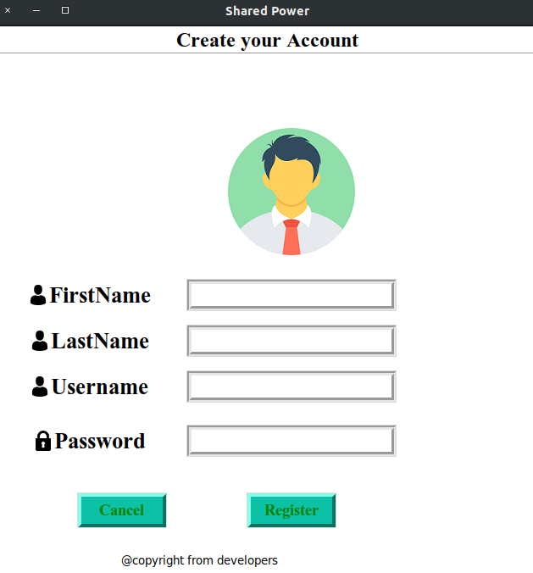
Login and Register

Slide 4

Seller Panel

Slide 5
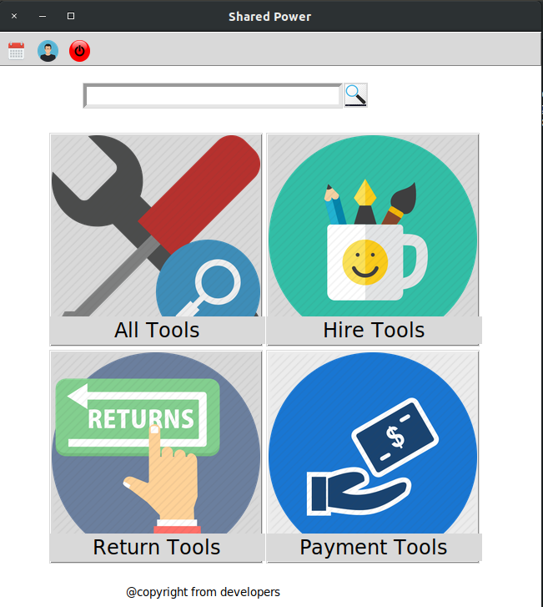
User Panel

Slide 6
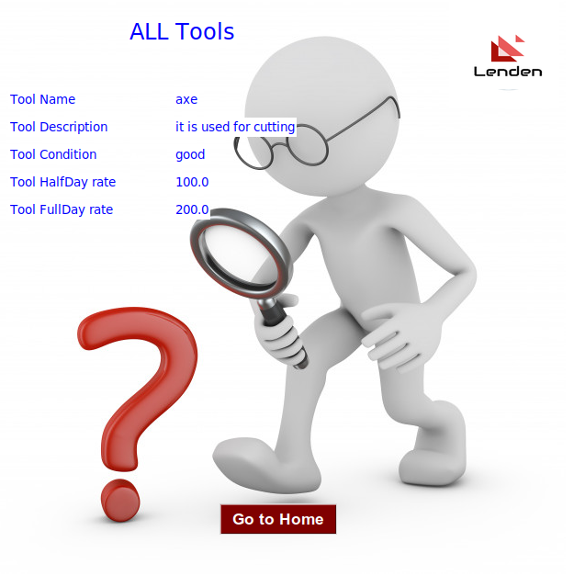
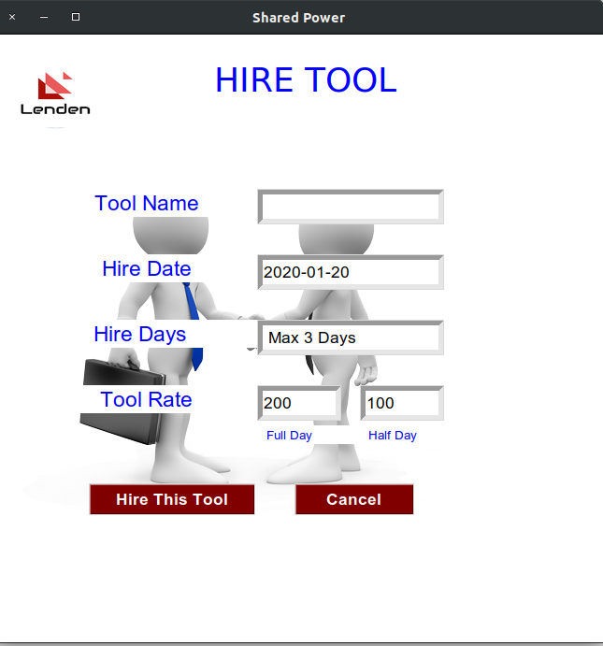

Slide 7
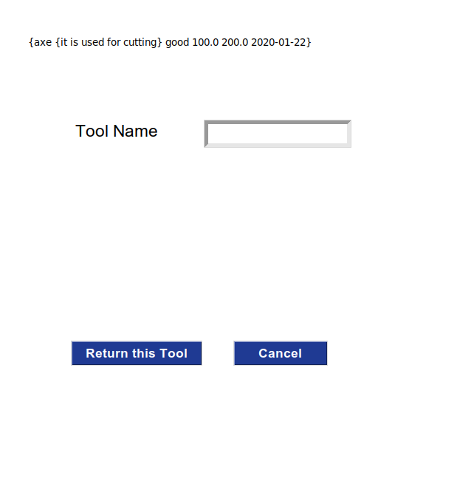
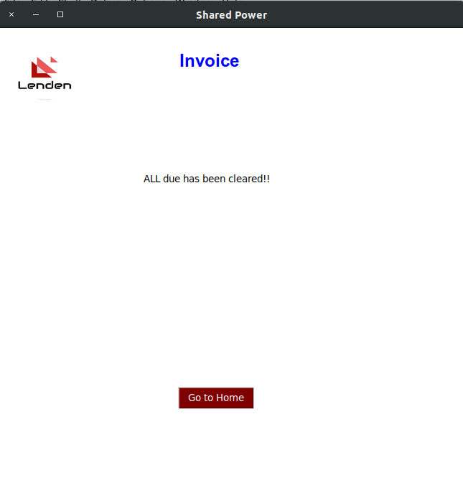
Return Tools and Payment (Invoice)

Slide 8

Insurance Panel

Slide 9
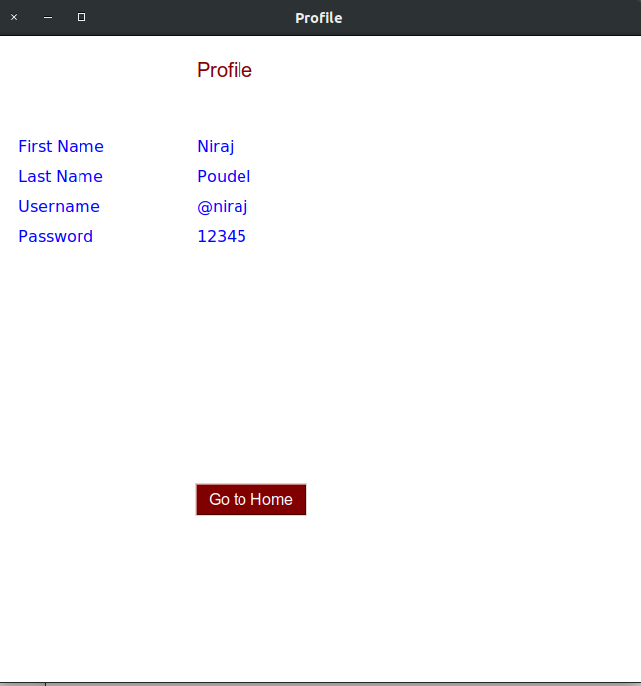
User Profile

