Slide 1
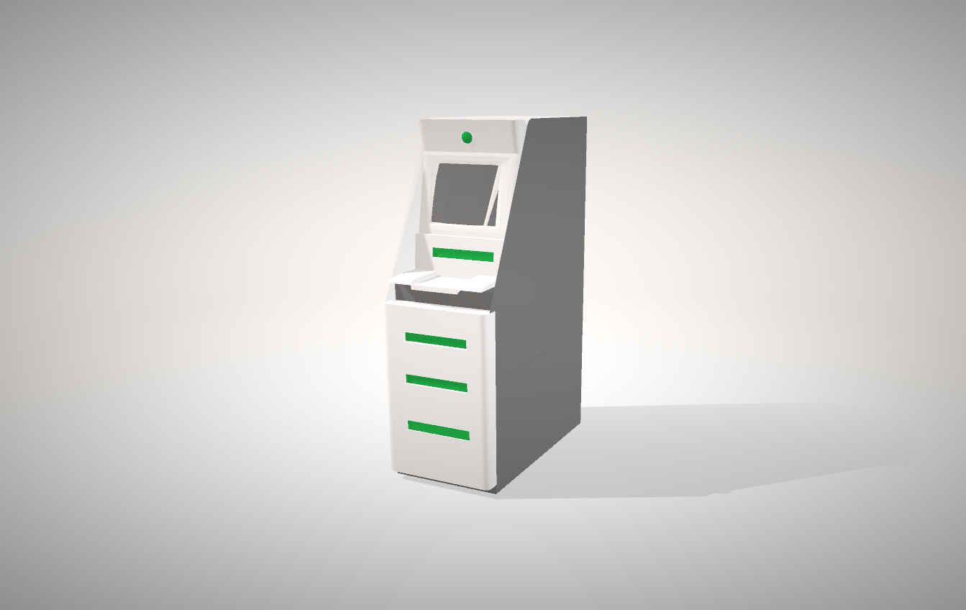
AirPrint System
Camera
Display
Recycle Paper
Keys
B/W Print
Color Print
Photo Print

Slide 3
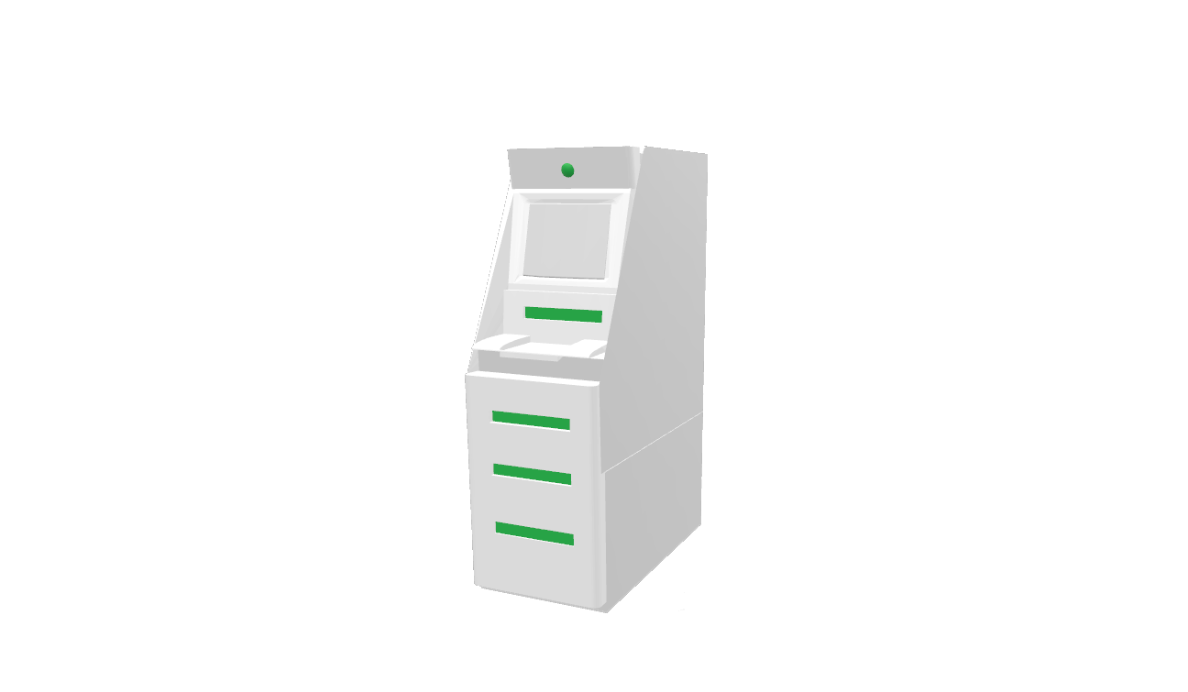
Camera
Display
Recycle Paper
Keys
B/W Print
Color Print
Photo Print

