Slide 1





A
B
C
D
E
Introduction
Aims & Objectives
Research
Future Works
Conclusion
WeCare
………………………………………………………………………………………………………………………………………………………………………………………………………………………………………………………………………………………………………………………………………………………………
The phases about a developed IoT-Based Smart Agricultural System using various gadgets to create a system for farmers works less.
The main aims and objectives of developing an IoT-based smart agricultural system to help farmers automate agricultural tasks in a very easy way.
The future of IoT-Based agricultural system that improves day by day on integrating wireless connectivity like Wi-Fi or GSM allowing to monitor it.
Adoption of IoT in agriculture explains a significant step towards modernizing traditional farming practices by utilizing real time data from sensors.
Documentation

Slide 2
A
B
C
D
E
Introduction
Aims & Objectives
Reason
Future Works
What we learnt
IoT Based Smart Irrigation System
………………………………………………………………………………………………………………………………………………………………………………………………………………………………………………………………………………………………………………………………………………………………
………………………………………………………………………………………………………………………………………………………………………………………………………………………………………………………………………………………………………………………………………………………………
………………………………………………………………………………………………………………………………………………………………………………………………………………………………………………………………………………………………………………………………………………………………
………………………………………………………………………………………………………………………………………………………………………………………………………………………………………………………………………………………………………………………………………………………………
………………………………………………………………………………………………………………………………………………………………………………………………………………………………………………………………………………………………………………………………………………………………
Presentation

Slide 3
Group Members
WeCare
Erick Pradhan (Leader)
Niraj Shrestha
Bikash Raj Chaurasiya
MD Rashid Fazeel
Surya Narayan Yadav

Slide 4
Introduction
WeCare is a two sided digital marketplace that connects customers with trusted local service providers, making it easy to search, compare, and book services. It empowers providers to showcase their skills, manage availability, and receive secure payments, creating value for both sides. With verified profiles, reviews, and a seamless booking process. WeCare aims to simplify everyday life and build a reliable community based service platform.

Slide 5
Aims & Objectives
Aim:
To develop a two sided digital marketplace that connects customers with trusted local service providers in a convenient, transparent and efficient way.
Objectives:
Enable customers to easily search, compare, and book services.
Help service providers showcase skills, manage availability, and get paid securely.
Build a reliable, user-friendly platform with trust and transparency.

Slide 6
Reason – Why our group chose this idea?
Solve the problem of finding reliable and trusted service providers easily.
Provide professionals a platform to showcase services and reach more customers.
Develop a practical, innovative project with real-world value and growth potential.

Slide 7
What we learnt
Learning how to use ClickUp.
Understanding what makes a good website and how we can make one.
Teamwork and communication.

Slide 8
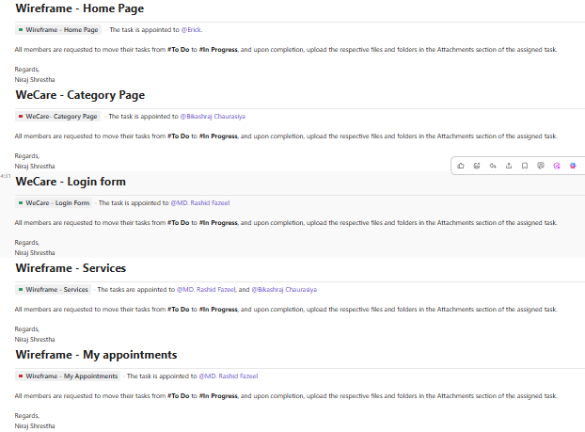
What we learnt

Slide 9
For Users Who Can’t Use The System
User friendly Design
Support and Assistance
Alternative Access
Awareness and Training

Slide 10
Future Works
Implementation of AI
Loyalty & Reward program

Slide 11
Any feedbacks…?

Slide 12
Thank You!

