Slide 1
Oracle Joins
By: Niraj Bhoyar
Team: 2

Slide 2
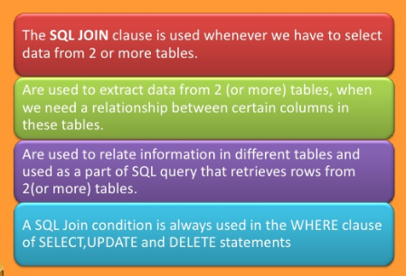
Why we use Joins ?

Slide 3
Types of Joins:
Inner Joins
Outer Joins
Left Outer Join
Right Outer Join
Full Outer Join
Self Joins

Slide 4
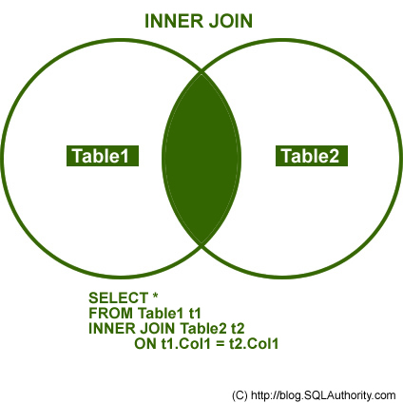
1.Inner Join
An inner join is a join that returns rows of the tables that satisfy the join condition.

Slide 5
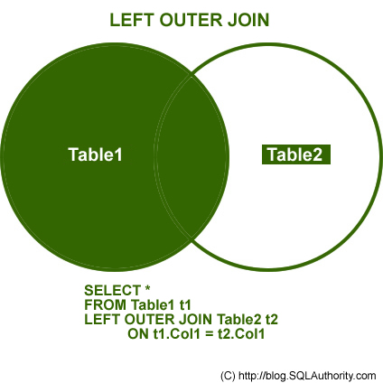
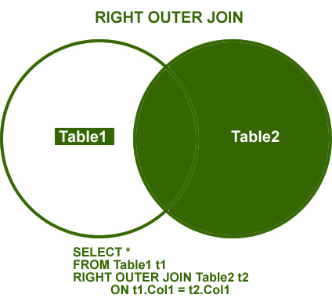
2. Outer Join:
LEFT OUTER JOIN This join returns all the rows from the left table in conjunction with the matching rows from the right table. If there are no columns matching in the right table, it returns NULL values.
RIGHT OUTER JOIN This join returns all the rows from the right table in conjunction with the matching rows from the left table. If there are no columns matching in the left table, it returns NULL values.

Slide 6
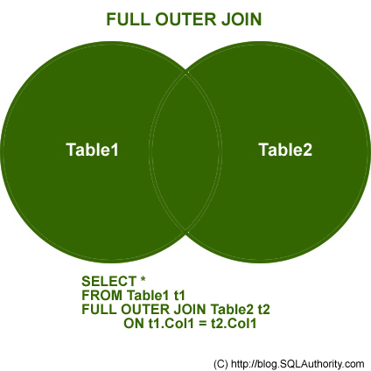
Continue:
FULL OUTER JOIN
This join combines left outer join and right outer join. It returns row from either table when the conditions are met and returns null value when there is no match.

Slide 7
3.Self Join:
A SQL Self join is a mechanism of joining a table to itself. You would use a self join when you wanted to create a result set joining records in the table with some other records from the same table.
SELECT e.ename, e.empno, m.ename as manager, e.mgr
FROM
emp e, emp m
WHERE e.mgr = m.empno
Table A

Slide 8


