Slide 1

34. Apply
Discount
By
Niraj Bhoyar
Team 5
190118

Slide 2
Introduction about CapStore:
CapStore is a web based e-commerce website that allows users to buy or sell products. Users can view products from different categories and buy them .The user will be able to see products of similar category, sort them, compare them etc.
Capstore will be a website for Capgemini employees. To buy a product, customer has to select the product and add to his cart, customer can add or remove items in cart at anytime. In the end an invoice will be generated, The Customer has options of buying product either through CashOnDelivery or through online payments. Customer has a facility to return the products and can also give a review on them.

Slide 3
Requirements:
Spring Tool Suite (STS) - for Spring Boot
Oracle SQL Developer - for Database
Visual Studio Code - for Angular

Slide 4
Problem Definition and Implementation:
If discount is on products the discounted price will be calculated and
reflected on invoice .
getPrice():
Retrieve price from the stored database
getDiscount():
Retrieve discount from the stored database
calculateDiscount():
Based on price and discount calculate the discount using formula
DiscountPrice = (price*discount)/100
finalPrice = price - discountPrice
And store the finalPrice in the database so that it will use for invoice details.

Slide 5

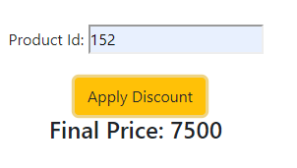

Output:
After Applying Discount:
Final Price will reflect in Database:

Slide 6
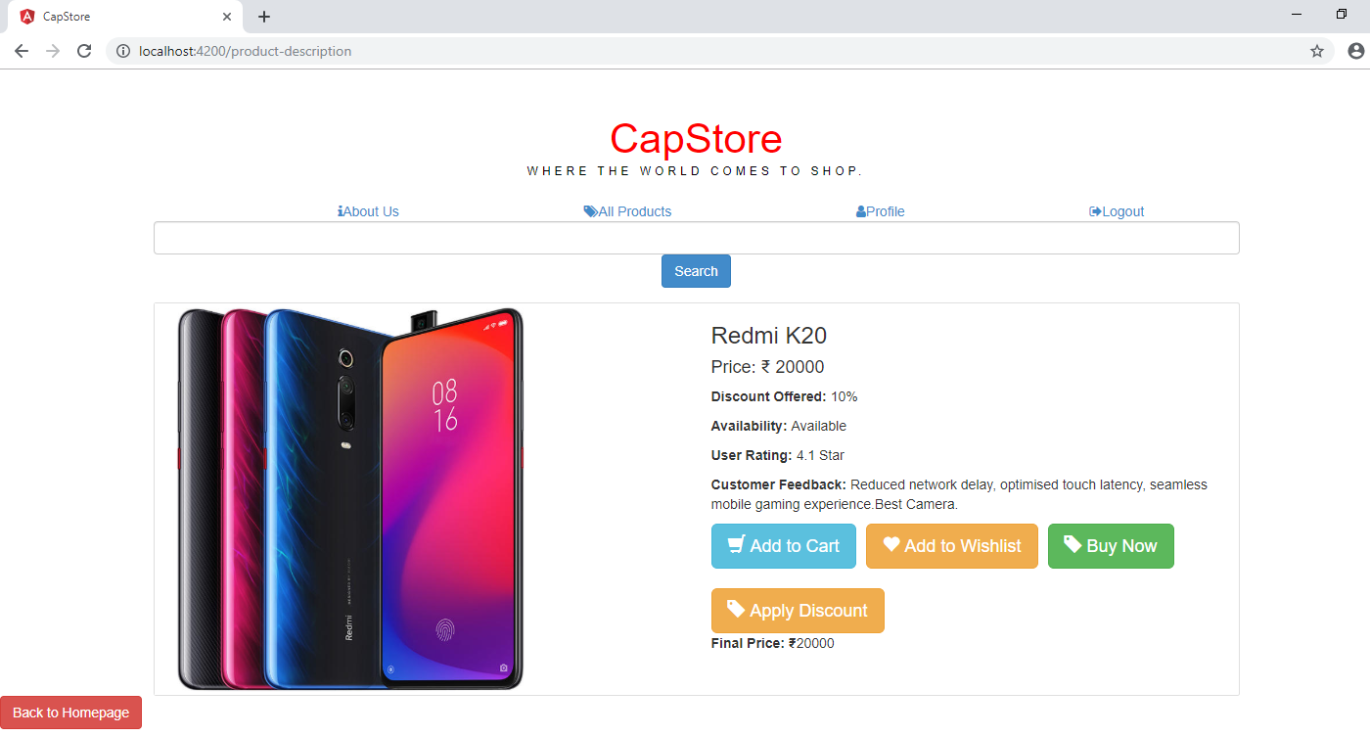
Output:

Slide 7

Output:
After applying
Discount

Slide 8
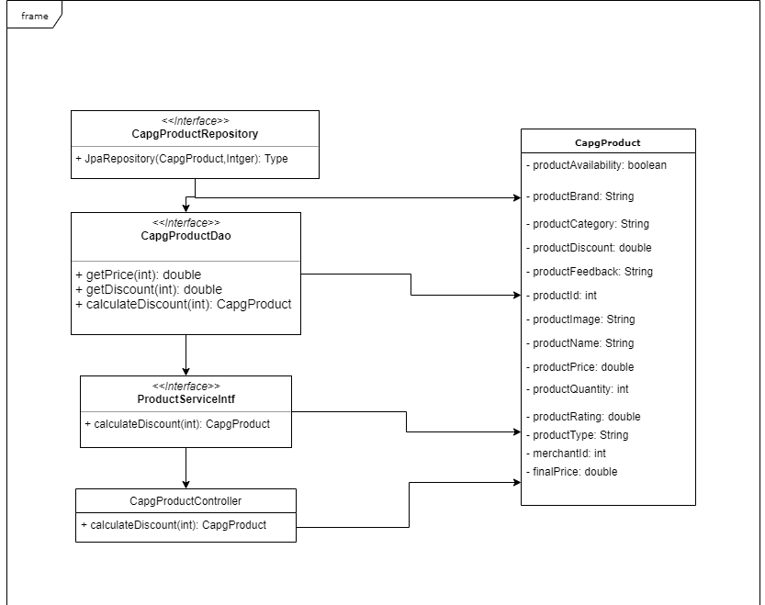
Class Diagram:

Slide 9
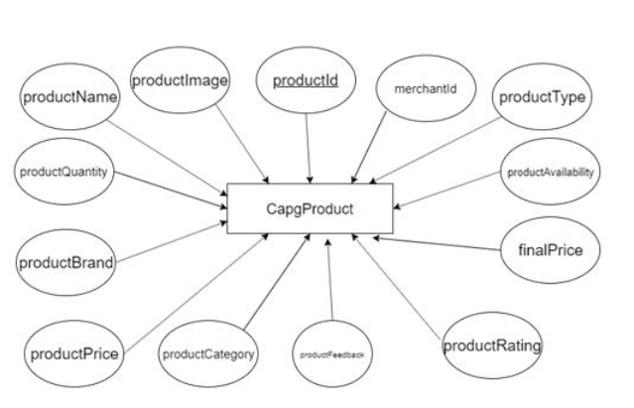
E-R Diagram:

Slide 10


