Slide 1

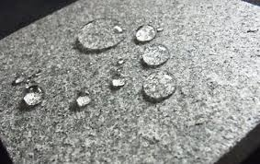
Hydrophobic Concrete
Course Code: CVL304T
Course Name: Concrete Technology
Project By-
ROLL NUMBER | NAME
P2366005 | Yash Sant
P2366007 | Sarang Deore

Slide 2
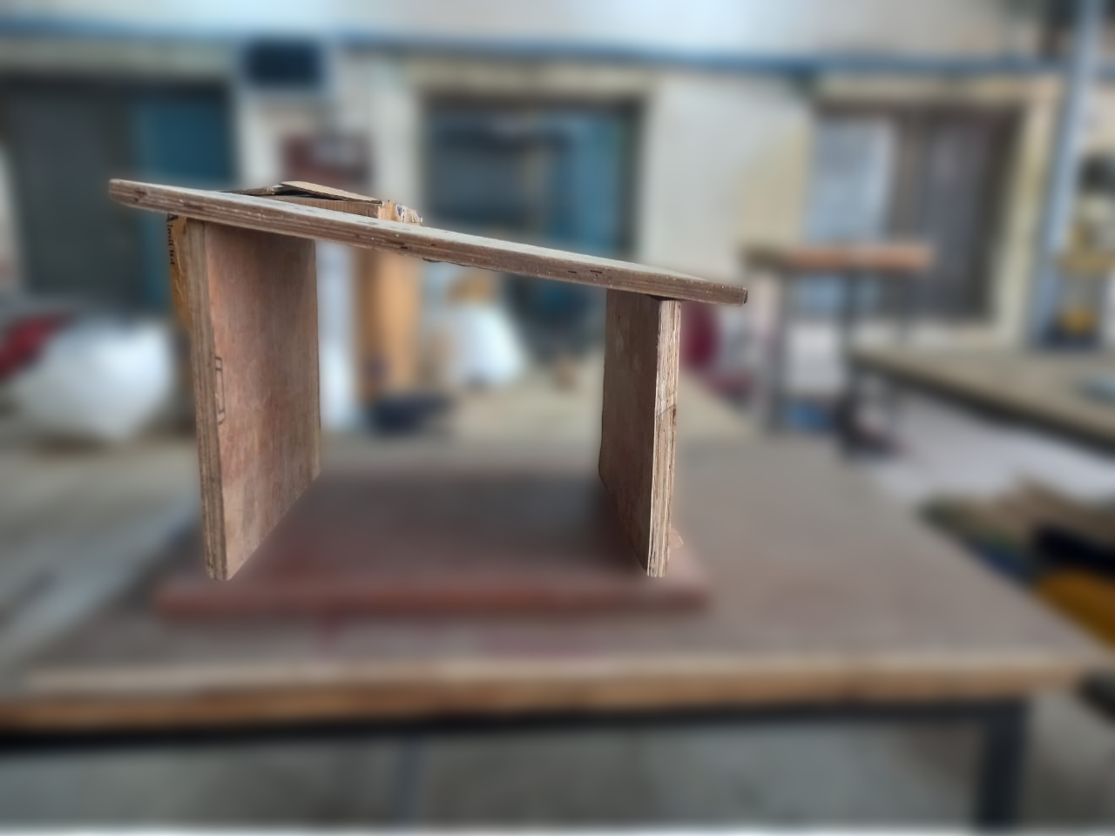
CONTENTS
Introduction
Mix Design
Preparation Process
Curing
Applications
Testing of Hydrophobic Concrete
Conclusion

Slide 3
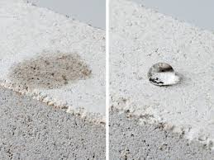
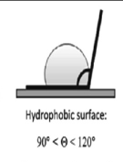
What is Hydrophobic Concrete and its Relevance
"Hydrophobic concrete incorporates water-repellent agents, such as oleic acid, into its mix, making it ideal for preventing water penetration in structures.

Slide 4
Designing of the Hydrophobic Concrete
Cement
Fine Sand
Fly Ash
Water
Oleic Acid (We used 20 grams of oleic acid to achieve the desired water-repellent properties after testing lower dosages of 2-4 grams, which were insufficient. Fly ash was added to Improve durability and reduce porosity)
Why Oleic Acid? (We chose oleic acid because it is a proven, effective hydrophobic agent that reacts with calcium in cement to form a stable water-repellent layer. It is readily available, cost-effective, and easy to handle in liquid form compared to solid alternatives like stearic acid. Unlike stronger acids (e.g., hydrochloric or sulfuric acid), oleic acid is non-corrosive, compatible with concrete, and environmentally friendly, making it ideal for this application)

Slide 5
Increase in Cost by using Oleic Acid For M30 Grade Concrete(1m^3)
Material | Quantity (kg) | Unit Cost (₹/kg) | Total Cost (₹)
Cement | 400 | 9 (₹450 per 50 kg bag) | 3600
Fine Aggregate (Sand) | 704 | 1.2 (₹1200/ton) | 844.8
Coarse Aggregate | 1120 | 1.0 (₹1000/ton) | 1120
Water | 144 | ~0 (Negligible) | ~0
Total cost for OPC Concrete=3600+845+1120=Rs-5565

Slide 6
Calculation for Hydrophobic Concrete(1m^3)
Material | Quantity (kg) | Unit Cost (₹/kg) | Total Cost (₹)
Cement | 320 | 9 | ₹2880
Fly Ash | 80 | 2.5 | ₹200
Fine Aggregate (Sand) | 704 | 1.2 | ₹844.8
Coarse Aggregate | 1120 | 1.0 | ₹1120
Water | 144 | ~0 (Negligible) | ~0
Oleic Acid | 0.64 | 500 | ₹320
Total cost for Hydrophobic Concrete=2880+200+845+1120+320=Rs-5365
COST INCREASE(%)=((5365-5565)/5565)*100
= -3.59%
Hence the cost is reduced, not increased

Slide 7
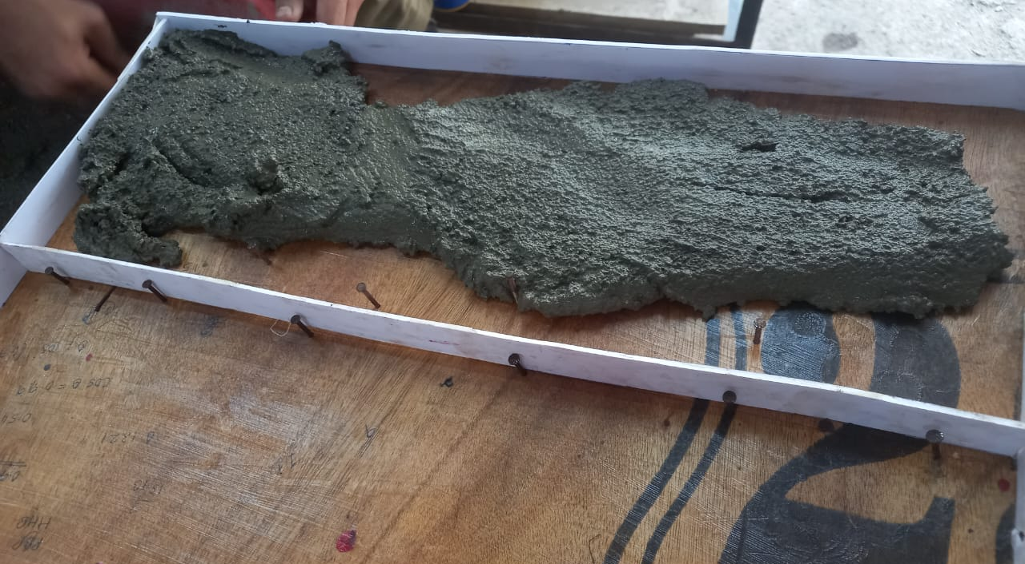
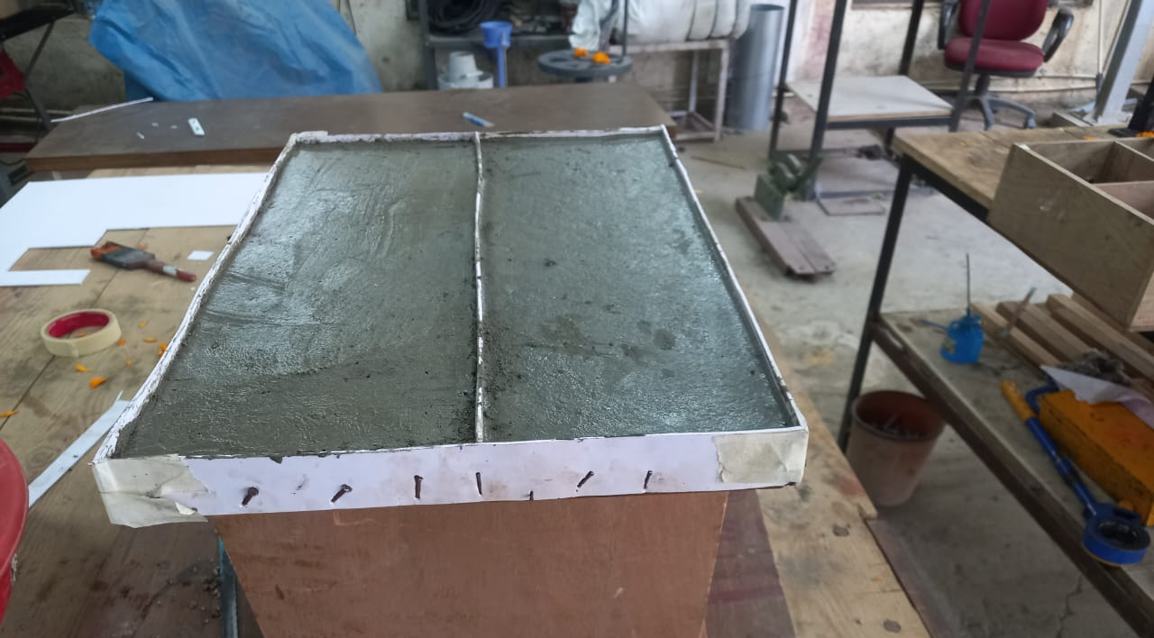
Preparation
Dry Mix
Preparation of Oleic Acid solution
Wet Mixing
Casting
Finishing

Slide 8
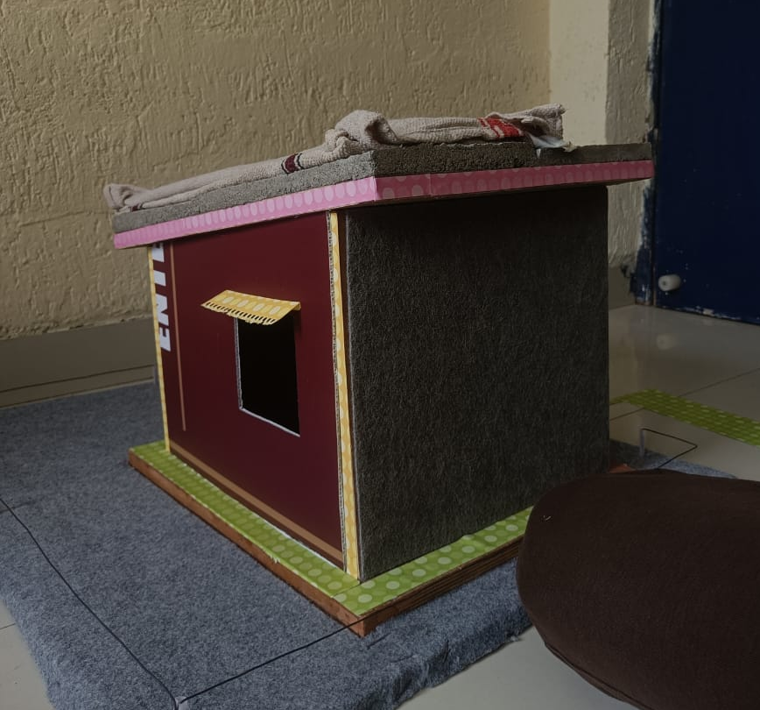
Curing
Curing is crucial for hydration and strength development.
Despite its water-repellent properties, hydrophobic concrete must be kept moist during the curing phase.
After about 7–28 days, the hydrophobic layer becomes more pronounced. By this time, most of the cement hydration reactions are complete, and curing is no longer significantly impacted.

Slide 9
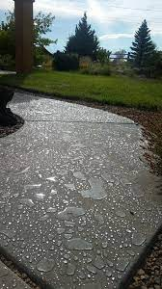
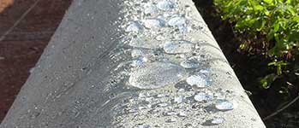
Applications
Roofs
Basements
Marine Structures
Pavements

Slide 10
Testing
Compressive Strength(M30 Grade)
IS Code Reference- IS 456(2000)
Type of Concrete | 7-Day Compressive Strength | 28-Day Compressive Strength
Ordinary Portland Cement | 38.5 MPa | 54.8 MPa
Hydrophobic Concrete | 35.2 MPa | 52.1 MPa

Slide 11
Testing
Water Absorption Test
Reference IS Code-1199: 1959
Type of Concrete | Weight Before Submersion (g) | Weight After Submersion (g) | Water Absorption (%)
Ordinary Portland Cement | 1200 | 1248 | 4.0%
Hydrophobic Concrete | 1185 | 1190 | 0.42%

Slide 12

Conclusion
In conclusion, hydrophobic concrete offers a durable, low-maintenance solution for water-sensitive structures. By refining the mix design, we successfully demonstrated its effectiveness for slanted roofing applications."

