Slide 1

Smart Rainwater Harvesting and Management System (SRHMS)
Project By: Sarang Deore College: NICMAR University Guide: Dr. Vijaya Desai Course: Introduction to Python

Slide 2
What is the Need?
Rainwater is often wasted due to lack of proper collection and monitoring systems.
Traditional systems lack intelligence, real-time feedback, and automation.
Need for a smart, scalable, and automated water management system for sustainability.

Slide 3
Objective of the Project
Design a Python-based application that simulates a real-time rainwater harvesting and management system.
1
Enable monitoring, automation, and decision-making based on simulated or manual environmental data.
2
Generate graphical reports and summaries in a professional format.
3

Slide 4

Applications
Smart Homes and Buildings
Agricultural Irrigation Systems
Urban Water Management
Educational Labs for Environmental & Civil Engineering
Smart Cities and Municipal Infrastructures

Slide 5
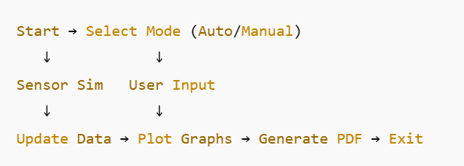
Flowchart

Slide 6

Key Features
Auto and Manual Input Modes
Real-Time Data Simulation (Rainfall, Tank Level, Soil Moisture)
Graphical Visualization of Data
Popup Interface for Data Entry
Dark Mode and UI Themes
PDF Report Export Function

Slide 7
Libraries Used
tkinter – GUI and Popup Management
matplotlib – Graph Plotting
threading – Background Auto Updates
random – Sensor Data Simulation
fpdf – PDF Report Generation
time, filedialog, etc. – Utilities

Slide 8
Input and Output
Input Sources:
Auto Mode: Simulated sensor values updated every 30 seconds
Manual Mode: Up to 10 user entries via popup interface
Outputs:
Real-time graphs
Data table
PDF report of current session

Slide 9
Innovations & Originality
Dual-mode architecture (Auto + Manual)
Popup-based user interaction for clean UI
Data visualization integrated
PDF export with structured formatting
Future-ready design for hardware IoT expansion

Slide 10
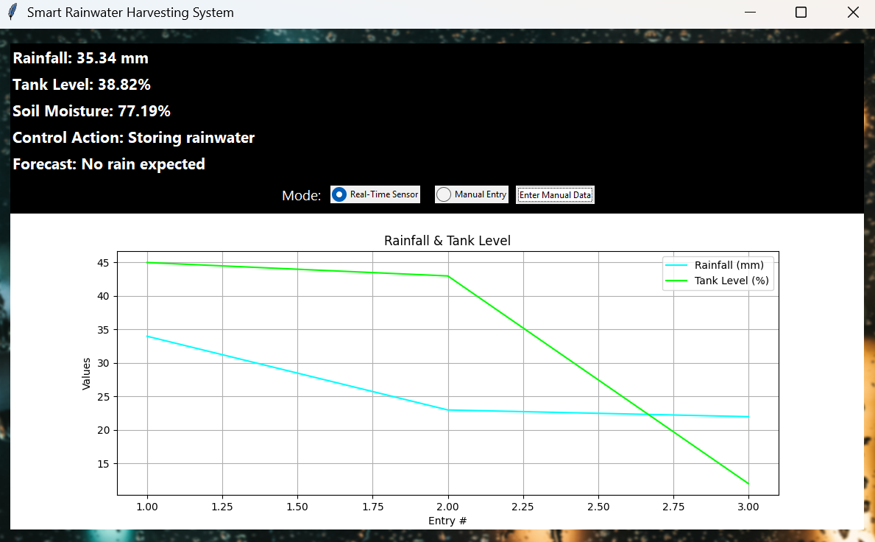
OUTPUT

Slide 11
THANK YOU!!

