Slide 1
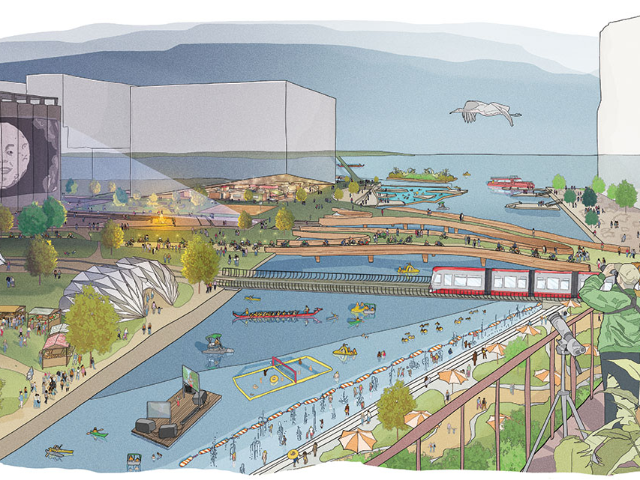
Pollution-Aware Zoning & Smart City Planning Using MATLAB
B.Tech 3rd Year Civil Engineering
Yash Sant – P2366005
Sarang Deore – P2366007
Madhav Goel – P2366010

Slide 2
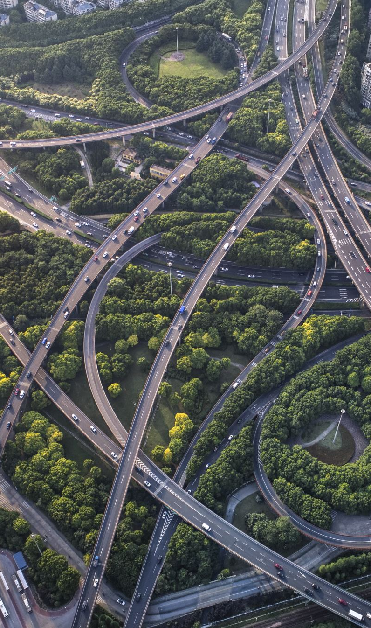
From Where We Got This Idea
Rapid urbanisation in India → pollution + traffic congestion
Smart Cities Mission in India → need for sustainable planning
Inspiration: Delhi NCR, Pune, Bangalore traffic/pollution issues
Use of real data sources (weather, terrain, traffic, pollution)

Slide 3
Problem Statement
Overlapping industrial & residential zones → health risks
Lack of traffic segregation (goods vs commuters vs students)
Poor zoning decisions → congestion & pollution hotspots
Cities need data-driven land use planning

Slide 4

Objectives

Slide 5
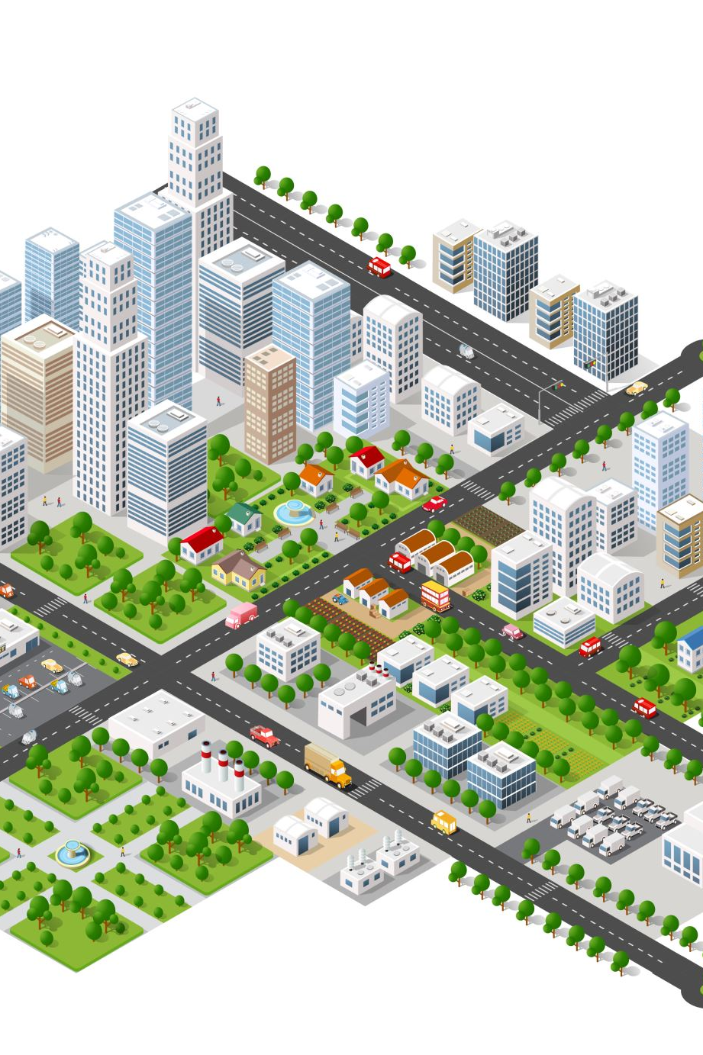
1. Categorize building types
Divide city land use into residential, industrial, commercial, educational, and office hubs.
Helps in assigning suitable areas by matching land use with environmental and social needs.

Slide 6

2. Classify traffic by user group
Group traffic flows into students, office-goers, business/tourists, and freight vehicles.
Each group has different timing patterns (e.g., school peaks vs. goods transport at night).

Slide 7
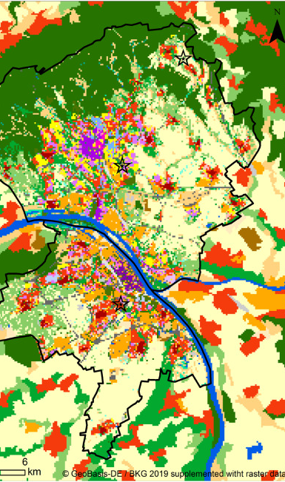
3. Optimize zoning with MATLAB (climate + terrain + pollution)
Use climate (temperature, humidity, wind), terrain (hilly/plain), and pollution (NO₂, AQI) data.
Apply MATLAB-based multi-criteria decision analysis to find the most suitable locations.

Slide 8
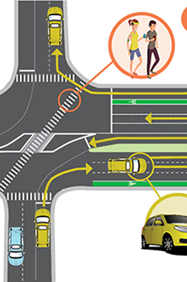
4. Design restricted-access road networks
Assign dedicated or time-based routes (e.g., freight-only ring roads at night, school zones restricted in morning/evening).
Reduces congestion and improves safety.

Slide 9
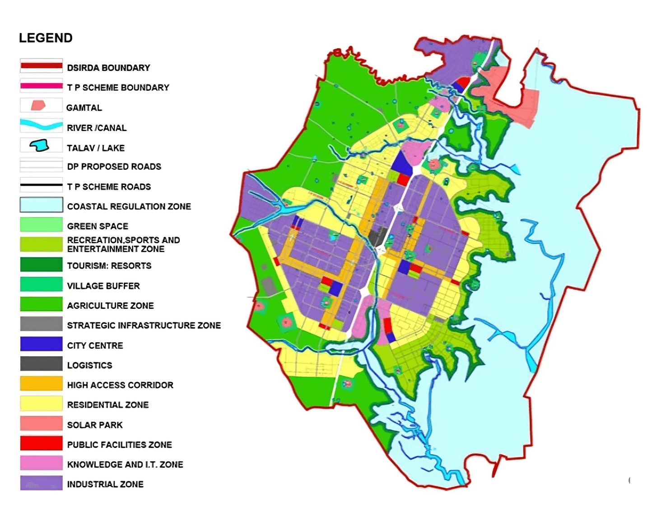
5. Develop zoning maps for smart city planning
Create a visual map showing placement of residential colonies, schools, industries, and offices.
Ensure balance between accessibility, reduced travel time, and lower pollution exposure.

Slide 10
Expected Outcomes
MATLAB-based zoning model & suitability maps
Optimized land-use allocation (residential, commercial, industrial, educational)
Reduction in congestion & pollution exposure
Restricted road policies for freight & commuters
Practical tool for urban planners & engineers

Slide 11
References & Data Sources
NASA POWER
Sentinel-5P (TROPOMI)
SRTM DEM (USGS)
OpenStreetMap
WorldPop
CPCB AQI Portal
Weather & climate data
Air quality (NO₂)
Terrain/slope data
Roads, schools, hospitals
Population density
Validation

Slide 12
Conclusion
Integrates weather, geography, traffic, pollution into MATLAB planning tool
Supports pollution-aware smart city development
Reduces congestion, health risks, and improves accessibility
Flexible: can be expanded or simplified as per project scope

