Slide 1
CT-Hospital

Slide 2
Technology Used
Frontend :
Angular
Backend :
Spring-boot
Database :
PostgreSQL
Security:
Key-Cloak

Slide 3
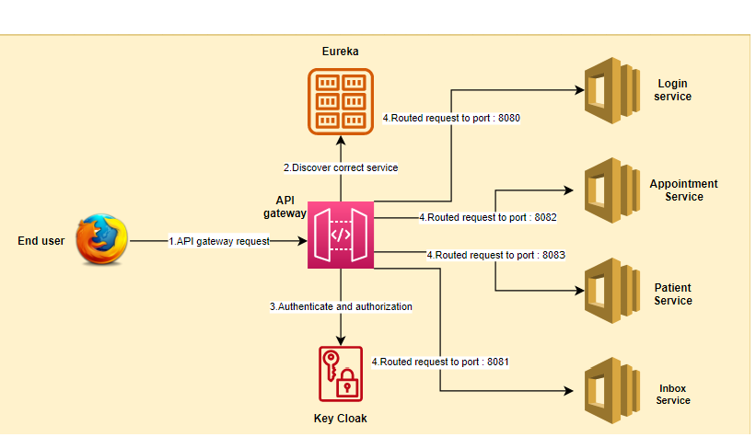
Project Flow

Slide 4
THANK YOU

