Slide 1
FACEBOOK-LIKE SERVICE
Members:
Niraj Dedhia
Shweta Yakkali

Slide 2
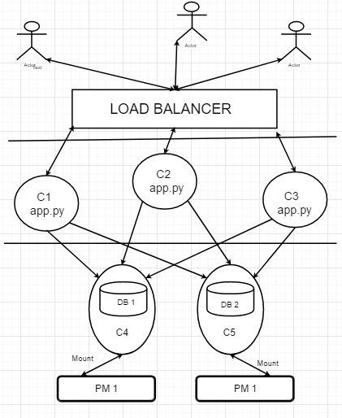
SYSTEM ARCHITECTURE:
Actors are Users
Load Balancer
Containers
Databases
PMs

Slide 3
FUNCTIONALITIES:
Login, Logout and Register
Send Message or Image/Files to Friends
See Received Messages

Slide 4
FEATURES IMPLEMENTED:
Load Balancing and Migration
Security

Slide 5
LOAD BALANCING:
Consistent Hashing
Round Robin

Slide 6
SECURITY:
User Authentication
Session Management
Hashing

Slide 7
DEMO

