Slide 1
Human Computer Interaction Dr. Yingcai Xiao
Sensory Feedback System
(Wireless Piano)
Presented by: Niraj Jaishwal

Slide 2
Description of Project
Goal: Create an interactive system using audio-visual feedback to enhance user engagement.
Components: Raspberry Pi Pico W, Ultrasonic sensor, Passive buzzer, RGB LED, MPR121 touch sensor.
Inspiration: HCI Principle, focusing on sensory feedback for enhanced interaction.

Slide 3
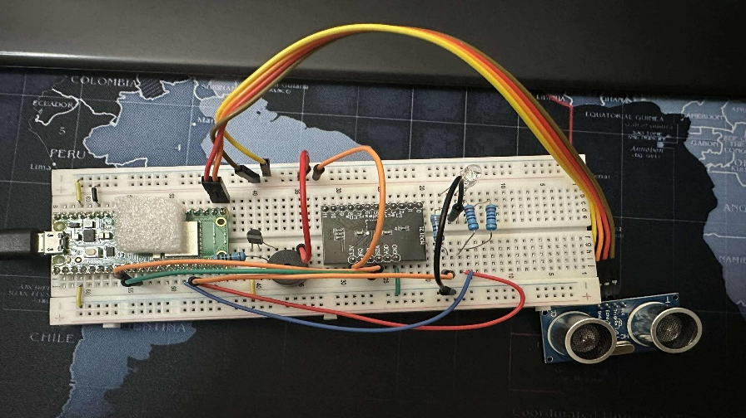
Design of the System
Component Interactions:
Ultrasonic Sensor: Measures distance for real-time feedback
Buzzer and RGB LED: Produce sounds and light feedback based on measurement distance
MPR121 Module: Adds touch-based feedback for additional interactivity

Slide 4
Implemented tools and issues
Software:
MicroPython: programmed to control PWM signal, sensor readings, and touch interactions.
Libraries Used: Modules for PWM, GPIO, and randomness for RGB lightining.
Hardware:
Raspberry Pi Pico W: Central microcontroller for controlling components
Ultrasonic Sensor, Passive Buzzer, RGB LED, MPR121 Module: Devices for real time feedback
Challenges:
Setup different component in the breadboard
Combining the function of RGB and ultrasonic sensor

Slide 5
Conclusions
Future Enhancements:
Display Integrations: For Clearer distance readouts
More Tones: Adding more tones variations to interpret proximity.
Wi-Fi Connectivity: Remote data logging for advanced applications
Project Takeaways:
Strengthened skills in PWM control, sensor integration, and user feedback systems
Learned practical debugging methods for sensor-based interactions

