Slide 1
GNU/Linux Command Line

Slide 2
Schedule
Morning
90min – Linux in theory
15min – Pause
90min – The command line
Lunch
Afternoon
90min – Vim
15min – Pause
90min – Git

Slide 3
Linux in Theory
History
Boot
Virtual Machines
Init
Processes
Filesystem
Memory management
Partitioning
User management
Permissions

Slide 4
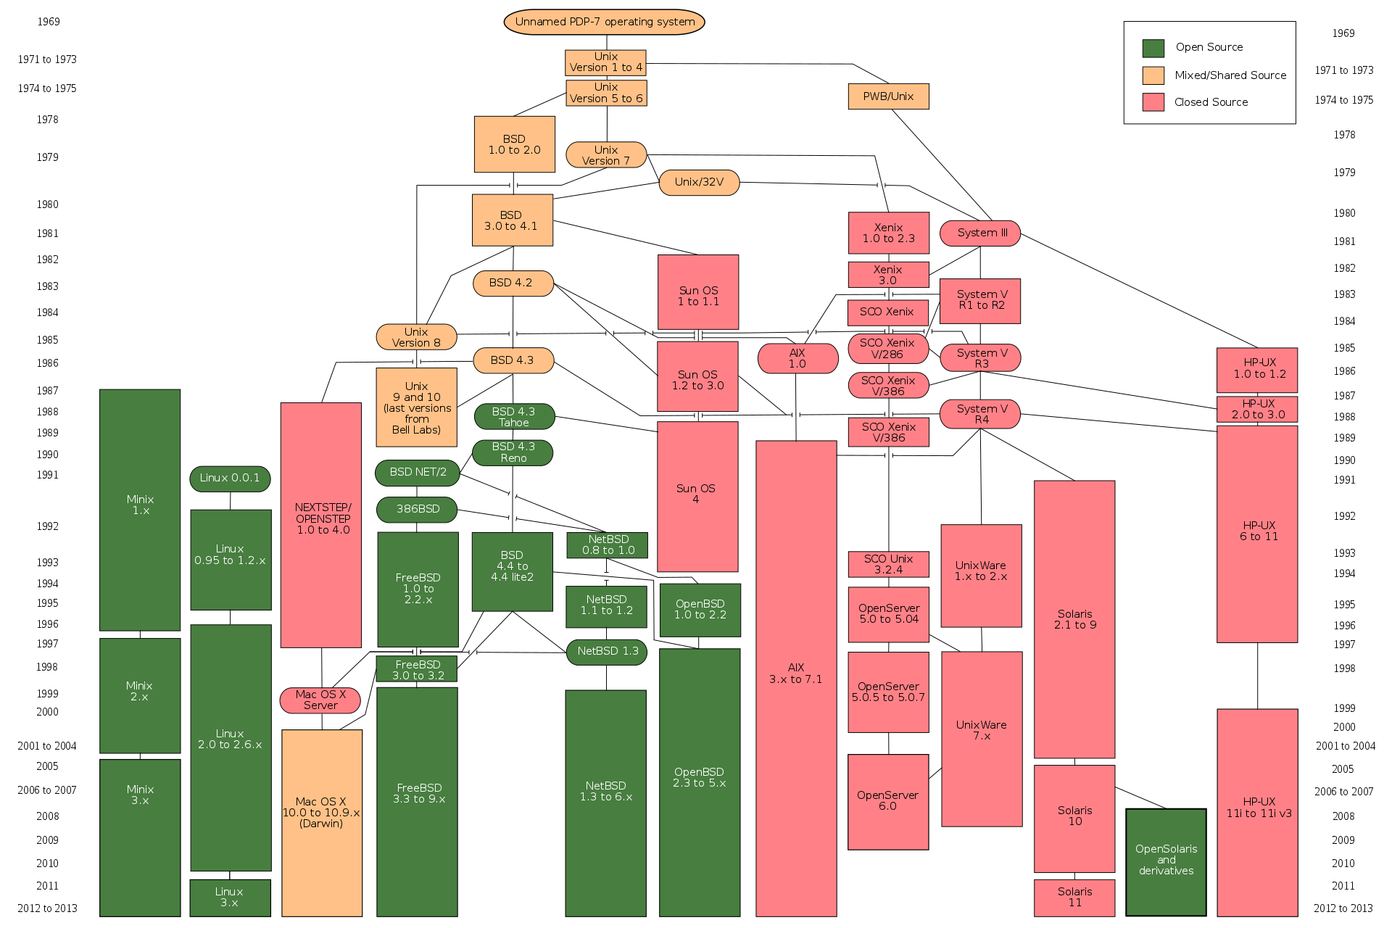
Linux Origins
Notes:
System V

Slide 5
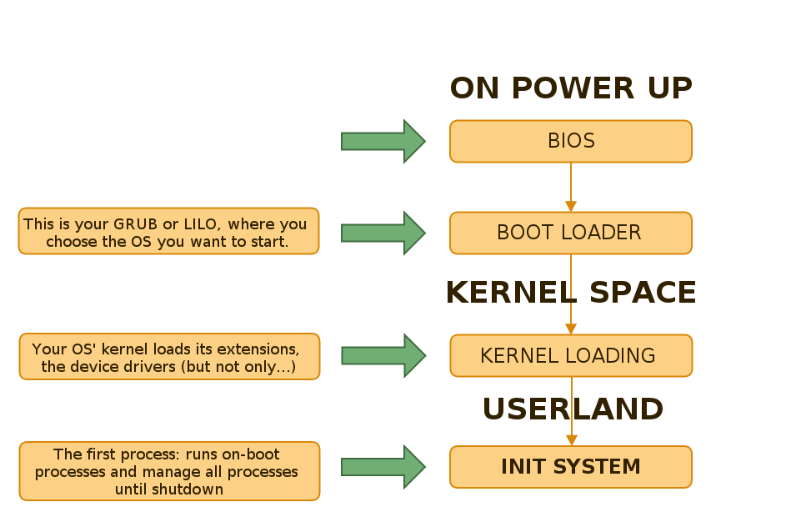
Booting Linux
Notes:
init ram disk

Slide 6
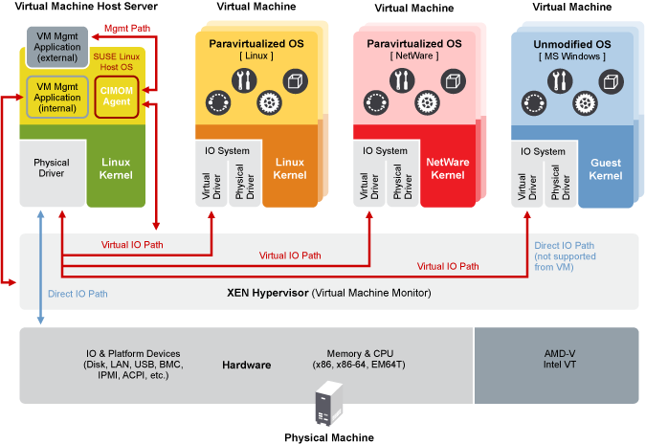
Virtualization

Slide 7
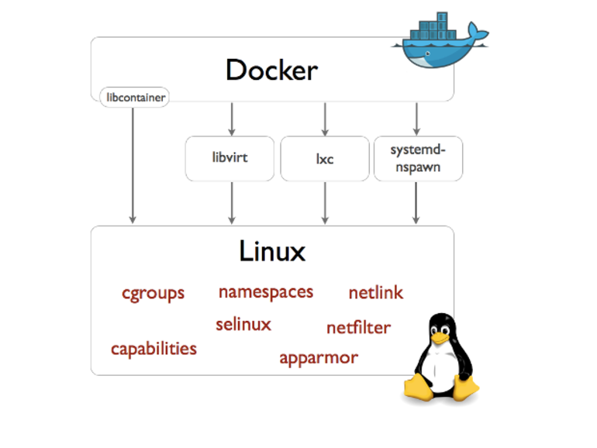
Containers
Notes:
open vz
proxmox

Slide 8
Initialization - Runlevels
Run level | Mode | Description
0 | Halt | Shuts down system
1 | Single-User Mode | Maintenance mode
2 | Multi-User Mode | Allow user users than root
3 | Multi-User + Networking | Starts the system normally
4 | Undefined
5 | X11 | 3 + Graphical environment
6 | Reboot | Reboots the system

Slide 9
Processes
ps – list of processes
kill – kill a process
killall – kill a process starting with “name”
pkill – kill a process by its name
nice – change scheduling priority of a process

Slide 10
Filesystems
Flat files
cat – concatenate a file
ls – list a folder
cd – change folder (directory)
mkdir – create a folder (make a directory)
touch – create an empty file
Notes:
cat “can of food”

Slide 11
Memory management
top – monitor processes
vmstat – monitor swap
cat /proc/meminfo – get info about the running system

Slide 12
Logs
dmesg – the kernel ring buffer
tail, head – to print the few first or last lines of a file
less – to paginate content (more or less)

Slide 13
Partitioning (hard drives)
mount, umount – attach/detach a partition or volume
fsck – check a partition
fdisk – (rustic) partitioning tool
cfdisk, gfdisk – (better) partitioning tool
mkfs – build a file system
lsblk – list attached volumes
df - “disk free” check space usage

Slide 14
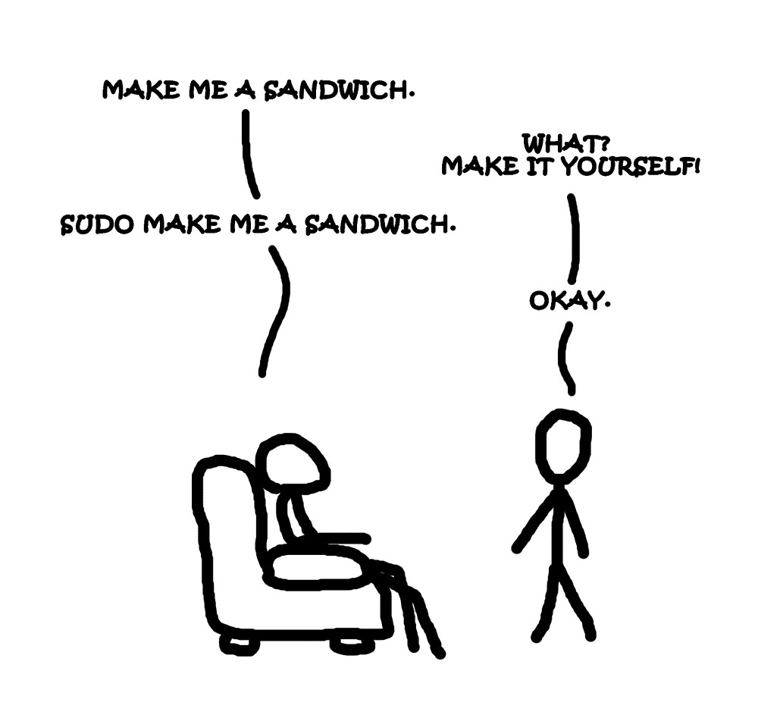
Users management
/etc/passwd,
/etc/shadow,
/etc/groups
Demo
  adduser – add a user
  rmuser – remove a user
  sudo – run something with “super user” privileges
  whoami – Who am I? (if you can’t afford a shrink)

Slide 15
Permissions
Demo
  chmod – change file mode bits (!)
  chown – change owner and groups

Slide 16
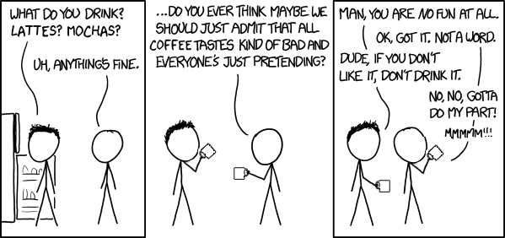
Pause

Slide 17
The Command Line
The shell is not boring
Documentation
Keyboard shortcuts
The prompt and environment variables
Where are the commands?
Installing new software (apt/yum)
SSH in a nutshell
Goodies

Slide 18
The Shell
bash, zsh and others
what are: $ | # | >
configuring the shell with .bashrc (or .zshrc)
multi-task
redirection
concatenations

Slide 19
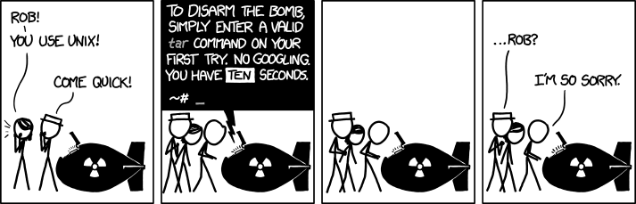
Documentation
-h or --help – as argument for most commands
man – or “man pages” stands for manual
whatis, type, which – what/where is what
google – a newcomer on the websphere

Slide 20
Cheat Sheets
Linux command line cheat sheet
http://bit.ly/2mTQr8l
Bash cheat sheet
http://bit.ly/1OIQ45M

Slide 21
Keyboard Shortcuts
CTRL-Z, bg, fg – pause, background and foreground
jobs – see running jobs
CTRL-C – break
CTRL-A, CTRL-E – move cursor
CTRL-R – search in history
CTRL-D – log out

Slide 22
The Prompt and environment vars
Change the prompt colors
set and $
export – export as a global variable

Slide 23
Command Locations
/bin, /usr/bin, /usr/local/bin
/sbin, /usr/sbin
the variable $
which, type – to find executable location

Slide 24
Package Managers
apt-get – debian based distros
yum – redhat based distros

Slide 25
Secure SHell
telnet – remote shell access, the old way
ssh – remote shell access, the secure way (encrypted)
access a remote machine’s shell
/home/user/.ssh folder
share public keys to log quickly
start a local server

Slide 26
Goodies
nohup – detach a command from the shell
screen – a multi-dimentional shell
htop – a better monitoring tool
explore init scripts in /etc/init.d/* or /etc/rc.d/*

Slide 27
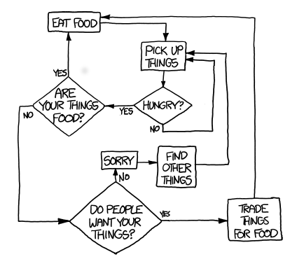
Lunch

Slide 28
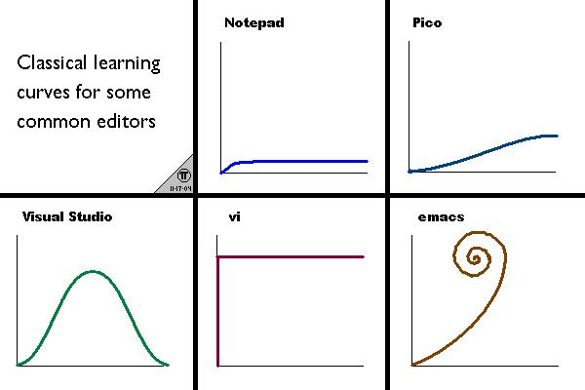
Vi (or vim)
Vi is an editor you can find on any *nix/*nux machine
it’s absolutely…
horrible (when you start)
and
wonderful (when you know it)

Slide 29
Show off
Edit a file
Start insert mode, change something
Save and quit

Slide 30
Documentation
i – enter insert mode
: – enter command mode
:q! - quit without saving
:wq – save and quit
A cheat sheet worth thousand of words
https://vim.rtorr.com/

Slide 31
Tutorial
https://linuxconfig.org/bash-scripting-tutorial

Slide 32
Exercises
Write a bash script in /home/$username/project/file to do something, save, change permissions and run.
Thing your script can do:
- say “hello world”
- create a serie of files with defined permissions
- rotate a serie of images
- fetch some file with scp (ssh) and deploy them on a folder with root privileges
- you name it (outloud)

Slide 33

Pause
https://what-if.xkcd.com/71/

Slide 34
Git basics
clone – clone a repo locally
status – check local changes and conflicts
add – add a file or directory
commit – commit changes
log – the commits log
branch – check local branches
merge – merge two branches
rebase – fusion two branches
help – get (a bit) of help

Slide 35
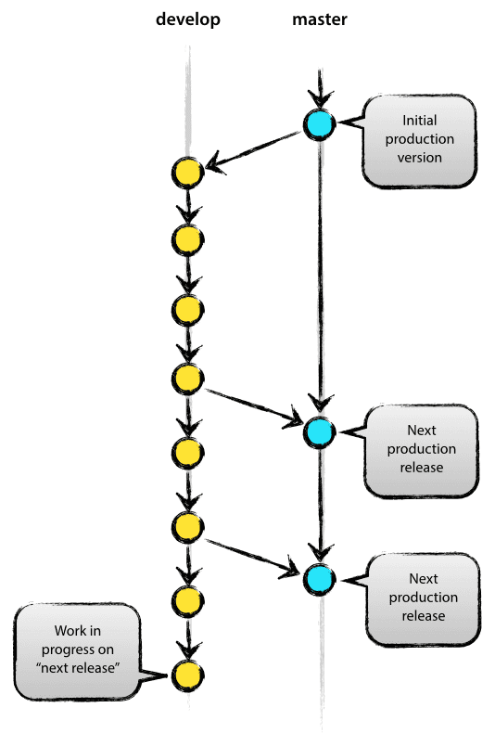
Branching

Slide 36
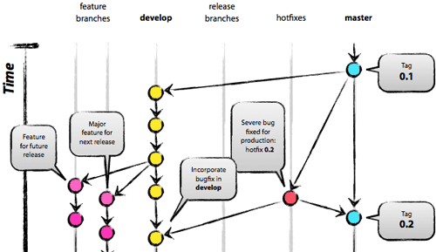
Branching

Slide 37
Exercises
In team, push files on the same repo (github) call each other scripts to do something useful or fun.
Ideas:
- one script takes filenames as argument, another call the first script with a bunch of files previously downloaded.
- ?
- you name it (outloud)

Slide 38
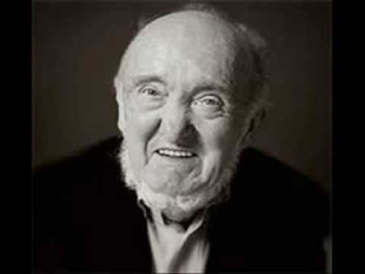
What we learned
GNU/Linux is community developed OS.
Albert Jacquard,
1925-2013
“To communicate is to share; And to share, it is the act that constitutes us. If one considers that this act is impossible, one refuses all human project.”
“Communiquer, c'est mettre en commun; et mettre en commun, c'est l'acte qui nous constitue. Si l'on estime que cet acte est impossible, on refuse tout projet humain.”

Slide 39
Credits – in order of appearance
Wikipedia
http://phndiaye.github.io/the-current-state-of-init-systems.html
XKCD !

